Slide 1
Accounting for Receivables
Chapter 7
Wild and Shaw
Financial and Managerial Accounting
9th Edition
Copyright ©2022 McGraw-Hill Education. All rights reserved. No reproduction or distribution without the prior written consent of McGraw-Hill Education.

Slide 2
Chapter 7 Learning Objectives
CONCEPTUAL
C1 Describe accounts receivable and how they occur and are recorded.
C2 Describe a note receivable, the computation of its maturity date, and the recording of its
existence.
C3 Explain how receivables can be converted to cash before maturity.
ANALYTICAL
A1 Compute accounts receivable turnover and use it to help assess financial condition.
PROCEDURAL
P1 Apply the direct write-off method to accounts receivable.
P2 Apply the allowance method to accounts receivable.
P3 Estimate uncollectibles based on sales and accounts receivable.
P4 Record the honoring and dishonoring of a note and adjustments for interest.
© McGraw-Hill Education
7-2

Slide 3
Describe accounts receivable and how they occur and are recorded.
Learning Objective C1
© McGraw-Hill Education
7-3

Slide 4
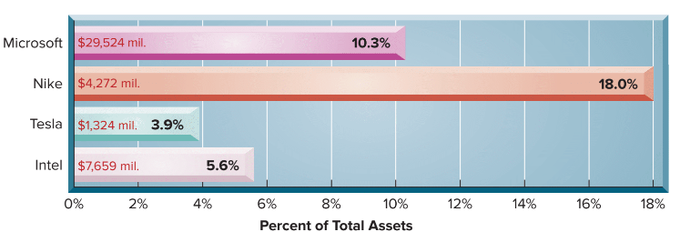
Valuing Accounts Receivable
Exhibit 7.1
A receivable is an amount due from another party.
This graph shows recent dollar amounts of receivables and their percent of total assets for four well-known companies.
A company must also maintain a separate account for each customer that tracks how much that customer purchases, has already paid, and still owes.
© McGraw-Hill Education
7-4
Learning Objective C1: Describe accounts receivable and how they occur and are recorded.
Notes:
A receivable is an amount due from another party. The two most common receivables are accounts receivable and notes receivable. Other receivables include interest receivable, rent receivable, tax refund receivable, and receivables from employees. Accounts receivable are amounts due from customers for credit sales.
The graph on this slide shows recent dollar amounts of receivables and their percent of total assets for four well-known companies.
Credit sales are recorded by increasing (debiting) Accounts Receivable. A company must maintain a separate account for each customer that tracks how much that customer purchases, has already paid, and still owes.
The general ledger has a single Accounts Receivable account (called a control account). A supplementary record has a separate account for each customer called the accounts receivable ledger (or accounts receivable subsidiary ledger).

Slide 5
Sales on Credit: Journal Entries
On July 1, TechCom had a credit sale of $950 to CompStore and a collection of $720 from RDA Electronics from a prior credit sale.
© McGraw-Hill Education
7-5
Learning Objective C1: Describe accounts receivable and how they occur and are recorded.
Notes:
To see how accounts receivable from credit sales are recognized in the accounting records, we look at two transactions on July 1 between TechCom and its credit customers.
The first is a credit sale of $950 to CompStore.
The second transaction is a collection of $720 from RDA Electronics from a prior credit sale.

Slide 6
Sales on Credit: Accounts Receivable Ledger
Exhibit 7.4
© McGraw-Hill Education
7-6
Learning Objective C1: Describe accounts receivable and how they occur and are recorded.
Notes:
This slide shows the general ledger and the accounts receivable ledger after recording the two July 1 transactions. The general ledger shows the effects of the sale, the collection, and the resulting balance of $3,230. These transactions are also shown in the individual customer accounts: RDA Electronics balance is $280, and CompStore’s ending balance is $2,950. The $3,230 total of customer accounts equals the balance of the Accounts Receivable account in the general ledger.

Slide 7
Sales on Bank Credit Cards
On July 15, TechCom has $100 of credit card sales with a 4% fee, and its $96 cash is received immediately on deposit.
© McGraw-Hill Education
7-7
Learning Objective C1: Describe accounts receivable and how they occur and are recorded.
Notes:
Most companies allow customers to pay using bank or third-party credit cards such as Visa, Mastercard, or American Express, and debit cards. Sellers allow customers to use credit cards and debit cards for several reasons. First, the seller does not have to decide who gets credit and how much. Second, the seller avoids the risk of customers not paying. This risk is transferred to the card company. Third, the seller typically receives cash from the card company sooner than had it granted credit directly to customers. Fourth, more credit options for customers can lead to more sales.
To illustrate, if TechCom has $100 of credit card sales with a 4% fee, and its $96 cash is received immediately on deposit, the entry is a credit to Sales for the entire amount of the sale of $100. However, TechCom will debit Cash for $96, which represents how much cash they will collect from the bank. The difference of $4 is the 4% fee that TechCom must pay for allowing customers to use the third-party credit card. The $4 will be debited to Credit Card Expense.

Slide 8
Apply the direct write-off method to accounts receivable.
Learning Objective P1
© McGraw-Hill Education
7-8

Slide 9
Bad Debts
Some customers may not pay their account. Uncollectible amounts are referred to as bad debts.
There are two methods of accounting for bad debts:
Direct Write-Off Method
Allowance Method
© McGraw-Hill Education
7-9
Learning Objective P1: Apply the direct write-off method to accounts receivable.
Notes:
When a company directly grants credit to customers, it expects some customers to not pay what they promised. The accounts of these customers are uncollectible accounts, commonly called bad debts. Uncollectible accounts is an expense of selling on credit. Why do companies sell on credit if they expect some accounts to be uncollectible? The answer is that companies believe that granting credit will increase total sales and net income enough to offset bad debts. Companies use two methods to account for uncollectible accounts: (1) direct write-off method and (2) allowance method.

Slide 10
Direct Write-Off Method – Recording and Writing Off Bad Debts
TechCom determines on January 23 that it cannot collect $520 owed to it by its customer J. Kent.
Notice that the specific customer is noted in the transaction so we can make the proper entry in the customer’s Accounts Receivable subsidiary ledger.
© McGraw-Hill Education
7-10
Learning Objective P1: Apply the direct write-off method to accounts receivable.
Notes:
The direct write-off method records the loss from an uncollectible account receivable when it is determined to be uncollectible. No attempt is made to predict bad debts expense.
If TechCom determines on January 23 that it cannot collect $520 owed to it by its customer J. Kent, it records the loss using the direct write-off method as shown in this slide.
The debit in this entry charges the uncollectible amount directly to the current period’s Bad Debts Expense account. The credit removes its balance from the Accounts Receivable account in the general ledger (and its subsidiary ledger).

Slide 11
Direct Write-Off Method – Recovering a Bad Debt
On March 11, J. Kent was able to make full payment to TechCom for the amount previously written-off.
© McGraw-Hill Education
7-11
Learning Objective P1: Apply the direct write-off method to accounts receivable.
Notes:
Sometimes an account written off is later collected. If the account of J. Kent that was written off directly to Bad Debts Expense is later collected in full, the two journal entries in this slide record this recovery.

Slide 12
Using the Direct Write-Off Method
Expense recognition principle requires expenses to be reported in the same accounting period as the sales they helped produce.
Materiality constraint permits direct write-off method if results approximate results using the allowance method.
The direct write-off method usually does not best match sales and expenses.
© McGraw-Hill Education
7-12
Learning Objective P1: Apply the direct write-off method to accounts receivable.
Notes:
Companies weigh at least two concepts when considering use of the direct write-off method.
Expense recognition requires expenses be reported in the same period as the sales they helped produce.
The materiality constraint permits use of the direct write-off method. The simple, low-cost direct write-off method adheres to GAAP and these two concepts when its results approximate those using the allowance method.

Slide 13
Apply the allowance method to accounts receivable.
Learning Objective P2
© McGraw-Hill Education
7-13

Slide 14
Allowance Method
At the end of each period, estimate total bad debts expected to be realized from that period’s sales.
Two advantages to the allowance method:
It records estimated bad debts expense in the period when the related sales are recorded.
It reports accounts receivable on the balance sheet at the estimated amount of cash to be collected.
© McGraw-Hill Education
Learning Objective P2: Apply the allowance method to accounts receivable.
7-14
Notes:
The allowance method for bad debts matches the estimated loss from uncollectible accounts receivable against the sales they helped produce. We use estimated losses because when sales occur, sellers do not know which customers will not pay. This means that at the end of each period, the allowance method requires an estimate of the total bad debts expected from that period’s sales. This method has two advantages over the direct write-off method:
it records estimated bad debts expense in the period when the related sales are recorded and
it reports accounts receivable on the balance sheet at the estimated amount to be collected.

Slide 15
Allowance Method - Recording Bad Debts Expense
TechCom had credit sales of $300,000 during its first year of operations. At the end of the first year, $20,000 of credit sales remained uncollected. Based on the experience of similar businesses, TechCom estimated that $1,500 of its accounts receivable would be uncollectible.
© McGraw-Hill Education
Learning Objective P2: Apply the allowance method to accounts receivable.
7-15
Notes:
The allowance method estimates bad debts expense at the end of each accounting period and records it with an adjusting entry. TechCom, had credit sales of $300,000 during its first year of operations. At the end of the first year, $20,000 of credit sales remained uncollected. TechCom estimated that $1,500 of its accounts receivable would be uncollectible and made the adjusting entry shown in this slide.
The estimated bad debts expense of $1,500 is reported on the income statement (as either a selling expense or an administrative expense). The Allowance for Doubtful Accounts is a contra asset account. A contra account is used instead of reducing accounts receivable directly because at the time of the adjusting entry, the company does not know which customers will not pay. After the bad debts adjusting entry is posted, TechCom’s account balances for Accounts Receivable and its Allowance for Doubtful Accounts are as shown at the bottom of this slide.

Slide 16
Balance Sheet Presentation
TechCom had credit sales of $300,000 during its first year of operations. At the end of the first year, $20,000 of credit sales remained uncollected. Based on the experience of similar businesses, TechCom estimated that $1,500 of its accounts receivable would be uncollectible.
7-16
Learning Objective P2: Apply the allowance method to accounts receivable.
© McGraw-Hill Education
Notes:
The Allowance for Doubtful Accounts credit balance of $1,500 has the effect of reducing accounts receivable to its realizable value. Although credit customers owe $20,000 to TechCom, only $18,500 is expected to be realized in cash collections from these customers. (TechCom continues to bill its customers a total of $20,000). In the balance sheet, the Allowance for Doubtful Accounts is subtracted from Accounts Receivable and is often reported as shown here.
Sometimes the Allowance for Doubtful Accounts is not reported separately in the Balance Sheet where Accounts receivable is to be reported by its realized value (net of the doubtful account balance).

Slide 17
Allowance Method – Writing Off a Bad Debt
TechCom has determined that J. Kent’s $520 account is uncollectible.
© McGraw-Hill Education
Learning Objective P2: Apply the allowance method to accounts receivable.
7-17
Notes:
When specific accounts become uncollectible, they are written off against the Allowance for Doubtful Accounts.
TechCom decides that J. Kent’s $520 account is uncollectible and makes the above entry to write it off.
This entry removes $520 from the Accounts Receivable account (and the subsidiary ledger). The general ledger accounts now appear as shown (assuming no other transactions affecting these accounts).

Slide 18
Writing Off a Bad Debt
Exhibit 7.5
The write-off does not affect the realizable value of accounts receivable.
© McGraw-Hill Education
Learning Objective P2: Apply the allowance method to accounts receivable.
7-18
Notes:
The write-off does not affect the realizable value of accounts receivable as shown in this slide. Neither total assets nor net income is affected by the write-off of a specific account. Instead, both assets and net income are affected in the period when bad debts expense is predicted and recorded with an adjusting entry.

Slide 19
Allowance Method – Recovering a Bad Debt
To help restore credit standing, a customer sometimes pays all or part of the amount owed on an account even after it has been written off.
On March 11, Kent pays in full his $520 account previously written off.
© McGraw-Hill Education
Learning Objective P2: Apply the allowance method to accounts receivable.
7-19
Notes:
If an account that was written off is later collected, two entries are made. The first is to reverse the write-off and reinstate the customer’s account. The second is to record the collection of the reinstated account as illustrated here.

Slide 20
Estimate uncollectibles based on sales and accounts receivable.
Learning Objective P3
© McGraw-Hill Education
7-20

Slide 21
Estimating Bad Debts Expense
Two Methods
Percent of Sales Method
Balance Sheet Methods‒Accounts Receivable
Percent of Accounts Receivable
Aging of Accounts Receivable
© McGraw-Hill Education
Learning Objective P3: Estimate uncollectibles based on sales and accounts receivable.
7-21
Notes:
Bad debts expense is estimated under the allowance method. There are two common methods. One is based on the income statement relation between bad debts expense and sales. The second is based on the balance sheet relation between accounts receivable and the allowance for doubtful accounts.

Slide 22
Percent of Sales Method
Bad debts expense is computed as follows:
© McGraw-Hill Education
Learning Objective P3: Estimate uncollectibles based on sales and accounts receivable.
7-22
Notes:
The percent of sales method, also called the income statement method, assumes that a percent of credit sales for the period is uncollectible.
When using the Percent of Sales Method, the estimate at the end of the period is determined by taking current period sales and multiplying by an established bad debt percentage. The bad debt percentage is determined based on past history of the company and current economic trends. Also, the sales transactions included in this computation are typically only the credit sales. There are no collection issues to consider for cash sales transactions.

Slide 23
Percent of Sales Method: Example
Musicland has credit sales of $400,000 in 2021. It is estimated that 0.6% of credit sales will eventually prove uncollectible.
Let’s look at recording Bad Debts Expense for 2021.
Musicland’s accountant computes estimated Bad Debts Expense of $2,400.
© McGraw-Hill Education
Learning Objective P3: Estimate uncollectibles based on sales and accounts receivable.
7-23
Notes:
The percent of sales method, also referred to as the income statement method, is based on the idea that a given percent of a company’s credit sales for the period is uncollectible. To illustrate, assume that Musicland has credit sales of $400,000 in year 2021. Based on past experience, Musicland estimates 0.6% of credit sales to be uncollectible. This implies that Musicland expects $2,400 of bad debts expense from its sales (computed as $400,000 x 0.006). The adjusting entry to record this estimated expense is shown here.
The Allowance for Doubtful Accounts ending balance on the balance sheet for this method would rarely equal the Bad Debts Expense on the income statement. This is because unless a company is in its first period of operations, its allowance account has a zero balance only if the prior amounts written off as uncollectible exactly equal the prior estimated bad debts expenses. (When computing bad debts expense as a percent of sales, managers monitor and adjust the percentage so it is not too high or too low.)

Slide 24
Percent of Receivables Method
Compute the estimate of the Allowance for Doubtful Accounts which will give you an estimate of Bad Debts Expense.
Year-end Accounts Receivable x Bad Debt % Bad Debts Expense is computed as:
Total Estimated Bad Debts Expense
– Previous Balance in Allowance Account
= Current Bad Debts Expense
© McGraw-Hill Education
Learning Objective P3: Estimate uncollectibles based on sales and accounts receivable.
7-24
Notes:
The percent of accounts receivable method, also called a balance sheet method, assumes that a percent of a company’s receivables is uncollectible. This percent is based on experience and economic trends. Total receivables is multiplied by this percent to get the estimated uncollectible amount as reported in the balance sheet as Allowance for Doubtful Accounts.

Slide 25
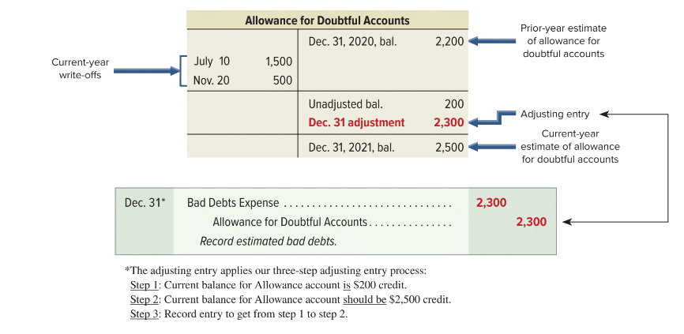
Percent of Receivables Method: Example
Musicland has $50,000 in accounts receivable and $200 credit balance in Allowance for Doubtful Accounts. Five percent of receivables are uncollectible. $50,000 x 5% = $2,500 ending balance.
Exhibit 7.7
© McGraw-Hill Education
Learning Objective P3: Estimate uncollectibles based on sales and accounts receivable.
7-25
Notes:
Musicland has $50,000 of accounts receivable on December 31, 2020. Five percent of its receivables is estimated to be uncollectible. This means that after the adjusting entry is posted, we want the Allowance for Doubtful Accounts to show a $2,500 credit balance (5% of $50,000). Musicland’s beginning balance is $2,200 on December 31, 2020.
During 2021, accounts of customers are written off on July 10 and November 20. Thus, the account has a $200 credit balance before the December 31, 2021, adjustment. The adjusting entry of $2,300 will give the allowance account the estimated $2,500 balance is shown on this slide.

Slide 26
Aging of Receivables Method
Classify each receivable by how long it is past due.
Each age group is multiplied by its estimated bad debts percentage.
Estimated bad debts for each group are totaled.
© McGraw-Hill Education
Learning Objective P3: Estimate uncollectibles based on sales and accounts receivable.
7-26
Notes:
The aging of accounts receivable method, another balance sheet method, uses both past and current receivables information to estimate the allowance amount.
Each receivable is classified by how long it is past its due date. Then estimates of uncollectible amounts are made assuming that the longer an amount is past due, the more likely it is to be uncollectible. After the amounts are classified (or aged), experience is used to estimate the percent of each uncollectible class. These percents are applied to the amounts in each class and then totaled to get the estimated balance of the Allowance for Doubtful Accounts.

Slide 27
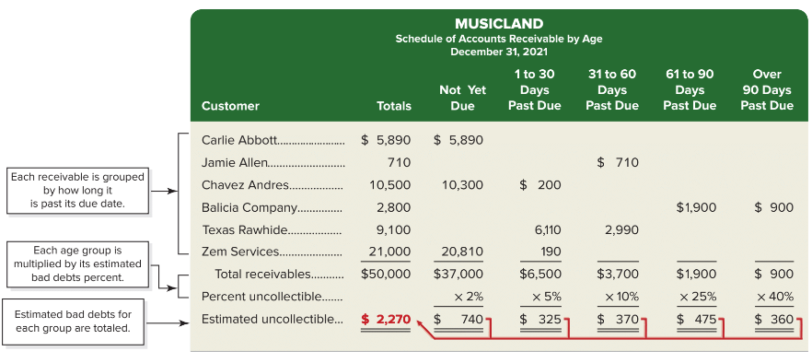
Aging of Accounts Receivable: Musicland
Exhibit7.8
© McGraw-Hill Education
Learning Objective P3: Estimate uncollectibles based on sales and accounts receivable.
7-27
Notes:
This aging of accounts lists each customer’s individual balances assigned to one of five classes based on its days past due. The amounts in each class are totaled and multiplied by the estimated percent of uncollectible accounts for each class. The percents used are regularly reviewed to reflect changes in the company and economy.
Musicland has $3,700 in accounts receivable that are 31 to 60 days past due. Its management estimates 10% of the amounts in this age class are uncollectible, or a total of $370 ($3,700 x 10%). Similar analysis is done for each of the other four classes. The final total of $2,270 ($740 + $325 + 370 + $475 + $360) shown in the first column is the estimated balance for the Allowance for Doubtful Accounts.

Slide 28
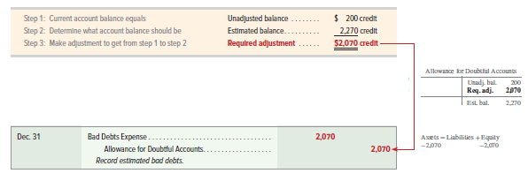
Aging of Accounts Receivable: Adjusting Entry with Credit Balance
Exhibit 7.9
© McGraw-Hill Education
Learning Objective P3: Estimate uncollectibles based on sales and accounts receivable.
7-28
Notes:
Notice that the allowance account has an unadjusted credit balance of $200, the required adjustment to the Allowance for Doubtful Accounts is $2,070. This yields the following end-of-period adjusting entry shown above.

Slide 29
Aging of Accounts Receivable: Adjusting Entry with Debit Balance
© McGraw-Hill Education
Learning Objective P3: Estimate uncollectibles based on sales and accounts receivable.
7-29
Notes:
Notice that if the allowance account has an unadjusted debit balance of $500, the required adjustment to the Allowance for Doubtful Accounts is $2,770 because we need to add the $500 debit balance to the desired ending balance. This yields the following end-of-period adjusting entry of $2,770 as shown on this slide.

Slide 30
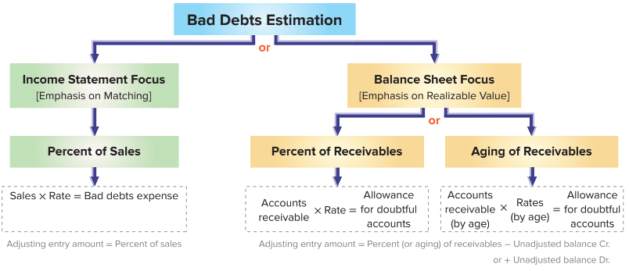
Estimating Bad Debts – Summary of Methods
Exhibit 7.10
© McGraw-Hill Education
Learning Objective P3: Estimate uncollectibles based on sales and accounts receivable.
7-30
Notes:
This diagram summarizes the three estimation methods and their focus of analysis.
The aging of accounts receivable method focuses on specific accounts and is usually the most reliable of the estimation methods.

Slide 31
Describe a note receivable, the computation of its maturity date, and the recording of its existence.
Learning Objective C2
© McGraw-Hill Education
7-31

Slide 32
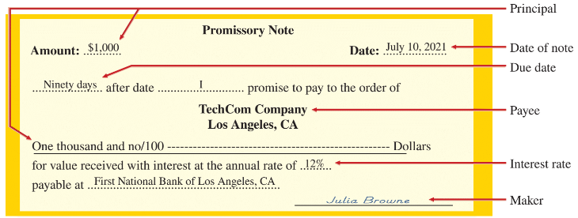
Notes Receivable
A promissory note is a written promise to pay a specified amount of money, usually with interest, either on demand or at a stated future date.
Exhibit 7.11
Learning Objective C2: Describe a note receivable, the computation of its maturity date, and the recording of its existence.
© McGraw-Hill Education
7-32
Notes:
A promissory note is a written promise to pay a specified amount, usually with interest, either on demand or at a stated future date. Promissory notes are used in many transactions, including paying for products and services, and lending and borrowing money. Sellers sometimes ask for a note to replace an account receivable when a customer requests additional time to pay a past-due account. Sellers prefer notes when the credit period is long and when the receivable is for a large amount. If a lawsuit is needed to collect from a customer, a note is the buyer’s written acknowledgment of the debt, its amount, and its terms.
The note illustrated on this slide shows a promissory note dated July 10, 2021. For this note, Julia Browne promises to pay TechCom or to its order (according to TechCom’s instructions) a specified amount of money ($1,000), called the principal of a note, at a stated future date (October 8, 2021). As the one who signed the note and promised to pay it at maturity, Browne is the maker of the note. As the person to whom the note is payable, TechCom is the payee of the note. To Browne, the note is a liability called a note payable. To TechCom, the same note is an asset called a note receivable. This note bears interest at 12%, as written on the note. Interest is the charge for using the money until its due date. To a borrower, interest is an expense. To a lender, it is revenue.

Slide 33
Computing Maturity Date
The maturity date of a note is the day the note
(principal and interest) must be repaid.
Exhibit 7.12
On July 10, TechCom received a $1,000, 90-day, 12% promissory note as a result of a sale to Julia Browne.
The note is due and payable on October 8.
Learning Objective C2: Describe a note receivable, the computation of its maturity date, and the recording of its existence.
© McGraw-Hill Education
7-33
Notes:
The maturity date of a note is the day the note (principal and interest) must be repaid. The period of a note is the time from the note’s (contract) date to its maturity date. Many notes mature in less than a full year, and the period they cover is often expressed in days.
As an example, a five-day note dated June 15 matures and is due on June 20. A 90-day note dated July 10 matures on October 8. This October 8 due date is computed as shown in this slide. The period of a note is sometimes expressed in months or years. When months are used, the note matures and is payable in the month of its maturity on the same day of the month as its original date. A nine-month note dated July 10, for instance, is payable on April 10. The same rule applies when years are used.

Slide 34
Interest Computation
Exhibit 7.13
Even for maturities less than one year, the rate is annualized.
If the note is expressed in days, base a year on 360 days using the “banker’s rule.”
Learning Objective C2: Describe a note receivable, the computation of its maturity date, and the recording of its existence.
© McGraw-Hill Education
7-34
Notes:
Interest is the cost of borrowing money for the borrower or, alternatively, the profit from lending money for the lender. Unless otherwise stated, the rate of interest on a note is the rate charged for the use of the principal for one year. The formula for computing interest on a note is shown in the slide. It is calculated as Principal times Rate times Time.
To simplify interest computations, a year is commonly treated as having 360 days (called the banker’s rule in business and widely used in business transactions). We treat a year as having 360 days for interest computations in examples and assignments. Using the promissory note in the earlier slide where we have a 90-day, 12%, $1,000 note, the total interest is $30.

Slide 35
Recording Notes Receivable
Notes receivable are usually recorded in a single Notes Receivable account to simplify recordkeeping. The original notes are kept on file, including information on the maker, rate of interest, and due date.
To illustrate the recording for the receipt of a note, we use the $1,000, 90-day, 12% promissory note from Julia Browne to TechCom. TechCom received this note at the time of a product sale to Julia Browne.
Learning Objective C2: Describe a note receivable, the computation of its maturity date, and the recording of its existence.
© McGraw-Hill Education
7-35
Notes:
Notes receivable are usually recorded in a single Notes Receivable account to simplify record-keeping.
To illustrate the recording for the receipt of a note, we use the $1,000, 90-day, 12% promissory note we discussed in a prior slide. TechCom received this note at the time of a product sale to Julia Browne. This transaction is recorded as shown above.

Slide 36
Notes Receivable in Acceptance of Past-Due Accounts Receivable
A seller may accept a note receivable from an account receivable customer to allow an extension to pay a past-due accounts receivable.
To illustrate, assume TechCom agreed to accept $232 in cash along with a $600, 60-day, 15% note from Jo Cook to settle her $832 past-due account.
Learning Objective C2: Describe a note receivable, the computation of its maturity date, and the recording of its existence.
© McGraw-Hill Education
7-36
Notes:
When a seller accepts a note from an overdue customer to grant a time extension on a past-due account receivable, it will often collect part of the past-due balance in cash. Assume that TechCom agreed to accept $232 in cash along with a $600, 60-day, 15% note from Jo Cook to settle her $832 past-due account. TechCom makes the entry shown.

Slide 37
Record the honoring and dishonoring of a note and adjustments for interest.
Learning Objective P4
© McGraw-Hill Education
7-37

Slide 38
Recording an Honored Note
The principal and interest of a note are due on its maturity date.
J. Cook has a $600, 15%, 60-day note receivable due to TechCom on December 4.
© McGraw-Hill Education
7-38
Learning Objective P4: Record the honoring and dishonoring of a note and adjustments for interest.
Notes:
The principal and interest of a note are due on its maturity date. The maker of the note usually honors the note and pays it in full. To illustrate, when J. Cook pays the note above on its due date, TechCom records the journal entry shown.
Interest revenue, also called interest earned, is reported on the income statement.

Slide 39
Recording a Dishonored Note
The act of dishonoring a note does not relieve the maker of the obligation to repay the principal and interest due.
J. Cook has a $600, 15%, 60-day note receivable due to TechCom on December 4.
© McGraw-Hill Education
7-39
Learning Objective P4: Record the honoring and dishonoring of a note and adjustments for interest.
Notes:
When a note’s maker does not pay at maturity, the note is dishonored. The act of dishonoring a note does not mean the maker no longer has to pay. The payee continues to attempt to collect. How do companies report this event? The balance of the Notes Receivable account should include only those notes that have not matured. Thus, when a note is dishonored, we remove the amount of this note from the Notes Receivable account and charge it back to an account receivable from its maker. To illustrate, assume that J. Cook dishonors the note above at maturity. The journal entry to record the dishonoring of the note is shown.

Slide 40
Recording End-of-Period Interest Adjustment: 12/31
On December 16, TechCom accepts a $3,000, 60-day, 12% note from a customer in granting an extension on a past-due account. When TechCom’s accounting period ends on December 31, $15 of interest has accrued on the note.
$3,000 x 12% x 15/360 = $15
© McGraw-Hill Education
7-40
Learning Objective P4: Record the honoring and dishonoring of a note and adjustments for interest.
Notes:
When notes receivable are outstanding at the period-end, any accrued interest earned is recorded. To illustrate, on December 16, TechCom accepts a $3,000, 60-day, 12% note from a customer. When TechCom’s accounting period ends on December 31, $15 of interest has accrued on this note ($3,000 x 12% x 15/360). The adjusting entry shown records this revenue.

Slide 41
Recording End-of-Period Interest Adjustment: 2/14
Recording collection on note at maturity.
$3,000 x 12% x 60/360 = $60
© McGraw-Hill Education
7-41
Learning Objective P4: Record the honoring and dishonoring of a note and adjustments for interest.
Notes:
When the December 16 note is collected on February 14, TechCom’s entry to record the cash receipt is shown.
Total interest earned on the 60-day note is $60 ($3,000 x 12% x 60/360). The $15 credit to Interest Receivable on February 14 reflects the collection of the interest accrued from the December 31 adjusting entry. The $45 interest earned reflects TechCom’s revenue from holding the note from January 1 to February 14 of the current period.

Slide 42
Explain how receivables can be converted to cash before maturity.
Learning Objective C3
© McGraw-Hill Education
7-42

Slide 43
Disposal of Receivables
Companies can convert receivables to cash before they are due.
Selling Receivables
Pledging Receivables
© McGraw-Hill Education
7-43
Learning Objective C3: Explain how receivables can be converted to cash before maturity.
Notes:
Companies can convert receivables to cash before they are due if they need cash or do not want to be involved in collection activities. This is usually done by (1) selling them or (2) using them as security for a loan.
A company can sell its receivables to a finance company or bank. The buyer, called a factor, charges the seller a factoring fee and then the buyer takes ownership of the receivables and receives cash when they come due. By incurring a factoring fee, the seller receives cash earlier and can pass the risk of bad debts to the factor. The seller also avoids costs of billing and accounting for the receivables.
A company can raise cash by borrowing money and pledging its receivables as security for the loan. If the borrower defaults on the loan, the lender has a right to be paid from the cash receipts of the receivable when collected.

Slide 44
Compute accounts receivable turnover and use it to help assess financial condition.
Learning Objective A1
7-44
© McGraw-Hill Education

Slide 45
Accounts Receivable Turnover
This ratio provides useful information for evaluating how efficient management has been in granting credit to produce revenue.
Exhibit 7.14
Exhibit 7.15
Learning Objective A1: Compute accounts receivable turnover and use it to help assess financial condition.
© McGraw-Hill Education
7-45
Notes:
Accounts receivable turnover measures how often, on average, receivables are collected during the period. The formula for this ratio is shown above.
Accounts receivable turnover shows how well management is doing in granting credit to customers in a desire to increase sales. A high turnover suggests that management should consider using less strict credit terms to increase sales. A low turnover suggests management should consider more strict credit terms and more aggressive collection efforts to avoid having its resources tied up in accounts receivable.
Visa’s current year turnover is 16.7, computed as $22,977/$1,375 ($ millions). This means that Visa’s average accounts receivable balance was converted into cash 16.7 times in the current year. Its turnover slightly decreased in the current year (16.7) compared with one year ago (17.6). Visa’s turnover also exceeds that for Mastercard in each of these three years. Both Visa and Mastercard seem to be doing an adequate job of managing receivables.

Slide 46
End of Chapter 7
© McGraw-Hill Education
7-46

