Slide 1
Adjusting Accounts For Financial Statements
Chapter 3
Wild and Shaw
Financial and Managerial Accounting
9th Edition
Copyright ©2022 McGraw-Hill Education. All rights reserved. No reproduction or distribution without the prior written consent of McGraw-Hill Education.

Slide 2
Chapter 3 Learning Objectives
CONCEPTUAL
C1 Explain the importance of periodic reporting and the role of accrual accounting.
C2 Explain and prepare a classified balance sheet.
ANALYTICAL
A1 Compute and analyze profit margin and current ratio.
PROCEDURAL
P1 Prepare adjusting entries for deferral of expenses.
P2 Prepare adjusting entries for deferral of revenues.
P3 Prepare adjusting entries for accrued expenses.
P4 Prepare adjusting entries for accrued revenues.
P5 Prepare financial statements from an adjusted trial balance.
P6 Prepare closing entries and a post-closing trial balance.
P7 Appendix 3A Explain the alternatives in accounting for prepaids.
P8 Appendix 3B Prepare a work sheet and explain its usefulness.
P9 Appendix 3C Prepare reversing entries and explain their purpose.
© McGraw-Hill Education

Slide 3
Explain the importance of periodic reporting and the role of accrual accounting.
Learning Objective C1
© McGraw-Hill Education

Slide 4
The Accounting Period
Exhibit 3.1
Learning Objective C1: Explain the importance of periodic reporting and the role of accrual accounting.
© McGraw-Hill Education
Notes:
To provide timely information, accounting systems prepare reports at regular intervals. The time period assumption presumes that an organization’s activities can be divided into specific time periods such as a month, a three-month quarter, a six-month interval, or a year. Most organizations use a year as their primary accounting period. Many organizations also prepare interim financial statements covering one, three, or six months of activity. Reports covering a one-year period are known as annual financial statements.
An organization can use a fiscal year which consists of any 12 consecutive months, or 52 weeks. A natural business year end is when sales for a company are at their lowest level for the year.

Slide 5
Accrual Basis versus Cash Basis
Accrual Basis
Revenues are recorded when products or services are delivered, and records expenses when incurred.
Cash Basis
Revenues are recorded when cash is received and expenses are recorded when cash is paid.
Learning Objective C1: Explain the importance of periodic reporting and the role of accrual accounting.
© McGraw-Hill Education
Notes:
Accrual basis accounting records revenues when services and products are delivered, and records expenses when incurred (matched with revenues).
Cash basis accounting records revenues when cash is received and records expenses when cash is paid. Cash basis income is cash receipts minus cash payments.
Most agree that accrual accounting better reflects business performance than cash basis accounting. Accrual accounting also increases the comparability of financial statements from period to period.

Slide 6
Accrual Basis versus Cash Basis Accrual Basis Example (1 of 2)
Exhibit 3.2
On the accrual basis, $100 of insurance expense is recognized in 2021, $1,200 in 2022, and $1,100 in 2023.
The expense is matched with the periods benefited by the insurance coverage.
Learning Objective C1: Explain the importance of periodic reporting and the role of accrual accounting.
© McGraw-Hill Education
Notes:
In our first transaction, FastForward paid $2,400 for 24 months’ of a business insurance policy that began on December 1, 2021.
On the accrual basis, we would record $100 of insurance expense in the month of December, 2021, $100 for each month in 2022, and $100 for the months January through November in 2023. We match the expense with the periods benefited by the insurance coverage. We believe this is a better cost matching of revenues and expenses.

Slide 7
Accrual Basis versus Cash Basis Cash Basis Example (2 of 2)
Exhibit 3.3
On December 1, 2021, FastForward paid $2,400 cash for a 24 month business insurance policy. Using the cash basis, the entire $2,400 would be recognized as insurance expense in 2021. No insurance expense from this policy would be recognized for the 2022 or 2023 periods covered by the policy.
Learning Objective C1: Explain the importance of periodic reporting and the role of accrual accounting.
© McGraw-Hill Education
Notes:
In our first transaction, on December 1, 2021, FastForward paid $2,400 cash for a 24 month business insurance policy.
On the cash basis, the entire $2,400 would be recognized as an expense in 2021 even though the policy provides protection for 2021, 2022, and part of 2023.

Slide 8
Recognizing Revenues
The revenue recognition principle requires that revenue be recorded when the goods or services are provided to customers and at an amount expected to be received from customers.
Learning Objective C1: Explain the importance of periodic reporting and the role of accrual accounting.
© McGraw-Hill Education
Notes:
We rely on two principles in the adjusting process: revenue recognition principle and expense recognition principle (the latter is often referred to as matching). Revenue recognition principle requires that revenue be recorded when goods or services are provided to customers and at an amount expected to be received from customers. A major goal of the adjusting process is to have revenue recognized (reported) in the time period when those services and products are delivered.

Slide 9
Recognizing Expenses
The expense recognition (or matching) principle requires that expenses be recorded in the same accounting period as the revenues that are recognized as a result of those expenses. This matching of expenses with the revenue benefits is a major part of the adjusting process.
Learning Objective C1: Explain the importance of periodic reporting and the role of accrual accounting.
© McGraw-Hill Education
Notes:
The expense recognition or matching principle aims to record expenses in the same accounting period as the revenues that are recognized as a result of those expenses. This matching of expenses with the revenue benefits is a major part of the adjusting process.

Slide 10
Framework for Adjustments
There are four types of adjustments for transactions that extend over more than one period.
Adjustments are made using a 3-step process:
Step 1: Determine what the current account balance equals.
Step 2: Determine what the current account balance should equal.
Step 3: Record an adjusting entry to get from step 1 to step 2.
Learning Objective C1: Explain the importance of periodic reporting and the role of accrual accounting.
© McGraw-Hill Education
Notes:
There are four types of adjustments that are necessary for transactions and events that extend over more than one period. Adjustments are made using a 3-step process.
An adjusting entry is made at the end of an accounting period to reflect a transaction or event that is not yet recorded. Each adjusting entry affects one or more income statement accounts and one or more balance sheet accounts (but never the Cash account).

Slide 11
Prepare adjusting entries for deferral of expenses.
Learning Objective P1
© McGraw-Hill Education

Slide 12
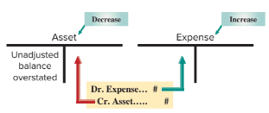
Prepaid (Deferred) Expenses
Prepaid expenses are assets paid for in advance of receiving their benefits.
Examples: Prepaid Insurance, Prepaid Rent, Supplies
Exhibit 3.5
Learning Objective P1: Prepare adjusting entries for deferral of expenses.
© McGraw-Hill Education
Notes:
Let’s start with the first type of adjusting entry, the payment of cash before the expense is recognized.
Prepaid expenses are assets paid for in advance of receiving their benefits. When these assets are used, those advance payments become expenses.
For all adjustments involving prepaid expenses, we increase, or debit, an expense account and reduce, or credit, an asset account.

Slide 13
Adjusting for Prepaid Insurance Step 1
Step 1: Determine current balance:
FastForward paid $2,400 to cover insurance for 24 months that began on December 1, 2021.
FastForward recorded the expenditure as Prepaid Insurance on December 1.
PREPAID INSURANCE
24-month policy
Beginning 12/01
$2,400
Learning Objective P1: Prepare adjusting entries for deferral of expenses.
© McGraw-Hill Education
Notes:
Step 1: We determine that the current balance of FastForward’s prepaid insurance is equal to its $2,400 payment for 24 months of insurance benefits that began on December 1, 2021.

Slide 14
Adjusting for Prepaid Insurance Step 2
Step 2: Balance in prepaid insurance should equal $2,300.
On 12/31, $100 for one month’s worth of insurance has expired.
PREPAID INSURANCE
INSURANCE EXPENSE
$2,400
$100
$100
$2,400/24 months = $100
Insurance Expense is debited $100 to recognize the amount of insurance
coverage for December and Prepaid Insurance is credited for $100 to reduce
it’s balance to $2,300.
Learning Objective P1: Prepare adjusting entries for deferral of expenses.
© McGraw-Hill Education
Notes:
Step 2: The benefits of the insurance expire over time and a portion of the Prepaid Insurance asset becomes expense. For instance, one month’s insurance coverage expires on December 31, 2021. This expense is $100, or 1/24 of $2,400, which leaves $2,300.

Slide 15
Adjusting for Prepaid Insurance Step 3
(Balance Sheet)
(Income Statement)
PREPAID INSURANCE
INSURANCE EXPENSE
$2,400
adj. $100
$100 adj.
Bal.
$2,300
The Income Statement will
show $100 (1 month) of
insurance expired!
The Balance Sheet will show
$2,300 (23 months) of
Prepaid Insurance remaining!
Learning Objective P1: Prepare adjusting entries for deferral of expenses.
© McGraw-Hill Education
Notes:
Step 3: The adjusting entry to record this expense will reduce the asset. After the adjustment, the Prepaid Insurance account will show the correct balance of $2,300 on the Balance sheet and the Insurance Expense account will report the correct amount of expired insurance of $100 on the Income Statement.

Slide 16
Adjusting Entry – Prepaid Insurance
The general journal adjustment on Dec. 31 and general ledger account balances are as follows:
128
637
Learning Objective P1: Prepare adjusting entries for deferral of expenses.
© McGraw-Hill Education
Notes:
The journal entry to record the adjusting entry for expired insurance includes: Insurance expense is debited for $100 and Prepaid insurance is credited for $100.

Slide 17
Adjusting for Supplies Steps 1 and 2
Step 1: FastForward purchased $9,720 of supplies in December. Some of these supplies were used during December.
Step 2: A physical count performed on 12/31 shows that unused supplies equal $8,670.
SUPPLIES
Purchases during December
$9,720
Learning Objective P1: Prepare adjusting entries for deferral of expenses.
© McGraw-Hill Education
Notes:
FastForward purchased $9,720 of supplies in December. Some of these were used during December.
Step 1: Current balance equals $9,720.
Step 2: A physical count performed on 12/31 shows that unused supplies equal $8,670.

Slide 18
Adjusting for Supplies Step 3
Step 3: Adjusting entry reduces Supplies by $1,050 or the difference between the beginning balance and the physical count on 12/31.
(Balance Sheet)
(Income Statement)
SUPPLIES
SUPPLIES EXPENSE
$9,720
adj. $1,050
$1,050 adj.
Bal.
$8,670
The Income Statement will
show $1,050 (1 month) of
Supplies expired!
The Balance Sheet will show
$8,670 of supplies remaining!
Learning Objective P1: Prepare adjusting entries for deferral of expenses.
© McGraw-Hill Education
Notes:
Step 3: Adjusting entry reduces Supplies by $1,050 or the difference between the beginning balance and the physical count taken on 12/31.
After the adjustment, the Supplies account will show the correct balance of $8,670 on the Balance sheet and the Supplies Expense account will report the correct amount of supplies used of $1,050, on the Income Statement.

Slide 19
Adjusting Entry – Supplies
We’ve seen the adjustment in the T-accounts but we need to record the adjustment on Dec. 31 in the General Journal
126
652
Learning Objective P1: Prepare adjusting entries for deferral of expenses.
© McGraw-Hill Education
Notes:
During December, FastForward paid a total of $9,720 for supplies. FastForward took a physical count of their supplies on 12/31 and determined that they actually had $8,670 on hand. Let’s look at the adjusting entry we would make on December 31 to show the supplies used.
We would debit, or increase, the supplies expense account for the difference between the beginning supplies balance and the ending supplies balance, or $1,050, and credit, or reduce, the asset supplies account. Now that we have recorded the supplies expense for December, we will post the adjusting entry to the two ledger accounts in the general ledger.

Slide 20
Depreciation
Instead of expensing the cost of a plant asset (equipment, building, cars, etc.) in the year it is purchased we allocate, or spread out, the cost over their expected useful lives. This is called depreciation.
The formula for straight-line depreciation is:
Straight-Line
Depreciation
Asset Cost - Salvage Value
Useful Life
=
Learning Objective P1: Prepare adjusting entries for deferral of expenses.
© McGraw-Hill Education
Notes:
A special category of prepaid expenses is plant assets, which are long-term tangible assets used to produce and sell products and services. Plant assets provide benefits for more than one period. Examples of plant assets are building, machines, vehicles, and equipment.
Depreciation is the process of allocating the cost of a plant asset over its useful life. At this point in the accounting process, we want to introduce you to a depreciation method known as straight-line depreciation. The amount of annual depreciation is calculated by taking the cost of the plant asset, subtracting the estimated salvage value and dividing that amount by the useful life of the asset. The salvage value is the amount we expect to receive for the asset when we dispose of it at the end of its useful life. In a later chapter, we will discuss other methods of depreciation. For now, let’s look at the adjusting entry to record depreciation expense.

Slide 21
Adjusting for Depreciation – Step 1
FastForward purchased equipment on Dec. 1 for $26,000.
It has an estimated useful life of five years.
The equipment is expected to be worth about $8,000 at the end of five years.
They purchased the equipment on Dec. 1 but it is now Dec. 31.
Because FastForward expects the equipment to be worth $8,000
when the five years are over, only $18,000 of the cost will be
spread over the next 5 years (60 months).
Learning Objective P1: Prepare adjusting entries for deferral of expenses.
© McGraw-Hill Education
Notes:
Let’s look at a depreciation adjustment for FastForward. The company purchased equipment on Dec. 1 for $26,000. It has an estimated useful life of 5 years or 60 months. The equipment is expected to be worth about $8,000 at the end of five years. They purchased the equipment on Dec. 1 but it is now Dec. 31. We will depreciate the net cost of $18,000 over its useful life of 5 years (60 months). Let’s see how this is done.
Step 1 is the purchase of equipment for $26,000. The equipment’s cost must be depreciated.

Slide 22
Straight-Line Depreciation
Step 1: FastForward purchased equipment on December 1 for $26,000.
Calculate Net Cost (amount to depreciate).
FORMULA:
Original Cost
Salvage Value
Net Cost
=
$26,000
$8,000
=
$18,000
Learning Objective P1: Prepare adjusting entries for deferral of expenses.
© McGraw-Hill Education
Notes:
Straight-line depreciation is calculated as shown on this slide. To calculate the net cost of the equipment over its useful life, we start with the $26,000 purchase price and subtract the salvage value of $8,000. This leaves a net cost of $18,000 and this is what we will depreciate.

Slide 23
Adjusting for Depreciation – Step 2
Equipment has a useful life of 5 years. The equipment is expected to be worth $8,000 at the end of five years. FastForward is using straight-line depreciation. $18,000 ($26,000 – $8,000) of the cost needs to be spread over the next 60 months. One month = $18,000 / 60 = $300.
Learning Objective P1: Prepare adjusting entries for deferral of expenses.
© McGraw-Hill Education
Notes:
The 2nd step to determine depreciation expense for this accounting period (one month) is to use the straight-line depreciation formula. Net cost of $18,000 divided by 60 months of useful life equals a monthly cost of $300. Now that we know depreciation for the month is $300, let’s figure out the adjusting entry.

Slide 24
Depreciation adjustment reflected in our T-accounts looks like this:
Adjusting for Depreciation – Step 3
Equipment
Depreciation Expense
12/1 26,000
12/31 300
Accumulated Depreciation
12/31 300
Record adjusting entry for $300 for one month.
The depreciation amount of $300 is credited to the Accumulated Depreciation account instead of the asset account.
Learning Objective P1: Prepare adjusting entries for deferral of expenses.
© McGraw-Hill Education
Notes:
Step 3: record an adjustment for depreciation. We have posted the $300 debit to the Depreciation Expense account and credited a new account called Accumulated Depreciation, for $300. The balance in the Equipment account will remain unchanged by this adjustment. The Accumulated Depreciation account is a contra account and will appear linked to the Equipment account on the Balance sheet. The Depreciation Expense account will appear on our income statement for the year ended December 31, 2021.

Slide 25
Adjusting Entry – Depreciation
Equipment
Depreciation Expense
12/1 26,000
12/31 300
Accumulated Depreciation-Equipment
12/31 300
Learning Objective P1: Prepare adjusting entries for deferral of expenses.
© McGraw-Hill Education
Notes:
On December 31, 2021, we will debit, or increase, Depreciation Expense for $300 and credit a new account called Accumulated Depreciation – Equipment.
Accumulated depreciation is a contra asset account. This is the first time we have seen a contra account, but it will not be the last. A contra account is an account linked with another account, it has an opposite normal balance, and it is reported as a subtraction from that other account’s balance. In our case, accumulated depreciation will reduce the asset account, equipment. Because this is a new type of account, let’s look at the treatment of the contra and related asset account on the balance sheet.

Slide 26
Depreciation – Balance Sheet
Exhibit 3.7
On February 28, 2022, after three months of depreciation have been taken, the Equipment is shown at its $25,100 book value, or net of accumulated depreciation.
Learning Objective P1: Prepare adjusting entries for deferral of expenses.
© McGraw-Hill Education
Notes:
The contra account, Accumulated Depreciation, will be shown as a reduction in the cost of the asset, equipment.
Cost of a plant asset less accumulated depreciation is known as book value. So the asset, Equipment, will be shown on the balance sheet at its net amount, or book value. In the partial balance sheet shown as of 2/28/22, three months of depreciation have been taken on the equipment for a total of 3 × $300 or $900. The Equipment account is being reported at $25,100 which is the cost that has not yet been depreciated. Because the contra account appears on the balance sheet it will not be closed at the end of the period. It will be carried forward to 2023 and used to accumulate the depreciation related to the equipment.

Slide 27
Prepare adjusting entries for deferral of revenues.
Learning Objective P2
© McGraw-Hill Education

Slide 28
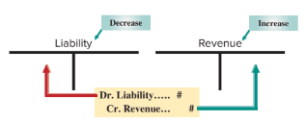
Deferral of Revenue
Unearned revenue is cash received in advance of providing products or services.
Exhibit 3.8
Learning Objective P2: Prepare adjusting entries for deferral of revenues.
© McGraw-Hill Education
Notes:
Unearned revenues refers to cash received in advance of providing products and services. Unearned revenues, also called deferred revenues, are liabilities.
When accounting for deferred revenues, we have a transaction where cash is received in advance of providing a product or service. In other words, we have received the cash, but have done nothing to earn it. In our example, we will examine accounting for the receipt of cash prior to our company rendering any services.
When we render consulting services, we will prepare an adjustment for deferred revenues (a liability). We always debit, or reduce, a liability account and credit, or increase, a revenue account.

Slide 29
Adjusting for Unearned Revenues Steps 1 and 2
Step 1: FastForward’s client paid a 60-day fee in advance covering the period from 12/27 – 2/24 and recorded:
Step 2: FastForward earns payment as time passes. At 12/31, 5 days’ service is earned, 5/60 × $3,000 = $250.
Step 3: Adjusting entry reduces liability, Unearned Consulting Revenue, by $250 for 5 days’ of revenue. Consulting Revenue of $250 is earned.
Learning Objective P2: Prepare adjusting entries for deferral of revenues.
© McGraw-Hill Education
Notes:
FastForward’s client paid a 60-day fee in advance covering the period from 12/27 – 2/24 and recorded a debit to cash and a credit to unearned consulting revenue, a liability account.
Step 1: Current balance equals $3,000.
Step 2: FastForward earns payment as time passes. At 12/31, 5 days’ service is earned or 5/60 × $3,000 = $250.
Step 3: Adjusting entry reduces liability, Unearned Consulting Revenue, by $250 or 5 days’ worth of revenue. Also, Consulting Revenue of $250 is earned.

Slide 30
Adjusting for Unearned Revenue Step 3
(Balance Sheet)
(Income Statement)
UNEARNED CONSULTING REVENUE
CONSULTING REVENUE
$3,000
$4,200 1,600
12/26
12/5
12/31 $250
12/12
250 12/31
$2,750
12/31 Bal.
$6,050
12/31 Bal.
The Balance Sheet will show
$2,750 of Unearned Consulting Revenue unearned.
The Income Statement will
show $6,050 total Consulting Revenue earned.
Learning Objective P2: Prepare adjusting entries for deferral of revenues.
© McGraw-Hill Education
Notes:
After the adjustment, the Unearned Consulting Revenue account will show the correct balance of $2,750 on the Balance sheet and the Consulting Revenue account will report the correct amount of earned revenue of $6,050, on the Income Statement.

Slide 31
Adjusting Entry – Unearned Revenue
Adjusting entry recorded on Dec. 31 transfers $250 from unearned to earned consulting revenue.
Learning Objective P2: Prepare adjusting entries for deferral of revenues.
© McGraw-Hill Education
Notes:
The journal entry to transfer the $250 earned into the revenue account includes a debit to the liability account, Unearned Consulting Revenue and a credit to the revenue account, Consulting Revenue.

Slide 32
Prepare adjusting entries for accrued expenses.
Learning Objective P3
© McGraw-Hill Education

Slide 33
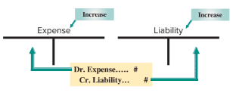
Accrued Expense
Accrued expenses are costs incurred in a period that are
both unpaid and unrecorded.
Exhibit 3.9
Learning Objective P3: Prepare adjusting entries for accrued expenses.
© McGraw-Hill Education
Notes:
Accrued expenses, or accrued liabilities, are costs incurred in the current period that are both unpaid and unrecorded. When you use your credit card, often you do not record the transaction until you pay your monthly invoice; even though you have incurred the cost. Accrued expenses are reported on the income statement of the period when incurred. Examples of accrued expenses are salaries, rent, taxes, and interest.
For all accrued expense adjusting entries, we debit, or increase an expense account, and credit, or increase, a liability account.

Slide 34
Adjusting for Accrued Salaries Steps 1, 2, and 3
Step 1: FastForward pays its employee $70 per day, or $350 for a five-day work week. Salaries are paid every two weeks on a Friday.
Step 2: 12/31 is a Wednesday, so three day’s salaries are owed at year end which equals $70 × 3 = $210.
Step 3: Adjusting entry increases a liability, Salaries Payable, and increases Salaries Expense for $210 with the following journal entry:
Learning Objective P3: Prepare adjusting entries for accrued expenses.
© McGraw-Hill Education
Notes:
Step 1: FastForward pays its employee $70 per day, or $350 for a five-day work. Salaries are paid every two weeks on a Friday.
Step 2: 12/31 is a Wednesday, so three day’s salaries are owed at year end which equals $70 × 3 = $210.
Step 3: Adjusting entry increases a liability, Salaries Payable, and increases the Salaries Expense account for $210.

Slide 35
Adjusting for Accrued Salaries – Financial Statements
(Balance Sheet)
(Income Statement)
SALARIES PAYABLE
SALARIES EXPENSE
$210
12/31 adj.
12/12
12/26
$700 700
210
$210
12/31 Bal.
12/31 adj.
12/31 Bal.
$1,610
The Balance Sheet will show
$210 of Salaries Payable owed.
The Income Statement will
show $1,610 total Salaries Expense.
Learning Objective P3: Prepare adjusting entries for accrued expenses.
© McGraw-Hill Education
Notes:
During the month of December, salaries of $700 each were paid on 12/12 and 12/26, for a total of $1,400. After the adjustment, the Salaries Payable account will show the correct balance of $210 of salaries owed on the Balance sheet and the Salaries Expense account will report the correct amount of salaries expense on the Income Statement.

Slide 36
Future Cash Payment of Accrued Expenses
Accrued expenses at the end of one period result in a cash payment in a future period.
On 12/31, FastForward recorded accrued salaries of $210.
On 1/9 of the next year, the following entry will reduce the accrued liability, salaries payable, and record the expense for 7 days of work in January.
Learning Objective P3: Prepare adjusting entries for accrued expenses.
© McGraw-Hill Education
Notes:
FastForward recorded accrued salaries of $210. On January 9, the first payday of the next period, the following entry settles the accrued liability (salaries payable) and records salaries expense for seven days of work in January.
The $210 debit reflects the payment of the liability for the three days’ salary accrued on December 31. The $490 debit records the salary for January’s first seven working days (including the New Year’s Day holiday) as an expense of the new accounting period. The $700 credit records the total amount of cash paid to the employee.

Slide 37
Prepare adjusting entries for accrued revenues.
Learning Objective P4
© McGraw-Hill Education

Slide 38
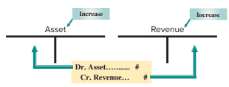
Accrued Revenue
Accrued revenues are revenues earned in a period that are both unrecorded and not yet received in cash or other assets.
Exhibit 3.11
Learning Objective P4: Prepare adjusting entries for accrued revenues.
© McGraw-Hill Education
Notes:
The adjusting entry to accrue revenues is needed because many firms have delivered a product or provided a service but have not recorded the revenue in the current period. In our example, a company completes a consulting engagement. The company has earned the revenue, but has not recorded it at year-end. The company has earned interest that will not be paid until the next period as well.
Accrued revenues are revenues earned in a period that are both unrecorded and not yet received in cash (or other assets).
The adjusting entries to record accrued revenue will always debit, or increase, an asset account and credit, or increase, a revenue account.

Slide 39
Adjusting for Accrued Services Revenue Steps 1, 2, and 3
Step 1: On 12/12, FastForward’s customer agreed to pay $2,700 on 1/10 of the next year for future services over the next 30 days.
Step 2: On 12/31, 20 days worth of services have been provided and earned which totals $1,800 ($2,700 × 20/30 days).
Step 3: Adjusting entry increases an asset, Accounts Receivable, and increases the Consulting Revenue account for $1,800 with the following journal entry:
Learning Objective P4: Prepare adjusting entries for accrued revenues.
© McGraw-Hill Education
Notes:
Step 1: On 12/12, FastForward’s customer agreed to pay $2,700 on 1/10 of the next year for future services over the next 30 days.
Step 2: On 12/31, 20 days worth of services have been provided and earned which totals $1,800 ($2,700 × 20/30 days).
Step 3: Adjusting entry increases an asset, Accounts Receivable, and increases the Consulting Revenue account for $1,800.

Slide 40
Adjusting for Accrued Services Revenue – Financial Statements
(Balance Sheet)
(Income Statement)
ACCOUNTS RECEIVABLE
CONSULTING REVENUE
adj.
$1,800
$6,050
1,800
adj.
Bal.
$1,800
$7,850
Bal.
The Balance Sheet will show
$1,800 of Accounts Receivable.
The Income Statement will
show $7,850 total Consulting Revenue
Learning Objective P4: Prepare adjusting entries for accrued revenues.
© McGraw-Hill Education
Notes:
After the adjustment, the Accounts Receivable account will show the correct balance of $1,800 on the Balance Sheet and the Consulting Revenue account will report the correct amount of revenue earned on the Income Statement.

Slide 41
Future Cash Receipt of Accrued Revenues
Accrued revenue at the end of one period results in a cash receipt in a future period.
On 12/31, FastForward recorded accrued revenue earned of $1,800.
On 1/10 of the next year, the following entry will reduce the accounts receivable, record revenue earned for 10 days and receipt of $2,700 cash.
Learning Objective P4: Prepare adjusting entries for accrued revenues.
© McGraw-Hill Education
Notes:
FastForward made an adjusting entry for $1,800 to record 20 days’ accrued revenue earned from its consulting contract. When FastForward receives $2,700 cash on January 10 for the entire contract amount, it makes the following entry to remove the accrued asset (accounts receivable) and recognize the revenue earned in January. The $2,700 debit reflects the cash received. The $1,800 credit reflects the removal of the receivable, and the $900 credit records the revenue earned in January.

Slide 42
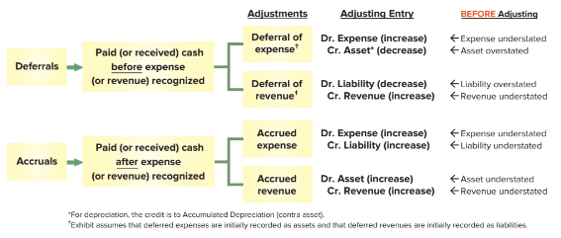
Links to Financial Statements
Exhibit 3.12
Learning Objective P4: Prepare adjusting entries for accrued revenues.
© McGraw-Hill Education
Notes:
This summary will prove very useful. Here is how we read the table. Before we adjust a prepaid expense, the assets of the company are overstated and the expenses are understated in the current period. The proper adjusting entry is to debit, or increase, an expense account and credit, or decrease, an asset account. Remember that each adjusting entry affects one or more income statement (revenue or expense) accounts and one or more balance sheet (asset or liability) accounts, but never the Cash account.
Take a few minutes to go over the remaining three types of adjusting entries before going to the next slide where we will use a spreadsheet to prepare the adjusting entries and financial statements.

Slide 43
Prepare financial statements from an adjusted trial balance.
Learning Objective P5
© McGraw-Hill Education

Slide 44
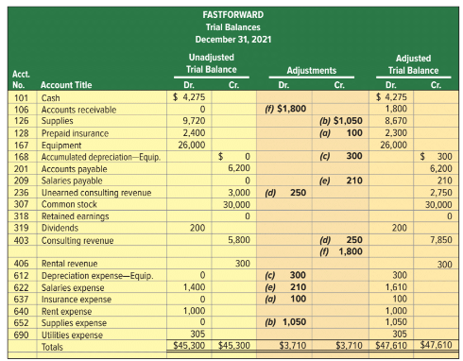
Adjusted Trial Balance
Exhibit 3.13
© McGraw-Hill Education
Learning Objective P5: Prepare financial statements from an adjusted trial balance.
Notes:
An Unadjusted Trial Balance is a list of accounts and balances prepared before adjustments are recorded. An Adjusted Trial Balance is a list of accounts and balances prepared after adjusting entries have been recorded and posted to the ledger. Here we show both the unadjusted and the adjusted trial balances for FastForward at December 31, 2021. The order of accounts in the trial balance is usually set up to match the order in the chart of accounts. Several new accounts arise from the adjusting entries.
Each adjustment (see middle columns) is identified by a letter in parentheses that links it to an adjusting entry explained earlier. Each amount in the Adjusted Trial Balance columns is computed by taking that account’s amount from the Unadjusted Trial Balance columns and adding or subtracting any adjustment(s).
Next, we will look at how to prepare financial statements from the adjusted trial balance.

Slide 45
Steps for Preparing Financial Statements from an Adjusted Trial Balance
Step 1— Prepare income statement using revenue and expense accounts from adjusted trial balance.
Step 2—Prepare statement of retained earnings using retained earnings and dividends from trial balance; and pull net income from step 1.
Step 3—Prepare balance sheet using asset and liability accounts along with common stock from trial balance; and pull updated retained earnings balance from step 2.
Step 4—Prepare statement of cash flows from changes in cash flows for the period (illustrated later in the book).
© McGraw-Hill Education
Learning Objective P5: Prepare financial statements from an adjusted trial balance.
Notes:
We can prepare financial statements directly from information in the adjusted trial balance. An Adjusted Trial Balance includes all accounts and balances appearing in financial statements and is easier to work from than the entire ledger when preparing financial statements.
Steps to Prepare Financial Statements
Step 1 Prepare income statement using revenue and expense accounts from trial balance.
Step 2 Prepare statement of retained earnings using retained earnings and dividends from trial balance; and pull net income from step 1.
Step 3 Prepare balance sheet using asset and liability accounts along with common stock from trial balance; and pull updated retained earnings balance from step 2.
Step 4 Prepare statement of cash flows from changes in cash flows for the period (illustrated later in the book).

Slide 46
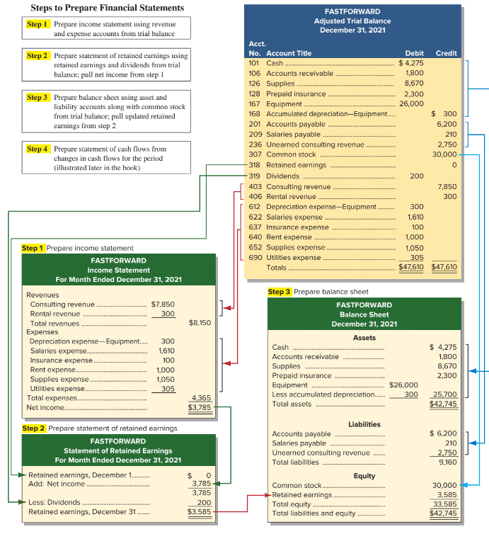
Preparing Financial Statements from an Adjusted Trial Balance
Exhibit 3.14
Learning Objective P5: Prepare financial statements from an adjusted trial balance.
© McGraw-Hill Education
Notes:
The four steps to prepare financial statements are shown in this slide.
Step 1 Prepare income statement using revenue and expense accounts from trial balance.
Step 2 Prepare statement of retained earnings, using retained earnings and dividends from trial balance; pull net income from step 1.
Step 3 Prepare balance sheet using asset and liability along with common stock from trial balance; pull updated retained earnings from step 2.
Step 4 Prepare statement of cash flows from changes in cash flows for the period (illustrated later in the book).

Slide 47
Prepare closing entries and a post-closing trial balance.
Learning Objective P6
© McGraw-Hill Education
3-47

Slide 48
Closing Process
Resets revenue, expense, and dividends account balances to zero at the end of the period.
Updates Retained Earnings account to match that reported in the balance sheet and statement of retained earnings.
Identify accounts for closing.
Record and post closing entries.
Prepare post-closing trial balance.
© McGraw-Hill Education
3-48
Learning Objective P6: Prepare closing entries and a post-closing trial balance.
Notes:
The closing process occurs at the end of an accounting period after financial statements are completed. In the closing process we (1) identify accounts for closing, (2) record and post the closing entries, and (3) prepare a post-closing trial balance.
The closing process has two purposes:
First, it resets revenue, expense, and dividends account balances to zero at the end of each period. This is done so that these accounts can properly measure income and dividends for the next period.
Second, it updates the balance of the Retained Earnings account, which matches that reported in the balance sheet and the statement of retained earnings.

Slide 49
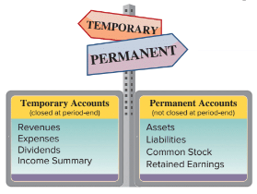
Temporary and Permanent Accounts
The closing process applies only to temporary accounts.
© McGraw-Hill Education
3-49
Learning Objective P6: Prepare closing entries and a post-closing trial balance.
Notes:
Temporary accounts accumulate data related to one accounting period. They include all income statement accounts, the Dividends account, and the Income Summary account. They are temporary because such accounts are used for a period and then closed at the period-end. The closing process applies only to temporary accounts.
Permanent accounts report on activities related to one or more future accounting periods. They include asset, liability, common stock, and retained earnings accounts (all balance sheet accounts). Permanent accounts are not closed each period and carry their ending balance into future periods.

Slide 50
Recording Closing Entries
Close Credit Balances in Revenue Accounts to Income Summary.
Close Debit Balances in Expense accounts to Income Summary.
Close Income Summary account to Retained Earnings.
Close Dividends to Retained Earnings.
© McGraw-Hill Education
Learning Objective P6: Prepare closing entries and a post-closing trial balance.
3-50
Notes:
Closing entries transfer the end-of-period balances in revenue, expense, and dividends accounts to the permanent retained earnings account. Closing entries are necessary at the end of each period after financial statements are prepared because: revenue, expense, and dividends accounts must begin each period with zero balances and retained earnings must reflect prior periods’ revenues, expenses, and dividends.
An income statement reports revenues and expenses for an accounting period. Owner dividends are also reported for an accounting period. Because revenue, expense, and dividends accounts record information separately for each period, they must start each period with zero balances. Exhibit 3.15 uses the adjusted account balances of FastForward (from the Adjusted Trial Balance columns of Exhibit 3.14 or from the left side of Exhibit 3.16) to show the four steps to close its temporary accounts. To close revenue and expense accounts, we transfer their balances to Income Summary. Income Summary is a temporary account only used for the closing process that contains a credit for total revenues (and gains) and a debit for total expenses (and losses).

Slide 51
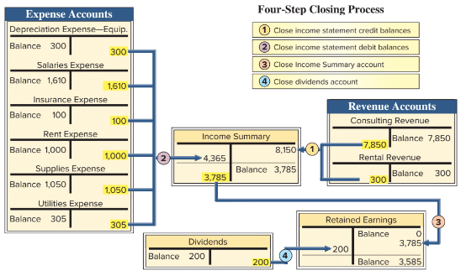
Recording Closing Entries Example
Exhibit 3.15
3-51
Learning Objective P6: Prepare closing entries and a post-closing trial balance.
© McGraw-Hill Education
Notes:
Here are the four steps in the closing process for FastForward:
Step 1: Close Credit Balances in Revenue Accounts to Income Summary First, we close revenues to Income Summary. We bring accounts with credit balances to zero by debiting them. The $8,150 credit entry to Income Summary equals total revenues for the period.
Step 2: Close Debit Balances in Expense Accounts to Income Summary Second, we close expenses to Income Summary. We bring expense accounts’ debit balances to zero by crediting them. With a balance of zero, these accounts are ready to accumulate a record of expenses for the next period. Total expenses for FastForward are $4,365.
Step 3: Close Income Summary to Retained Earnings After steps 1 and 2, the balance of Income Summary equals the period’s net income, $3,785 ($8,150 credit less $4,365 debit) for FastForward. The third closing entry transfers the balance of the Income Summary account to the retained earnings account. This entry closes the Income Summary account. (If a net loss occurred because expenses exceeded revenues, the third entry is reversed: debit retained earnings and credit income summary.)
Step 4: Close Dividends Account to Retained Earnings The fourth closing entry transfers the debit balance in the dividends account to the retained earnings account. This entry gives the dividends account a zero balance, and the account is now ready to record next period’s dividends. Retained earnings is debited for $200. The balance in the Retained earnings account is now $3,585.

Slide 52
Post-Closing Trial Balance
List of permanent accounts and their balances after posting closing entries.
Total debits and credits must be equal.
All temporary accounts have a zero balance.
© McGraw-Hill Education
Learning Objective P6: Prepare closing entries and a post-closing trial balance.
3-52
Notes:
After all four of our closing entries have been made, we prepare a post-closing trial balance. A post-closing trial balance is a list of permanent accounts and their balances after all closing entries have been journalized and posted. Only balance sheet accounts are on a post-closing trial balance. These accounts comprise a company’s assets, liabilities, and equity. A post-closing trial balance verifies that (1) total debits equal total credits for permanent accounts and (2) all temporary accounts have zero balances. The post-closing trial balance usually is the last step in the accounting process.

Slide 53
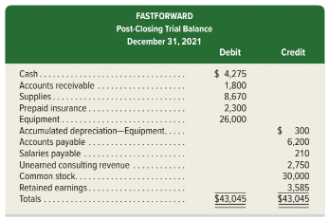
Post-Closing Trial Balance Example
Exhibit 3.18
3-53
Learning Objective P6: Prepare closing entries and a post-closing trial balance.
© McGraw-Hill Education
Notes:
FastForward’s post-closing trial balance is shown in this slide. The post-closing trial balance usually is the last step in the accounting process.

Slide 54
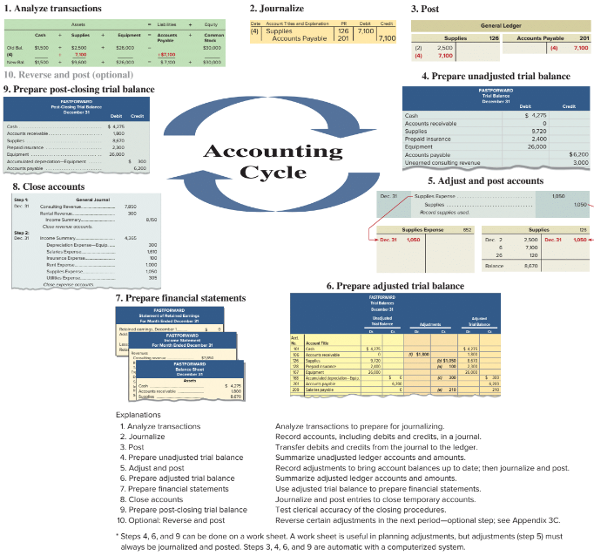
Accounting Cycle
Exhibit 3.19
© McGraw-Hill Education
Learning Objective P6: Prepare closing entries and a post-closing trial balance.
3-54
Notes:
The accounting cycle is the steps in preparing financial statements. It is called a cycle because the steps are repeated each reporting period. There are ten steps in the cycle which include:
1. Analyze transactions--Analyze transactions to prepare for journalizing.
2. Journalize--Record accounts, including debits and credits, in a journal.
3. Post--Transfer debits and credits from the journal to the ledger.
4. Prepare unadjusted trial balance--Summarize unadjusted ledger accounts and amounts.
5. Adjust and Post--Record adjustments to bring account balances up to date; then journalize and post.
6. Prepare adjusted trial balance--Summarize adjusted ledger accounts and amounts.
7. Prepare financial statements--Use adjusted trial balance to prepare financial statements.
8. Close accounts--Journalize and post entries to close temporary accounts.
9. Prepare post-closing trial balance--Test clerical accuracy of the closing procedures.
10. Optional: Reverse and post --Reverse certain adjustments in the next period—optional step; see Appendix 3C.

Slide 55
Explain and prepare a classified balance sheet.
Learning Objective C2
3-55
© McGraw-Hill Education

Slide 56
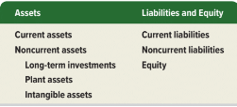
Classified Balance Sheet
Exhibit 3.20
Current items are expected to come due (collected and owed) within the longer of one year or the company’s normal operating cycle.
Most operating cycles are less than one year, so most companies use a one year period in deciding what assets and liabilities are current.
© McGraw-Hill Education
3-56
Learning Objective C2: Explain and prepare a classified balance sheet.
Notes:
A classified balance sheet organizes assets and liabilities into subgroups that provide more information to decision makers.
On the asset side of the balance sheet, we group assets as current (short-term) or noncurrent (long-term). A current asset is one that is expected to be converted into cash in one year or the company’s normal operating cycle, whichever is longer.
The operating cycle of a company is the time it takes to acquire inventory, sell the inventory, and collect cash from the sale of goods and services. Most operating cycles are less than one year which means that most companies use a one-year period to classify current and noncurrent items.
On the liabilities plus equity side of the balance sheet, we divide liabilities between current and noncurrent.
Current assets and current liabilities are listed in order of how quickly they will be converted to, or paid in, cash.
Let’s see how new classifications appear on the balance sheet.

Slide 57
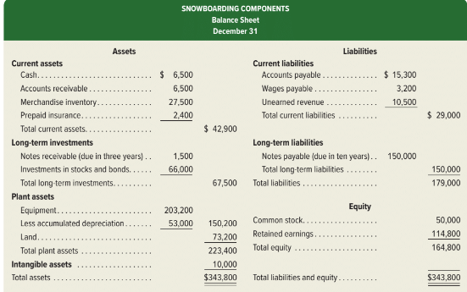
Classified Balance Sheet Example
Exhibit 3.21
© McGraw-Hill Education
3-57
Learning Objective C2: Explain and prepare a classified balance sheet.
Notes:
A classified balance sheet organizes assets and liabilities into subgroups that provide more information to decision makers.

Slide 58
Current Assets
Current assets are expected to be sold, collected, or used within one year or the company’s operating cycle, whichever is longer.
Examples: cash, short-term investments, accounts receivable, short-term notes receivable, merchandise inventory, and prepaid expenses.
3-58
© McGraw-Hill Education
Learning Objective C2: Explain and prepare a classified balance sheet.
Notes:
Current assets are cash and other resources that are expected to expected to come due (collected) within one year or the company’s operating cycle, whichever is longer. Examples are cash, short-term investments, accounts receivable, short-term notes receivable, merchandise inventory (goods for sale), and prepaid expenses.

Slide 59
Long-Term Investments
Long-term investments are expected to be held for more than one year or the operating cycle.
Examples: notes receivable and investments in stocks and bonds expected to be held for more than the longer of one year or the operating cycle.
© McGraw-Hill Education
3-59
Learning Objective C2: Explain and prepare a classified balance sheet.
Notes:
Long-term (or noncurrent) investments. Notes receivable and investments include stocks and bonds and are long-term assets when they are expected to be held for more than the longer of one year or the operating cycle.

Slide 60
Plant Assets
Plant assets are tangible long-lived assets used to produce or sell products and services.
Examples: equipment, machinery, buildings, and land that are used to sell products and services.
Also called property, plant, and equipment (PP&E) or fixed assets.
© McGraw-Hill Education
3-60
Learning Objective C2: Explain and prepare a classified balance sheet.
Notes:
Plant assets are tangible assets that are both long-lived and used to produce or sell products and services. Examples are equipment, machinery, buildings, and land that are used to produce or sell products and services. Plant assets are called property, plant, and equipment (PP&E) or fixed assets.

Slide 61
Intangible Assets
Intangible assets are long-term assets that benefit business operations but lack physical form.
Examples: patents, trademarks, copyrights, franchises, and goodwill.
© McGraw-Hill Education
3-61
Learning Objective C2: Explain and prepare a classified balance sheet.
Notes:
Intangible assets are long-term assets that benefit business operations, and usually lack physical form. Examples are patents, trademarks, copyrights, franchises, and goodwill. Their value comes from the privileges or rights granted to or held by the owner.

Slide 62
Current Liabilities
Current liabilities are liabilities due within the longer of one year or the company’s operating cycle.
Examples: accounts payable, wages payable, taxes payable, interest payable, and unearned revenues.
3-62
© McGraw-Hill Education
Learning Objective C2: Explain and prepare a classified balance sheet.
Notes:
Current liabilities are liabilities due to be paid or settled within one year or the operating cycle, whichever is longer. They are usually settled by paying out cash. Current liabilities often include accounts payable, wages payable, taxes payable, interest payable, and unearned revenues. Also, any portion of a long-term liability due to be paid within one year or the operating cycle, whichever is longer, is a current liability.

Slide 63
Long-Term Liabilities
Long-term liabilities are liabilities not due within the longer of one year or the company’s operating cycle.
Examples: notes payable, mortgages payable, bonds payable, and lease obligations.
3-63
© McGraw-Hill Education
Learning Objective C2: Explain and prepare a classified balance sheet.
Notes:
Long-term liabilities are liabilities not due within one year or the operating cycle, whichever is longer. Notes payable, mortgages payable, bonds payable, and lease obligations are common long-term liabilities.

Slide 64
Equity
Equity is the owner’s claim on the assets.
For a corporation, reported in retained earnings and common stock accounts.
Equity is not separated into current and noncurrent categories.
© McGraw-Hill Education
3-64
Learning Objective C2: Explain and prepare a classified balance sheet.
Notes:
Equity is the owner’s claim on assets. For a corporation, this claim is reported in the equity section as common stock and retained earnings. Equity is not separated into current and noncurrent categories.

Slide 65
Compute and analyze profit margin and current ratio.
Learning Objective A1
© McGraw-Hill Education

Slide 66
Profit Margin
The profit margin ratio measures the company’s net income to net sales.
Exhibit 3.22
Profit
Margin
Net income
Net sales
=
Visa and Mastercard’s Profit Margin
Exhibit 3.23
© McGraw-Hill Education
Learning Objective A1: Compute and analyze profit margin and current ratio.
Notes:
Profit margin is a useful measure of a company’s operating results. It tells us about the relationship between net income and net sales. We calculate the ratio by dividing net income for the period by net sales.
Visa’s profit margins are shown for a three-year period. Visa’s profit margin is better than Mastercard in each of the last three years. For Mastercard to improve its profit margin, it must either reduce expenses, or increase revenues at a relatively greater amount than expenses.

Slide 67
Current Ratio
Helps assess the company’s ability to pay its debts in the near future
 | Current ratio | = | Current assets Current liabilities
Exhibit 3.24
Exhibit 3.25
3-67
© McGraw-Hill Education
Learning Objective A1: Compute and analyze profit margin and current ratio.
Notes:
An important use of financial statements is to help assess a company’s ability to pay its debts in the near future. Such analysis affects decisions by suppliers when allowing a company to buy on credit. It also affects decisions by creditors when lending money to a company, including loan terms such as interest rate and due date. The current ratio is one measure of a company’s ability to pay its short-term obligations. It is defined above as current assets divided by current liabilities.
Costco’s current ratio for each of the last three years is in Exhibit 3.25. A current ratio of over 1.0 means that current obligations can be covered with current assets. For the most recent three years, Costco’s current ratio has been slightly below or slightly above 1.0. This means Costco could face challenges in covering current liabilities. Although Costco has a better ratio than Walmart in each of the last three years, management must continue to monitor current assets and liabilities.

Slide 68
Appendix 3A Explain the alternatives in accounting for prepaids.
Learning Objective P7
© McGraw-Hill Education

Slide 69
Alternative Accounting for Prepayments
An alternative method is to record all prepaid expenses
with debits to expense accounts.
Exhibits 3A.1 & 3A.2
The adjusting entry depends on how the original payment
was recorded.
© McGraw-Hill Education
Learning Objective P7: Explain the alternatives in accounting for prepaids.
Notes:
An alternative method is to record all prepaid expenses with debits to expense accounts. If any prepaids remain unused or unexpired at the end of an accounting period, then adjusting entries must transfer the cost of the unused portions from expense accounts to prepaid expense (asset) accounts. This alternative method is acceptable. The financial statements are identical under either method, but the adjusting entries are different. To illustrate the differences between these two methods, let’s look at FastForward’s cash payment of December 1 for 24 months of insurance coverage beginning on December 1. FastForward recorded that payment with a debit to an asset account, but it could have recorded a debit to an expense account. These alternatives are shown on this slide in the first graphic.
At the end of its accounting period on December 31, insurance protection for one month has expired. This means $100 ($2,400/24 months) of insurance coverage has expired and is an expense for December. The adjusting entry depends on how the original payment was recorded. This is shown on this slide in the second graphic.

Slide 70
Alternative Accounting for Prepayments – Account Balances
Exhibit 3A.3
© McGraw-Hill Education
Learning Objective P7: Explain the alternatives in accounting for prepaids.
Notes:
When the entries are posted to the accounts in the ledger, we can see that these two methods give identical ending balances. The December 31 adjusted account balances show Prepaid Insurance of $2,300 and Insurance Expense of $100 for both methods.

Slide 71
Alternative Accounting for Revenues
An alternative method is to record all revenues to a liability account or a revenue account.
Exhibits 3A.4 & 3A.5
The adjusting entry depends on how the original receipt
was recorded.
© McGraw-Hill Education
Learning Objective P7: Explain the alternatives in accounting for prepaids.
Notes:
An alternative method is to record all unearned revenues with credits to revenue accounts. If any revenues are unearned at the end of an accounting period, then adjusting entries must transfer the unearned portions from revenue accounts to unearned revenue (liability) accounts. This alternative method is acceptable. The adjusting entries are different for these two alternatives, but the financial statements are identical.
Assume FastForward’s December 26 receipt of $3,000 for consulting services covering the period December 27 to February 24. FastForward recorded this transaction with a credit to a liability account. The alternative is to record it with a credit to a revenue account.
By the end of its accounting period on December 31, FastForward has earned $250 of this revenue. This means $250 of the liability has been satisfied. Depending on how the initial receipt is recorded, the adjusting entry is as shown.

Slide 72
Alternative Accounting for Revenues – Account Balances
Exhibit 3A.6
Learning Objective P7: Explain the alternatives in accounting for prepaids.
© McGraw-Hill Education
Notes:
When the entries are posted, we can see that these two methods give identical ending balances. The December 31 adjusted account balances show Unearned Consulting Revenue of $2,750 and Consulting Revenue of $250 for both methods.

Slide 73
Appendix 3B Prepare a work sheet and explain its usefulness.
Learning Objective P8
© McGraw-Hill Education
4-73

Slide 74
Benefits of a Work Sheet
Helps in preparing financial statements.
Reduces risk of errors.
Not a required report.
Links accounts and adjustments to financial statements.
Shows effects of proposed “what-if” transactions.
© McGraw-Hill Education
3-74
Learning Objective P8: Prepare a work sheet and explain its usefulness.
Notes:
A work sheet is a document that is used internally by companies to help with adjusting and closing accounts and with preparing financial statements. Specifically, a work sheet:
1. Helps in preparing financial statements.
Reduces the risk of errors when working with many accounts and adjustments.
Links accounts and adjustments to financial statements.
Shows the effects of proposed or “what-if” transactions.

Slide 75
Use of a Work Sheet
Five steps:
Step 1: Enter Unadjusted Trial Balance
Step 2: Enter Adjustments
Step 3: Prepare Adjusted Trial Balance
Step 4: Sort Adjusted Trial Balance Amounts to Financial Statements
Step 5: Total Statement Columns, Compute Income or Loss, and Balance Columns
© McGraw-Hill Education
3-75
Learning Objective P8: Prepare a work sheet and explain its usefulness.
Notes:
When a work sheet is used to prepare financial statements, it is constructed at the end of a period before the adjusting process. Preparing the work sheet has five steps.
Step 1: The first step in preparing a work sheet is to list the title of each account and its account number. This includes all accounts in the ledger plus expected ones from adjusting entries. The unadjusted balance for each account is then entered in the correct Debit or Credit column of the unadjusted trial balance columns. The totals of these two columns must be equal.
Step 2: The second step is to enter adjustments in the Adjustments columns.
Step 3: The adjusted trial balance is prepared by combining the adjustments with the unadjusted balances for each account.
Step 4: This step involves sorting account balances from the adjusted trial balance to their proper financial statement columns. Expenses go to the Income Statement Debit column and revenues to the Income Statement Credit column. Assets and dividends go to the Balance Sheet & Statement of Retained Earnings Debit column. Liabilities and owner’s capital go to the Balance Sheet & Statement of Retained Earnings Credit column.
Step 5: Each financial statement column (from step 4) is totaled. The difference between the Debit and Credit column totals of the Income Statement columns is net income or net loss. This occurs because revenues are entered in the Credit column and expenses in the Debit column. If the Credit total exceeds the Debit total, there is net income. If the Debit total exceeds the Credit total, there is a net loss.

Slide 76
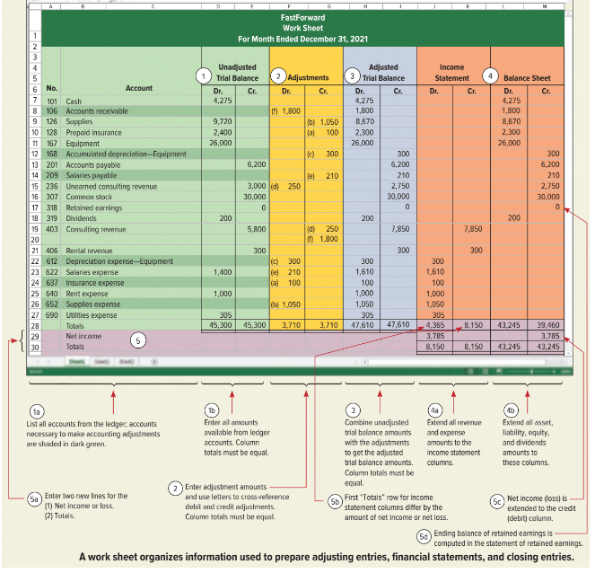
Work Sheet Example
Exhibit 3B.1
3-76
Learning Objective P8: Prepare a work sheet and explain its usefulness.
© McGraw-Hill Education
Notes:
A worksheet organizes information used to prepare adjusting entries, financial statements, and closing entries. A work sheet does not substitute for financial statements. It is a tool we use to help prepare financial statements.

Slide 77
Appendix 3C Prepare reversing entries and explain their purpose.
Learning Objective P9
3-77
© McGraw-Hill Education

Slide 78
Appendix 3C – Reversing Entries
Reversing entries are optional. They reverse the debits and credits of adjusting entries involving accrued revenues and accrued expenses.
The purpose is to simplify recordkeeping.
Let’s see how the accounting for our payroll accrual will be handled with and without reversing entries.
3-78
© McGraw-Hill Education
Learning Objective P9: Prepare reversing entries and explain their purpose.
Notes:
Reversing entries are optional. They are dated the first day of the next accounting period, and they reverse the debits and credits of adjusting entries using the same accounts and amounts. Reversing entries are used for adjusting entries involving accrued revenues and accrued expenses. The purpose of reversing entries is to simplify recordkeeping.
Let’s see how the accounting for our payroll accrual will be handled with and without reversing entries.

Slide 79
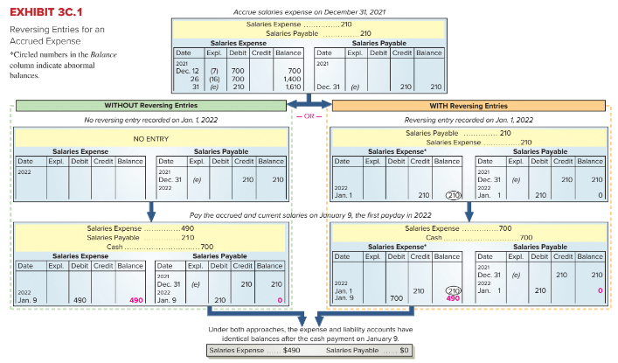
Reversing Entries (1 of 2)
© McGraw-Hill Education
3-79
Learning Objective P9: Prepare reversing entries and explain their purpose.
Notes:
The purpose of reversing entries is to simplify a company’s recordkeeping. This slide shows an example of FastForward’s reversing entries. The top of the exhibit shows the adjusting entry FastForward recorded on December 31 for its employee’s earned but unpaid salary. The entry recorded three days’ salary of $210, which increased December’s total salary expense to $1,610. The entry also recognized a liability of $210. The expense is reported on December’s income statement. The expense account is then closed. The ledger on January 1, 2022, shows a $210 liability and a zero balance in the Salaries Expense account. At this point, the choice is made between using or not using reversing entries.

Slide 80
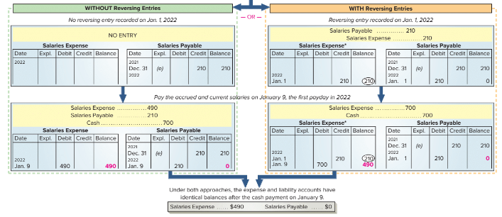
Reversing Entries (2 of 2)
Exhibit 3C.1
Without Reversing Entries
With Reversing Entries
© McGraw-Hill Education
3-80
Learning Objective P9: Prepare reversing entries and explain their purpose.
Notes:
Accounting without Reversing Entries The path down the left side is described in the chapter. To summarize here, when the next payday occurs on January 9, we record payment with a compound entry that debits both the expense and liability accounts and credits Cash. Posting that entry creates a $490 balance in the expense account and reduces the liability account balance to zero because the payable has been settled.
Accounting with Reversing Entries The right side shows reversing entries. A reversing entry is the exact opposite of an adjusting entry. For FastForward, the Salaries Payable liability account is debited for $210, meaning that this account now has a zero balance after the entry on January 1 is posted. The Salaries Payable account temporarily understates the liability, but this is not a problem since financial statements are not prepared before the liability is settled on January 9. The credit to the Salaries Expense account is unusual because it gives the account an abnormal credit balance. We highlight an abnormal balance by circling it. Because of the reversing entry, the January 9 entry to record payment debits the Salaries Expense account and credits Cash for the full $700 paid. It is the same as all other entries made to record 10 days’ salary for the employee. Notice that after the payment entry is posted, the Salaries Expense account has a $490 balance that reflects seven days’ salary of $70 per day. The zero balance in the Salaries Payable account is now correct. The lower section shows that the expense and liability accounts have exactly the same balances whether reversing entries are used or not.

Slide 81
End of Chapter 3
© McGraw-Hill Education

