Slide 1
Accounting in Business
Chapter 1
Wild and Shaw
Financial and Managerial Accounting
9th Edition
Copyright ©2022 McGraw-Hill Education. All rights reserved. No reproduction or distribution without the prior written consent of McGraw-Hill Education.

Slide 2
Chapter 1 Learning Objectives
CONCEPTUAL
C1 Explain the importance of accounting and identify its users.
C2 Describe the importance of ethics and GAAP.
ANALYTICAL
A1 Define and interpret the accounting equation and each of its components.
A2 Compute and interpret return on assets.
PROCEDURAL
P1 Analyze business transactions using the accounting equation.
P2 Identify and prepare basic financial statements and explain how they interrelate.
© McGraw-Hill Education

Slide 3
Explain the importance of accounting and identify its users.
Learning Objective C1
© McGraw-Hill Education

Slide 4
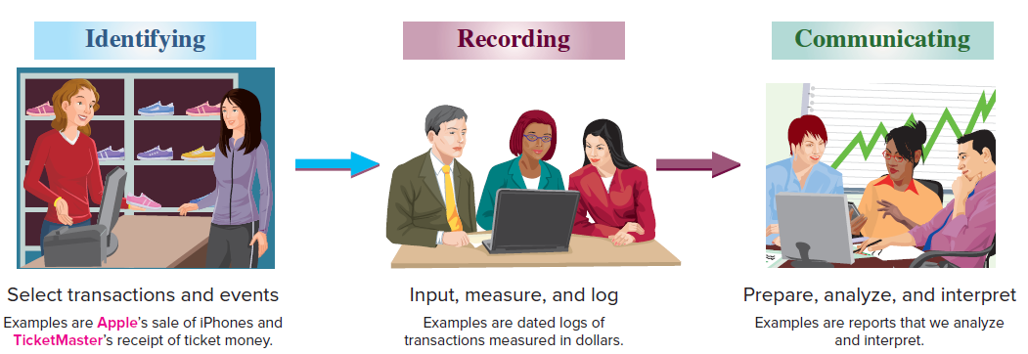
Importance of Accounting
Exhibit 1.1
Accounting is an information and measurement system that identifies, records, and communicates an organization’s business activities.
Learning Objective C1: Explain the importance of accounting and identify its users.
© McGraw-Hill Education
Notes:
Accounting is an information and measurement system that identifies, records, and communicates an organization’s business activities.
Identifying business activities requires that we select relevant transactions and events.
Recording business activities requires that we keep a chronological log of transactions and events measured in dollars.
Communicating business activities includes preparing accounting reports such as financial statements, which we analyze and interpret.
Recordkeeping, or bookkeeping, includes the recording of transactions and events and is just one part of accounting. Accounting also includes analysis and interpretation of information.

Slide 5
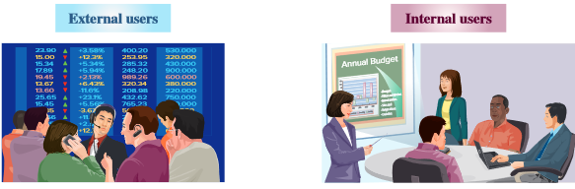
Users of Accounting Information
Accounting is called the language of business because it communicates data that help people make better decisions. People using accounting information are divided into two groups: external users and internal users.
Shareholders
Lenders
External auditors
Nonmanagerial employees
Regulators
Purchasing managers
Human resource managers
Production managers
Research and development managers
Marketing managers
Learning Objective C1: Explain the importance of accounting and identify its users.
© McGraw-Hill Education
Notes:
Accounting is called the language of business because it communicates data that help people make better decisions. People using accounting information are divided into two groups: external users and internal users.
External users of accounting information do not directly run the organization and have limited access to its accounting information. Financial accounting is the area of accounting that serves external users. External users include shareholders (investors), lenders, external auditors, customers, nonmanagerial and nonexecutive employees, suppliers, regulators, and voters and government officials. External user’s business decisions depend on information that is reliable, relevant, and comparable.
Internal users of accounting information directly manage the organization and includes the chief executive officer (CEO) and managers. Internal reports are designed for the unique needs of managerial or executive employees. Managerial accounting focuses on the needs of internal users. Examples of internal users include purchasing managers, human resource managers, production managers, distribution managers, marketing managers, and research and development managers.

Slide 6
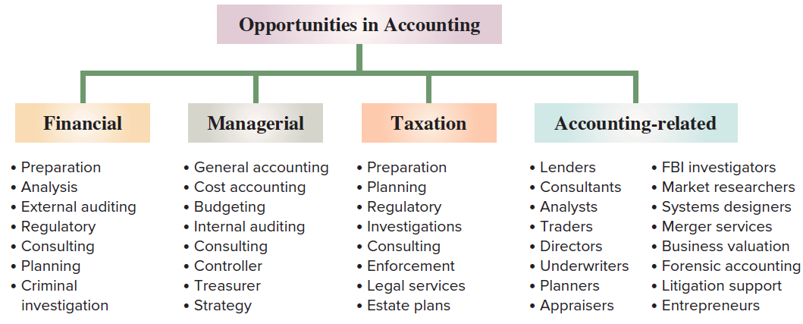
Opportunities in Accounting
Exhibit 1.2
The majority of opportunities are in private accounting where employees work for businesses. Public accounting involves accounting services such as auditing, taxation, and advisory services.
Learning Objective C1: Explain the importance of accounting and identify its users.
© McGraw-Hill Education
Notes:
Accounting has four areas of opportunities including financial, managerial, taxation, and accounting-related.
The majority of opportunities are in private accounting, where employees work for businesses. Public accounting offers the next largest number of opportunities, which involve accounting services such as auditing, taxation and advisory services. Other opportunities exist in government and not-for-profit agencies, including business regulation and law enforcement.
Accounting specialists are highly regarded. Their professional standing often is denoted by a certificate. Certified public accountants (CPAs) must meet education and experience requirements, pass an exam, and be ethical. Other common certifications include the certificate in management accounting, CMA, and the certified internal auditor, CIA.

Slide 7
Artificial Intelligence and Data Analytics
Artificial Intelligence (AI) uses software and can be used to complete repetitive tasks such as entering invoices and transaction data.
Accountants are needed to help develop advanced AI systems and analyze reports and graphics.
Data analytics is a process of analyzing data to identify meaningful relations and trends.
Data visualization is a graphical presentation of data to help individuals make informed business decisions.
Learning Objective C1: Explain the importance of accounting and identify its users.
© McGraw-Hill Education
Notes:
Some estimate that AI could replace 40% of the workforce and is used for repetitive tasks including entering invoices and transaction data. Accountants are needed to help develop advanced AI systems and analyze reports and graphics.
Data analytics and data visualization are highly sought top skills by employers. Data analytics is the process of analyzing data to identify meaningful relations and trends. Data visualization is a graphical presentation of data to help people understand their significance and help individuals make informed business decisions.

Slide 8
Describe the importance of ethics and GAAP.
Learning Objective C2
© McGraw-Hill Education

Slide 9
Ethics – A Key Concept
For information to be useful, it must be trusted. This demands ethics in accounting. Ethics are beliefs that separate right from wrong. They are accepted standards of good and bad behavior.
Exhibit 1.5
Learning Objective C2: Describe the importance of ethics and GAAP.
© McGraw-Hill Education
Notes:
For information to be useful, it must be trusted. This demands ethics in accounting. Ethics are beliefs that separate right from wrong. They are accepted standards of good and bad behavior.
When faced with an ethical concern, the first step is to recognize it as such. Next, we should analyze all options and consider all consequences. Finally, we must choose the best option after weighing all the consequences.
Good ethics are good business.

Slide 10
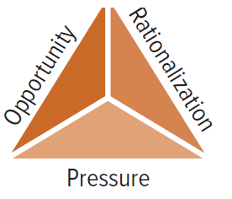
Fraud Triangle
Three factors must exist for a person to commit fraud: opportunity, pressure, and rationalization.
Envisions a way to commit fraud with low risk of getting caught
Fails to see the criminal nature of the fraud or justifies the action
Must have some pressure to commit fraud, like unpaid bills
Learning Objective C2: Describe the importance of ethics and GAAP.
© McGraw-Hill Education
Notes:
The fraud triangle shows three factors must push a person to commit fraud: opportunity, pressure, and rationalization.
Opportunity. A person must be able to commit fraud with a low risk of getting caught.
Pressure, or incentive. A person must have pressure or have incentive to commit fraud. Examples are unpaid bills and addictions.
Rationalization, or attitude. A person justifies fraud or does not see its criminal nature.
It is important to recognize that all three factors of the fraud triangle must usually exist for fraud to occur. The key to stopping fraud is to focus on prevention by using internal controls. Internal controls are procedures to protect assets, ensure reliable accounting, promote efficiency, and uphold company policies. Examples are good records, physical controls, and independent reviews. It is less expensive and more effective to prevent fraud from happening than it is to try to detect the crime. By the time the fraud is discovered, the money is gone. Additionally, it is costly and time-consuming to investigate a fraud.
Auditors verify the effectiveness of internal controls.

Slide 11
Generally Accepted Accounting Principles (GAAP)
Financial accounting is governed by concepts and rules known as generally accepted accounting principles (GAAP). GAAP wants information to have relevance and faithful representation.
Relevant information affects decisions
of users.
Faithful representation means information accurately reflects business results.
Learning Objective C2: Describe the importance of ethics and GAAP.
© McGraw-Hill Education
Notes:
Financial accounting is governed by concepts and rules known as generally accepted accounting principles (GAAP). GAAP wants information to have relevance and faithful representation. Relevant information affects decisions of users. Faithful representation means information accurately reflects the business results.

Slide 12
Financial Accounting Standards Board (FASB)
The FASB sets GAAP.
Authority provided by the Securities and Exchange Commission (SEC).
The SEC is a U.S. government agency that oversees GAAP by companies that sell stock and debt to the public.
Learning Objective C2: Describe the importance of ethics and GAAP.
© McGraw-Hill Education
Notes:
The Financial Accounting Standards Board (FASB) is given the task of setting GAAP from the Securities and Exchange Commission (SEC). The SEC is a U.S. government agency that oversees proper use of GAAP by companies that sell stock and debt to the public. An audit examines whether financial statements are prepared using GAAP.

Slide 13
International Standards
In today’s global economy, there is increased demand by external users for comparability in accounting reports.
International Accounting Standards Board (IASB)
Issues International Financial Reporting Standards (IFRS).
Standards identify preferred accounting practices.
Standards are similar to, but sometimes different from, U.S. GAAP.
FASB and IASB are working to reduce differences.
Learning Objective C2: Describe the importance of ethics and GAAP.
© McGraw-Hill Education
Notes:
In today’s global economy, there is increased demand by external users for comparability in accounting reports. The International Accounting Standards Board (IASB) is a group (consisting of individuals from many countries) that issues International Financial Reporting Standards (IFRS), which identify preferred accounting practices.
The FASB and IASB are working to reduce the differences between U.S. GAAP and IFRS.

Slide 14
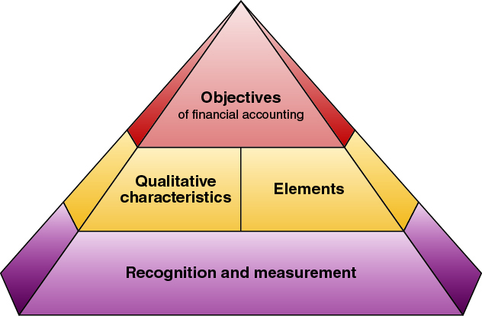
Conceptual Framework
Exhibit 1.6
Objectives – provide useful information to investors, creditors, and others.
Qualitative characteristics – information has relevance and faithful representation.
Elements – defines items in financial statements.
Recognition and measurement – criteria for an item to be recognized as an element and how to measure it.
Learning Objective C2: Describe the importance of ethics and GAAP.
© McGraw-Hill Education
Notes:
The FASB framework consists of the following:
Objectives—to provide information useful to investors, creditors, and others.
Qualitative Characteristics—to require information that has relevance and faithful representation.
Elements—to define items in financial statements.
Recognition and Measurement—to set criteria that an item must meet for it to be recognized as an element; and how to measure that element.

Slide 15
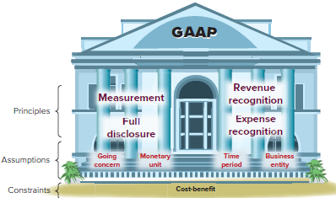
Principles, Assumptions and Constraint
Exhibit 1.7
General principles are the assumptions, concepts, and guidelines for preparing financial statements.
Specific principles are detailed rules used in reporting business transactions and events.
Learning Objective C2: Describe the importance of ethics and GAAP.
© McGraw-Hill Education
Notes:
Accounting principles (and assumptions) are of two types. General principles are the basic assumptions, concepts, and guidelines for preparing financial statements. Specific principles are detailed rules used in reporting business transactions and events.

Slide 16
Accounting Principles
Measurement Principle
(Cost Principle)
Accounting information is based on actual cost. Actual cost is considered objective.
Revenue Recognition Principle
Recognize revenue when goods or services are provided to customers and
at an amount expected to be received from the customer.
Expense Recognition Principle
(Matching Principle)
A company records its expenses incurred to generate the revenue reported.
Full Disclosure Principle
A company reports the details behind financial statements that would impact users’ decisions in the notes to the financial statements.
Learning Objective C2: Describe the importance of ethics and GAAP.
© McGraw-Hill Education
Notes:
There are four general principles.
The measurement principle, also called the cost principle, usually means that accounting information is based on actual cost. Cost is measured on a cash or equal-to-cash basis. This means if cash is given for a service, its cost is measured as the amount of cash paid. Information based on cost is considered objective. Objectivity means that information is supported by independent, unbiased evidence.
Two concepts are important to the revenue recognition principle:
Revenue is recognized when the services are performed or the goods are provided to the buyer and
(2) Revenue is recognized at the amount expected to be received from the customer. The amount received is usually in cash, but it is also common to receive a customer’s promise to pay at a future date, called credit sales.
The expense recognition principle, also called the matching principle, states that the company records expenses incurred to generate the revenue reported. The principles of matching and revenue recognition are key to modern accounting.
The full disclosure principle states that a company reports the details that would impact users’ decisions. Most of the details are reported in the footnotes to the financial statements.

Slide 17
Accounting Assumptions
Going-Concern Assumption
The business is presumed to continue operating instead of being closed or sold.
Monetary Unit Assumption
Transactions and events are expressed in monetary, or
money, units.
Time Period Assumption
The life of a company
can be divided into time periods,
such as months and years.
Business Entity Assumption
A business is accounted for separately from other business entities, including its owner.
Learning Objective C2: Describe the importance of ethics and GAAP.
© McGraw-Hill Education
Notes:
Now we will look at four fundamental assumptions of accounting.
The going-concern assumption states that, accounting information presumes that the business will continue operating instead of being closed or sold.
The monetary unit assumption tells us that we will only record accounting information that can be expressed in monetary units, usually dollars in the United States.
The time period assumption presumes that the life of a company can be divided into time periods such as months and years, and that useful reports can be prepared for those periods.
Finally, the business entity assumption tells us that a business is accounted for separately from other business entities and its owner.

Slide 18
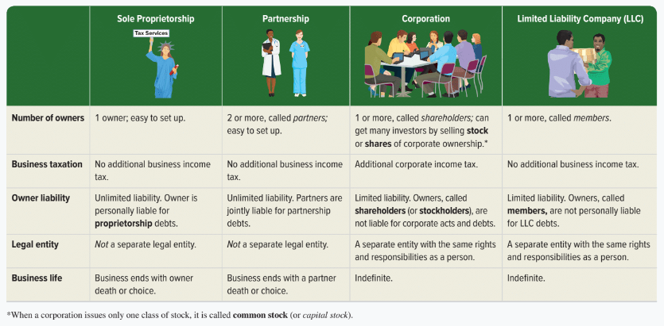
Proprietorship, Partnership, and Corporation
Here are some of the major attributes of sole proprietorships, partnerships, corporations, and limited liability companies (LLC):
Exhibit 1.8
Learning Objective C2: Describe the importance of ethics and GAAP.
© McGraw-Hill Education
Notes:
A sole proprietorship, or simply proprietorship, is a business owned by one person. The business is a separate entity for accounting purposes. However, the business is not a separate legal entity from its owner.
A partnership is a business owned by two or more people, called partners, which are jointly liable for tax and other obligations. Like a proprietorship, no special legal requirements must be met in starting a partnership. The only requirement is an agreement between partners to run a business together. The agreement can be either oral or written and usually indicates how income and losses are to be shared. A partnership, like a proprietorship, is not legally separate from its owners.
A corporation, also called a C corporation, is a business legally separate from its owner or owners, meaning it is responsible for its own acts and its own debts. Separate legal status means that a corporation can conduct business with the rights, duties, and responsibilities of a person. A corporation acts through its managers, who are its legal agents. Separate legal status also means that its owners, who are called shareholders (or stockholders), are not personally liable for corporate acts and debts.
A limited liability company (LLC) includes one or more members who are not personally liable for the LLC’s debts. This is a separate entity with the same rights and responsibilities as a person.

Slide 19
Accounting Constraints
Cost-benefit constraint
Information disclosed must have benefits to the user greater than the cost of providing it.
Materiality constraint
Ability of information to influence decisions of a user need be disclosed.
Conservatism and industry practices are sometimes included as a constraint, also.
Learning Objective C2: Describe the importance of ethics and GAAP.
© McGraw-Hill Education
Notes:
The cost-benefit constraint says that only information with benefits which are greater than their costs need to be disclosed.
Materiality is sometimes included as a constraint and is the ability of information to influence decisions.
Conservatism and industry practices are sometimes included as accounting constraints, also.

Slide 20
Define and interpret the accounting equation and each of its components.
Learning Objective A1
© McGraw-Hill Education

Slide 21
Business Transactions and Accounting
The Accounting Equation
=
+
Assets
Liabilities
Equity
Expanded Accounting Equation:
Net Income
Learning Objective A1: Define and interpret the accounting equation and each of its components.
© McGraw-Hill Education
Notes:
Accounting reflects two basic aspects of a company: what it owns and what it owes.
Assets are resources a company owns or controls. These resources are expected to yield future benefits. Examples are cash, accounts receivable, supplies, equipment, land, and web servers for an online services company. The term receivable refers to an asset that promises a future inflow of resources. A company that provides a service or product on credit is said to have an account receivable from that customer.
Liabilities are creditors’ claims on assets. These claims reflect company obligations to provide assets, products, or services to others. The term payable refers to a liability that promises a future outflow of resources. Examples are wages payable to workers, accounts payable to suppliers, and notes payable to banks.
Equity is the owner’s claim on assets and is equal to assets minus liabilities. This is the reason equity is also called net assets or residual equity. Equity is increased by common stock and from revenues. It is decreased by dividends and expenses. Equity (also called net assets or residual equity) refers to the claims of its owner(s). Together, liabilities and equity are the source of funds to acquire assets.
Equity has four parts: common stock, dividends, revenues, and expenses.
Common Stock reflects inflows of cash and other net assets from shareholders in exchange for stock (stock is part of contributed capital) which increase equity.
Dividends are outflows of cash and other assets to shareholders that reduce equity.
Revenues increase equity from sales of products and services to customers.
Expenses decrease equity from costs of providing products and services to customers.

Slide 22
Analyze business transactions using the accounting equation.
Learning Objective P1
© McGraw-Hill Education

Slide 23
Transaction 1: Investment by Owner
Chas Taylor forms a consulting business named FastFoward set up as a corporation. Taylor invests $30,000 cash in the new company in exchange for common stock.
The accounts involved are:
(1) Cash (asset)
(2) Common Stock (equity)
Learning Objective P1: Analyze business transactions using the accounting equation.
© McGraw-Hill Education
Notes:
Let’s look at the identification and recording of business transactions. We can begin by analyzing a transaction where Chas Taylor forms a consulting business named FastForward. Taylor invests $30,000 cash in the new company in exchange for common stock and sets up the company as a corporation.
First, we have to identify the assets, liability, or equity accounts involved in this transaction. We can see that the Cash account will increase by $30,000 and the equity account, Common Stock, will also increase by $30,000.
Let’s see how the books of the company will appear after we record this transaction.

Slide 24
Accounting Equation 1
Chas Taylor invests $30,000 cash to start the business, FastForward.
Learning Objective P1: Analyze business transactions using the accounting equation.
© McGraw-Hill Education
Notes:
Here we show the increase in the asset account, Cash, and the increase in the equity account, Common Stock, by $30,000. Our basic accounting equation is in balance. Assets have a total balance of $30,000 and liabilities plus equity have a total balance of $30,000. Let’s move on to another transaction.

Slide 25
Transaction 2: Purchase Supplies for Cash
FastFoward purchased supplies paying $2,500 cash.
The accounts involved are:
(1) Cash (asset)
(2) Supplies (asset)
Learning Objective P1: Analyze business transactions using the accounting equation.
© McGraw-Hill Education
Notes:
In this transaction, the company purchases supplies of Nike and Adidas footwear by paying $2,500 cash. The asset account, cash, will decrease by the $2,500 cash paid. The asset account, supplies, will increase by $2,500, the cost of the supplies. In this transaction we are giving up one asset, cash, and receiving another asset, supplies. Let’s look at our books after this transaction is recorded.

Slide 26
Accounting Equation 2
FastFoward purchased supplies paying $2,500 cash.
Accounting Equation must remain in balance!!
Learning Objective P1: Analyze business transactions using the accounting equation.
© McGraw-Hill Education
Notes:
We can see the decrease in cash and the increase in supplies. The total assets are still equal to $30,000 but are divided between cash and supplies. There is no change on the liabilities plus equity section of our books.

Slide 27
Transaction 3: Purchase Equipment for Cash
FastForward purchased equipment for $26,000 cash.
The accounts involved are:
(1) Cash (asset)
(2) Equipment (asset)
Learning Objective P1: Analyze business transactions using the accounting equation.
© McGraw-Hill Education
Notes:
This transaction is similar to the last one we recorded. Here we purchase equipment by paying $26,000 cash. The asset account, cash, will decrease by $26,000. The asset account, equipment, will increase by $26,000. Once again, we are exchanging one asset for another. Can you predict what our books will look like after recording this transaction?

Slide 28
Accounting Equation 3
Purchased equipment for $26,000 cash.
Accounting Equation still remains in balance!!
Learning Objective P1: Analyze business transactions using the accounting equation.
© McGraw-Hill Education
Notes:
Cash is reduced by $26,000 and equipment is increased by $26,000. The balance in our cash account is now $1,500. We have a current balance in supplies of $2,500, and equipment of $26,000. The three asset accounts total $30,000. Once again, there has been no change in the liabilities plus equity side of the equation.

Slide 29
Transaction 4: Purchase Supplies on Credit
FastFoward purchased supplies of $7,100 on credit.
The accounts involved are:
(1) Supplies (asset)
(2) Accounts Payable (liability)
Learning Objective P1: Analyze business transactions using the accounting equation.
© McGraw-Hill Education
Notes:
In this transaction, the company purchases supplies of $7,100 on credit. We do not pay cash but agree to pay off the account at some point in the future. The asset account, Supplies, increases by $7,100 and the liability account, accounts payable, increases by $7,100 as well. Let’s see what our books look like now.

Slide 30
Accounting Equation 4
FastForward purchased supplies of $7,100 on credit.
Accounting Equation still remains in balance!!
Learning Objective P1: Analyze business transactions using the accounting equation.
© McGraw-Hill Education
Notes:
You can see the balance in the cash, supplies, and equipment accounts. The total on the asset side of the equation is $37,100. We acquired the assets without paying cash. If you use a credit card to purchase gas for your car, you receive an asset, gas, and incur an account payable to the credit card company. The balance in the liabilities accounts is now $7,100, and the Common Stock account balance is still $30,000.

Slide 31
Transaction 5: Provide Services for Cash
FastForward provided consulting services to a customer and received $4,200 cash immediately.
The accounts involved are:
(1) Cash (asset)
(2) Revenues (equity)
Learning Objective P1: Analyze business transactions using the accounting equation.
© McGraw-Hill Education
Notes:
The company rendered consulting services to a customer receiving $4,200 cash in full payment. The asset account, cash, will increase by $4,200. The equity account, revenues, will also increase by the same amount. Let’s look at our expanded book balances.

Slide 32
Accounting Equation 5
FastForward provided consulting services to a customer and received $4,200 cash immediately.
Learning Objective P1: Analyze business transactions using the accounting equation.
© McGraw-Hill Education
Notes:
You see that our cash account increases by $4,200, to a current balance of $5,700. Total assets amount to $41,300. The revenue account also increased by $4,200. Recall that from our expanded accounting equation that revenues increase equity and expenses decrease equity. The total of our liabilities plus equity is now $41,300.

Slide 33
Transactions 6 and 7: Payment of Expenses in Cash
FastForward paid rent of $1,000 and salaries of $700 to employees.
The accounts involved are:
(1) Cash (asset)
(2) Rent expense (equity)
(3) Salaries expense (equity)
Remember that the balance in the Expense accounts actually increase.
But, total Equity decreases, because expenses reduce equity.
Learning Objective P1: Analyze business transactions using the accounting equation.
© McGraw-Hill Education
Notes:
The company paid cash rent of $1,000 and cash salaries of $700 to employees. The asset account, cash, decreases by $1,700. The equity account, rent expense increases by $1,000 and salaries expense increases by $700. Remember, an increase in an expense account will decrease total equity. Do you think you can get this transaction recorded properly in our books?

Slide 34
Accounting Equation 6 and 7
FastForward paid rent of $1,000 and salaries of $700 to employees.
Remember that expenses decrease equity.
Learning Objective P1: Analyze business transactions using the accounting equation.
© McGraw-Hill Education
Notes:
How did you do? You got the decrease in the cash account, but did you remember to show the increase in expenses as a decrease in total equity. Our expanded equation is getting to look more and more complicated. Don’t worry, practice will help you fully understand the recording of these and similar transactions. Our books are still in balance.

Slide 35
Transaction 8: Provide Services and Facilities for Credit
The accounts involved are:
(1) Accounts receivable (asset)
(2) Consulting revenue (equity)
(3) Rental revenue (equity)
FastForward provided consulting services of $1,600 and rents facilities for $300 to a customer for credit.
Learning Objective P1: Analyze business transactions using the accounting equation.
© McGraw-Hill Education
Notes:
The company provided consulting services of $1,600 and rented its test facilities for $300 to a customer. The asset account, Accounts receivable, will increase by $1,900. The equity account, Consulting revenue will increase by $1,600 and the equity account Rental Revenue, will also increase by the $300. Let’s look at our expanded book balances.

Slide 36
Accounting Equation 8
FastForward provided consulting services of $1,600 and rents facilities for $300 to a customer for credit.
Learning Objective P1: Analyze business transactions using the accounting equation.
© McGraw-Hill Education
Notes:
Our expanded equation is getting to look more and more complicated. Don’t worry, practice will help you fully understand the recording of these and similar transactions. Our books are still in balance.

Slide 37
Transaction 9: Receipt of Cash from Accounts Receivable
The accounts involved are:
(1) Cash (asset)
(2) Accounts receivable (asset)
Client in transaction 8 pays $1,900 for consulting services.
Learning Objective P1: Analyze business transactions using the accounting equation.
© McGraw-Hill Education
Notes:
The client in transaction 8 pays $1,900 10 days after it is billed for consulting services.

Slide 38
Accounting Equation 9
Client in transaction 8 pays $1,900 for consulting services.
Learning Objective P1: Analyze business transactions using the accounting equation.
© McGraw-Hill Education
Notes:
The client in transaction 8 pays $1,900 10 days after it is billed for consulting services. The total amount of assets remains the same, and liabilities and equity remain the same as well.

Slide 39
Transaction 10: Payment of Accounts Payable
The accounts involved are:
(1) Cash (asset)
(2) Accounts payable (liability)
FastForward pays $900 as partial payment for supplies purchased in transaction 4.
Learning Objective P1: Analyze business transactions using the accounting equation.
© McGraw-Hill Education
Notes:
FastForward pays $900 as partial payment for its earlier purchase of supplies purchased in transaction 4 leaving $6,200 balance unpaid.

Slide 40
Accounting Equation 10
FastForward pays $900 as partial payment for supplies purchased in transaction 4.
Learning Objective P1: Analyze business transactions using the accounting equation.
© McGraw-Hill Education
Notes:
FastForward pays $900 as partial payment for its earlier purchase of supplies purchased in transaction 4 leaving $6,200 balance unpaid in its accounts payable account.

Slide 41
Transaction 11: Payment of Cash Dividend
The accounts involved are:
(1) Cash (asset)
(2) Dividends (equity)
FastFoward declares and pays a $200 cash dividend to its shareholder.
Remember that Dividends increases.
But total Equity decreases because dividends cause equity to go down!!
Learning Objective P1: Analyze business transactions using the accounting equation.
© McGraw-Hill Education
Notes:
FastForward declares and pays a $200 cash dividend to its owner (the only shareholder). The company’s Cash account decreases by $200. The equity account, Dividends, increases by $200. Once again, refer back to the expanded accounting equation and you will see that dividends decrease total equity.

Slide 42
Accounting Equation 11
FastForward paid a $200 cash dividend.
Learning Objective P1: Analyze business transactions using the accounting equation.
© McGraw-Hill Education
Notes:
The company’s Cash account decreased by $200. The equity account, Dividends, increased by $200.

Slide 43
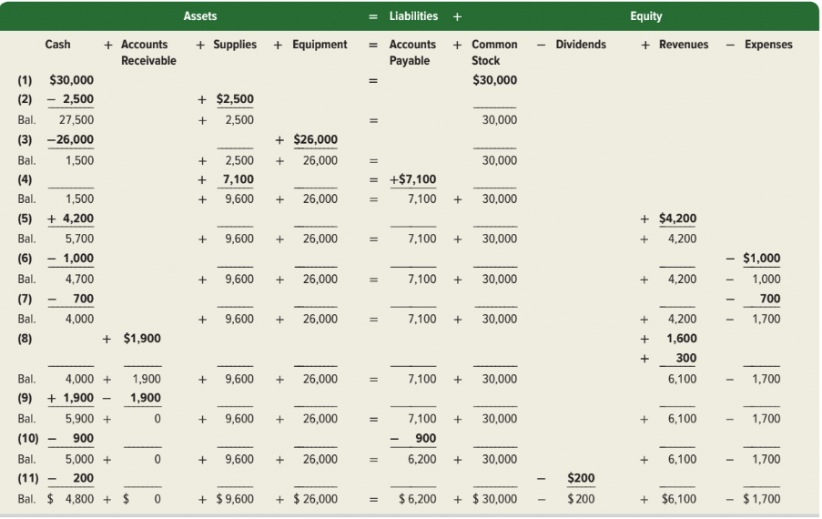
Summary of Transactions
Exhibit 1.9
Learning Objective P1: Analyze business transactions using the accounting equation.
© McGraw-Hill Education
Notes:
Exhibit 1.9 shows the effects of all 11 transactions using the accounting equation.

Slide 44
Identify and prepare basic financial statements and explain how they interrelate.
Learning Objective P2
© McGraw-Hill Education

Slide 45
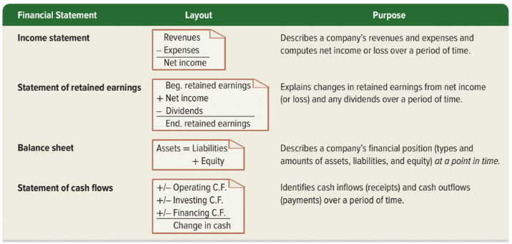
Financial Statements
Learning Objective P2: Identify and prepare basic financial statements and explain how they interrelate.
© McGraw-Hill Education
Notes:
This section introduces us to how financial statements are prepared from the analysis of business transactions. The four financial statements and their purposes are:
Income statement — describes a company’s revenues and expenses and computes net income or loss over a period of time.
Statement of retained earnings— reports how retained earnings changes from net income (or loss) and from any dividends over a period of time.
Balance sheet — describes a company’s financial position (types and amounts of assets, liabilities, and equity) at a point in time.
Statement of Cash Flows — identifies cash inflows (receipts) and cash outflows (payments) over a period of time.

Slide 46
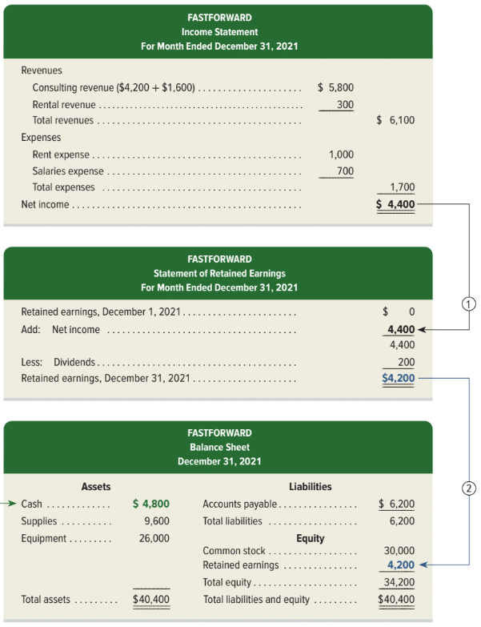
Exhibit 1.10: Financial Statements and Their Links – Part 1
Income Statement, Statement of Retained Earnings, and Balance Sheet
Exhibit 1.10
Learning Objective P2: Identify and prepare basic financial statements and explain how they interrelate.
© McGraw-Hill Education
Notes:
Financial Statements and Their Links.
Income Statement for FastForward includes revenues of $6,100 and expenses which total $1,700 for net income of $4,400.
The Statement of Retained Earnings has a beginning balance of $0, adds the net income of $4,400 from the Income Statement, and subtracts dividends of $200 for an ending retained earnings balance of $4,200.
The Balance Sheet shows total assets of $40,400 and total liabilities and equity of $40,400. Common stock of $30,000 is included in the equity section along with the ending retained earnings balance from the Statement of Retained Earnings of $4,200. Adding the total liabilities of $6,200, we get Total liabilities and Equity of $40,400.

Slide 47
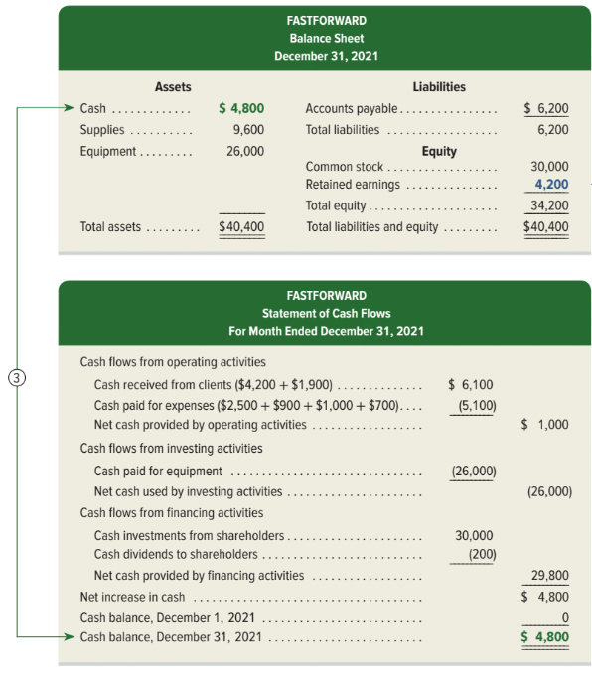
Exhibit 1.10: Financial Statements and Their Links – Part 2
Balance Sheet &
Statement of Cash Flows
Exhibit 1.10
Learning Objective P2: Identify and prepare basic financial statements and explain how they interrelate.
© McGraw-Hill Education
Notes:
FastForward’s statement of cash flows is the final report in Exhibit 1.10. The first section reports cash flows from operating activities. It shows the $6,100 cash received from clients and the $5,100 cash paid for supplies, rent, and employee salaries. Outflows are in parentheses to denote subtraction. Net cash provided by operating activities for December is $1,000.
The second section reports investing activities, which involve buying and selling assets such as land and equipment that are held for long-term use (typically more than one year). The only investing activity is the $26,000 purchase of equipment.
The third section shows cash flows from financing activities, which include long-term borrowing and repaying of cash from lenders and the cash investments from, and dividends paid to the shareholders. FastForward reports $30,000 cash investment from the shareholder and a $200 cash dividend. The net cash effect of all financing transactions is a $29,800 cash inflow. The final part of the statement shows an increased cash balance of $4,800. The ending balance is also $4,800 as it started with no cash—see line 3. Statement of cash flows identifies the cash inflows (receipts) and cash outflows (payments) over a period of time.

Slide 48
Compute and interpret return on assets.
Learning Objective A2
© McGraw-Hill Education

Slide 49
Return on Assets
Return on assets (ROA) is stated in ratio form as net income divided by the average total assets invested.
Net income
Average total assets
Exhibit 1.11
Return on assets =
Exhibit 1.12
Learning Objective A2: Compute and interpret return on assets.
© McGraw-Hill Education
Notes:
This chapter presents a profitability measure: return on assets. Return on assets is useful in evaluating management, analyzing and forecasting profits, and planning activities.
Return on assets (ROA), also called return on investment (ROI), is defined as net income divided by total average assets.
Net income is from the annual income statement, and average total assets is computed by adding the beginning and ending amounts for that same period and dividing by 2.
Is a 17.4% return on assets good or bad for Nike? To help answer this question, we compare (benchmark) Nike’s return with its prior performance and the returns of competitors (such as Under Armour). Nike’s return shows a stable pattern and has outperformed Under Armour in each of the last three years.

Slide 50
End of Chapter 1
© McGraw-Hill Education

