Slide 1
Job Order Costing and Analysis
Chapter 15
Wild and Shaw
Financial and Managerial Accounting
8th Edition
Copyright ©2019 McGraw-Hill Education. All rights reserved. No reproduction or distribution without the prior written consent of McGraw-Hill Education.
Notes:
Chapter 15: Job Order Costing and Analysis

Slide 2
Chapter 15 Learning Objectives
CONCEPTUAL
C1 Describe important features of job order production.
C2 Explain job cost sheets and how they are used in job order costing.
ANALYTICAL
A1 Apply job order costing in pricing services.
PROCEDURAL
P1 Describe and record the flow of materials costs in job order costing.
P2 Describe and record the flow of labor costs in job order costing.
P3 Describe and record the flow of overhead costs in job order costing.
P4 Determine adjustments for overapplied and underapplied factory overhead.
© McGraw-Hill Education
2

Slide 3
C1:
Describe important features of job order production.
Learning Objective
© McGraw-Hill Education
3

Slide 4
Cost Accounting Systems
Process
Costing
Job
Costing
Chapter 16
Used for production of large, unique, or
high-cost items.
Built to order rather than mass produced.
Many costs can be directly traced to each job.
© McGraw-Hill Education
4
Learning Objective C1: Describe important features of job order production.
Notes:
A cost accounting system accumulates manufacturing costs and then assigns them to products and services.
The two basic types of cost accounting systems are job order costing and process costing.
Many companies produce products individually designed to meet the needs of a specific customer. Each customized product is manufactured separately and its production is called job order production.
Process operations, also called process manufacturing or process production, is the mass production of products in a continuous flow of steps. Unlike job order production, where every product differs depending on customer needs, process operations are designed to mass-produce large quantities of identical products.

Slide 5
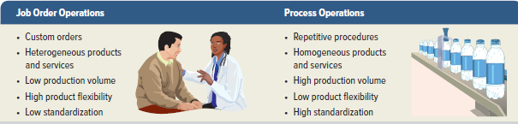
Job Order Production
Exhibit 15.1
© McGraw-Hill Education
5
Learning Objective C1: Describe important features of job order production.
Notes:
Exhibit 15.1 lists important features of job order and process operations. Both types of operations are used by manufacturers and also by service companies. Movies made by Walt Disney and financial audits done by KPMG are examples of job order service operations. Order processing in large mail-order firms like L.L. Bean is an example of a process service operation.

Slide 6
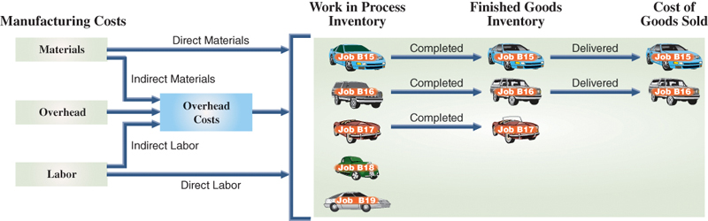
Production Activities in Job
Order Costing
Exhibit 15.2
© McGraw-Hill Education
6
Learning Objective C1: Describe important features of job order production.
Notes:
An overview of job order production activity and cost flows is shown. This slide shows the March production activity of Road Warriors, which installs entertainment systems and security devices in cars and trucks. The company customizes any vehicle by adding speakers, amplifiers, video systems, alarms, and reinforced exteriors.
Job order production requires materials, labor, and overhead costs. Recall that direct materials are used in manufacturing and can be clearly identified with a particular job. Similarly, direct labor is employee effort devoted to a particular job. Overhead costs support production of more than one job. Common overhead items are depreciation on factory buildings and equipment, factory supplies (indirect materials), supervision and maintenance (indirect labor, factory insurance and property taxes), cleaning, and utilities.
This slide shows that materials, labor, and overhead are added to five jobs started during the month (March). Alarm systems are added to Jobs B15 and B16; Job B17 receives a high-end audio and video entertainment system. Road Warriors completed Jobs B15, B16, and B17 in March and delivered Jobs B15 and B16 to customers. At the end of March, Jobs B18 and B19 remain in work in process inventory and Job B17 is in finished goods inventory.

Slide 7
Cost Flows
Manufacturing costs flow:
Raw materials – direct and indirect materials
Work in process –job is being produced
Finished goods –completed goods
Cost of goods sold – goods which are sold
Subsidiary records store information about the manufacturing costs for each individual job.
© McGraw-Hill Education
7
Learning Objective C1: Describe important features of job order production.
Notes:
Because they are product costs, manufacturing costs flow through inventory accounts (Raw Materials Inventory, Work in Process Inventory, and Finished Goods Inventory) until the related goods are sold. While a job is being produced, its accumulated costs are kept in Work in Process Inventory. When a job is finished, its accumulated costs are transferred from Work in Process Inventory to Finished Goods Inventory. When a finished job is delivered to a customer, its accumulated costs are transferred from Finished Goods Inventory to Cost of Goods Sold.
These general ledger inventory accounts, however, do not provide enough detail for managers of job order operations to plan and control production activities. Managers need to know the costs of each individual job (or job lot). Subsidiary records store this information about the manufacturing costs for each individual job. The next section describes the use of these subsidiary records and how they relate to the general ledger accounts.

Slide 8
C2:
Explain job cost sheets and how they are used in job order costing.
Learning Objective
© McGraw-Hill Education
8

Slide 9
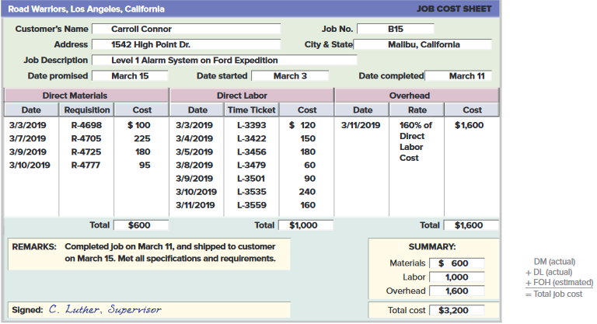
Job Cost Sheet
Exhibit 15.3
© McGraw-Hill Education
9
Learning Objective C2: Explain job cost sheets and how they are used in job order costing.
Notes:
A major aim of a job order costing system is to determine the cost of producing each job or job lot. In the case of a job lot, the system also computes the cost per unit. The accounting system must include separate records for each job to accomplish this.
A job cost sheet is a separate record maintained for each job.
This job cost sheet identifies the customer, the job number assigned, the product, and key dates. Only product costs are recorded on job cost sheets. Direct materials and direct labor costs actually incurred on the job are immediately recorded on this sheet. For Job B15, these actual direct materials and direct labor costs total $600 and $1,000, respectively.
Estimated overhead costs are included on job cost sheets, through a process we discuss later in the chapter. For Job B15, estimated overhead costs are $1,600 and $1,000 of actual direct labor costs x $160% When each job is complete, the supervisor enters the date of completion, records any remarks, and signs the sheet. The balance in the Work in Process Inventory account at any point in time is the sum of the costs on job cost sheets for all jobs that are not yet complete. The balance in the Finished Goods Inventory account at any point in time is the sum of the costs on job cost sheets for all jobs that are complete and awaiting sale. The balance in Cost of Goods Sold is the sum of all job sheets for jobs that have been sold and delivered to the customer. Managers use job cost sheets to monitor costs incurred to date and to predict and control costs for each job. In the next section we use Road Warriors’ production and sales activity for March to illustrate job order costing and the use of job cost sheets.

Slide 10
P1:
Describe and record the flow of materials costs in job order costing.
Learning Objective
© McGraw-Hill Education
10

Slide 11
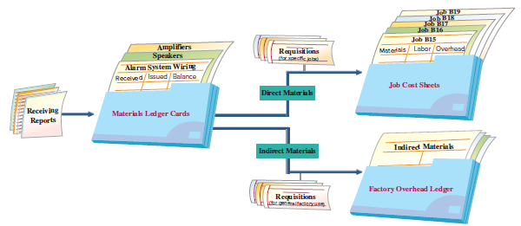
Materials and Labor Costs
Materials received recorded in a receiving report
Receiving report – materials source document
Materials ledger cards –updated when materials are purchased and issued for use in production.
Exhibit 15.4
© McGraw-Hill Education
11
Learning Objective P1: Describe and record the flow of materials costs in job order costing.
Notes:
Exhibit 15.4 shows flow of materials costs. When materials are first received from suppliers, the employees count and inspect them and record the items’ quantity and cost on a receiving report. The receiving report serves as the source document for recording materials received in both a materials ledger card
and in the general ledger. In nearly all job order cost systems, materials ledger cards (or electronic files) are perpetual records that are updated each time materials are purchased and each time materials are issued for use in production.
To illustrate the purchase of materials, Road Warriors purchased $2,750 of materials on credit on March 4, 2019. These include both direct and indirect materials. This purchase is recorded as shown below. After this entry is recorded, each individual materials ledger card is updated to reflect the added materials. Entry is posted to the Raw Materials Inventory and Accounts Payable general ledger accounts.

Slide 12
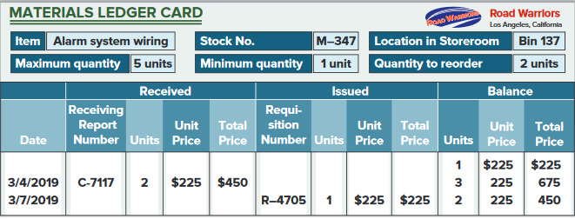
Materials Ledger Card
Exhibit 15.5
© McGraw-Hill Education
12
Learning Objective P1: Describe and record the flow of materials costs in job order costing.
Notes:
This slide shows a materials ledger card for one type of material received and issued by Road Warriors. The card identifies the item as alarm system wiring and shows the item’s stock number, its location in the storeroom, information about the maximum and minimum quantities that should be available, and the reorder quantity. For example, two units of alarm system wiring were purchased on March 4, 2019, as evidenced by receiving report C-7117. After this purchase the company has three units of alarm system wiring on hand. Materials ledger cards would also be updated for each of the other materials purchased.

Slide 13
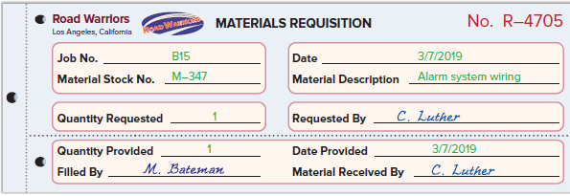
Materials Requisition
Exhibit 15.6
© McGraw-Hill Education
13
Learning Objective P1: Describe and record the flow of materials costs in job order costing.
Notes:
When materials are needed in production, a production manager prepares a materials requisition and sends it to the materials manager. For direct materials, the requisition shows the job number, the type of material, the quantity needed, and the signature of the manager authorized to make the requisition.
This slide shows the materials requisition for alarm system wiring for Job B15. For requisitions of indirect materials, which cannot be traced to individual jobs, the “Job No.” line in the requisition form might read, “For General Factory Use.”

Slide 14
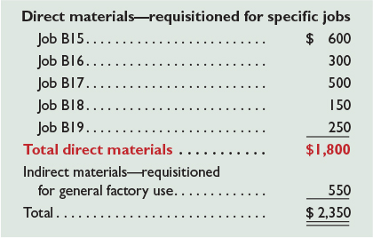

Materials Requisition (continued)
© McGraw-Hill Education
14
Learning Objective P1: Describe and record the flow of materials costs in job order costing.
Notes:
Requisitions are often accumulated and recorded in one journal entry. The frequency of entries depends on the job, the industry, and management procedures. In this example, Road Warriors records materials requisitions at the end of each week. These materials requisitions are shown here.
The use of direct materials for the week (including alarm system wiring for Job B15) yields the entry shown.
This entry is posted both to general ledger accounts and to subsidiary records. Posting to subsidiary records includes debits to job cost sheets and credits to materials ledger cards.

Slide 15
P2:
Describe and record the flow of labor costs in job order costing.
Learning Objective
© McGraw-Hill Education
15

Slide 16
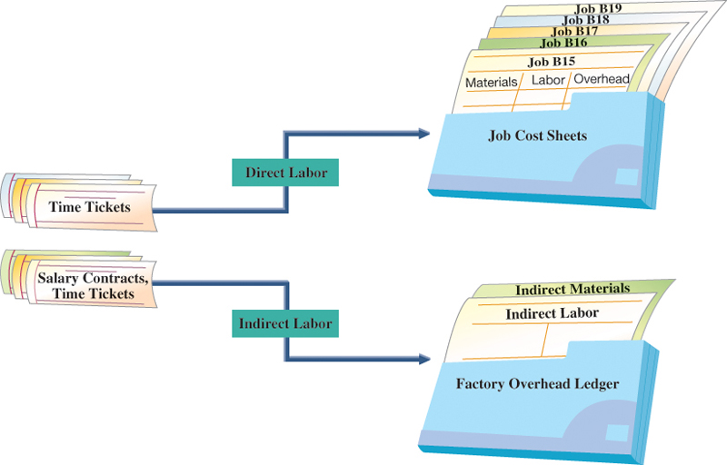
Labor Cost Flows
Exhibit 15.8
© McGraw-Hill Education
16
Learning Objective P2: Describe and record the flow of labor costs in job order costing.
Notes:
Labor is the next manufacturing cost to account for. This slide shows that factory labor costs are classified as either direct or indirect. Direct labor costs flow to job cost sheets. To assign direct labor costs to individual jobs, companies use time tickets to track how each employee’s time is used.
Exhibit 15.9 shows a time ticket reporting the time a Road Warrior employee spent working on Job B15. The employee’s supervisor signed the ticket to confirm its accuracy. The hourly rate and total labor cost are computed after the time ticket is turned in.

Slide 17
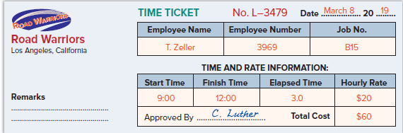
Labor Time Ticket
Exhibit 15.9
© McGraw-Hill Education
17
Learning Objective P2: Describe and record the flow of labor costs in job order costing.
Notes:
This slide shows a time ticket reporting the time a Road Warrior employee spent working on Job B15. The employee’s supervisor signed the ticket to confirm its accuracy. The hourly rate and total labor cost are computed after the time ticket is turned in.

Slide 18
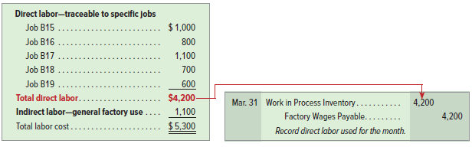
Labor Time Ticket (continued)
© McGraw-Hill Education
18
Learning Objective P2: Describe and record the flow of labor costs in job order costing.
Notes:
Time tickets are often accumulated and recorded in one journal entry. The frequency of these entries varies across companies. In this example, Road Warriors journalizes direct labor monthly. During March, Road Warriors’ factory payroll costs total $5,300. Of this amount, $4,200 can be traced directly to jobs, and the remaining $1,100 is classified as indirect labor, as shown here.
The entry shown records direct labor for the month, based on all the direct labor time tickets for the month.

Slide 19
P3:
Describe and record the flow of overhead costs in job order costing.
Learning Objective
© McGraw-Hill Education
19

Slide 20
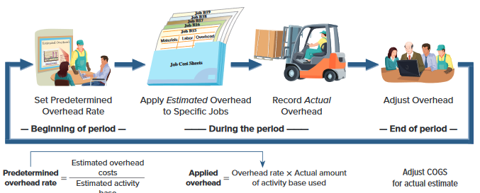
Overhead Costs
Exhibit 15.11
© McGraw-Hill Education
20
Learning Objective P3: Describe and record the flow of overhead costs in job order costing.
Notes:
We turn now to overhead costs. Unlike direct materials and direct labor, actual overhead costs are not traced directly to individual jobs. Still, each job’s total cost must include estimated overhead costs. The accounting for overhead costs follows the four-step process shown in this slide. Overhead accounting requires managers to first estimate what total overhead costs will be for the coming period. We cannot wait until the end of a period to allocate overhead to jobs, because managers’ decisions require up-to-date costs. This estimated overhead cost, even if it is not exactly precise, is needed to estimate a job’s total costs before its completion. Such estimated costs are useful for managers in many decisions, including setting prices and identifying costs that are out of control. At the end of the year, the company adjusts its estimated overhead to the actual amount of overhead incurred for that year, and then considers whether to change its predetermined overhead rate for the next year.

Slide 21

Set Predetermined Overhead Rate
Road Warriors uses a predetermined overhead rate (POHR) based on direct labor cost to apply overhead to jobs.
Exhibit 15.12
© McGraw-Hill Education
21
Learning Objective P3: Describe and record the flow of overhead costs in job order costing.
Notes:
Being able to estimate overhead in advance requires a predetermined overhead rate, also called predetermined overhead allocation (or application) rate. The predetermined overhead rate requires an estimate of total overhead cost and an estimated activity base such as total direct labor cost before the start of the period. This slide shows the usual formula for computing a predetermined overhead rate (estimates are commonly based on annual amounts). This rate is used during the period to allocate estimated overhead to jobs. Some companies use multiple activity (allocation) bases and multiple predetermined overhead rates for different types of products and services.
To illustrate, Road Warriors applies (also termed allocates, assigns, or charges) overhead by linking it to direct labor costs. At the start of the current year, management estimates total direct labor costs of $125,000 and total overhead costs of $200,000. Using these estimates, management computes its predetermined overhead rate as 160% of direct labor cost ($200,000 / $125,000).

Slide 22

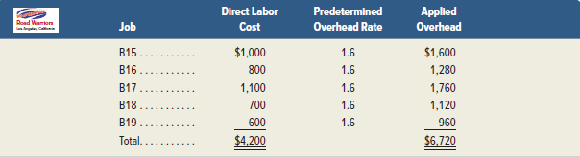
Predetermined Overhead Rate
Exhibit 15.13
© McGraw-Hill Education
22
Learning Objective P3: Describe and record the flow of overhead costs in job order costing.
Notes:
Earlier we showed that Road Warriors used $4,200 of direct labor in March. We then use the predetermined overhead rate of 160% to allocate $6,720 (equal to $4,200 x 1.60) of overhead. The entry to record this allocation is shown.
Then, the $6,720 of overhead is allocated to each individual job based on the amount of the activity base that job used (in this example, direct labor). This slide shows these calculations for Road Warriors’ March production activity.

Slide 23
Record Actual Overhead
Indirect Material
Indirect Labor
Other
© McGraw-Hill Education
23
Learning Objective P3: Describe and record the flow of overhead costs in job order costing.
Notes:
We now show the accounting for actual overhead costs. Actual overhead costs are not recorded in job cost sheets. Factory overhead includes all factory costs other than direct materials and direct labor. Two major sources of overhead costs are indirect materials and indirect labor. These costs are recorded from materials requisition forms for indirect materials and from salary contracts or time tickets for indirect labor. Other sources of information on overhead costs include (1) vouchers authorizing payment for factory items such as supplies or utilities and (2) adjusting journal entries for costs such as depreciation on factory assets.
Factory overhead usually contains many different costs. These costs are recorded with debits to the Factory Overhead general ledger account, and with credits to various accounts. Next we show how to record journal entries for actual overhead costs. While journal entries for different types of overhead costs might be recorded with varying frequency, in our example we assume these entries are each made at the end of the month.

Slide 24

Record Indirect Materials Used
© McGraw-Hill Education
24
Learning Objective P3: Describe and record the flow of overhead costs in job order costing.
Notes:
During March, Road Warriors incurred $550 of actual indirect materials costs, as supported by materials requisitions. The use of these indirect materials yields the following entry.
This entry is posted to the general ledger accounts, Factory Overhead and Raw Materials Inventory, and is posted to Indirect Materials in the subsidiary factory overhead ledger. Unlike the recording of direct materials, actual indirect materials costs incurred are not recorded in Work in Process Inventory and are not posted to job cost sheets.

Slide 25

Record Indirect Labor Used
© McGraw-Hill Education
25
Learning Objective P3: Describe and record the flow of overhead costs in job order costing.
Notes:
During March, Road Warriors incurred $1,100 of actual indirect labor costs. These costs might be supported by time tickets for maintenance workers or by salary contracts for production supervisors. The use of this indirect labor yields the following entry.
This entry is posted to the general ledger accounts, Factory Overhead and Factory Wages Payable, and is posted to Indirect Labor in the subsidiary factory overhead ledger. Unlike the recording of direct labor, actual indirect labor costs incurred are not recorded immediately in Work in Process Inventory and are not posted to job cost sheets.

Slide 26
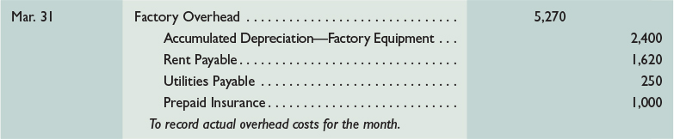
Record Other Overhead Costs
© McGraw-Hill Education
26
Learning Objective P3: Describe and record the flow of overhead costs in job order costing.
Notes:
During March, Road Warriors incurred $5,270 of actual other overhead costs. These costs could include items such as factory building rent, depreciation on the factory building, factory utilities, and other costs indirectly related to production activities. These costs are recorded with debits to Factory Overhead and credits to other accounts such as Cash, Accounts Payable, Utilities Payable, and Accumulated Depreciation—Factory Equipment. The entry to record these other overhead costs for March is as follows.
This entry is posted to the general ledger account, Factory Overhead, and is posted to separate accounts for each of the overhead items in the subsidiary factory overhead ledger. These actual overhead costs are not recorded in Work in Process Inventory and are not posted to job cost sheets. Only estimated overhead is recorded in Work in Process Inventory and posted to job cost sheets.

Slide 27
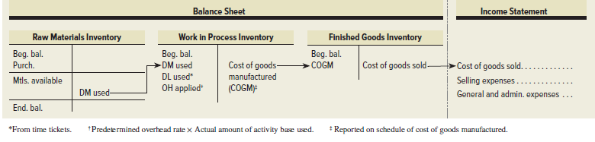
Summary of Cost Flows
Exhibit 15.15
© McGraw-Hill Education
27
Learning Objective P3: Describe and record the flow of overhead costs in job order costing.
Notes:
This slide shows that direct materials used, direct labor used, and factory overhead applied flow through the Work in Process Inventory and Finished Goods balance sheet accounts. The cost of goods manufactured (COGM) is computed and shown on the schedule of cost of goods manufactured. When goods are sold, their costs are transferred from Finished Goods Inventory on the balance sheet to the income statement as cost of goods sold.
Period costs (selling and general and administrative expenses) do not impact inventory accounts. As a result, they do not impact cost of goods sold, and they are not reported on the schedule of cost of goods manufactured. They are reported on the income statement as operating expenses.
.

Slide 28
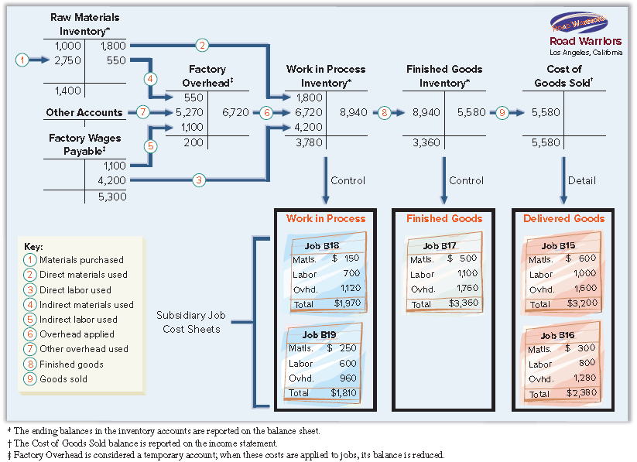
Summary of Cost Flows (Pt. 2)
Exhibit 15.16
© McGraw-Hill Education
28
Learning Objective P3: Describe and record the flow of overhead costs in job order costing.
Notes:
The upper part of Exhibit 15.16 shows the flow of Road Warriors’ product costs through general ledger accounts. Arrow lines are numbered to show the flows of costs for March. Each numbered cost flow reflects journal entries made in March. The lower part of Exhibit 15.16 shows summarized job cost sheets at the end of March. The sum of costs assigned to the two jobs in process ($1,970 + $1,810) equals the $3,780 balance in Work in Process Inventory. Also, costs assigned to the completed Job B17 equal the $3,360 balance in Finished Goods Inventory. These balances in Work in Process Inventory and Finished Goods Inventory are reported on the end-of-period balance sheet. The sum of costs assigned to the sold Jobs B15 and B16 ($3,200 + $2,380) equals the $5,580 balance in Cost of Goods Sold. This amount is reported on the income statement for the period.

Slide 29
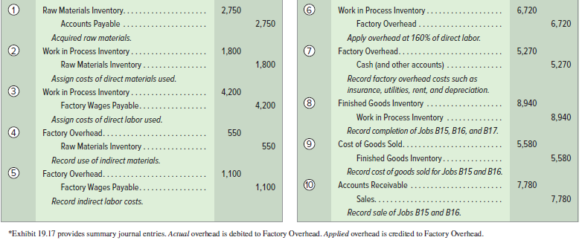
Summary of Cost Flows (Pt. 3)
Exhibit 15.17
© McGraw-Hill Education
29
Learning Objective P3: Describe and record the flow of overhead costs in job order costing.
Notes:
This slide shows the journal entries made in March. Each entry is numbered to link with the arrow lines in the prior slide. In addition, this slide concludes with the summary journal entry to record the sales (on account) of Jobs B15 and B16.

Slide 30
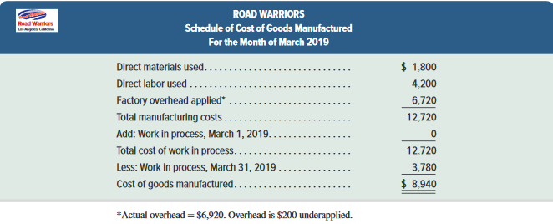
Schedule of Cost of Goods Manufactured
Exhibit 15.18
© McGraw-Hill Education
30
Learning Objective P3: Describe and record the flow of overhead costs in job order costing.
Notes:
We end the Road Warriors example with the schedule of cost of goods manufactured shown here. This schedule is similar to the one reported in the previous chapter, with one key difference: Total manufacturing costs include overhead applied rather than actual overhead costs. In this example, actual overhead costs were $6,920, while applied overhead was $6,720. We discuss how to account for the difference between applied and actual overhead difference next.

Slide 31

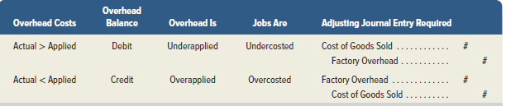
Adjust Factory Overhead
Exhibit 15.19
Exhibit 15.20
© McGraw-Hill Education
31
Learning Objective P3: Describe and record the flow of overhead costs in job order costing.
Notes:
The top graphic in this slide shows a Factory Overhead T-account. The company applies overhead (credits the Factory Overhead account) using a predetermined rate estimated at the beginning of the year. During the year, the company records actual overhead costs with debits to the Factory Overhead account. At year-end, we determine whether the applied overhead is more or less than the actual overhead:
When less overhead is applied than is actually incurred, the remaining debit balance in the Factory Overhead account is called underapplied overhead.
When more overhead is applied than is actually incurred, the resulting credit balance in the Factory Overhead account is called overapplied overhead.
When overhead is underapplied, it means that individual jobs have not been charged enough overhead during the year, and cost of goods sold for the year is too low. When overhead is overapplied, it means that jobs have been charged too much overhead during the year, and cost of goods sold is too high. In either case, a journal entry is needed to adjust Factory Overhead and Cost of Goods Sold.
The bottom graphic summarizes the journal entry assuming the difference between applied and actual overhead is immaterial.

Slide 32
P4:
Determine adjustments for overapplied and underapplied factory overhead.
Learning Objective
© McGraw-Hill Education
32

Slide 33

Adjust Underapplied or Overapplied Overhead
© McGraw-Hill Education
33
Learning Objective P4: Determine adjustments for overapplied and underapplied factory overhead.
Notes:
To illustrate, assume that Road Warriors applied $200,000 of overhead to jobs during 2019. This equals the amount of overhead that management estimated in advance for the year. We further assume that Road Warriors incurred a total of $200,480 of actual overhead costs during 2019. Thus, at the end of the year, the Factory Overhead account has a debit balance of $480. This amount is the difference between estimated (applied) and actual overhead costs for the year.
The $480 debit balance reflects manufacturing costs not assigned to jobs. This means that the balances in Work in Process Inventory, Finished Goods Inventory, and Cost of Goods Sold do not include all production costs incurred. However, the difference between applied and actual overhead in this case is immaterial, and it is closed to Cost of Goods Sold with the adjusting entry shown in this slide.
The $480 debit (increase) to Cost of Goods Sold reduces income by $480. After this entry, the Factory Overhead account has a zero balance. Also, Cost of Goods Sold reflects actual overhead costs for the period. (When the underapplied or overapplied overhead is material, the amount is normally allocated to the Cost of Goods Sold, Finished Goods Inventory, and Work in Process Inventory accounts. This process is covered in advanced courses.) We treat overapplied overhead at the end of the period similarly, except that we debit Factory Overhead and credit Cost of Goods Sold for the amount.

Slide 34
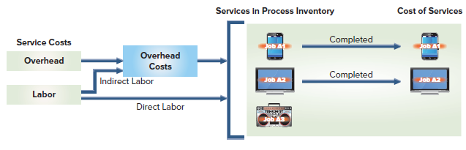
Job Order Costing of Services
Job order costing applies to service companies. Differences for service firms:
Service firms do not have raw materials or finished goods inventory. They have supplies, but these may be considered overhead.
Direct labor is used to apply overhead.
Typically use different account titles such as Services in Process Inventory and Services Overhead.
Exhibit 15.21
© McGraw-Hill Education
34
Learning Objective P4: Determine adjustments for overapplied and underapplied factory overhead.
Notes:
Job order costing also applies to service companies. Most service companies meet customers’ needs by performing a custom service for a specific customer.
Job order costing has some important differences for service firms.
1. Most service firms have neither raw materials inventory nor finished goods inventory. They do, however, have inventories of supplies, and they can have work in process inventory. Often these supplies are immaterial and are considered overhead costs.
2. Direct labor is often used to apply overhead because service firms do not use direct materials.
3. Service firms typically use different account titles, for example Services in Process Inventory and Services Overhead.

Slide 35
A1:
Apply job order costing in pricing services.
Learning Objective
© McGraw-Hill Education
35

Slide 36
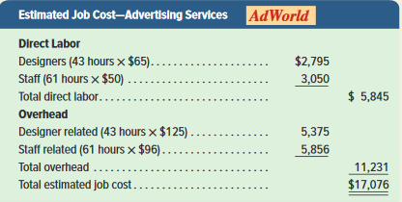
Pricing for Services
Service providers also use job order costing.
Cost for each individual job are track separately.
Total costs include labor and overhead.
© McGraw-Hill Education
36
Learning Objective A1: Apply job order costing in pricing services.
Notes:
Service providers also use job order costing. Cost for each individual job are track separately. Total costs include labor and overhead which are determined for each job using the procedures in this chapter.
Consider AdWorld, an advertising agency that develops web-based ads (and ads for other types of media). Each of its customers has unique requirements, so costs for each individual job must be tracked separately.
AdWorld uses two types of labor: web designers ($65 per hour) and computer staff ($50 per hour). It also incurs overhead costs that it assigns using two different predetermined overhead allocation rates: $125 per designer hour and $96 per staff hour. For each job, AdWorld must estimate the number of designer and staff hours needed. Then, total costs of each job are determined using the procedures in the chapter.
To illustrate, a chip manufacturer requested a quote from AdWorld for an advertising engagement. AdWorld estimates that the job will require 43 designer hours and 61 staff hours, with the following total estimated cost for this job.

Slide 37
End of Chapter 15
© McGraw-Hill Education
37

