Slide 1
Cash, Fraud, and Internal Control
Chapter 6
Wild and Shaw
Financial and Managerial Accounting
8th Edition
Copyright ©2019 McGraw-Hill Education. All rights reserved. No reproduction or distribution without the prior written consent of McGraw-Hill Education.

Slide 2
Chapter 6 Learning Objectives
CONCEPTUAL
C1 Define internal control and identify its purpose and principles.
C2 Define cash and cash equivalents and explain how to report them.
ANALYTICAL
A1 Compute the days’ sales uncollected ratio and use it to assess liquidity.
PROCEDURAL
P1 Apply internal control to cash receipts and payments.
P2 Explain and record petty cash fund transactions.
P3 Prepare a bank reconciliation.
P4 Appendix 6A Describe use of documentation and verification to control cash payments.
© McGraw-Hill Education
2

Slide 3
Define internal control and identify its purpose and principles.
Learning Objective C1
© McGraw-Hill Education
3

Slide 4
Internal Control System
Policies and procedures used to:
Protect assets.
Ensure reliable accounting.
Uphold company policies.
Promote efficient operations.
© McGraw-Hill Education
4
Learning Objective C1: Define internal control and identify its purpose and principles.
Notes:
Managers (or owners) of small businesses often control the entire operation. They know whether the business is actually receiving the assets and services paid for. Most companies cannot maintain personal supervision and must rely on internal controls.
Managers use an internal control system to monitor and control business activities. An internal control system is policies and procedures used to:
Protect assets.
Ensure reliable accounting.
Uphold company policies.
Promote efficient operations.

Slide 5
Sarbanes-Oxley Act (SOX)
The Sarbanes-Oxley Act requires managers and auditors of public companies to document and certify the system of internal controls.
Section 404 of SOX requires that managers document and assess the effectiveness of all internal control processes that can impact financial reporting.
© McGraw-Hill Education
5
Learning Objective C1: Define internal control and identify its purpose and principles.
Notes:
Sarbanes-Oxley Act (SOX) requires managers and auditors of companies whose stock is traded on an exchange (called public companies) to document and verify internal controls. Following are some of the requirements:
The company must have effective internal controls.
Auditors must evaluate internal controls.
Violators receive harsh penalties up to 25 years in prison with fines.
Auditors’ work is overseen by Public Company Accounting Oversight Board (PCAOB).

Slide 6
Committee of Sponsoring Organizations (COSO)
Committee of Sponsoring Organizations five ingredients of internal control which add quality to
accounting information:
Control environment
Risk assessment
Control activities
Information & communication
Monitoring
© McGraw-Hill Education
6
Learning Objective C1: Define internal control and identify its purpose and principles.
Notes:
Committee of Sponsoring Organizations lists five ingredients of internal control which add quality to accounting information:
Control environment – company structure, ethics and integrity for internal control.
Risk assessment – identify, analyze and manage risk factors.
Control activities – policies and procedures to reduce risk of loss.
Information & communication – reports to internal and external parties.
Monitoring – regular review on adequacy of internal control.

Slide 7
Principles of Internal Control
Internal control principles common to
all companies:
Establish responsibilities.
Maintain adequate records.
Insure assets and bond key employees.
Separate recordkeeping from custody of assets.
Divide responsibility for related transactions.
Apply technological controls.
Perform regular and independent reviews.
© McGraw-Hill Education
7
Learning Objective C1: Define internal control and identify its purpose and principles.
Notes:
Internal control varies from company to company because of the nature and size of the business. Certain fundamental internal control principles apply to all companies. The principles of internal control are to
Establish responsibilities.
Maintain adequate records.
Insure assets and bond key employees.
Separate recordkeeping from custody of assets.
Divide responsibility for related transactions.
Apply technological controls.
Perform regular and independent reviews.

Slide 8
Internal Control: Establish Responsibilities
Establish responsibilities:
Tasks should be clearly established.
Tasks should be assigned to one person.
3. Can then determine who is at fault.
© McGraw-Hill Education
8
Learning Objective C1: Define internal control and identify its purpose and principles.
Notes:
Establish Responsibilities:
Responsibility for a task should be clearly established and assigned to one person. When a problem occurs in a company where responsibility is not established, determining who is at fault is difficult. For instance, if two salesclerks share the same cash register and cash is missing, neither clerk can be held accountable. To prevent this problem, a company can use separate cash drawers for each clerk.

Slide 9
Internal Control: Maintain Adequate Records
Maintain Adequate Records:
1. Protects assets.
Helps managers monitor company activities.
Includes:
Detailed records.
Use of chart of accounts.
Preprinted forms.
Prenumbered sales slips.
Computerized point-of-sale systems.
© McGraw-Hill Education
9
Learning Objective C1: Define internal control and identify its purpose and principles.
Notes:
Maintain Adequate Records:
Good recordkeeping helps protect assets and helps managers monitor company activities. When there are detailed records of equipment, for instance, items are unlikely to be lost or stolen without detection. Similarly, transactions are less likely to be entered in wrong accounts if a chart of accounts is used. Preprinted forms are also part of good internal control. When sales slips are properly designed, employees can record information efficiently with fewer errors. When sales slips are prenumbered, each slip is the responsibility of one salesperson, preventing the salesperson from stealing cash by making a sale and destroying the sales slip. Computerized point-of-sale systems achieve the same control results.

Slide 10
Internal Control: Insure Assets and Bond Key Employees
Insure Assets and Bond Key Employees:
Assets should be insured against losses.
Employees handling a lot of cash and other assets should be bonded.
Bonded means the company has purchased an insurance policy against theft by that employee.
© McGraw-Hill Education
10
Learning Objective C1: Define internal control and identify its purpose and principles.
Notes:
Insure Assets and Bond Key Employees:
Assets should be insured against losses, and employees handling lots of cash and easily transferable as sets should be bonded. An employee is bonded when a company purchases an insurance policy, or a bond, against theft by that employee. Bonding discourages theft because bonded employees know the bonding company will pursue reported theft.

Slide 11
Internal Control: Separate Recordkeeping from Custody of Assets
Separate Recordkeeping from Custody of Assets:
Person who controls or has access to assets must not have access to that asset’s accounting records.
Reduces risk of theft or waste of an asset.
Employees would need to collude, agree in secret to commit fraud under this control.
© McGraw-Hill Education
11
Learning Objective C1: Define internal control and identify its purpose and principles.
Notes:
Separate Recordkeeping from Custody of Assets:
A person who controls or has access to an asset must not have access to that asset’s accounting records. This principle reduces the risk of theft or waste of an asset because the person with control over it knows that another person keeps its records. Also, a recordkeeper who does not have access to the asset has no reason to falsify records. This means that to steal an asset and hide the theft from the records, two or more people must collude —or agree in secret to commit the fraud.

Slide 12
Internal Control: Divide Responsibility for Related Transactions
Divide Responsibility for Related Transactions:
Responsibility for a transactions should be divided between two or more individuals.
Ensures work of one person acts as a check on the other to prevent fraud or errors.
3. Called separation of duties.
© McGraw-Hill Education
12
Learning Objective C1: Define internal control and identify its purpose and principles.
Notes:
Divide Responsibility for Related Transactions:
Responsibility for a transaction should be divided between two or more individuals or departments. This ensures the work of one person acts as a check on the other to prevent fraud and errors. This principle, called separation of duties, does not mean duplication of work. For example, when a company orders inventory, the task should be split among several employees. One employee submits a request to purchase inventory, a second employee approves the request, a third employee makes the payment, and a fourth employee records the transaction.

Slide 13
Internal Control: Apply Technological Controls
Apply Technological Controls:
Cash registers make an electronic file/record of each sale.
Time clock records exact time employee works.
Personal scanners limit access to authorized individuals.
© McGraw-Hill Education
13
Learning Objective C1: Define internal control and identify its purpose and principles.
Notes:
Apply Technology Controls:
Cash registers, time clocks, and ID scanners are examples of devices that can improve internal control. A cash register with a locked-in tape or electronic file makes a record of each cash sale. A time clock records the exact time an employee both arrives at and departs from the job. ID scanners limit access to authorized individuals.

Slide 14
Internal Control: Perform Regular and Independent Reviews
Apply Technological Controls:
Helps ensure that procedures are followed.
Preferably done by auditors not directly involved in the activities.
Auditors evaluate the efficiency and effectiveness of internal controls.
© McGraw-Hill Education
14
Learning Objective C1: Define internal control and identify its purpose and principles.
Notes:
Perform Regular and Independent Reviews:
Regular reviews of internal controls help ensure that procedures are followed. These reviews are preferably done by auditors not directly involved in the activities. Auditors evaluate the efficiency and effectiveness of internal controls. Many companies pay for audits by independent auditors. These auditors test the company’s financial records and evaluate the effectiveness of internal controls.

Slide 15
Technology, Fraud, and Internal Control
Reduced
Processing
Errors
More
Extensive Testing
of Records
New
Evidence of
Processing
Separation of
Duties
Increased
E-Commerce
© McGraw-Hill Education
15
Learning Objective C1: Define internal control and identify its purpose and principles.
Notes:
The principles of internal control are relevant no matter what the technological state of the accounting system, from manual to fully automated. Technology allows us quicker access to information. Technology improves managers’ abilities to monitor and control business activities. This section describes technological impacts we must be alert to.
Reduced Processing Errors Technology reduces, but does not eliminate all errors in processing information. Provided the software and data entry are correct, the risk of mechanical and mathematical errors is nearly eliminated. Less human involvement can cause data entry errors to go undiscovered. Errors in software can produce consistent but inaccurate processing of transactions.
More Extensive Testing of Records When accounting records are kept manually, only small samples of data are usually checked for accuracy. When data are accessible with technology, large samples or even the entire database can be quickly tested.
New Evidence of Processing Technology makes it possible to record additional transaction details not possible with manual systems. A system can record who made the entry, the date and time, the source of the entry, and so on. This means that internal control depends more on the design and operation of the information system and less on the analysis of its resulting documents.
Separation of Duties A company with a few employees risks losing its separation of duties. For instance, the person who designs the information system should not operate it. The company must also separate control over programs and files from the activities related to cash receipts and payments. For instance, a computer operator should not control check-writing activities.
Increased E-Commerce Amazon and eBay are examples of successful e-commerce companies. All transactions in e-commerce involve at least three risks. (1) Credit card number theft. (2) Computer viruses. (3) Impersonation or identify theft. Companies use technological internal controls to combat these risks.

Slide 16
Limitations of Internal Control
Human Error
Human Fraud
Intentionally defeating internal
controls for
personal gain
Carelessness
Misjudgment
Confusion
Human fraud triple-threat:
Opportunity, Financial Pressure, Rationalization
Cost-benefit principle: costs of internal controls
must not exceed their benefits.
© McGraw-Hill Education
16
Learning Objective C1: Define internal control and identify its purpose and principles.
Notes:
Internal controls have limitations from both (1) human element and (2) the cost-benefit principle. The human element limitations can be from either: human error or human fraud.
Human error – carelessness, misjudgment or confusion.
Human fraud - intentional defeating internal controls, such as management override, for personal gain. Human fraud is driven by the triple-threat of fraud:
Opportunity—internal control weaknesses in a business.
Pressure—financial, family, and societal stresses to succeed.
Rationalization—employees justifying fraudulent behavior.
The second limitation on internal control is the cost-benefit principle, which says that the costs of internal controls must not exceed their benefits. Analysis of costs and benefits must consider all factors, including the impact on morale. Most companies, for instance, have a legal right to read employees’ e-mails, yet companies rarely do unless there is evidence of potential harm to the company.

Slide 17
Define cash and cash equivalents and explain how to report them.
Learning Objective C2
© McGraw-Hill Education
17

Slide 18
Control of Cash
An effective system of internal control that protects cash and cash equivalents should meet three basic guidelines:
Handling cash is separated from recordkeeping for cash.
Cash receipts are promptly deposited in a bank.
Cash disbursements are made by check.
© McGraw-Hill Education
18
Learning Objective C2: Define cash and cash equivalents and explain how to report them.
Notes:
Cash is easily hidden and moved. Internal controls protect cash and meet three guidelines:
Handling cash is separate from recordkeeping of cash.
Cash receipts are promptly deposited in a bank.
Cash payments are made by check or electronic funds transfer, (EFT).

Slide 19
Cash, Cash Equivalents, and Liquidity
Cash and similar assets are called liquid assets because
they can be readily used to pay current liabilities.
Cash Currency, coins, and deposits in bank accounts. Also includes items such as customer checks, cashier checks, certified checks, and money orders.
Cash Equivalents
Short-term, highly liquid investments that are:
Readily convertible to a known cash amount.
Close to maturity date and not sensitive to changes.
© McGraw-Hill Education
19
Learning Objective C2: Define cash and cash equivalents and explain how to report them.
Notes:
Liquidity refers to a company’s ability to pay for its current liabilities. Cash and similar assets are called liquid assets because they can be readily used to pay for liabilities. A company needs liquid assets to effectively operate.
Cash includes currency, coins, and deposits in bank accounts. Cash also includes items that can be deposited in these accounts such as customer checks, cashier’s checks, certified checks, and money orders.
Cash equivalents are short-term, highly liquid investment assets meeting two criteria: (1) readily convertible to a known cash amount and (2) close enough to their due date so that their market value will not greatly change.
Only investments within three months of their due date usually meet these criteria. Cash equivalents are short-term investments such as U.S. Treasury bills.

Slide 20
Cash Management
The goals of cash management are twofold:
Plan cash receipts to meet cash payments when due.
Keep a minimum level of cash necessary to operate.
Effective cash management involves applying the following cash management strategies:
Encourage collection of receivables.
Delay payment of liabilities.
Keep only necessary assets.
Plan expenditures.
Invest excess cash.
© McGraw-Hill Education
20
Learning Objective C2: Define cash and cash equivalents and explain how to report them.
Notes:
Common reason companies fail is inability to manage cash. Companies must plan both cash receipts and cash payments.
Goals of cash management are:
Plan cash receipts to meet cash payments when due.
Keep a minimum level of cash necessary to operate.
The treasurer is responsible for cash management. Effective cash management involves applying the following cash management strategies.
Encourage collection of receivables. The more quickly customers and others pay the company, the more quickly that company can use the money. Some companies offer discounts for payments received early.
Delay payment of liabilities. The more delayed a company is in paying others, the more time it has to use the money. Companies regularly wait to pay their bills until the last possible day.
Keep only necessary assets. Acquiring expensive and rarely used assets can cause cash shortages. Some companies lease warehouse space or rent equipment as needed instead of buying it.
Plan expenditures. Companies must look at seasonal and business cycles to plan expenditures when money is available.
Invest excess cash. Excess cash earns no return and should be invested in productive assets like factories. Excess cash from seasonal cycles can be placed in a short-term investment for interest.

Slide 21
Apply internal control to cash receipts and payments.
Learning Objective P1
© McGraw-Hill Education
21

Slide 22
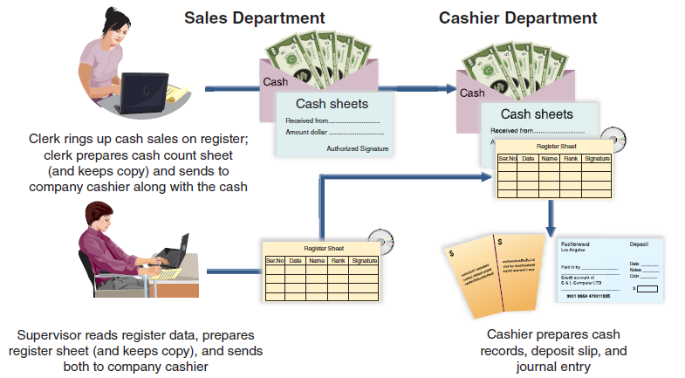
Over-the-Counter Cash Receipts
This graphic illustrates that none of the people involved can make a mistake or divert cash without the difference being revealed.
© McGraw-Hill Education
22
Learning Objective P1: Apply internal control to cash receipts and payments.
Notes:
Over-the-counter cash sales should be recorded on a cash register after each sale. Customers should get a receipt. Cash registers provide a permanent, locked-in record of each transaction. The register is linked with the accounting system. Less advanced registers record each transaction on a paper tape or electronic file locked inside the register.
Custody over cash should be separate from recordkeeping. The clerk who has access to cash in the register should not have access to its record. At the end of the clerk’s work period, the clerk should count the cash in the register, record the amount, and turn over the cash and a record of its amount to the company cashier. The cashier, like the clerk, has access to the cash but should not have access to accounting records (or the register tape or file). A third employee, often a supervisor, compares the record of total register transactions (or the register tape or file) with the cash receipts reported by the cashier. This record is the basis for a journal entry recording over-the-counter cash receipts. The third employee has access to the records for cash but not to the actual cash. The clerk and the cashier have access to cash but not to the accounting records. None of them can make a mistake or divert cash without the difference being revealed.

Slide 23
Cash Over and Short: Overage
Sometimes errors in making change are discovered from differences between the cash in the cash register and the record of the amount of cash receipts.
If a cash register’s record shows $550 but the count of cash
in the register is $555, we would prepare the following
journal entry:
© McGraw-Hill Education
23
Learning Objective P1: Apply internal control to cash receipts and payments.
Notes:
Sometimes errors in making change are discovered from differences between the cash in a cash register and the record of the amount of cash receipts. One or more customers can be given too much or too little change. This means that at the end of a work period, the cash in a cash register might not equal the record of cash receipts.
This difference is reported in the Cash Over and Short account, also called Cash Short and Over, which is an income statement account recording the income effects of cash overages and cash shortages. To illustrate, if a cash register’s record shows $550 but the count of cash in the register is $555, the entry to record cash sales and its overage is shown above.

Slide 24
Cash Over and Short: Shortage
Sometimes errors in making change are discovered from differences between the cash in the cash register and the record of the amount of cash receipts.
On the other hand, if a cash register’s record shows $625 but the count of cash in the register is
$621, the entry to record cash sales and its shortage is:
© McGraw-Hill Education
24
Learning Objective P1: Apply internal control to cash receipts and payments.
Notes:
Alternatively, if a cash register’s record shows $625 but the count of cash in the register is $621, the entry to record cash sales and its shortage is shown.

Slide 25
Cash Receipts by Mail
Two people are assigned the task of opening the mail.
The cashier deposits the cash in a bank.
The recordkeeper records the amounts received in the accounting records.
© McGraw-Hill Education
25
Learning Objective P1: Apply internal control to cash receipts and payments.
Notes:
Two people are assigned the task of opening the mail. In this case, theft of cash receipts by mail requires collusion between these two employees. The person(s) opening the mail enters a list (in triplicate) of money received. This list contains a record of each sender’s name, the amount, and an explanation of why the money is sent. The first copy is sent with the money to the cashier. A second copy is sent to the recordkeeper. A third copy is kept by the clerk(s) who opened the mail. The cashier deposits the money in a bank, and the recordkeeper records the amounts received.
This process is good internal control because the bank’s record of cash deposited must agree with the records from each of the three. If the mail person does not report all receipts correctly, customers will question their account balances. If the cashier does not deposit all receipts, the bank balance does not agree with the recordkeeper’s cash balance. The recordkeeper does not have access to cash and therefore has no opportunity to steal cash. This system makes errors and fraud highly unlikely. The exception is employee collusion.

Slide 26
Control of Cash Payments
Control of cash payments important as most large thefts are from payment of fictitious invoices.
Keys to Controlling Cash Payments:
Require all payments to be made by check.
Limit access to checks except for those who have the authority to sign checks.
Cash Budget:
Includes projected cash receipts and cash disbursements.
© McGraw-Hill Education
26
Learning Objective P1: Apply internal control to cash receipts and payments.
Notes:
Control of cash payments is important as most large thefts occur from payment of fictitious invoices. One key to controlling cash payments is to require all payments to be made by check. The only exception is small payments made from petty cash. Another key is to deny access to the accounting records to anyone other than the owner who has the authority to sign checks. A small-business owner often signs checks and knows from personal contact that the items being paid for are actually received. This arrangement is impossible in large businesses. Instead, internal control procedures must be substituted for personal contact. Such procedures are designed to assure the check signer that the obligations recorded are properly incurred and should be paid.
Cash Budgets are Projected cash receipts and cash payments are summarized in a cash budget. If there is enough cash for operations, companies wish to minimize the cash they hold because of its risk of theft and its low return versus other assets.

Slide 27
Voucher System of Control
A voucher system establishes procedures for:
Verifying, approving, and recording liabilities for eventual cash payments.
Issuing checks for payment of verified, approved, and recorded liabilities.
© McGraw-Hill Education
27
Learning Objective P1: Apply internal control to cash receipts and payments.
Notes:
A voucher system is a set of procedures and approvals designed to control cash payments and the acceptance of cash payments for liabilities that consist of:
Verifying, approving, and recording liabilities for cash payments.
Issuing checks for payment of verified, approved, and recorded liabilities.
A reliable voucher system follows standard procedures for every transaction. This applies even when multiple purchases are made from the same supplier.

Slide 28
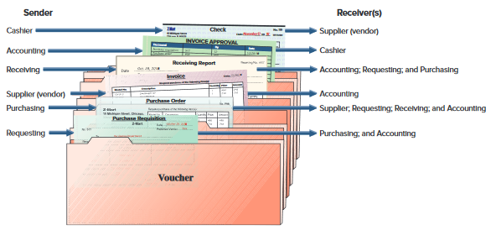
Voucher System of Control (continued)
Exhibit 6.1
© McGraw-Hill Education
28
Learning Objective P1: Apply internal control to cash receipts and payments.
Notes:
A voucher system’s control over cash payments begins when a company incurs an obligation that will result in payment of cash. A key factor in this system is that only authorized departments and individuals to incur such obligations. The system often limits the type of obligations that a department or individual can incur. In a large retail store, for instance, only a purchasing department should be authorized to incur obligations for merchandise inventory. Another key factor is that procedures for purchasing, receiving, and paying for merchandise are divided among several departments (or individuals). These departments include the one requesting the purchase, the purchasing department, the receiving department, and the accounting department. To coordinate and control responsibilities of these departments, a company uses several different business documents. This slide shows how documents are accumulated in a voucher, which is an internal document (or file) used to accumulate information to control cash disbursements and to ensure that a transaction is properly recorded.

Slide 29
Explain and record petty cash fund transactions.
Learning Objective P2
© McGraw-Hill Education
29

Slide 30
Petty Cash System of Control
Small payments for items such as:
Shipping fees
Minor repairs and
Low-cost supplies
© McGraw-Hill Education
30
Learning Objective P2: Explain and record petty cash fund transactions.
Notes:
To avoid writing checks for small amounts, a company sets up a petty cash system.
Petty cash payments, are small payments for items such as shipping fees, minor repairs, and low-cost supplies. To avoid the time and cost of writing checks for small amounts, a company sets up a petty cash fund to make small payments. (Petty cash activities are part of an imprest system, which designates advance money to establish the fund, to withdraw from the fund, and to reimburse the fund.)

Slide 31
Establishing a Petty Cash Fund
To establish a petty cash fund:
Petty Cash is debited to increase
Cash is credited to decrease
© McGraw-Hill Education
31
Learning Objective P2: Explain and record petty cash fund transactions.
Notes:
A petty cash fund requires estimating the amount of small payments made during a short period of time. A check is drawn for an amount slightly in excess of this estimate. The check is cashed and given to the petty cashier or petty cash custodian. The petty cashier keeps the cash safe, makes payments from the fund, and keeps records in a secure petty cashbox.
In this example, Z-Mart establishes a petty cash account for $75. To illustrate, assume Z-Mart establishes a petty cash fund on November 1 and designates one of its office employees as the petty cashier. A $75 check is drawn, cashed, and the proceeds given to the petty cashier. The entry to record the setup of this petty cash fund is shown in this slide as a debit to Petty Cash for $75 and a credit to Cash for $75.

Slide 32
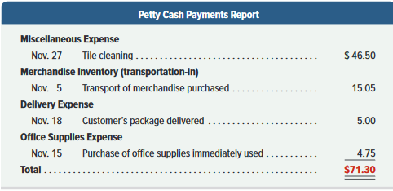
Operating a Petty Cash Fund
Summary of petty cash receipts:
Exhibit 6.3
© McGraw-Hill Education
32
Learning Objective P2: Explain and record petty cash fund transactions.
Notes:
Next, assume that Z-Mart’s petty cashier makes several November payments from petty cash. Each person who received payment is required to sign a receipt. On November 27, after making a $46.50 cash payment for tile cleaning, only $3.70 cash remains in the fund. The petty cashier then summarizes and totals the petty cash receipts as shown in this slide.

Slide 33
Reimbursement of Petty Cash Fund
Cash payments report is used in making the journal entry to reimburse the fund.
Debit each of the expenses and credit Cash.
© McGraw-Hill Education
33
Learning Objective P2: Explain and record petty cash fund transactions.
Notes:
The petty cash payments report and all receipts are given to the company cashier in exchange for a $71.30 check to reimburse the fund. The petty cashier cashes the check and puts the $71.30 cash in the petty cashbox. The company records this reimbursement as shown in this slide.

Slide 34
Increasing or Decreasing a Petty Cash Fund
To increase, debit Petty Cash and credit Cash.
To decrease, debit Cash and credit Petty Cash.
© McGraw-Hill Education
34
Learning Objective P2: Explain and record petty cash fund transactions.
Notes:
If a decision is made to increase the Petty Cash fund, Petty Cash is debited, to increase, and Cash is credited, to decrease.
Alternatively, if the company decides to decrease the fund, Cash is debited, to increase, and Petty Cash is credited, to decrease.

Slide 35
Cash Over and Short
If petty cashier fails to obtain a receipt for payment or overpays an amount, cash over or short will result.
Petty cash payments report plus cash left in account will not total to the fund balance.
Shortage: difference is debited to Cash Over and Short.
Overage: difference is credited to Cash Over and Short.
© McGraw-Hill Education
35
Learning Objective P2: Explain and record petty cash fund transactions.
Notes:
Sometimes errors in making change are by the petty cashier which will result in a difference between the amount of total receipts and cash required to bring the fund back to it’s original balance.
This difference is reported in the Cash Over and Short account, also called Cash Short and Over, which is an income statement account recording the income effects of cash overages and cash shortages.
To illustrate, a petty cash fund had $200 and the cash payments report shows $178 in miscellaneous expenses and $15 cash left. This means that the fund is short $7 ($200 – 15 = $185. $185 – 178 = $7). The entry to record the reimbursement includes a debit to Miscellaneous Expenses for $178, a debit to Cash Over and Short for $7, and a credit to Cash for $185.

Slide 36
Basic Bank Services
Signature Cards
Bank Accounts
Deposit Tickets
Bank Statements
Checks
Electronic Funds Transfer
© McGraw-Hill Education
36
Learning Objective P2: Explain and record petty cash fund transactions.
Notes:
Banks offer certain protections for your cash. For example, use of a bank account is a more secure place for your cash than a safe at the office. Signature cards are used so the bank knows whose signature is authorized for writing checks. Deposit tickets provide support for deposits to your account. Checks provide authorization for payments from your account. Electronic funds is the transfer of cash from one party to another. Bank statements are provided so customers can reconcile their accounts in a timely manner and can detect any unusual or unauthorized activity.

Slide 37
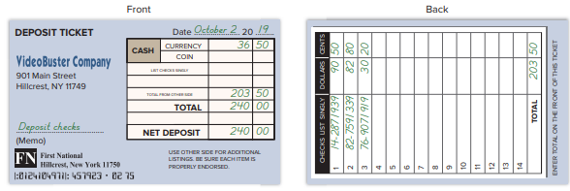
Deposit Ticket
Used to deposit money in the bank.
Lists cash and checks along with the amounts.
Serves as proof of deposit.
Exhibit 6.4
© McGraw-Hill Education
37
Learning Objective P2: Explain and record petty cash fund transactions.
Notes:
A bank account is used to deposit money for safekeeping and helps control withdrawals. Persons authorized to write checks on the account must sign a signature card, which the bank uses to verify signatures. Each bank deposit has a deposit ticket, which lists items such as currency, coins, and checks deposited along with amounts. The bank gives the customer a receipt as proof of the deposit.
Exhibit 6.4 shows one type of deposit ticket.

Slide 38
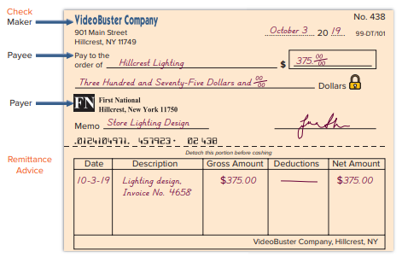
Check
Used to withdraw money from the bank.
Includes maker, signor of check; payee; and payer (bank).
Exhibit 6.5
© McGraw-Hill Education
38
Learning Objective P2: Explain and record petty cash fund transactions.
Notes:
To withdraw money, the depositor can use a check, which is a document telling the bank to pay a specified amount to a designated recipient. A check involves three parties: a maker who signs the check, a payee who is the recipient, and a bank (or payer) on which the check is drawn. The bank provides the depositor the checks. Exhibit 6.5 shows one type of check. It has an optional remittance advice explaining the payment. The memo line is used for an explanation.
Electronic funds transfer (EFT) is the electronic transfer of cash from one party to another. Companies are increasingly using EFT because of its convenience and low cost. Payroll, rent, utilities, insurance, and interest payments usually done by EFT. The bank statement lists cash withdrawals by EFT with the checks and other deductions. Cash receipts by EFT are listed with deposits and other additions.

Slide 39
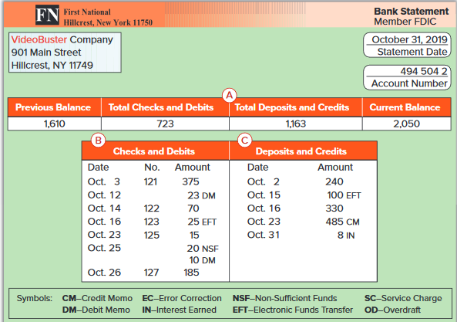
Bank Statement
Exhibit 6.6
Usually once a month, the bank sends each depositor a bank statement showing the activity in the account.
© McGraw-Hill Education
39
Learning Objective P2: Explain and record petty cash fund transactions.
Notes:
Usually once a month, the bank sends a bank statement showing the account activity. Different banks use different formats for their bank statements, but all of them include the following:
Beginning-of-period account balance.
Checks and other debits decreasing the account during the period.
Deposits and other credits increasing the account during the period.
End-of-period account balance.
This slide shows one type of bank statement. Identify each of these four items in that statement.
Part A summarizes changes in the account.
Part B lists paid checks along with other debits.
Part C lists deposits and credits to the account.

Slide 40
Prepare a bank reconciliation.
Learning Objective P3
© McGraw-Hill Education
40

Slide 41
Bank Reconciliation
A bank reconciliation is prepared periodically to explain the difference between cash reported on the bank statement and the cash balance on company’s books.
© McGraw-Hill Education
41
Learning Objective P3: Prepare a bank reconciliation.
Notes:
A bank reconciliation is a report explaining any differences between the checking account balance in the depositor’s records and the balance on the bank statement.

Slide 42
Purpose of Bank Reconciliation
The balance of a checking account reported on the bank statement rarely equals the balance in the depositor’s accounting records.
Cash Balance per Bank
Cash Balance per Book
+ Deposits in Transit
+ Collections & Interest
- Outstanding Checks
- Bank fees and NSF Checks
+/- Bank Errors
+/- Book Errors
Adjusted Cash Balance
=
Adjusted Cash Balance
Adjusting entries are recorded for the reconciling items on the book side of the reconciliation.
© McGraw-Hill Education
42
Learning Objective P3: Prepare a bank reconciliation.
Notes:
The balance of a checking account reported on the bank statement rarely equals the balance in the depositor’s accounting records. This is usually due to information that one party has that the other does not. We must therefore prove the accuracy of both the depositor’s records and those of the bank. To do this, we prepare a bank reconciliation to explain differences between the checking account balance in the depositor’s records and the balance on the bank statement.
Deposits in transit
Outstanding checks
Additions for collections and for interest
Bank fees and NSF checks
Errors

Slide 43
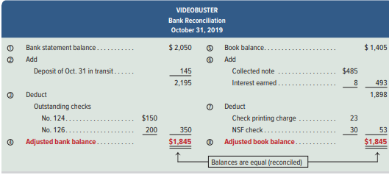
Bank Reconciliation Demonstration: Steps 1-4
Exhibit 6.7
© McGraw-Hill Education
43
Learning Objective P3: Prepare a bank reconciliation.
Notes:
In preparing the bank reconciliation, it is helpful to refer to Exhibit 6.7 and steps 1 through 9.
1. Enter the bank statement balance of the Cash account (balance per bank). VideoBuster’s bank balance is $2,050.
2. Add any unrecorded deposits and bank errors that understate the bank balance. VideoBuster’s $145 deposit placed in the bank’s night depository on October 31 is not recorded on its bank statement.
3. Subtract any outstanding checks and bank errors that overstate the bank balance. VideoBuster’s comparison of canceled checks with its books shows two checks outstanding: No. 124 for $150 and No. 126 for $200.
4. Compute the adjusted bank balance

Slide 44
Bank Reconciliation Demonstration: Steps 5-8
Exhibit 6.7
© McGraw-Hill Education
44
Learning Objective P3: Prepare a bank reconciliation.
Notes:
5. Enter the company’s book balance of the Cash account (balance per book). VideoBuster’s book balance is $1,405.
6. Add any unrecorded cash receipts, interest earned, and errors understating the book balance. VideoBuster’s bank statement shows the bank collected a note receivable for the company on October 23. The note’s proceeds of $485 are credited to the company’s account. The bank statement also shows a credit of $8 for interest earned that was not yet recorded on the books.
7. Subtract any unrecorded debit memoranda from the bank, service charges, and errors overstating the book balance. Debits on VideoBuster’s bank statement that are not yet recorded include (a) a $23 charge for check printing and (b) an NSF check for $30. (The NSF check is dated October 16 and was in the book balance.)
Compute the adjusted book balance, also called corrected or reconciled balance.
Verify that the two adjusted balances from steps 4 and 8 are equal. If so, they are reconciled.
A bank reconciliation often identifies unrecorded items that need recording by the company. In VideoBuster’s reconciliation, the adjusted balance of $1,845 is the correct balance as of October 31. But the company’s accounting records show a $1,405 balance. We must prepare journal entries to adjust the book balance to the correct balance. Only items impacting the book balance need adjustment.

Slide 45
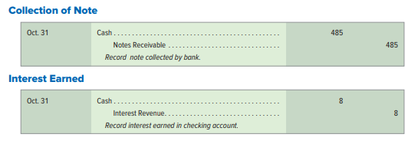
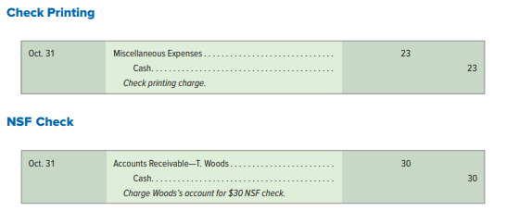
Adjusting Entries from a Bank Reconciliation
Only items reconciling the book balance require adjustment.
© McGraw-Hill Education
45
Learning Objective P3: Prepare a bank reconciliation.
Notes:
The first entry is to record collection of its note receivable by the bank.
The second entry records interest earned to its account by the bank.
The third entry records expenses for the check printing charge.
The fourth entry records the NSF check that is returned as uncollectible. The $30 check was received from T. Woods in payment of his account and then deposited. This means the entry must reverse the effects of the original entry when the check was received. After these four entries are recorded, the book balance of cash is adjusted to the correct amount of $1,845 (the adjusted book balance).

Slide 46
Compute the days’ sales uncollected ratio and use it to assess liquidity.
Learning Objective A1
© McGraw-Hill Education
46

Slide 47
Days’ Sales Uncollected
Exhibit 6.9
Indicates how much time is likely to pass before
we receive cash receipts from credit sales.
Days’
sales
uncollected
Accounts receivable
Net sales
=
× 365
© McGraw-Hill Education
47
Learning Objective A1: Compute the days’ sales uncollected ratio and use it to assess liquidity.
Notes:
One measure of how quickly a company can convert its accounts receivable into cash is the days’ sales uncollected, also called days’ sales in receivables. This measure is computed by dividing the current balance of receivables by net credit sales over the year just completed and then multiplying by 365 (number of days in a year). Since net credit sales usually are not reported to external users, the net sales (or revenues) figure is commonly used in the computation as shown in this slide.
We use days’ sales uncollected to estimate how much time is likely to pass before the current amount of accounts receivable is received in cash. It is used to determine if cash is being collected quickly enough to pay upcoming obligations. For evaluation, we also compare this estimate to that for other companies in the same industry. We also make comparisons between current and prior periods. To illustrate, we select data from the annual reports of Starbucks and Jack in the Box. Their days’ sales uncollected figures are shown in this slide.
Days’ sales uncollected for Starbucks is 14.2 days for the current year, computed as ($870/$22,387) × 365 days. This means it takes 14.2 days to collect cash from ending accounts receivable. This number reflects one or more of the following factors: a company’s ability to collect receivables, customer financial health, customer payment strategies, and discount terms. To further assess Starbucks, we compare it to Jack in the Box. We see that Starbucks’s 14.2 days’ sales uncollected is better than Jack in the Box’s 16.2 days’ sales uncollected for the current year. Starbucks took less time to collect its receivables. The less time money is tied up in receivables, the better.

Slide 48
Appendix 6-A Describe use of documentation and verification to control cash payments.
Learning Objective P4
© McGraw-Hill Education
48

Slide 49
Documentation and Verification
Purchase Requisition
Purchase Order
Invoice
Receiving Report
© McGraw-Hill Education
49
Learning Objective P4: Describe use of documentation and verification to control cash payments.
Notes:
This appendix describes the important business documents of a voucher system of control.
Department managers are usually not allowed to place orders directly with suppliers for control purposes. Instead, a department manager must inform the purchasing department of its needs by preparing and signing a purchase requisition, which lists the merchandise needed and requests that it be purchased.
A purchase order is a document the purchasing department uses to place an order with a vendor (seller or supplier).
An invoice is an itemized statement of goods prepared by the vendor listing the customer’s name, items sold, sales prices, and terms of sale. An invoice is also a bill sent to the buyer from the supplier. From the vendor’s point of view, it is a sales invoice.
Many companies maintain a separate department to receive all merchandise and purchased assets. When each shipment arrives, this receiving department counts the goods and checks them for damage and agreement with the purchase order. It then prepares four or more copies of a receiving report, which is used within the company to notify the appropriate persons that ordered goods have been received and to describe the quantities and condition of the goods.

Slide 50
Invoice Approval
Accounting department will record purchase and approve payment after all documents are in order.
Information across all documents are verified.
Invoice approval also called check authorization.
Checklist of steps necessary for approving invoice and payment.
© McGraw-Hill Education
50
Learning Objective P4: Describe use of documentation and verification to control cash payments.
Notes:
The accounting department should have copies of the following documents in the voucher: purchase requisition, purchase order, and invoice. With the information in these documents, the accounting department can record the purchase and approve its payment. In approving an invoice for payment, it checks and compares information across all documents. To facilitate this checking and to ensure that no step is omitted, it often uses an invoice approval, also called check authorization.

Slide 51
Voucher
Voucher is complete after invoice has been checked and approved.
Used to authorize recording obligation.
Certain information is required on the inside of a voucher.
Certain information is also required on the outside of a voucher.
© McGraw-Hill Education
51
Learning Objective P4: Describe use of documentation and verification to control cash payments.
Notes:
Once an invoice has been checked and approved, the voucher is complete. A complete voucher is a record summarizing a transaction. Once the voucher certifies a transaction, it authorizes recording an obligation. A voucher also contains approval for paying the obligation on an appropriate date.
Typical information required on the inside of a voucher is shown in Exhibit 6A.4, and that for the outside is shown in Exhibit 6A.5. This information is taken from the invoice and the supporting documents filed in the voucher.

Slide 52
End of Chapter 6
© McGraw-Hill Education
52

