Slide 1
Accounting for Business Transactions
Chapter 2
Wild and Shaw
Financial and Managerial Accounting
8th Edition
Copyright ©2019 McGraw-Hill Education. All rights reserved. No reproduction or distribution without the prior written consent of McGraw-Hill Education.

Slide 2
Chapter 2 Learning Objectives
CONCEPTUAL
C1 Explain the steps in processing transactions and the role of source documents.
C2 Describe an account and its use in recording transactions.
C3 Describe a ledger and a chart of accounts.
C4 Define debits and credits and explain double-entry accounting.
ANALYTICAL
A1 Analyze the impact of transactions on accounts and financial statements.
A2 Compute the debt ratio and describe its use in analyzing financial condition.
PROCEDURAL
P1 Record transactions in a journal and post entries to a ledger.
P2 Prepare and explain the use of a trial balance.
P3 Prepare financial statements from business transactions.

Slide 3
Explain the steps in processing transactions and the role of source documents.
Learning Objective C1

Slide 4
Basis of Financial Statements
Business transactions and events are the starting points of financial statements. Process from transactions to financial statements is as follows:
Identify each transaction and event from source documents.
Analyze each transaction and event using the accounting equation.
Record relevant transactions and events in a journal.
Post journal information to ledger accounts.
Prepare and analyze the trial balance and financial statements.
© McGraw-Hill Education
Learning Objective C1: Explain the steps in processing transactions and the role of source documents.
Notes:
Business transactions and events are the starting points of financial statements. The process to go from transactions and events to financial statements includes the following:
Identify each transaction and event from source documents.
Analyze each transaction and event using the accounting equation.
Record relevant transactions and events in a journal.
Post journal information to ledger accounts.
Prepare and analyze the trial balance and financial statements.

Slide 5
Source Documents
Source documents identify and describe transactions entering the accounting system.
Examples:
Bills from suppliers
Sales receipts
Checks
Purchase orders
Payroll records
Bank statements
Learning Objective -C1: Explain the steps in processing transactions and the role of source documents.
© McGraw-Hill Education
Notes:
Source documents identify and describe transactions and events entering the accounting system. They can be in hard copy or electronic form. Examples are sales receipts, checks, purchase orders, bills from suppliers, payroll records, and bank statements.
Source documents provide objective and reliable evidence about transactions and events and their amounts.

Slide 6
Describe an account and its use in recording transactions.
Learning Objective C2
© McGraw-Hill Education

Slide 7
The Account Underlying Financial Statements
An account is a record of increases and decreases in a specific asset, liability, equity, revenue, or expense.
The general ledger is a record of all accounts used by the company.
Learning Objective C2: Describe an account and its use in recording transactions.
© McGraw-Hill Education
Notes:
An account is a record of increases and decreases in a specific asset, liability, equity, revenue, or expense. The general ledger is a record of all accounts used by the company.

Slide 8
The Account and Its Analysis
Exhibit 2.1
Learning Objective C2: Describe an account and its use in recording transactions.
© McGraw-Hill Education
Notes:
Recall the basic accounting equation – Assets are equal to Liabilities plus Equity. The equity section is composed of the owner’s capital account and the owner’s withdrawal account as well as revenues and expenses.
Asset accounts – Assets are resources owned or controlled by a company and that have expected future benefits. Most accounting systems include (at a minimum) separate accounts for the assets described, such as cash, accounts receivable, note receivable, and prepaid accounts.
Liability accounts – Liabilities are claims (by creditors) against assets, which means they are obligations to transfer assets or provide products or services to other entities. Creditors often use a balance sheet to help decide whether to loan money to a company. A loan is less risky if the borrower’s liabilities are small in comparison to assets because this means there are more resources than claims on resources. Common liability accounts are accounts payable, notes payable, unearned revenue accounts, and accrued liabilities.
Equity accounts – The owner’s claim on a company’s assets is called equity or owner’s equity. Equity is the owner’s residual interest in the assets of a business after subtracting liabilities.

Slide 9
Asset Accounts
Cash
Land
Accounts Receivable
Asset Accounts
Buildings
Notes Receivable
Equipment
Prepaid Accounts
Supplies
Learning Objective C2: Describe an account and its use in recording transactions.
© McGraw-Hill Education
Notes:
Here is a listing of common asset accounts we are likely to find in all businesses.
Cash reflects a company’s cash balances. It includes money and any funds that a bank accepts for deposit (coins, checks, money orders, and checking account balances).
Accounts Receivable are held by a seller and are promises of payment from customers to sellers. These transactions are often called credit sales or sales on account (or on credit). Accounts receivable are increased by credit sales on account.
Prepaid accounts, also called prepaid expenses, are assets that represent prepayments of future expenses (expenses expected to be incurred in one or more future accounting periods). When the expenses are later incurred, the amounts in prepaid accounts are transferred to expense accounts. Examples include prepaid insurance, prepaid rent, and prepaid services.

Slide 10
Liability Accounts
Accounts Payable
Notes Payable
Liability Accounts
Accrued Liabilities
Unearned Revenue
Learning Objective C2: Describe an account and its use in recording transactions.
© McGraw-Hill Education
Notes:
Liabilities are claims by creditors against assets. Creditors are individuals and organizations that have rights to receive payments from a company.
This is a listing of common liability accounts we are likely to see in the general ledger.
Accounts payable are promises to pay later, which usually come from purchases of merchandise for resale.
A note payable is a written promissory note to pay a future amount.
Accrued liabilities are amounts owed that are not yet paid.
Unearned revenue is a liability that is settled in the future when a company delivers its product or services. If you subscribe to a magazine, you generally pay a one-year subscription in advance. For the publishing company, cash is received but nothing has been done to earn the revenue. As the magazine is delivered to you, the publishing company recognizes a portion of the money received as revenue. At the end of the year, all the revenue will be earned and the liability no longer exists.

Slide 11
Equity Accounts
-
Dividends
+
Common Stock
Equity Accounts
+
Revenues
-
Expenses
Learning Objective C2: Describe an account and its use in recording transactions.
© McGraw-Hill Education
Notes:
The owner’s claim on a company’s assets is called equity or stockholders’ equity, or shareholders’ equity. Equity is the owner’s residual interest in the assets of a business after deducting liabilities.
Equity is impacted by four types of accounts:
Common Stock
Dividends
Revenues
Expenses
Owner Investments increase both assets and equity. The increase to equity is recorded in an account titled Common Stock. Owner investments are not revenues of the business.

Slide 12
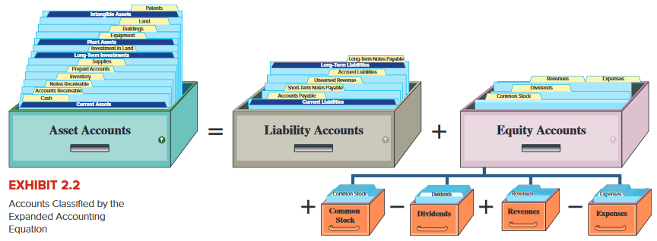
Expanded Accounting Equation
Revenues and common stock increases equity.
Expenses and dividends decrease equity.
Learning Objective C2: Describe an account and its use in recording transactions.
© McGraw-Hill Education
Notes:
Do you remember the expanded accounting equation we used to record transactions in Chapter 1? Remember that revenues increase the equity side of the equation and expenses decrease equity. In addition, owner investments are recorded in Common Stock and increase equity and Dividends decrease equity.

Slide 13
Describe a ledger and a chart of accounts.
Learning Objective C3
© McGraw-Hill Education

Slide 14
Ledger and Chart of Accounts
The ledger is a collection of all accounts and their balances for an accounting system. A company’s size and diversity of operations affect the number of accounts needed.
The chart of accounts is a list of all
accounts and includes an identifying number for each account.
Exhibit 2.4
Learning Objective C3: Describe a ledger and a chart of accounts.
© McGraw-Hill Education
Notes:
The ledger is a collection of all accounts and their balances. A company’s size and diversity of operations affect the number of accounts needed.
A chart of accounts is a listing of all accounts and includes an identifying number assigned to each account. Notice that all assets accounts begin with an account number of one, all liabilities with two, equities with three, revenues with four, and expenses with six.

Slide 15
Define debits and credits and explain double-entry accounting.
Learning Objective C4
© McGraw-Hill Education

Slide 16
Debits and Credits
A T-account represents a ledger account and is used to show the effects of one or more transactions.
Exhibit 2.5
Learning Objective C4: Define debits and credits and explain double-entry accounting.
© McGraw-Hill Education
Notes:
Accountants often use a T-account to represent a general ledger account. The account title is entered on the top of the T-account. The left side of a T-account is always called the debit side, and the right side is always called the credit side. This terminology comes from the time when the first double-entry system was developed. We still use the terms as a convention. The term debit or credit, by itself, does not mean increase or decrease. Whether a debit or a credit is an increase or decrease depends on the account. The difference between total debits and total credits for an account is the account balance. When the sum of the debits exceed the sum of the credits in a particular account, the account has a debit balance.

Slide 17
Double-Entry Accounting
=
+
Assets
Liabilities
Equity
Exhibit 2.6
© McGraw-Hill Education
Learning Objective C4: Define debits and credits and explain double-entry accounting.
Notes:
Double-entry accounting demands the accounting equation remain in balance which means that for each transaction:
● At least two accounts are involved, with at least one debit and one credit.
● The total amount debited must equal the total amount credited.
Net increases or decreases on one side have equal net effects on the other side. For example, a net increase in assets must be accompanied by an equal net increase on the liabilities and equity side. Some transactions affect only one side of the equation, such as acquiring a land asset by giving up a cash asset, but their net effect on this one side is zero.
The left side is the normal balance side for assets, and the right side is the normal balance side for liabilities and equity. This matches their layout in the accounting equation, where assets are on the left side of this equation and liabilities and equity are on the right.
It will take you a short while to become accustomed to using the terms debit and credit, but with practice you will master the concept easily.

Slide 18
Double-Entry Accounting: Expanded Accounting Equation
Here is the expanded accounting equation showing the equity section.
Exhibit 2.7
Learning Objective C4: Define debits and credits and explain double-entry accounting.
© McGraw-Hill Education
Notes:
Equity increases from revenues and owner investments (common stock) and it decreases from expenses and dividends. We see this by expanding the accounting equation to include debits and credits in double-entry form.
Increases (credits) to common stock and revenues increase equity; increases (debits) to dividends and expenses decrease equity. The normal balance of each account (asset, liability, common stock, dividends, revenue, or expense) is to the side where increases are recorded.

Slide 19
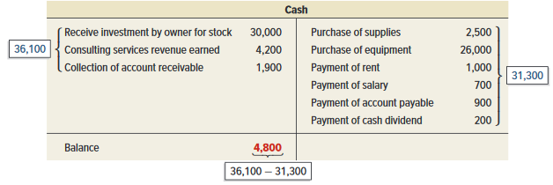
Double-Entry Accounting: Account Balance
An account balance is the difference between the increases and decreases in an account. Notice the T-Account.
Exhibit 2.8
© McGraw-Hill Education
Learning Objective C4: Define debits and credits and explain double-entry accounting.
Notes:
We determined the balance in the accounts in the last chapter, but in this chapter we will look at a more comprehensive way to determine an account balance.
The cash account is an asset, so increases, or receipts, are shown on the debit, or left side, and decreases, or payments, are shown on the credit side, or right side. To determine if an account has a debit or credit balance, we total the right and left sides and place the balance on the larger side. In this example, our increases in cash amount to $36,100 and the decreases total $31,300 so the cash account has a debit, or positive balance of $4,800.

Slide 20
Record transactions in a journal and post entries to a ledger.
Learning Objective P1
© McGraw-Hill Education

Slide 21
Journalizing and Posting Transactions
Exhibit 2.9
Learning Objective P1: Record transactions in a journal and post entries to a ledger.
© McGraw-Hill Education
Notes:
In the accounting process, you first analyze a transaction by looking at proper source documentation. Next, we apply the rules of double-entry accounting and record a general journal entry. The general journal is a chronological listing of the transactions. At the end of the accounting period, we post the information from the general journal to the proper general ledger account. The general ledger groups all transactions that impact a particular account. That is, all the transactions that increase or decrease the cash account are posted to the general ledger cash account.

Slide 22
Journalizing Transactions
Transaction Date
Titles of Affected Accounts
Exhibit 2.10
Transaction explanation
Dollar amount of debits and credits
© McGraw-Hill Education
Learning Objective P1: Record transactions in a journal and post entries to a ledger.
Notes:
Here is an example of the proper recording of a general journal transaction. We have seen a similar transaction before. In this case, the owner of the business contributes $30,000 cash to start the business. Let’s see how we get the various pieces.
The transaction occurred on December 1, 2019. The date is important when recording general journal transactions and is recorded on the left side of the journal.
Next we identify the accounts affected by the transactions. The cash account is an asset that has increased. We show increases in asset accounts with a debit to that account. The Common Stock account also increased and we show increases in equity accounts with a credit. Debits are always listed first in the journal followed by credits that are slightly indented below the debits.
The dollar amount is placed in the appropriate debit or credit column. In this case, the cash account was debited for $30,000, so we place that amount in the debit column.
Finally, we prepare a brief description of the transaction so that other people who view our work will understand the nature of the transaction. This explanation is indented about as far as the credited account titles to avoid confusing it with accounts and it is italicized.

Slide 23
Balance Account Column
Exhibit 2.11
T-accounts are useful illustrations, but balance column ledger accounts are used in practice.
Learning Objective P1: Record transactions in a journal and post entries to a ledger.
© McGraw-Hill Education
Notes:
T-accounts are useful illustrations, but balance column ledger accounts are used in practice.
The balance column account format is similar to a T-account in having columns for debits and credits. It is different in including transaction date and explanation columns. It also has a column with the balance of the account after each entry is recorded. The Cash account is debited on December 1 for the $30,000 common stock yielding a $30,000 debit balance. The account is credited on December 2 for $2,500, yielding a $27,500 debit balance. On December 3, it is credited again, this time for $26,000, and its debit balance is reduced to $1,500. The Cash account is debited for $4,200 on December 10, and its debit balance increases to $5,700; and so on.

Slide 24
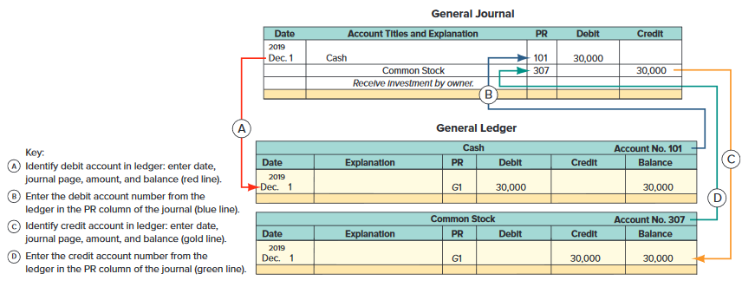
Posting Journal Entries
Exhibit 2.12
Learning Objective P1: Record transactions in a journal and post entries to a ledger.
© McGraw-Hill Education
Notes:
Posting is the process of transferring the information from the general journal to the general ledger. There are four steps in the posting process.
Identify debit account in Ledger: enter date, journal page, amount, and balance.
Enter the debit account number from the Ledger in the PR column of the journal.
Identify the credit account in Ledger: enter date, journal page, amount, and balance.
Enter the credit account number from the Ledger in the PR column of the journal.

Slide 25
Analyze the impact of transactions on accounts and financial statements.
Learning Objective A1
© McGraw-Hill Education

Slide 26
Processing Transactions
Double-entry accounting is useful in analyzing and processing transactions. Analysis of each transaction follows these four steps.
© McGraw-Hill Education
Learning Objective A1: Analyze the impact of transactions on accounts and financial statements.
Notes:
Double-entry accounting is useful in analyzing and processing transactions. To analyze each transaction follow these four steps:
Identify the transaction and any source documents.
Analyze the transaction using the accounting equation.
Record the transaction in journal entry form applying double-entry accounting.
Post the entry (for simplicity, we use T-accounts to represent ledger accounts).
Let’s look at some examples.

Slide 27
Processing Transactions #1
Learning Objective A1: Analyze the impact of transactions on accounts and financial statements.
© McGraw-Hill Education
Notes:
In the first transaction, the owner invests $30,000 to start a company called FastForward. From our previous work, we know that the cash account and the Common Stock account will increase.
We record this information in the general journal with a debit, increase, to cash, and a credit, increase, to Common Stock. Notice that the account number for the cash account is 101 and Common Stock is 307. We are going to post the information in the journal to the general ledger. We will use T-accounts to accomplish this.
We place the $30,000 on the left, or debit, side of the cash account and on the right, or credit, side of the Common Stock account. Our books are in balance because total assets are equal to total liabilities plus equity. Let’s move to another transaction.

Slide 28
Processing Transactions #2
© McGraw-Hill Education
Learning Objective A1: Analyze the impact of transactions on accounts and financial statements.
Notes:
In our second transaction, FastForward purchases office supplies paying $2,500 cash. We have exchanged one asset, cash, for another asset, supplies. The cash account will decrease and the supplies account will increase. Can you make the general journal entry to record this transaction?
We increase the supplies account with a debit and decrease the asset account, cash, with a credit. Let’s post the amounts.
The general ledger account for supplies increased by $2,500, so the amount is placed on the debit side of the account. The cash account, an asset, decreased by $2,500, so the amount is placed on the credit side of the general ledger account. Let’s move on to another transaction.

Slide 29
Processing Transactions #3
© McGraw-Hill Education
Learning Objective A1: Analyze the impact of transactions on accounts and financial statements.
Notes:
In our third transaction, FastForward purchases equipment paying $26,000 cash. Once again, we have exchanged one asset, cash, for another asset, equipment. The cash account will decrease and the equipment account will increase. This general journal entry will look similar to the one we just completed.
We increase the equipment account with a debit and decrease the asset account, cash, with a credit. Let’s post the amounts.
The general ledger account for equipment increased by $26,000, so it is placed on the debit side of the account. The cash account, an asset, decreased by $26,000, so the amount is placed on the credit side of the general ledger account. Let’s look at another transaction.

Slide 30
Processing Transactions #4
© McGraw-Hill Education
Learning Objective A1: Analyze the impact of transactions on accounts and financial statements.
Notes:
In this transaction, FastForward purchases $7,100 of office supplies on account. The supplies account, an asset, will increase and the liability account, accounts payable will increase. Let’s make the general journal entry to record this transaction.
We increase the supplies account with a debit and increase the liability account, accounts payable, with a credit. It is time to post the transaction.
The general ledger account for supplies increased by $7,100, so the amount is placed on the debit side of the account. The accounts payable account, a liability, increased by the same amount, so we place it on the credit side of the general ledger account. Let’s analyze another transaction.

Slide 31
Processing Transactions #5
Learning Objective A1: Analyze the impact of transactions on accounts and financial statements.
© McGraw-Hill Education
Notes:
FastForward provided consulting services and collected $4,200 cash. The asset account, cash, increased by $4,200 and the equity account, consulting revenue, increased by the same amount. See if you can make the general journal entry to record this transaction before moving to the next slide.
We increase the cash account with a debit and increase the revenue account, consulting revenue, with a credit. Let’s post the amounts.
The general ledger account for cash increased by $4,200, so the amount is placed on the debit side of the account. The consulting revenue account increased by the same amount, so it is placed on the credit side of the general ledger account.
We could continue on with more transactions, but your homework will help reinforce what we have done here. Let’s take a look at the trial balance of FastForward at the end of December.

Slide 32
Processing Transactions #6
Learning Objective A1: Analyze the impact of transactions on accounts and financial statements.
© McGraw-Hill Education
Notes:
FastForward provided pays $1,000 cash for December rent. The asset account, cash, decreased by $1,000 and the equity account, rent expense, increased by the same amount.
We decrease the cash account with a credit and increase the expense account, rent expense, with a debit. Let’s post the amounts.
The general ledger account for cash decreased by $1,000, so the amount is placed on the credit side of the account. The rent expense account increased by the same amount, so it is placed on the debit side of the general ledger account.

Slide 33
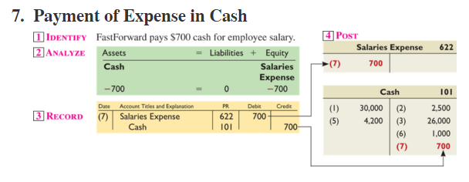
Processing Transactions #7
Learning Objective A1: Analyze the impact of transactions on accounts and financial statements.
© McGraw-Hill Education
Notes:
FastForward provided pays $700 cash for employee salaries. The asset account, cash, decreased by $700 and the equity account, salaries expense, increased by the same amount.
We decrease the cash account with a credit and increase the expense account, salaries expense, with a debit. Let’s post the amounts.
The general ledger account for cash decreased by $700, so the amount is placed on the credit side of the account. The salaries expense account decreased by the same amount, so it is placed on the debit side of the general ledger account increased.

Slide 34
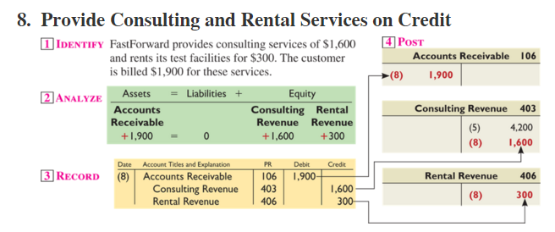
Processing Transactions #8
Learning Objective A1: Analyze the impact of transactions on accounts and financial statements.
© McGraw-Hill Education
Notes:
FastForward provided consulting services of $1,600 and rents its test facilities for $300. The customer is billed $1,900 for services.
The asset account, accounts receivable, increased by $1,900, the equity account, consulting revenue, increased by $1,600 and the equity account, rental revenue, increased by $300.
We increase the accounts receivable account with a debit and increase the two revenue accounts, consulting revenue and rental revenue, with credits. This is a compound journal entry which affects three or more accounts.
The general ledger account for accounts receivable increased by $1,900, so the amount is placed on the debit side of the account. The consulting revenue account increased by $1,600 and rental revenue increased by $300, so these are placed on the credit side of the general ledger accounts.

Slide 35
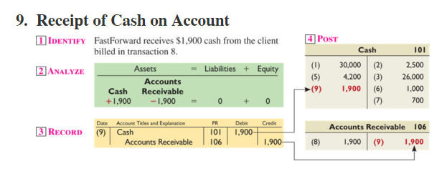
Processing Transactions #9
Learning Objective A1: Analyze the impact of transactions on accounts and financial statements.
© McGraw-Hill Education
Notes:
FastForward receives $1,900 cash from the client billed in transaction 8. This transaction will increase the cash account and decrease the accounts receivable account by $1,900.
We increase the cash account with a debit and decrease the accounts receivable account for $1,900.
In posting these amounts to the general ledger accounts, $1,900 is placed on the debit side of the cash account and $1,900 is placed on the credit side of the accounts receivable account.

Slide 36
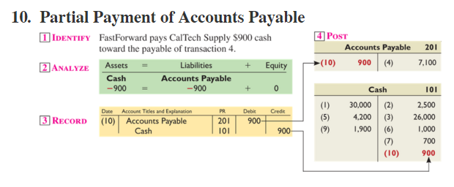
Processing Transactions #10
Learning Objective A1: Analyze the impact of transactions on accounts and financial statements.
© McGraw-Hill Education
Notes:
FastForward pays $900 cash toward the payable in transaction 4. This transaction will decrease the cash account and decrease the accounts payable account by $900.
Decrease the cash account with a credit and decrease the accounts payable account with a debit for $900.
In posting these amounts to the general ledger accounts, $900 is placed on the credit side of the cash account and $900 is placed on the debit side of the accounts payable account.

Slide 37
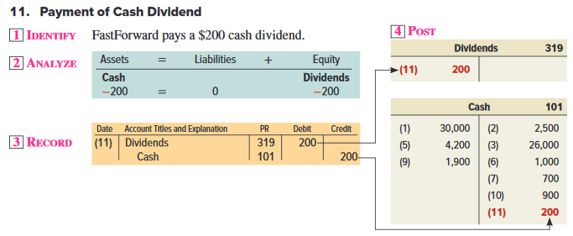
Processing Transactions #11
Learning Objective A1: Analyze the impact of transactions on accounts and financial statements.
© McGraw-Hill Education
Notes:
FastForward pays a $200 dividend to its sole stockholder. This transaction will decrease the cash account and increase Dividends account by $200.
Decrease the cash account with a credit and increase the Dividends account with a debit for $200.
In posting these amounts to the general ledger accounts, $200 is placed on the credit side of the cash account and $200 is placed on the debit side of the Dividends account.

Slide 38
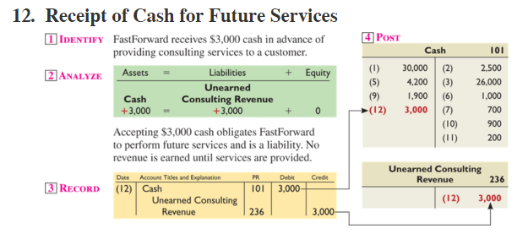
Processing Transactions #12
Learning Objective A1: Analyze the impact of transactions on accounts and financial statements.
© McGraw-Hill Education
Notes:
FastForward receives $3,000 cash in advance of providing consulting services to a customer. This transaction will increase the cash account and increase the liability account, unearned consulting revenue account by $3,000.
We increase the cash account with a debit and increase the unearned consulting revenue account for $3,000.
In posting these amounts to the general ledger accounts, $3,000 is placed on the debit side of the cash account and $3,000 is placed on the credit side of the unearned consulting revenue account.

Slide 39
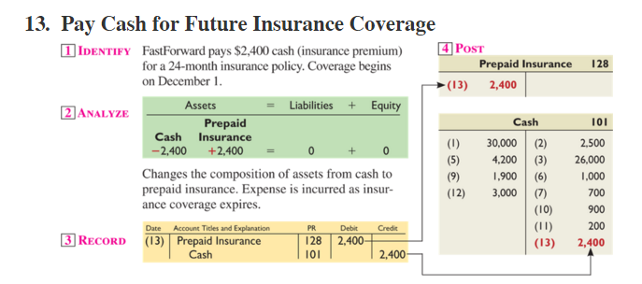
Processing Transactions #13
Learning Objective A1: Analyze the impact of transactions on accounts and financial statements.
© McGraw-Hill Education
Notes:
FastForward pays $2,400 cash for a 24-month insurance policy. This transaction will decrease the cash account and increase the asset account, prepaid insurance, by $2,400.
Decrease the cash account with a credit and increase the prepaid insurance account with a debit for $2,400.
In posting these amounts to the general ledger accounts, $2,400 is placed on the credit side of the cash account and $2,400 is placed on the debit side of the prepaid insurance account.

Slide 40
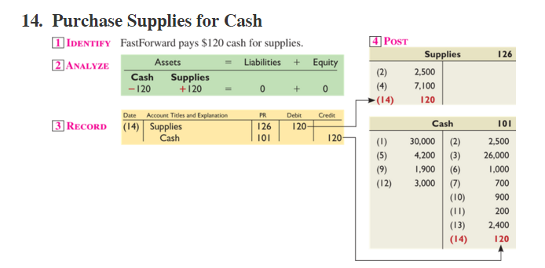
Processing Transactions #14
Learning Objective A1: Analyze the impact of transactions on accounts and financial statements.
© McGraw-Hill Education
Notes:
FastForward pays $120 cash for supplies. This transaction will decrease the cash account and decrease the asset account, supplies account by $120.
Decrease the cash account with a credit and increase the supplies account with a debit for $120.
In posting these amounts to the general ledger accounts, $120 is placed on the credit side of the cash account and $120 is placed on the debit side of the supplies account.

Slide 41
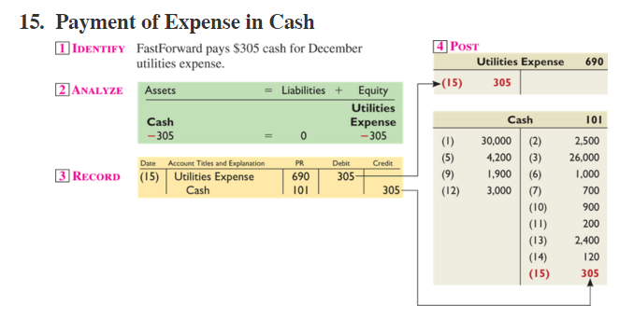
Processing Transactions #15
Learning Objective A1: Analyze the impact of transactions on accounts and financial statements.
© McGraw-Hill Education
Notes:
FastForward pays $305 cash for December utilities expense. This transaction will decrease the cash account and increase the equity account, utilities expense account by $305.
Decrease the cash account with a credit and increase the utilities expense account with a debit for $305.
In posting these amounts to the general ledger accounts, $305 is placed on the credit side of the cash account and $305 is placed on the debit side of the utilities expense account.

Slide 42
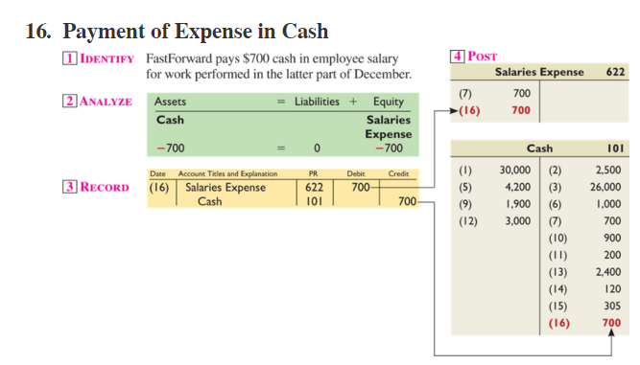
Processing Transactions #16
Learning Objective A1: Analyze the impact of transactions on accounts and financial statements.
© McGraw-Hill Education
Notes:
FastForward provided pays $700 cash for employee salaries. The asset account, cash, decreased by $700 and the equity account, salaries expense, increased by the same amount.
We decrease the cash account with a credit and increase the expense account, salaries expense, with a debit. Let’s post the amounts.
The general ledger account for cash decreased by $700, so the amount is placed on the credit side of the account. The salaries expense account decreased by the same amount, so it is placed on the debit side of the general ledger account.

Slide 43
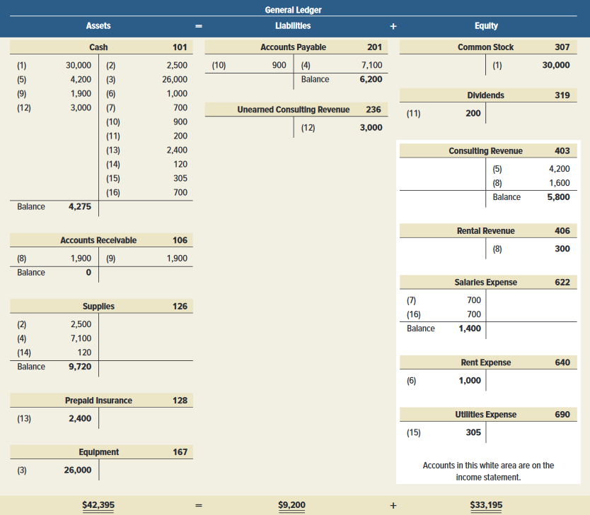
Summarizing Transactions in a Ledger
Exhibit 2.13
Learning Objective A1: Analyze the impact of transactions on accounts and financial statements.
© McGraw-Hill Education
Notes:
Exhibit 2.13 shows the ledger accounts (in T-account form) of FastForward after all 16 transactions are recorded and posted and the balances computed. The accounts are grouped into three columns corresponding to the accounting equation: assets, liabilities, and equity. The totals for the three columns obey the accounting equation: assets equal $42,395 ($4,275 + $0 + $9,720 + $2,400 + $26,000); liabilities equal $9,200 ($6,200 + $3,000); and equity equals $33,195 ($30,000 - $200 + $5,800 + $300 - $1,400 - $1,000 - $305) which obey the accounting equation: $42,395 = $9,200 + $33,195. The common stock, dividends, revenue, and expense accounts reflect transactions that change equity. These four accounts make up the statement of retained earnings.

Slide 44
Prepare and explain the use of a trial balance.
Learning Objective P2
© McGraw-Hill Education

Slide 45
Preparing a Trial Balance
Preparing a trial balance has three steps:
List each account title and its amount (from ledger) in the trial balance. If an account has a zero balance, list it with a zero in the normal balance column (or omit it entirely).
Compute the total of debit balances and the total of credit balances.
Verify (prove) total debit balances equal total credit balances.
Learning Objective P2: Prepare and explain the use of a trial balance.
© McGraw-Hill Education
Notes:
Preparing a trial balance has three steps:
List each account title and its amount (from ledger) in the trial balance. If an account has a zero balance, list it with a zero in the normal balance column (or omit it entirely).
Compute the total of debit balances and the total of credit balances.
Verify (prove) total debit balances equal total credit balances.
The total of debit balances equals the total of credit balances for the trial balance. However, equality of these two totals does not guarantee that no errors were made.

Slide 46
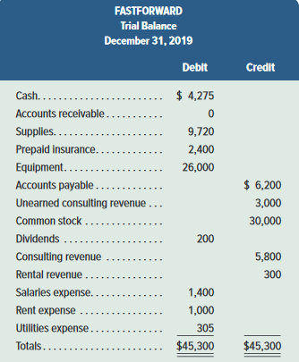
FastForward’s Trial Balance
The trial balance lists all ledger accounts and their balances at a point in time. If the books are in balance, the total debits will equal the total credits.
Learning Objective P2: Prepare and explain the use of a trial balance.
© McGraw-Hill Education
Notes:
The total of debit balances equals the total of credit balances for the trial balance as shown in this slide. Equality of these two totals does not guarantee that no errors were made. For example, the column totals still will be equal when a debit or credit of a correct amount is made to a wrong account. Another error that does not cause unequal column totals occurs when equal debits and credits of an incorrect amount are entered.

Slide 47
Searching for Errors
If the trial balance does not balance, the error(s) must be found and corrected.
❶ Make sure the trial balance columns are correctly added.
❹ Recompute each account balance in the ledger.
❷ Make sure account balances are correctly entered from the ledger.
❺ Verify that each journal entry is posted correctly.
❸ See if debit or credit accounts are mistakenly placed on the trial balance.
❻ Verify that each original journal entry has equal debits and credits.
Learning Objective P2: Prepare and explain the use of a trial balance.
© McGraw-Hill Education
Notes:
If the trial balance does not balance, the error(s) must be found and corrected.
Step 1: Verify that the trial balance columns are correctly added.
Step 2: Verify that account balances are accurately entered from the ledger.
Step 3: See whether a debit (or credit) balance is mistakenly listed in the trial balance as a credit (or debit).
Step 4: Recompute each account balance in the ledger.
Step 5: Verify that each journal entry is properly posted.
Step 6: Verify that the original journal entry has equal debits and credits.

Slide 48
Prepare financial statements from business transactions
Learning Objective P3
© McGraw-Hill Education

Slide 49
Financial Statements Prepared from Trial Balance
Exhibit 2.15
Learning Objective P3: Prepare financial statements from business transactions.
© McGraw-Hill Education
Notes:
As we have seen in the last chapter, after the trial balance has been prepared we begin preparing the financial statements. We always begin with the income statement because net income from the income statement appears on the statement of retained earnings. After the income statement, we prepare the statement of retained earnings because the ending balance in retained earnings appears on the balance sheet. Next, we prepare the balance sheet and, finally, we prepare the statement of cash flows.

Slide 50
Financial Statements
The four financial statements and their purposes are:
Income statement—reports revenues less expenses incurred by a business over a period of time.
Statement of retained earnings—reports changes in retained earnings over the reporting period from net income (or loss) and from any dividends over a period of time.
Balance sheet—reports the financial position (types and amounts of assets, liabilities, and equity) at a point in time.
Statement of Cash Flows—lists the cash inflows and cash outflows for the period.
**For simplicity, we do not show the statement of cash flows for FastForward in this chapter, but we do return to this statement in the next chapter.**
Learning Objective P3: Prepare financial statements from business transactions.
© McGraw-Hill Education
Notes:
This section introduces us to how financial statements are prepared from the analysis of business transactions. The four financial statements and their purposes are:
Income statement — reports revenues less expenses along with the resulting net income or loss by a business over a period of time.
Statement of retained earnings— reports changes in retained earnings over the reporting period from net income (or loss) and from any dividends over a period of time.
Balance sheet — reports the financial position (types and amounts of assets, liabilities, and equity) at a point in time.
. Statement of Cash Flows – lists the cash inflows and cash outflows for the period.

Slide 51
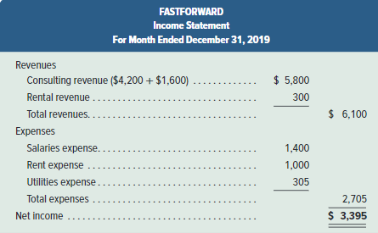
Income Statement
Exhibit 2.16
Learning Objective P3: Prepare financial statements from business transactions.
© McGraw-Hill Education
Notes:
FastForward’s income statement for December is shown in this slide. Information about revenues and expenses is conveniently taken from the trial balance. Net income of $3,395 is reported at the bottom of the statement. Owner investments and dividends are not part of income.

Slide 52
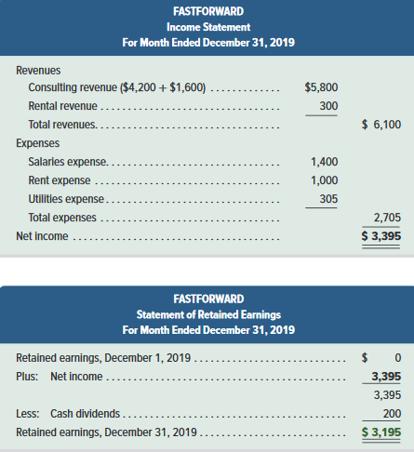
Statement of Retained Earnings
Exhibit 2.16
Learning Objective P3: Prepare financial statements from business transactions.
© McGraw-Hill Education
Notes:
FastForward’s statement of retained earnings is the second report in this slide. It shows the beginning retained earnings balance of $0, plus $3,395 of net income, less the $200 dividends, for a $3,195 end-of-period retained earnings balance. The beginning retained earnings balance in the statement of retained earnings is rarely zero; an exception is for the first period of operations. The beginning retained earnings balance in January 2020 is $3,195, which is December 2019’s ending balance.

Slide 53
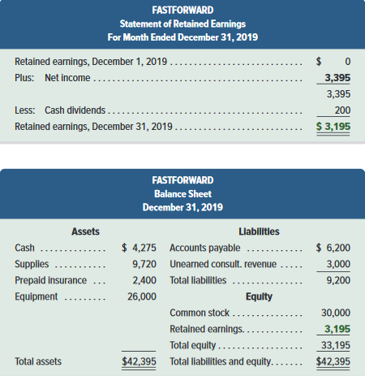
Balance Sheet
Exhibit 2.16
Learning Objective P3: Prepare financial statements from business transactions.
© McGraw-Hill Education
Notes:
FastForward’s balance sheet is the bottom report shown in this slide. This statement refers to financial condition at the close of business on December 31. The left side of the balance sheet lists its assets: cash, supplies, prepaid insurance, and equipment. The upper right side of the balance sheet shows that it owes $6,200 to creditors and $3,000 in services to customers who paid in advance. The equity section shows an ending retained earnings balance of $3,195, from the Statement of Retained Earnings plus the $30,000 common stock from the initial investment by the owner. Note the link between the ending balance of the statement of retained earnings and the equity balance.

Slide 54
Presentation Issues
Dollar signs are not used in journals and ledgers.
Dollar signs appear in financial statements and other reports such as trial balances. Put dollar signs beside only the first and last numbers in a column.
When amounts are entered in the journal, ledger, or trial balance, commas are optional to indicate thousands, millions, and so forth.
Commas are always used in financial statements.
Companies commonly round amounts in reports to the nearest dollar, or even to a higher level.
Learning Objective P3: Prepare financial statements from business transactions.
© McGraw-Hill Education
Notes:
There are many common standards for formatting in accounting. Here are some standards used by most companies:
Dollar signs are not used in journals and ledgers.
Dollar signs appear in financial statements and other reports such as trial balances. Put dollar signs beside only the first and last numbers in a column.
When amounts are entered in the journal, ledger, or trial balance, commas are optional to indicate thousands, millions, and so forth.
Commas are always used in financial statements.
Companies commonly round amounts in reports to the nearest dollar, or even to a higher level.

Slide 55
Compute the debt ratio and describe its use in analyzing financial condition.
Learning Objective A2
© McGraw-Hill Education

Slide 56
Debt Ratio - Equation
Total Liabilities
Debt Ratio =
Total Assets
Evaluates the level of debt risk.
A higher ratio indicates that there is a greater probability that a company will not be able to pay its debt in the future.
Learning Objective A2: Compute the debt ratio and describe its use in analyzing financial condition.
© McGraw-Hill Education
Notes:
Borrowing money is risky business. The debt to assets ratio helps evaluate the level of debt risk. We determine a company’s ability to pay its debts (liabilities) using the debt ratio. The debt ratio is equal to total liabilities divided by total assets. A higher ratio indicates that there is greater probability a company will not be able to pay its debts in the future.

Slide 57
Debt Ratio - Computation
Total Liabilities
Debt Ratio =
Total Assets
Exhibit 2.18
57
Learning Objective A2: Compute the debt ratio and describe its use in analyzing financial condition.
Notes:
Costco’s debt ratio ranges from a low of 0.63 to a high of 0.70. Its ratio is exceeds the Walmart’s in each of the last three years, suggesting a higher than average risk from financial leverage. If Costco is making more money with this debt than it is paying the lenders, then it is successfully borrowing money to make more money. A company’s use of debt can quickly turn unprofitable if its return from that money drops below the rate it is paying lenders.

Slide 58
End of Chapter 2
© McGraw-Hill Education

