Slide 1
Chapter 21
The Statement of Cash
Flows Revisited
Notes:
The objective of financial reporting is to provide investors and creditors with useful information, primarily in the form of financial statements. The balance sheet and the income statement—the focus of your study in earlier chapters—do not provide all the information needed by these decision makers. Here we will learn how the statement of cash flows fills the information gap left by the other financial statements.

Slide 2
Decision Makers’ Perspective— Usefulness of Cash Flow Information
LO21-1
Meaningful projections of a company’s future profitability and risk depend on answers to such questions as:
In what types of activities is the company investing?
Are these activities being financed with debt? With equity? By cash generated from operations?
Are facilities being acquired to accommodate future expansion?
How does the amount of cash generated from operations compare with net income over time?
Why isn’t the increase in retained earnings reflected as an increase in dividends?
What happens to the cash received from the sale of assets?
By what means is debt being retired?
21-02
Notes:
Investors and creditors continually face decisions that require projections of the relative ability of a business to generate future cash flows and of the risk associated with those forecasts. To make these projections, decision makers rely heavily on the information reported in periodic financial statements. In the final analysis, cash flows into and out of a business enterprise are the most fundamental events on which investors and creditors base their decisions. Naturally, these decisions focus on the prospects of the decision makers receiving cash returns from their dealings with the firm. However, it is the ability of the firm to generate cash flows to itself that ultimately determines the potential for cash flows from the firm to investors and creditors.
The financial statements that have been the focus of your study in earlier chapters—the income statement and the balance sheet—offer information helpful in forecasting future cash-generating ability. Cash flows to investors and creditors depend on the corporation generating cash flows to itself.
Some important questions, however, are not easily answered from the information these financial statements provide. For example, meaningful projections of a company’s future profitability and risk depend on answers to such questions as:
In what types of activities is the company investing?
Are these activities being financed with debt? with equity? by cash generated from operations?
Are facilities being acquired to accommodate future expansion?
How does the amount of cash generated from operations compare with net income over time?
Why isn’t the increase in retained earnings reflected as an increase in dividends?
What happens to the cash received from the sale of assets?
By what means is debt being retired?

Slide 3
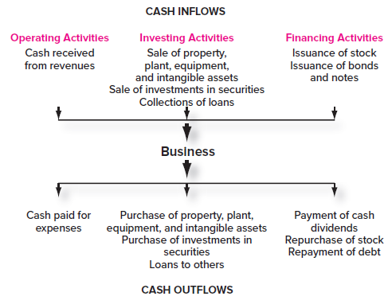
Cash Inflows and Cash Outflows
LO21-1
21-03
Notes:
Illustration 21–1 Cash Inflows and Cash Outflows
Cash continually flows into and out of an active business. Businesses disburse cash to acquire property and equipment to maintain or expand productive capacity. When no longer needed, these assets may be sold for cash. Cash is paid to produce or purchase inventory for resale, as well as to pay for the expenses of selling these goods. The ultimate outcome of these selling activities is an inflow of cash. Cash might be invested in securities of other firms. These investments provide cash inflows during the investment period in the form of dividends or interest and at the end of the investment period when the securities are sold. To raise cash to finance their operations, firms sell stock and/or acquire debt. Cash payments are made as dividends to shareholders and interest to creditors. When debt is repaid or stock repurchased, cash flows out of the firm. To visualize the continual process of cash receipts and cash payments, that process is diagrammed in the illustration. The diagram also previews the way we will later classify the cash flows in a statement of cash flows.
Embodied in this assortment of cash flows is a wealth of information that investors and creditors require to make educated decisions. Much of the value of the underlying information provided by the cash flows is lost when reported only indirectly by the balance sheet and the income statement. Each cash flow eventually impacts decision makers by affecting the balances of various accounts in the balance sheet. Also, many of the cash flows—those related to income-producing activities—are represented in the income statement. However, they are not necessarily reported in the period the cash flows occur because the income statement measures activities on an accrual basis. The statement of cash flows fills the information gap by reporting the cash flows directly.

Slide 4
Statement of Cash Flows
UNITED BRANDS CORPORATION Statement of Cash Flows For Year Ended December 31, 2021
Cash Flows from Operating Activities |  | ($ in millions)
Cash inflows: From customers From investment revenue | $ 98 3
Cash outflows: To suppliers of goods To employees For interest For insurance For income taxes |  |  | (50) (11) (3) (4) (11)
Net cash flows from operating activities |  |  |  | $ 22
Cash Flows from Investing Activities Purchase of land Purchase of short-term investment Sale of land Sale of equipment |  |  | (30) (12) 18 5
Net cash flows from investing activities |  |  |  | (19)
Cash Flows from Financing Activities Sale of common shares Retirement of bonds payable Payment of cash dividends |  |  | 26 (15) (5)
Net cash flows from financing activities |  |  |  | 6
Net increase in cash Cash balance, January 1 Cash balance, December 31 |  |  |  | 9 20 $ 29
LO21-1
21-04
Notes:
Illustration 21–2 Statement of Cash Flows
A statement of cash flows is shown in the illustration. The statement lists all cash inflows and cash outflows during the reporting period. To enhance the informational value of the presentation, the cash flows are classified according to the nature of the activities that bring about the cash flows. The three primary categories of cash flows are:
cash flows from operating activities,
cash flows from investing activities, and
cash flows from financing activities.
Classifying each cash flow by source (operating, investing, or financing activities) is more informative than simply listing the various cash flows.
The GAAP requirement for the statement of cash flows was issued in direct response to FASB Concept Statement 1, which stated that the primary objective of financial reporting is to “provide information to help investors and creditors, and others assess the amounts, timing, and uncertainty of prospective net cash inflows to the related enterprise.”
Many companies suffered bankruptcy because they were unable to generate sufficient cash to satisfy their obligations. Doubtless, many investors in the stock of these firms would have been spared substantial losses if the financial statements had been designed to foresee the cash flow problems the companies were experiencing. A noted illustration is the demise of W. T. Grant during the 1970s. Grant, a general retailer in the days before malls, was a blue chip stock of its time. Grant’s statement of changes in financial position (the predecessor of the statement of cash flows) reported working capital from operations of $46 million in 1972. Yet, if presented, a statement of cash flows would have reported cash flows from operating activities of negative $10 million. In fact, the unreported cash flow deficiency grew to $114 million in 1973, while working capital from operations was reported as having increased by $1 million. That year, without the benefit of cash flow information, investors were buying Grant’s stock at prices that represented up to 20 times its earnings.
More recently, even with cash flow information available, cash flow problems can go unheeded or unsuccessfully addressed. An example is the recent demise of Toys R Us. The relationship of cash inflows and cash outflows illustrates a major aspect of a leveraged buyout (LBO) which fashioned the latest ownership of the company. Typically, an LBO is followed by layoffs, spending cuts, and other cost-cutting initiatives designed to create enough cash inflow to meet the cash outflow needed to service the massive debt created by the LBO itself. In Toys R Us’ final three years (2014—2016), by far the most notable aspect of its statement of cash flows was a positive cash flow from operations being dwarfed by a huge and accelerating cash outflow for debt repayments.
Realize, too, that an unprofitable company with good cash flow can survive. Amazon. com provides an excellent example. Founded as an online seller of books in 1995, Amazon didn’t actually make a profit for a decade, but it did raise huge amounts of cash by selling stock, so much so that it was able to weather 10 years of sizable losses. The financing cash inflows funded expansion into many new lines of business and made up for the continual losses. Amazon now has enormously positive operating cash flows and is one of the largest companies in the world.

Slide 5
Statement of Cash Flows (continued)
LO21-1
Note X: Noncash Investing and Financing Activities
Acquired $20 million of equipment by issuing a 12%, 5-year note |  | $ 20
Reconciliation of Net Income to Cash Flows from Operating Activities:
Net income |  | $ 12
Adjustments for noncash effects:
Gain on sale of land |  | (8)
Depreciation expense |  | 3
Loss on sale of equipment |  | 2
Changes in operating assets and liabilities:
Increase in accounts receivable |  | (2)
Decrease in inventory |  | 4
Increase in accounts payable |  | 6
Increase in salaries payable |  | 2
Discount on bonds payable |  | 2
Decrease in prepaid insurance |  | 3
Decrease in income tax payable |  | (2)
Net cash flows from operating activities |  | $ 22
21-05
Notes:
Illustration 21–2 Statement of Cash Flows (continued)
Notice, too, that the noncash investing and financing activities—investing and financing activities that do not directly increase or decrease cash—also are reported.

Slide 6
Cash, Cash Equivalents, and Restricted Cash
LO21-2
Cash equivalents
No differentiation between cash and cash equivalent investments
Similarly, cash set aside for designated purposes is also part of the reported cash balance
Company must establish a policy regarding which short-term, highly liquid investments it classifies as cash equivalents
Short-term
readily converted to cash
with little
risk of loss
Highly liquid investments
Should be disclosed in the notes to the statement
21-06
Notes:
Skilled cash managers will invest temporarily idle cash in short-term investments to earn interest on those funds, rather than maintain an unnecessarily large balance in a checking account. The FASB views short-term, highly liquid investments that can be readily converted to cash, with little risk of loss, as cash equivalents. Amounts held as investments of this type are essentially equivalent to cash because they are quickly available for use as cash. Therefore, on the statement of cash flows there is no differentiation between amounts held as cash (e.g., currency and checking accounts) and amounts held in cash equivalent investments. Similarly, sometimes companies might have contractual agreements that require specific amounts to be set aside for designated purposes, like debt repayment or workers’ compensation claims. Those restricted cash amounts also are part of reported cash balances. So, when we refer in this chapter to cash, we are referring to the total of cash, cash equivalents, and restricted cash.
Examples of cash equivalents are money market funds, Treasury bills, and commercial paper. To be classified as cash equivalents, these investments must have a maturity date not longer than three months from the date of purchase. Flexibility is permitted in designating cash equivalents. Each company must establish a policy regarding which short-term, highly liquid investments it classifies as cash equivalents. The policy should be consistent with the company’s customary motivation for acquiring various investments and should be disclosed in the notes to the statement.

Slide 7
Disclosure of Cash Equivalents— ExxonMobil Corporation
LO21-2
Note 4: Cash Flow Information (in part)
The consolidated statement of cash flows provides information about changes in cash and cash equivalents. Highly liquid investments with maturities of three months or less when acquired are classified as cash equivalents.
21-07
Notes:
Illustration 21–3 Disclosure of Cash Equivalents—ExxonMobil Corporation
A recent annual report of ExxonMobil Corporation provides the description of its cash equivalents, as shown in the illustration.

Slide 8
Cash Equivalents
LO21-2
To record the purchase of a treasury bill:
Treasury bill 100,000
Cash 100,000
Would this be an Inflow or outflow of cash?
Neither—moves $100,000 from one cash account to another “cash” account
Mere transfers from cash to cash equivalents or from cash equivalents to cash should not be reported on the statement of cash flows
21-08
Notes:
Transactions that involve merely transfers from cash to cash equivalents (such as the purchase of a three-month Treasury bill), or from cash equivalents to cash (such as the sale of a Treasury bill), should not be reported on the statement of cash flows. The total of cash and cash equivalents is not altered by such transactions. The cash balance reported in the balance sheet also represents the total of cash and cash equivalents, which allows us to compare the change in that balance with the net increase or decrease in the cash flows reported on the statement of cash flows.

Slide 9
Primary Elements of the Statement of Cash Flows
LO21-3
Primary Elements of the Statement of Cash Flows
Operating Activities
Investing Activities
Financing Activities
Noncash Investing and Financing Activities
Reconciliation of the Net Increase or Decrease in Cash
21-09
Notes:
This section describes the three primary activity classifications: (1) operating activities, (2) investing activities, and (3) financing activities. It also describes two other requirements of the statement of cash flows: (4) the reconciliation of the net increase or decrease in cash with the change in the balance of the cash account, and (5) noncash investing and financing activities.

Slide 10
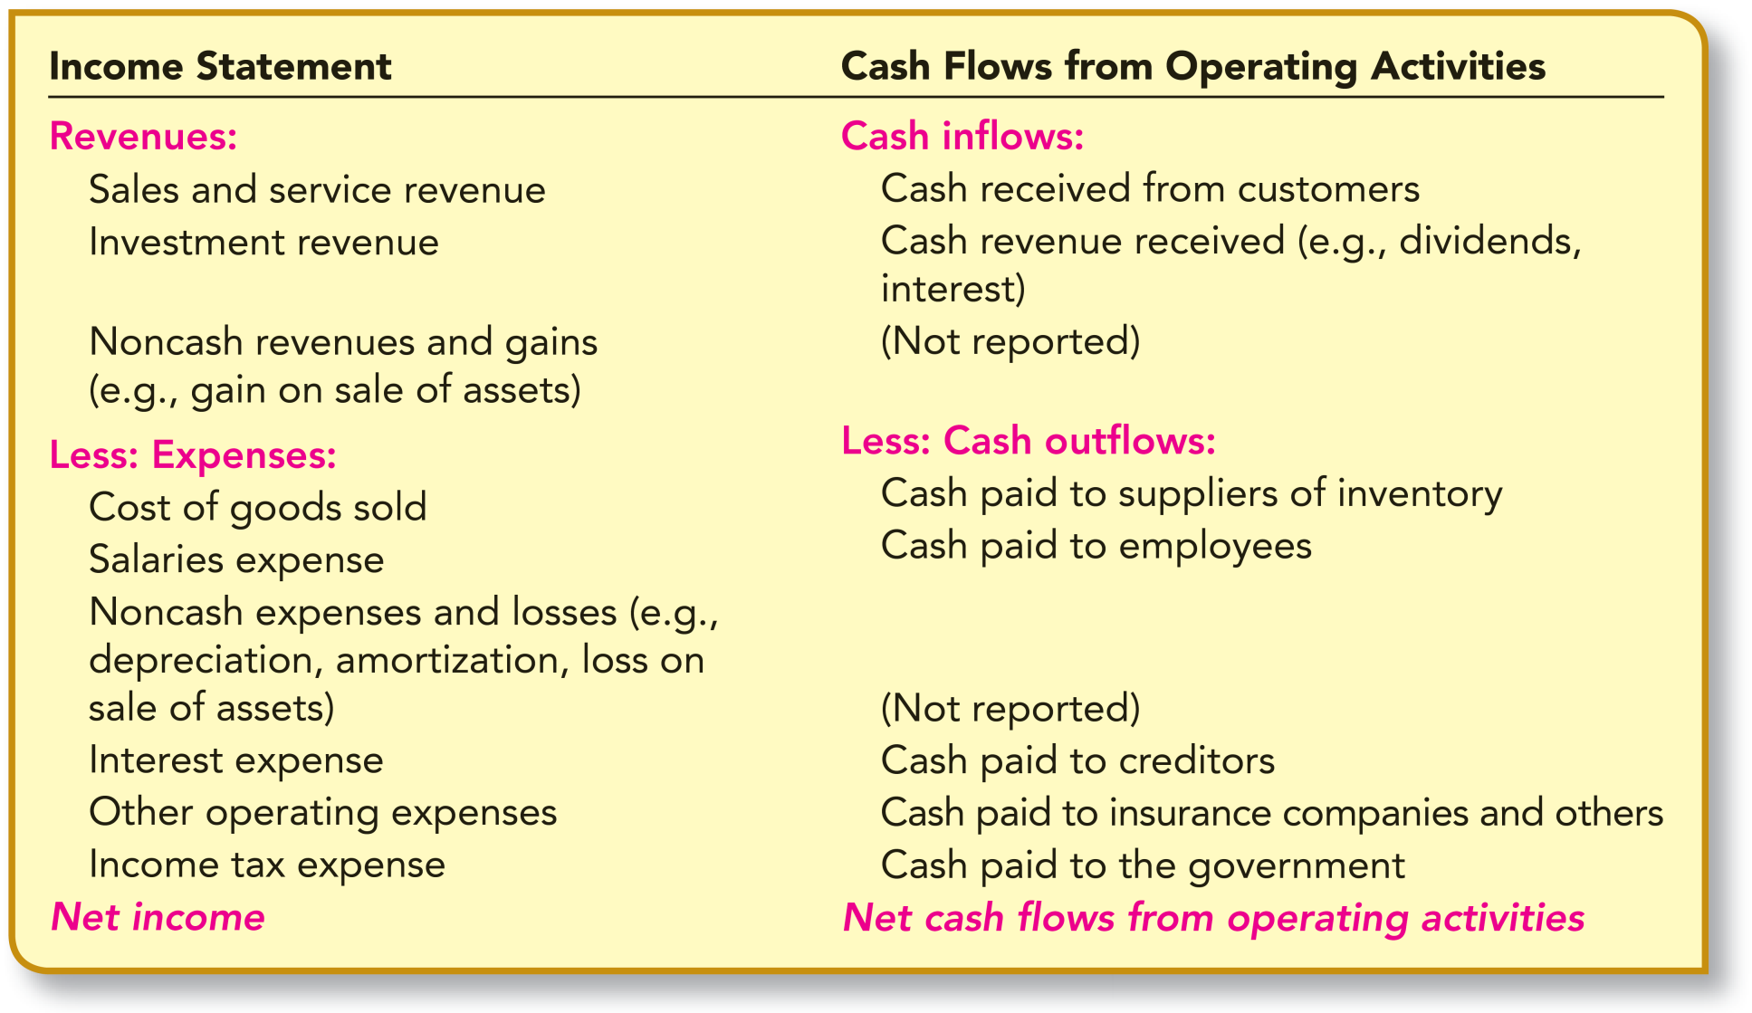
Relationship between the Income Statement and Cash Flows from Operating Activities (Direct Method)
LO21-3
21-10
Notes:
Illustration 21–4 Relationship between the Income Statement and Cash Flows from Operating Activities (Direct Method)
The income statement reports the success of a business in generating a profit from its operations. Net income (or loss) is the result of netting together the revenues recognized during the reporting period, regardless of when cash is received, and the expenses incurred in generating those revenues, regardless of when cash is paid. This is the accrual concept of accounting that has been emphasized throughout your study of accounting. Information about net income and its components, measured by the accrual concept, generally provides a better indication of current operating performance than does information about current cash receipts and payments. Nevertheless, as indicated earlier, the cash effects of earning activities also provide useful information that is not directly accessible from the income statement. The first cash flow classification in the statement of cash flows reports that information.
Cash flows from operating activities are both inflows and outflows of cash that resut from activities reported in the income statement. In other words, this classification of cash flows include the elements of net income, but reported on a cash basis. The components of this section of the statement of cash flows, and their relationship with the elements of the income statement, are illustrated.

Slide 11
Cash Flows from Operating Activities— Direct Method
LO21-3
Cash flows from operating activities are the elements of net income, but reported on a cash basis
Cash Flows from Operating Activities:
Cash inflows:
From customers
$98
From investment revenue
3
Cash outflows:
To suppliers of goods
(50)
To employees
(11)
For interest
(3)
For insurance
(4)
For income taxes
(11)
Net cash flows from operating activities
$22
21-11
Notes:
Illustration 21–5 Cash Flows from Operating Activities; Direct Method
To see the concept applied, let’s look again at the cash flows from operating activities reported by United Brands Corporation. That section of the statement of cash flows is extracted from a previous illustration and reproduced here.
The presentation by UBC of cash flows from operating activities shown in the illustration is referred to as the direct method. The method is named for the fact that the cash effect of each operating activity (i.e., income statement item) is reported directly in the statement of cash flows.
Cash inflows from operating activities exceeded cash outflows for expenses by $22 million. We’ll see later that UBC’s net income from the same operating activities was only $12 million. Why did operating activities produce net cash inflows greater than net income? The reason will become apparent when we determine, in a later section, the specific amounts of these cash flows.
You also should be aware that the generalization stated earlier that cash flows from operating activities include the elements of net income reported on a cash basis is not strictly true for all elements of the income statement. Notice in the illustration that no cash effects are reported for depreciation and amortization of property, plant, and equipment, and intangibles, nor for gains and losses from the sale of those assets. Cash outflows occur when these assets are acquired, and cash inflows occur when the assets are sold. However, as described later, the acquisition and subsequent resale of these assets are classified as investing activities, rather than as operating activities.
Quite the opposite, the purchase and the sale of inventory are considered operating activities. The cash effects of these transactions—namely, (1) cash payments to suppliers and (2) cash receipts from customers—are included in the determination of cash flows from operating activities. Why are inventories treated differently from property, plant, equipment, and intangible assets when classifying their cash effects if they all are acquired for the purpose of producing revenues? The essential difference is that inventory typically is purchased for the purpose of being sold as part of the firm’s current operations, while the other assets are purchased as investments to benefit the business over a relatively long period of time.

Slide 12
Cash Flows from Operating Activities— Indirect Method
LO21-4
More on the indirect method later
Cash Flows from Operating Activities:
Net income
$12
Adjustments for noncash effects:
Gain on sale of land
(8)
Depreciation expense
3
Loss on sale of equipment
2
Changes in operating assets and liabilities:
Increase in accounts receivable
(2)
Decrease in inventory
4
Increase in accounts payable
6
Increase in salaries payable
2
Decrease in discount on bonds payable
2
Decrease in prepaid insurance
3
Decrease in income tax payable
(2)
Net cash flows from operating activities
$22
21-12
Notes:
Illustration 21–6 Cash Flows from Operating Activities; Indirect Method
Another way UBC might have reported cash flows from operating activities is by the indirect method. By this approach, the net cash increase or decrease from operating activities ($22 million in our example) would be derived indirectly by starting with reported net income and working backwards to convert that amount to a cash basis. As we see later in the chapter, UBC’s net income is $12 million. Using the indirect method, UBC would replace the previous presentation of net cash flows from operating activities with the one shown in the illustration.
Be sure to note that the indirect method generates the same $22 million net cash flows from operating activities as the direct method. Rather than directly reporting only the components of the income statement that do represent increases or decreases in cash, by the indirect method we begin with net income—which includes both cash and noncash components—and back out all amounts that don’t reflect increases or decreases in cash. Later in the chapter, we explore the specific adjustments made to net income to achieve this result. At this point, it is sufficient to realize that two alternative methods are permitted for reporting net cash flows from operating activities. Either way, we convert accrual-based income to cash flows produced by those same operating activities.
Notice also that the indirect method presentation is identical to what UBC reported earlier as the “Reconciliation of Net Income to Cash Flows from Operating Activities” in Note X of a previous illustration. Whether cash flows from operating activities are reported by the direct method or by the indirect method, the financial statements must reconcile the difference between net income and cash flows from operating activities. When a company uses the direct method, the company presents the reconciliation in a separate schedule as UBC does. That presentation is precisely the same as the presentation of net cash flows from operating activities by the indirect method. On the other hand, a company choosing to use the indirect method is not required to provide a separate reconciliation schedule because the “cash flows from operating activities” section of the statement of cash flows serves that purpose. Most companies use the indirect method.

Slide 13
Cash Flows from Investing Activities
LO21-5
Outflows and inflows of cash caused by the acquisition and disposition of assets
Included in this classification are cash payments to acquire
Property, plant, and equipment and other productive assets
Investments in securities (except cash equivalents and trading securities)
Non-trade receivables
When these assets later are liquidated, any cash inflows from their disposition also are classified as investing activities
21-13
Notes:
It’s important to understand, too, that regardless of which method a company chooses to report operating activities, that choice has no effect on the way it identifies and reports cash flows from investing and financing activities. We turn our attention now to those two sections of the statement of cash flows.
Companies periodically invest cash to replace or expand productive facilities such as property, plant, and equipment. Investments might also be made in other assets, such as securities of other firms, with the expectation of a return on those investments. Information concerning these investing activities can provide valuable insight to decision makers regarding the nature and magnitude of assets being acquired for future use, as well as provide clues concerning the company’s ambitions for the future.
Cash flows from investing activities are both outflows and inflows of cash caused by the acquisition and disposition of assets. Included in this classification are cash payments to acquire (1) property, plant, and equipment and other productive assets (except inventories), (2) investments in securities (except cash equivalents and trading securities), and (3) nontrade receivables. When these assets later are liquidated, any cash receipts from their disposition also are classified as investing activities. For instance, cash received from the sale of the assets or from the collection of a note receivable (principal amount only) represents cash inflows from investing activities. Be sure to realize that, unlike what the label might imply, any investment revenue like interest, dividends, or other cash return from these investments is not an investing activity. The reason, remember, is that investment revenue is an income statement item and therefore is an operating activity.

Slide 14
Cash Flows from Investing Activities (continued)
LO21-5
From our example company (UBC)
Cash Flows from Investing Activities:
Purchase of land
$(30)
Purchase of short-term investment
(12)
Sale of land
18
Sale of equipment
5
Net cash flows from investing activities
$(19)
21-14
Notes:
Illustration 21–7 Cash Flows from Investing Activities
For illustration, notice the cash flows reported as investing activities by UBC. That section of the statement of cash flows is extracted from the complete statement in a previous illustration and reproduced here.
Cash flows from investing activities include investments in assets and their subsequent sale.
UBC reports as investing activities the cash paid to purchase both land and a short-term investment. The other two investing activities reported are cash receipts for the sale of assets—equipment and land—that were acquired in earlier years. The specific transactions creating these cash flows are described in a later section of this chapter.
The purchase and sale of inventories are not considered investing activities. Inventories are purchased for the purpose of being sold as part of the firm’s primary operations, so their purchase and sale are classified as operating activities.
Also, the purchase and sale of assets classified as cash equivalents are not reported as investing activities. In fact, these activities usually are not reported on the statement of cash flows. For example, when temporarily idle cash is invested in a money market fund considered to be a cash equivalent, the total of cash and cash equivalents does not change. Likewise, when the cash is later withdrawn from the money market fund, the total remains unchanged. The exception is when cash equivalents are sold at a gain or a loss. In that case, the total of cash and cash equivalents actually increases or decreases in the process of transferring from one cash equivalent account to another cash equivalent account. As a result, the change in cash would be reported as a cash flow from operating activities. This is illustrated later in the chapter.

Slide 15
Cash Flows from Financing Activities
LO21-6
Inflows and outflows of cash resulting from the external financing of a business
Cash inflows from
Sale of common and preferred stock
Issuance of bonds and other debt securities
Cash outflows related to these transactions also are classified as financing activities
Buyback of stock
Repayment of debt
Payment of cash dividends to shareholders
21-15
Notes:
Not only is it important for investors and creditors to be informed about how a company is investing its funds, but also how its investing activities are being financed. Hopefully, the primary operations of the firm provide a source of internal financing. Information revealed in the cash flows from operating activities section of the statement of cash flows lets statement users know the extent of available internal financing. However, a major portion of financing for many companies is provided by external sources, specifically by shareholders and creditors.
Cash flows from financing activities are both inflows and outflows of cash resulting from the external financing of a business. We include in this classification cash inflows from (a) the sale of common and preferred stock and (b) the issuance of bonds and other debt securities. Subsequent transactions related to these financing transactions, such as a buyback of stock (to retire the stock or as treasury stock), the repayment of debt, and the payment of cash dividends to shareholders, also are classified as financing activities.

Slide 16
Cash Flows from Financing Activities (continued)
LO21-6
From our example company (UBC)
Cash Flows from Financing Activities:
Sale of common shares
$26
Retirement of bonds payable
(15)
Payment of cash dividends
(5)
Net cash flows from financing activities
$6
21-16
Notes:
Illustration 21–8 Cash Flows from Financing Activities
For illustration, refer to the shown illustration excerpted from the complete statement of cash flows of UBC in a previous illustration.
The cash received from the sale of common stock is reported as a financing activity. Since the sale of common stock is a financing activity, providing a cash return (dividend) to common shareholders also is a financing activity. Similarly, when the bonds being retired were issued in a prior year, that cash inflow was reported as a financing activity. In the current year, when the bonds are retired, that same amount of the resulting cash outflow is likewise classified as a financing activity.
At first glance, it may appear inconsistent to classify the payment of cash dividends to shareholders as a financing activity when, as stated earlier, paying interest to creditors is classified as an operating activity. But remember, cash flows from operating activities should reflect the cash effects of items that enter into the determination of net income. Interest expense is a determinant of net income. A dividend, on the other hand, is a distribution of net income and not an expense.

Slide 17
Concept Check: Investing Activities
LO21-5
Selected information from Curl Up and Dye Salon’s accounting records and financial statements for 2021 is as follows ($ in millions):
Cash paid to acquire equipment $20
Treasury stock purchased for cash 22
Proceeds from sale of land and buildings 45
Gain from the sale of land and buildings 16
Investment revenue received 33
Cash paid to acquire office equipment 40
On its statement of cash flows, the company should report net cash flows from investing activities of:
$15 million net outflow
$37 million net outflow
$30 million net inflow
$ 1 million net inflow
The correct answer is a:
$45 proceeds from sale of land and buildings
(20) cash paid to acquire equipment
(40) cash paid to acquire office equipment
($15) net cash outflow
21-17
Notes:
The correct answer is a:
$45 proceeds from sale of land and buildings
(20) cash paid to acquire equipment
(40) cash paid to acquire office equipment
($15) net cash outflow

Slide 18
Concept Check: Financing Activities
LO21-6
Selected information from Vinyl Resting Place Corporation’s accounting records and financial statements for 2021 is as follows ($ in millions):
Cash paid to retire bonds $30
Treasury stock purchased for cash 50
Proceeds from issuance of common stock 70
Proceeds from issuance of mortgage bonds 80
Cash dividends paid on common stock 25
Cash interest paid to bondholders 15
In its statement of cash flows, the company should report net cash flows from financing activities of:
$35 million net outflow
$45 million net inflow
$30 million net inflow
$125 million net outflow
The correct answer is b:
$70 proceeds from issuance of common stock
80 proceeds from mortgage bonds
(30) cash paid to retire bonds
(50) treasury stock purchased for cash
(25) cash dividends paid on common stock
$45 net cash inflow
21-18
Notes:
The correct answer is b:
$70 proceeds from issuance of common stock
80 proceeds from mortgage bonds
(30) cash paid to retire bonds
(50) treasury stock purchased for cash
(25) cash dividends paid on common stock
$45 net cash inflow

Slide 19
Reconciliation with Change in Cash Balance
LO21-6
Net amount of cash inflows and outflows reconciles the change in the company’s beginning and ending cash balances
Net increase in cash
$ 9
Cash balance, January 1
20
Cash balance, December 31
$29
21-19
Notes:
One of the first items you may have noticed about UBC’s statement of cash flows is that there is a net change in cash of $9 million. Is this a significant item of information provided by the statement? The primary objective of the statement of cash flows is not to tell us that cash increased by $9 million. We can readily see the increase or decrease in cash by comparing the beginning and ending balances in the cash account in comparative balance sheets. Instead, the purpose of the statement of cash flows is to explain why cash increased by $9 million.
To reinforce the fact that the net amount of cash inflows and outflows explains the change in the cash balance, the statement of cash flows includes a reconciliation of the net increase (or decrease) in cash with the company’s beginning and ending cash balances.

Slide 20
Noncash Investing and Financing Activities
LO21-7
UBC acquired $20 million of new equipment by issuing a $20 million long-term note payable in a single transaction.
Reported in a separate disclosure schedule or note
UBC reported this transaction in the following manner:
Noncash Investing and Financing Activities:
Acquired $20 million of equipment by issuing a 12%, 5-year note.
21-20
Notes:
Suppose UBC were to borrow $20 million cash from a bank, issuing a long-term note payable for that amount. This transaction would be reported on a statement of cash flows as a financing activity. Now suppose UBC used that $20 million cash to purchase new equipment. This second transaction would be reported as an investing activity.
Instead of two separate transactions, as indicated by an earlier illustration, UBC acquired $20 million of new equipment by issuing a $20 million long-term note payable in a single transaction. Undertaking a significant investing activity and a significant financing activity as two parts of a single transaction does not diminish the value of reporting these activities. For that reason, transactions that do not increase or decrease cash, but which result in significant investing and financing activities, must be reported in related disclosures.
These noncash investing and financing activities, such as UBC’s acquiring equipment (an investing activity) by issuing a long-term note payable (a financing activity), are reported in a separate disclosure schedule or note. UBC reported this transaction as shown.
It’s convenient to report noncash investing and financing activities on the same page as the statement of cash flows as did UBC only if there are few such transactions. Otherwise, precisely the same information would be reported in disclosure notes to the financial statements.
Examples of noncash transactions that would be reported in this manner are:
Acquiring an asset by incurring a debt payable to the seller
Acquiring use of an asset by entering into a lease agreement
Converting debt into common stock or other equity securities
Exchanging noncash assets or liabilities for other noncash assets or liabilities
Noncash transactions that do not affect a company’s assets or liabilities, such as the distribution of stock dividends, are not considered investing or financing activities and are not reported. Recall from Chapter 18 that stock dividends merely increase the number of shares of stock owned by existing shareholders. From an accounting standpoint, the stock dividend causes a dollar amount to be transferred from one part of shareholders’ equity (retained earnings) to another part of shareholders’ equity (paid-in capital). Neither assets nor liabilities are affected; therefore, no investing or financing activity has occurred.

Slide 21
Preparation of the Statement of Cash Flows
LO21-8
Information available to assist the statement preparer includes:
An income statement for the year
Balance sheets for both the current and preceding years
Additional information about transactions that caused changes in account balances during the year
Common approach is to use an electronic spreadsheet
Reconstructing the events and transactions that caused cash to increase or decrease during the period helps identify the operating, investing, and financing activities to be reported
21-21
Notes:
The objective in preparing the statement of cash flows is to identify all transactions and events that represent operating, investing, or financing activities and to list and classify those activities in proper statement format. A difficulty in preparing a statement of cash flows is that typical accounting systems are not designed to produce the specific information we need for the statement. At the end of a reporting cycle, balances exist in accounts reported in the income statement (sales revenue, cost of goods sold, etc.) and the balance sheet (accounts receivable, common stock, etc.). However, the ledger contains no balances for cash paid to acquire equipment, or cash received from sale of land, or any other cash flow needed for the statement. As a result, it’s necessary to find a way of using available information to reconstruct the various cash flows that occurred during the reporting period. Typically, the information available to assist the statement preparer includes an income statement for the year and balance sheets for both the current and preceding years (comparative statements). The accounting records also can provide additional information about transactions that caused changes in account balances during the year.
In situations involving relatively few transactions, it is possible to prepare the statement of cash flows by merely inspecting the available data and logically determining the reportable activities. Few real-life situations are sufficiently simple to be solved this way. Usually, it is more practical to use some systematic method of analyzing the available data to ensure that all operating, investing, and financing activities are detected. A common approach is to use either a manual or electronic spreadsheet to organize and analyze the information used to prepare the statement.
Whether the statement of cash flows is prepared by an unaided inspection and analysis or with the aid of a systematic technique such as spreadsheet analysis, the analytical process is the same. To identify the activities to be reported on the statement, we use available data to reconstruct the events and transactions that involved operating, investing, and financing activities during the year. It is helpful to reproduce the journal entries that were recorded at the time of the transaction. Examining reconstructed journal entries makes it easier to visualize whether a reportable activity is involved and how that activity is to be classified.

Slide 22
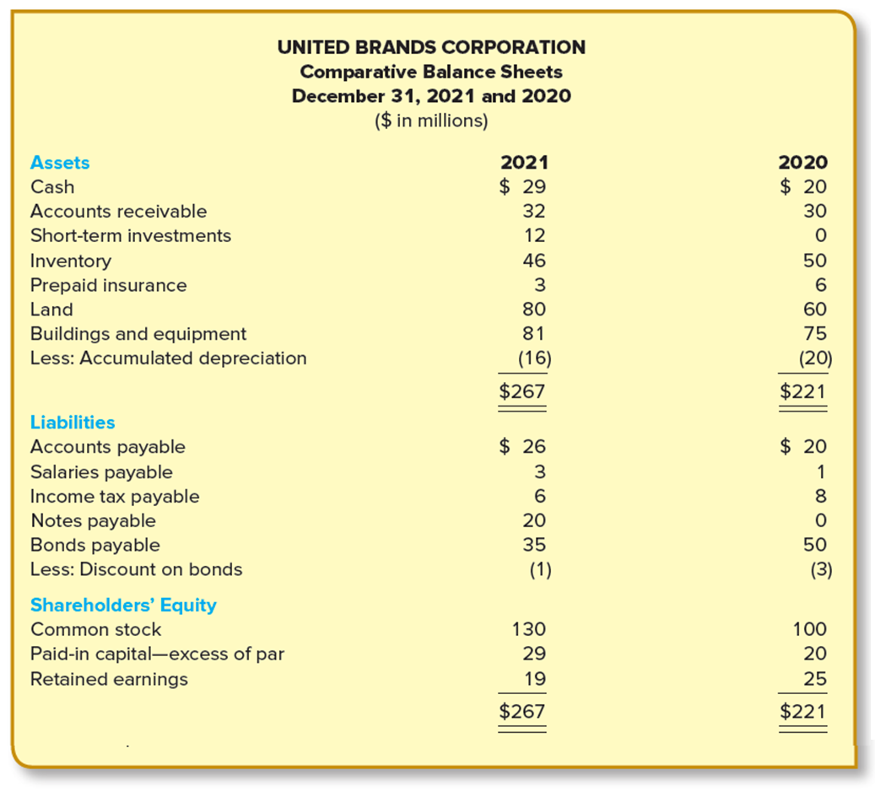
Comparative Balance Sheets and Income Statement
LO21-8
21-22
Notes:
Illustration 21–9 Comparative Balance Sheets and Income Statement
The typical year-end data (comparative balance sheets) is provided for UBC in the illustration shown here. We have referred frequently to the statement of cash flows of UBC to illustrate the nature of the activities the statement reports. Now we will see how that statement is developed from the data provided in that illustration.

Slide 23
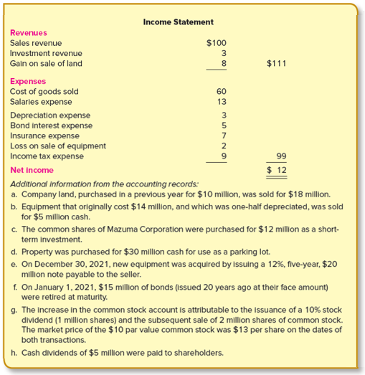
Comparative Balance Sheets and Income Statement (continued)
LO21-8
21-23
Notes:
Illustration 21–9 Comparative Balance Sheets and Income Statement (continued)
The typical year-end data (income statement) is provided for UBC in the illustration. We have referred frequently to the statement of cash flows of UBC to illustrate the nature of the activities the statement reports. Now we will see how that statement is developed from the data provided in that illustration.

Slide 24
Preparing the SCF: Direct Method—Using a Spreadsheet
LO21-8
For cash to increase or decrease, there must be a corresponding change in an account other than cash
Identify operating, investing, and financing activities
Event/transaction
or Cash
In an account other than cash
Step 1
Beginning and ending balances of each account are entered on the spreadsheet
Step 2
Journal entries are reconstructed in our analysis of the data
Entries explain changes in account balances
21-24
Notes:
An important advantage gained by using a spreadsheet is that it ensures that no reportable activities are inadvertently overlooked. Spreadsheet analysis relies on the fact that, in order for cash to increase or decrease, there must be a corresponding change in an account other than cash. Therefore, if we can identify the events and transactions that caused the change in each noncash account during the year, we will have identified all the operating, investing, and financing activities that are to be included in the statement of cash flows.
The beginning and ending balances of each account are entered on the spreadsheet. Then, as journal entries are reconstructed in our analysis of the data, those entries are recorded on the spreadsheet so that the debits and credits of the spreadsheet entries explain the changes in the account balances. Only after spreadsheet entries have explained the changes in all account balances can we feel confident that all operating, investing, and financing activities have been identified. The spreadsheet is designed in such a way that, as we record spreadsheet entries that explain account balance changes, we are simultaneously identifying and classifying the activities to be reported on the statement of cash flows.

Slide 25
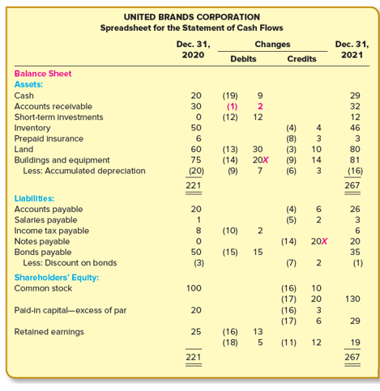
Spreadsheet—Direct Method
LO21-8
X—As explained later, the Xs serve as a reminder to report this noncash transaction
21-25
Notes:
Illustration 21–9A Spreadsheet—Direct Method
We begin by transferring the comparative balance sheets and income statement to a blank spreadsheet. For illustration, refer to the 2021 and 2020 balances in the completed spreadsheet for UBC. Notice that the amounts for elements of the income statement are ending balances resulting from accumulations during the year. Beginning balances in each of these accounts are always zero.

Slide 26
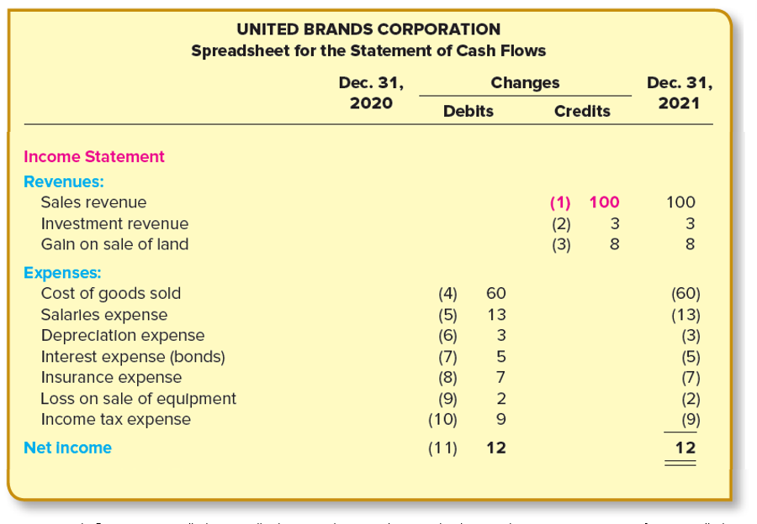
Spreadsheet—Direct Method (continued)
LO21-8
21-26
Notes:
Illustration 21–9A Spreadsheet—Direct Method (continued)
Following the balance sheets and income statement, we allocate space on the spreadsheet for the statement of cash flows. Although at this point we have not yet identified the specific cash flow activities shown in the completed spreadsheet, we can include headings for the major categories of activities: cash flows from operating activities, cash flows from investing activities, and cash flows from financing activities. Leaving several lines between headings allows adequate space to include the specific cash flows identified in subsequent analysis.
The spreadsheet entries shown in the two changes columns, which separate the beginning and ending balances, explain the increase or decrease in each account balance. You will see in the next section how these entries were reconstructed. We number each entry and enter those numbers on the spreadsheet with the debit(s) and credit(s) of the entry as we go along. Although spreadsheet entries are in the form of debits and credits like journal entries, they are entered on the spreadsheet only. They are not recorded in the formal accounting records. In effect, these entries duplicate, frequently in summary form, the actual journal entries used to record the transactions as they occurred during the year.
To reconstruct the journal entries, we analyze each account, one at a time, deciding at each step what transaction or event caused the change in that account. Often, the reason for the change in an account balance is readily apparent from viewing the change in conjunction with that of a related account elsewhere in the financial statements. Sometimes it’s necessary to consult the accounting records for additional information to help explain the transaction that resulted in the change.
You may find it helpful to diagram in T-account format the relationship between accounts to better visualize certain changes, particularly in your initial study of the chapter. The analysis that follows is occasionally supplemented with such diagrams to emphasize why, rather than merely how, specific cash flow amounts emerge from the analysis.

Slide 27
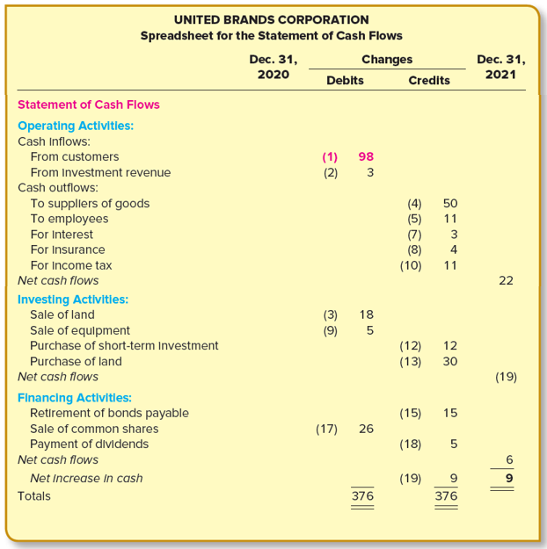
Spreadsheet—Direct Method (concluded)
LO21-8
21-27
Notes:
Illustration 21–9A Spreadsheet—Direct Method (concluded)
Although there is no mandatory order in which to analyze the accounts, it is convenient to begin with the income statement accounts, followed by the balance sheet accounts. We analyze the accounts of UBC in that order below. Although our analysis of each account culminates in a spreadsheet entry, keep in mind that the analysis described also is appropriate to identify reportable activities when a spreadsheet is not used.

Slide 28
Income Statement Accounts
LO21-8
Amounts reported in the income statement usually are not the same as the cash effects reported
Example:
UBC reports sales revenue of $100 million.
This does not mean that it collected $100 million cash from customers during the year
By referring to the beginning and ending balances in accounts receivable, we see that cash received from customers could not have been $100 million
Some of the sales revenue recognized must not yet have been collected
21-28
Notes:
As described in an earlier section, cash flows from operating activities are inflows and outflows of cash that result from activities reported in the income statement. Thus, to identify those cash inflows and outflows, we begin by analyzing the components of the income statement. It is important to keep in mind that the amounts reported in the income statement usually do not represent the cash effects of the items reported.
For example, UBC reports sales revenue of $100 million. This does not mean, however, that it collected $100 million cash from customers during the year. In fact, by referring to the beginning and ending balances in accounts receivable, we see that cash received from customers could not have been $100 million. Since accounts receivable increased during the year, some of the sales revenue recognized must not yet have been collected. This is explained further in the next section.
The cash effects of other income statement elements can be similarly discerned by referring to changes in the balances of the balance sheet accounts that are directly related to those elements. So, to identify cash flows from operating activities we examine, one at a time, the elements of the income statement in conjunction with any balance sheet accounts affected by each element.

Slide 29
Sales Revenue
LO21-8
Accounts receivable is the balance sheet account affected
Relating sales and the change in accounts receivable during the period helps determine the amount of cash received from customers:
Accounts Receivable
Beginning balance
30
Credit sales
100
?
Cash received
(increases A/R)
(decreases A/R)
Ending balance
32
98
21-29
Notes:
Accounts receivable is the balance sheet account that is affected by sales revenue. Specifically, accounts receivable is increased by credit sales and is decreased as cash is received from customers. We can compare sales and the change in accounts receivable during the year to determine the amount of cash received from customers. This relationship can be viewed in T-account format as shown.
We see from this analysis that cash received from customers must have been $98 million.

Slide 30
Sales Revenue (continued)
LO21-8
Even if some of the year’s sales were cash sales, say $40 M cash sales and $60 M credit sales, the result is the same.
Net effect of selling and collecting activities during the year:
Accounts Receivable
Beginning balance
30
Cash sales
$40
Credit sales
60
58
Received on account
58
Ending balance
32
Cash received
$98
($ millions)
Entry (1)
Cash (received from customers)
98
Accounts receivable (given)
2
Sales revenue ($100 − $0)
100
21-30
Notes:
Note that even if some of the year’s sales were cash sales, say $40 million cash sales and $60 million credit sales, the result is the same.
Thus, cash flows from operating activities should include cash received from customers of $98 million. The net effect of sales revenue activity during the year can be summarized in the entry.
The entry appears as entry (1) in the completed spreadsheet for UBC, shown in the previous illustration. The entry explains the changes in two account balances—accounts receivable and sales revenue. Since the entry affects cash, it also identifies a cash flow to be reported on the statement of cash flows. The $98 million debit to cash is therefore entered in the statement of cash flows section of the spreadsheet under the heading of cash flows from operating activities.
Notice that we enter the cash portion of entry (1) as one of several cash flows on the statement of cash flows rather than as a debit to the cash account. Only after all cash inflows and outflows have been identified will the net change in cash be entered as a debit to the cash account. In fact, the entry to reconcile the $9 million increase in the cash account and the $9 million net increase in cash on the statement of cash flows will serve as a final check of the accuracy of our spreadsheet analysis.
The remaining summary entries are described in subsections 2 through 19. When including the entries on the spreadsheet, it is helpful to number the entries sequentially to provide a means of retracing the steps taken in the analysis if the need arises. You also may find it helpful to put a check mark (✔) to the right of the ending balance when the change in that balance has been explained. Then, once you have check marks next to every noncash account, you will know you are finished.

Slide 31
Concept Check: Cash Received from Customers
LO21-8
Accounts receivable for Shyster, Kruk, and Swindler, Attorneys, was $40,000 on Jan. 1 and $52,000 on Dec. 31. If total legal fees for the year were $800,000, then how much cash was received from clients?
$800,000
$760,000
$812,000
$788,000
The correct answer is d.
A/R increased $12,000 during the year.
Cash (received from clients) 788 Accounts receivable 12 Legal fees 800
21-31
Notes:
The correct answer is d.
A/R increased $12,000 during the year.
Cash (received from clients) 788 Accounts receivable 12 Legal fees 800

Slide 32
Additional Consideration: Bad Debts
LO21-8
In the UBC example, we have assumed that bad debts are immaterial and not separately reported on the financial statements
If bad debts are material, management must consider the write-off of bad debts in determining the cash received from customers
The write-off of bad debts reduced the accounts receivable balance, while cash does not increase
Thus, this amount must be considered when computing the change in accounts receivable for the purpose of determining the resulting increase or decrease in operating cash flows
21-32
Notes:
Notice that bad debt expense does not appear in the income statement and allowance for uncollectible accounts does not appear in the balance sheet. We have assumed that bad debts are immaterial for UBC. When this is not the case, it’s necessary to consider the write-off of bad debts as we determine cash received from customers. Here’s why.
When using the allowance method to account for bad debts, a company estimates the dollar amount of customer accounts that will ultimately prove uncollectible and records both bad debt expense and allowance for uncollectible accounts for that estimate.
Bad debt expense ………………………………………...……xxx
Allowance for uncollectible accounts ………………………………….xxx
Then, when accounts actually prove uncollectible, accounts receivable and the allowance are reduced.
Allowance for uncollectible accounts........................xxx
Accounts receivable............................................................................... xxx
In our illustration, we concluded that UBC received $2 million less cash ($98 million) than sales for the year ($100 million) because accounts receivable increased by that amount. However, if a portion of the change in accounts receivable had been due to write-offs of bad debts, that conclusion would be incorrect. Let’s say, for instance, that UBC had bad debt expense of $2 million and its allowance for uncollectible accounts had increased by $1 million. Because the allowance for uncollectible accounts would be credited by $2 million in the adjusting entry for bad debts expense, necessarily there also would have been a $1 million debit to the account in order for there to have been a net increase (credit) in its balance of only $1 million. That debit would occur due to write-offs of bad debts totaling $1 million.
($ in millions)
Allowance for uncollectible accounts.................................................. 1
Accounts receivable............................................................................................. 1
This would indicate that a portion ($1 million credit) of the total change in accounts receivable ($2 million debit) would have been due to write-offs of bad debts, and the remaining change ($3 million debit) would have been due to cash collections being less than sales revenue. Cash received from customers would have been only $97 million in that case.
The effect of write-offs of bad debts can be explicitly considered by combining all the accounts related to sales and collection activities into a single summary spreadsheet entry:
($ in millions)
Cash (received from customers)……………………………………………………………… 97
Accounts receivable ($32 − 30) ………………………………………………………………. 2
Bad debt expense (from income statement)…………………………………………… 2
Allowance for uncollectible accounts ($3 − 2)……………………………………. 1
Sales revenue ($100 − 0)……………………………………………………………………... 100
This single entry summarizes all transactions related to sales, bad debt expense, write-offs of accounts receivable, and cash collections from sales.

Slide 33
Investment Revenue
LO21-8
As neither an investment revenue receivable account nor a long-term investment account appears on the comparative balance sheets, we can conclude that $3 million of investment revenue was collected in cash.
Entry on the spreadsheet is as follows:
Entry (2)
($ millions)
Cash (received from investment revenue)
3
Investment revenue ($3 − $0)
3
The presence of and changes in an investment revenue receivable account and/or a long-term investment account might indicate that investment revenue reported in the income statement is a different amount from cash received from the investment.
21-33
Notes:
Because neither an investment revenue receivable account nor a long-term investment account appears on the comparative balance sheets, we can conclude that $3 million of investment revenue was collected in cash. Entry (2) on the spreadsheet is shown here.
The income statement reports investment revenue of $3 million. Before concluding that this amount was received in cash, we first refer to the balance sheets to see whether a change in an account there indicates otherwise. A change in either of two balance sheet accounts, (a) investment revenue receivable or (b) long-term investments, might indicate that cash received from investment revenue differs from the amount reported in the income statement.

Slide 34
Gain on Sale of Land
LO21-8
cash received in the sale of an asset
Difference between
Gain or loss
and
book value of the asset
The entry recorded when the land was sold also serves as our summary entry:
($ millions)
Journal Entry
Debit
Credit
Entry (3)
Cash (received from sale of land)
18
Land (given)
10
Gain on sale of land ($8 − $0)
8
21-34
Notes:
The third item reported in the income statement is an $8 million gain on the sale of land. Recall that our objective in analyzing each element of the statement is to determine the cash effect of that element. To do so, we need additional information about the transaction that caused this gain. The accounting records—item (a) in Illustration 21–9—indicate that land that originally cost $10 million was sold for $18 million.
The entry recorded in the journal when the land was sold also serves as our summary entry as shown here.

Slide 35
Gain on Sale of Land
LO21-8
What’s the cash effect of this transaction?
A cash increase of $18 million.
We include that amount as an investing activity in the SCF.
The gain is simply the difference between cash received and the book value of the land. To report the $8 million gain in the SCF in addition to the $18 million would be to double count it.
($ millions)
Journal Entry
Debit
Credit
Entry (3)
Cash (received from sale of land)
18
Land (given)
10
Gain on sale of land ($8 − $0)
8
21-35
Notes:
The cash effect of this transaction is a cash increase of $18 million. We therefore include the debit as a cash inflow in the statement of cash flows section of the spreadsheet. However, unlike the cash effect of the previous two spreadsheet entries, it is not reported as an operating activity. The sale of land is an investing activity, so this cash inflow is listed under that heading of the spreadsheet. The entry also accounts for the $8 million gain on sale of land. The $10 million credit to land does not, by itself, explain the $20 million increase in that account. As we will later discover, another transaction also affected the land account.
It is important to understand that the gain is simply the difference between cash received in the sale of land (reported as an investing activity) and the book value of the land. To report the $8 million gain as a cash flow from operating activities, in addition to reporting $18 million as a cash flow from investing activities, would be to report the $8 million twice.

Slide 36
Cost of Goods Sold
LO21-8
$56
Inventory
Beginning balance
50
Cost of goods purchased
?
60
Cost of goods sold
(increases inventory)
(decreases inventory)
Ending balance
46
$50
Accounts Payable
20
Beginning balance
Cash paid to suppliers
?
56
Cost of goods purchased
(decreases A/P)
(increases A/P)
26
Ending balance
21-36
Notes:
During the year, UBC sold goods that had cost $60 million. This does not necessarily indicate that $60 million cash was paid to suppliers of those goods. To determine the amount of cash paid to suppliers, we look to the two current accounts affected by merchandise purchases—inventory and accounts payable. The analysis can be viewed as a two-step process.
First, we compare cost of goods sold with the change in inventory to determine the cost of goods purchased (not necessarily cash paid) during the year. To facilitate our analysis, we can examine the relationship in T-account format as illustrated.
From the analysis, we see that $56 million of goods were purchased during the year. It is not necessarily true, though, that $56 million cash was paid to suppliers of these goods. By looking in accounts payable, we can determine the cash paid to suppliers.
We now see that cash paid to suppliers was $50 million.

Slide 37
Cost of Goods Sold (continued)
LO21-8
Although $60 million of goods were sold during the year, only $50 million cash was paid to suppliers of these goods
The entry that summarizes merchandise acquisitions is as follows:
($ millions)
Journal Entry
Debit
Credit
Entry (4)
Cost of goods sold ($60 − $0)
60
Inventory ($46 − $50)
4
Accounts payable ($26 − $20)
6
Cash (paid to suppliers of goods)
50
21-37
Notes:
Although $60 million of goods were sold during the year, only $50 million cash was paid to suppliers of these goods. The entry (4) that summarizes merchandise acquisitions is shown here.

Slide 38
Concept Check: Inventory Payments
LO21-8
Determine how much was paid for inventory during the year. Cost of goods sold $900,000
Inventory Jan. 1 $130,000 Dec. 31 $165,000 Accts Pay. Jan. 1 $ 23,000 Dec. 31 $ 35,000
$900,000
$923,000
$947,000
$877,000
The correct answer is b:
Cost of goods sold 900 Inventory 35 Accounts payable 12 Cash (paid to suppliers) 923
21-38
Notes:
The correct answer is b:
Cost of goods sold 900 Inventory 35 Accounts payable 12 Cash (paid to suppliers) 923

Slide 39
Salaries Expense
$11
LO21-8
Salaries Payable
1
Beginning balance
Cash paid to employees
?
13
Salaries expense
(decreases salaries payable)
(increases salaries
payable)
3
Ending balance
($ millions)
Journal Entry
Debit
Credit
Entry (5)
Salaries expense ($13 − $0)
13
Salaries payable ($3 − $1)
2
Cash (paid to employees)
11
Although salaries expense was $13 million, only $11 million cash was paid to employees
21-39
Notes:
The balance sheet account affected by salaries expense is salaries payable. By analyzing salaries expense in relation to the change in salaries payable, we can determine the amount of cash paid to employees.
This analysis indicates that only $11 million cash was paid to employees; the remaining $2 million of salaries expense is reflected as an increase in salaries payable. Viewing the relationship in journal entry format provides the same conclusion and also gives us the entry in our spreadsheet analysis.
In entry (5), the Salaries expense account is debited for $13, and Salaries payable and Cash account is credited for $2 million and $11 million respectively.

Slide 40
Concept Check: Cash Paid to Employees
LO21-8
Determine how much was paid to employees during the year.
Salaries expense $700,000
Salaries Pay. Jan. 1 $35,000 Dec. 31 $10,000
$700,000
$735,000
$725,000
$675,000
The correct answer is c:
Salaries expense 700,000 Salaries payable 25,000 Cash (paid to employees) 725,000
21-40
Notes:
The correct answer is c:
Salaries expense 700,000 Salaries payable 25,000 Cash (paid to employees) 725,000

Slide 41
Depreciation Expense
LO21-8
Does not require a current cash expenditure
The entry used to record depreciation, which also serves as our summary entry, is:
($ millions)
Journal Entry
Debit
Credit
Entry (6)
Depreciation expense ($3 − $0)
3
Accumulated depreciation
3
So, using the direct method, we don’t include this noncash expense in the SCF
21-41
Notes:
The income statement reports depreciation expense of $3 million. The entry used to record depreciation, which also serves as our summary entry (6) is as shown.
Depreciation is a noncash expense. It is merely an allocation in the current period of a prior cash expenditure (for the depreciable asset). Therefore, unlike the other entries to this point, the depreciation entry has no effect on the statement of cash flows. However, it does explain the change in the depreciation expense account and a portion of the change in accumulated depreciation.

Slide 42
Interest Expense
LO21-8
Bond interest expense is not the same as the amount of cash paid to bondholders when bonds are issued at either a premium or a discount
($ millions)
Journal Entry
Debit
Credit
Entry (7)
Interest expense ($5 − $0)
5
Discount on bonds payable ($1 − $3)
2
Cash (paid to bondholders)
3
21-42
Notes:
Recall from Chapter 14 that bond interest expense differs from the amount of cash paid to bondholders when bonds are issued at either a premium or a discount. The difference between the two amounts is the reduction of the premium or discount. By referring to the balance sheet, we see that UBC’s bonds were issued at a discount. Since we know that bond interest expense is $5 million and that $2 million of the discount was reduced in 2021, we can determine that $3 million cash was paid to bondholders by recreating the entry that summarizes the recording of bond interest expense.
Recording entry (7) on the spreadsheet explains the change in both the bond interest expense and discount on bonds payable accounts. It also provides us with another cash outflow from operating activities. Of course, if a premium were being reduced, rather than a discount, the cash outflow would be greater than the expense.

Slide 43
Concept Check: Interest Paid
LO21-8
Interest paid to bondholders is reported in connection with a statement of cash flows as:
An operating activity
An investing activity
A financing activity
A noncash activity
The correct answer is a.
Since interest expense is reported in the income statement under GAAP, it is reported in the operating activities section of the statement of cash flows.
21-43
Notes:
The correct answer is a.
Since interest expense is reported in the income statement under GAAP, it is reported in the operating activities section of the statement of cash flows.

Slide 44
Insurance Expense
LO21-8
Since $3 million of prepaid insurance was allocated to insurance expense, only $4 million of the expense was paid in cash during the period
$4
Prepaid Insurance
Beginning balance
6
Cash paid for insurance
?
7
Insurance expense
(increases prepaid insurance)
(decreases prepaid insurance)
Ending balance
3
($ millions)
Journal Entry
Debit
Credit
Entry (8)
Insurance expense ($7 − $0)
7
Prepaid insurance ($3 − $6)
3
Cash (paid for insurance)
4
Notes:
A decrease of $3 million in the prepaid insurance account indicates that cash paid for insurance coverage was $3 million less than the $7 million insurance expense for the year. Viewing prepaid insurance in T-account format clarifies this point.
From this analysis, we can conclude that $4 million was paid for insurance. We reach the same conclusion by preparing the spreadsheet entry (8).
The entry accounts for the change in both the insurance expense and prepaid insurance accounts and also identifies a cash outflow from operating activities.

Slide 45
Loss on Sale of Equipment
LO21-8
UBC sold equipment for $5 million that had cost $14 million and was half depreciated
The sale of equipment is an investing activity.
Note: The loss is simply the difference between cash received in the sale of equipment (reported as an investing activity) and the book value of the equipment.
($ millions)
Entry (9)
Cash (from sale of equipment)
5
Loss on sale of equipment ($2 − $0)
2
Accumulated depreciation ($14 × 50%)
7
Buildings and equipment (given)
14
21-45
Notes:
A $2 million loss on the sale of equipment is the next item reported in the income statement. To determine the cash effect of the sale of equipment, we need additional information about the transaction. The information we need is provided in item (b) of IIlustration 21–9.
Recreating the journal entry for the sale of equipment reveals a $5 million cash inflow from investing activities and gives us entry (9).
The $5 million cash inflow is entered in the statement of cash flows section of the spreadsheet as an investing activity. The $2 million debit to the loss on sale of equipment explains the change in that account balance. Referring to the spreadsheet, we see that a portion of the change in accumulated depreciation was accounted for in entry (6). The debit to accumulated depreciation in the entry completes the explanation for the change in that account. However, the credit to buildings and equipment only partially justifies the change in that account. We must assume that the analysis of a subsequent transaction will account for the unexplained portion of the change.
Recognize too that the loss, like the gain in entry (3), has no cash effect in the current period. Therefore, it is not reported in the statement of cash flows when using the direct method.

Slide 46
Income Tax Expense
LO21-8
$11
A T-account analysis can be used to find the cash effect:
Income Tax Payable
8
Beginning balance
Cash paid for income tax
?
9
Income tax expense
(decreases the liability)
6
Ending balance
($ millions)
Journal Entry
Debit
Credit
Entry (10)
Income tax expense ($9 − $0)
9
Income tax payable ($6 − $8)
2
Cash (paid for income tax)
11
Notes:
The final expense reported in the income statement is income tax expense. Since income taxes payable is the balance sheet account affected by this expense, we look to the change in that account to help determine the cash paid for income tax. A T-account analysis can be used to find the cash effect as shown.
This analysis reveals that $11 million cash was paid for income tax, $2 million more than the year’s expense. The overpayment explains why the liability for income taxes decreased by $2 million. The same conclusion can be reached from the summary entry (10) shown, which represents the net effect of income taxes on UBC’s accounts.

Slide 47
Net Income
LO21-8
The following entry represents the closing of net income to retained earnings:
This entry partially explains the change in the retained earnings account.
($ millions)
Journal Entry
Debit
Credit
Entry (11)
Net income
12
Retained earnings
12
21-47
Notes:
The balance in the retained earnings account at the end of the year includes an increase due to net income. If we are to account for all changes in each of the accounts, we must include entry (11) on the spreadsheet, which represents the closing of net income to retained earnings.
This entry does not affect amounts reported on the statement of cash flows. We include the entry in the spreadsheet analysis only to help explain account balance changes.

Slide 48
Balance Sheet Accounts— Short-Term Investments
LO21-8
Must account for the changes in each account in the balance sheet
Short-Term Investments
The entry to record the investment and our summary entry is as follows:
Reported in the statement of cash flows as an investing activity
($ millions)
Journal Entry
Debit
Credit
Entry (12)
Short-term investment ($12 − $0)
12
Cash (purchase of short-term investment)
12
21-48
Notes:
To identify all the operating, investing, and financing activities when using a spreadsheet, we must account for the changes in each account on both the income statement and the balance sheet. Thus far, we have explained the change in each income statement account. Since the transactions that gave rise to some of those changes involved balance sheet accounts as well, some changes in balance sheet accounts have already been explained. We now reconstruct the transactions that caused changes in the remaining balances.
With the exception of the cash account, the accounts are analyzed in the order of their presentation in the balance sheet. As noted earlier, we save the entry that reconciles the change in the cash account with the net change in cash from the statement of cash flows as a final check on the accuracy of the spreadsheet.
Since the change in accounts receivable was explained previously [in entry (1)], we proceed to the next asset in the balance sheet. The balance in short-term investments increased from zero to $12 million. In the absence of evidence to the contrary, we could assume that the increase is due to the purchase of short-term investments during the year. This assumption is confirmed by item (c) of Illustration 21–9.
The $12 million cash outflow is recorded as entry (12) in the statement of cash flows section of the spreadsheet as an investing activity. An exception is when an investment is classified as a “trading security,” in which case the cash outflow is reported as an operating activity.

Slide 49
Land
LO21-8
A $30 million purchase of land accounts for the portion of the $20 million increase in the account that was not previously explained by the sale of land
Reported as a cash outflow from investing activities
($ millions)
Journal Entry
Debit
Credit
Entry (13)
Land (given)
30
Cash (purchase of land)
30
21-49
Notes:
The changes in the balances of both inventory and prepaid insurance were accounted for in previous summary entries: (4) and (8). Land is the next account whose change has yet to be fully explained. We discovered in a previous transaction that a sale of land caused a $10 million reduction in the account. Yet, the account shows a net increase of $20 million. It would be logical to assume that the unexplained increase of $30 million was due to a purchase of land. The transaction described in item (d) of Illustration 21–9 supports that assumption and is portrayed in the summary entry (13).
The $30 million payment is reported as a cash outflow from investing activities.

Slide 50
Noncash Investing and Financing Activities Example
LO21-8
Suppose new equipment costing $20 million was purchased by issuing a $20 million note payable
Investing in new equipment is a significant investing activity and financing the acquisition with long-term debt is a significant financing activity
This noncash entry will not affect cash flows, but we report it in the cash flow disclosure note
($ millions)
Entry (14)
Debit
Credit
Buildings and equipment (given)
20
Note payable (given)
20
21-50
Notes:
When examining a previous transaction [entry (9)], we determined that the buildings and equipment account was reduced by $14 million from the sale of used equipment. And yet the account shows a net increase of $6 million for the year. The accounting records reveal the remaining unexplained cause of the net increase. New equipment costing $20 million was purchased by issuing a $20 million note payable. Recall from the discussion in a previous section of this chapter that, although this is a noncash transaction, it represents both a significant investing activity (investing in new equipment) and a significant financing activity (financing the acquisition with long-term debt).
The journal entry used to record the transaction when the equipment was acquired also serves as our summary entry (14).
Remember that the statement of cash flows section of the spreadsheet will serve as the basis for our preparation of the formal statement. But the noncash entry will not affect the cash flows section of the spreadsheet. Because we want to report this noncash investing and financing activity when we prepare the statement of cash flows, it is helpful to “mark” the spreadsheet entry as a reminder not to overlook this transaction when the statement is prepared. Crosses (X) serve this purpose on the spreadsheet as shown previously.

Slide 51
Concept Check: Changes in Fixed Assets
LO21-8
Dewey, Cheatem, and Howe, Attorneys, sold a printer with a cost of $16,000 and with accumulated depreciation of $7,000 for $8,000 cash. This transaction would be reported as:
An operating activity
An investing activity
A financing activity
None of the above
The correct answer is b.
Selling (as well as buying) fixed assets are considered investing activities.
21-51
Notes:
The correct answer is b.
Selling (as well as buying) fixed assets are considered investing activities.

Slide 52
Bonds Payable
LO21-8
The entry that duplicates the journal entry that was recorded when the bonds were retired is:
Reported in the statement of cash flows as a financing activity
($ millions)
Journal Entry
Debit
Credit
Entry (15)
Bonds payable ($35 − $50)
15
Cash (retirement of bonds payable)
15
21-52
Notes:
The balance in the bonds payable account decreased during the year by $15 million. Illustration 21–9, item (f), reveals the cause. Cash was paid to retire $15 million face value of bonds. The spreadsheet entry (15) duplicates the journal entry that was recorded when the bonds were retired.
The cash outflow is reported as a financing activity.

Slide 53
Common Stock
LO21-8
To record a small stock dividend, we capitalize retained earnings for the market value of the shares distributed:
Stock dividends do not represent a significant investing or financing activity. So, this transaction is not reported in the statement of cash flows.
($ millions)
Journal Entry
Debit
Credit
Entry (16)
Retained earnings (1 million shares × $13)
13
Common stock (1 million shares × $10 par)
10
Paid-in capital—excess of par (difference)
3
21-53
Notes:
The comparative balance sheets indicate that the common stock account balance increased by $30 million. We look to the accounting records—in Illustration 21–9, item (g)—for an explanation. Two transactions, a stock dividend and a sale of new shares of common stock, combined to cause the increase. To create the summary entries for our analysis, we replicate the journal entries for the two transactions.
Remember from Chapter 18 that to record a small stock dividend, we capitalize retained earnings for the market value of the shares distributed—in this case, 1 million shares times $13 per share, or $13 million. Entry (16) is made as follows: Retained earnings account is debited for $13 million, and Common stock and Paid-in capital—excess of par are credited for $10 million and $3 million difference, respectively.
Also recall from the discussion of noncash investing and financing activities earlier in the chapter, that stock dividends do not represent a significant investing or financing activity. Therefore, this transaction is not reported in the statement of cash flows. We include entry (16) in our spreadsheet analysis only to help explain changes in the account balances affected.

Slide 54
Common Stock (continued)
LO21-8
The sale of 2 million shares of common stock at $13 per share is represented by the following entry:
Reported in the statement of cash flows as a financing activity
($ millions)
Journal Entry
Debit
Credit
Entry (17)
Cash (from sale of common stock)
26
Common stock ([$130 − $100] − $10)
20
Paid-in capital—excess of par ([$29 − $20] − $3)
6
21-54
Notes:
The sale of 2 million shares of common stock at $13 per share is represented by spreadsheet entry (17), shown.
Cash account is debited for $26 million, and Common stock account and Paid-in capital—excess of par accounts are credited for $20 million and $6 million respectively.
This explains the remaining increase in the common stock account and the remaining increase in paid-in capital—excess of par. The cash inflow is reported in the statement of cash flows as a financing activity.
Together, the two entries (the stock dividend and the stock sale) account for both the $30 million increase in the common stock account and the $9 million increase in paid-in capital—excess of par.

Slide 55
Retained Earnings
LO21-8
Retained Earnings
25
Beginning balance
(16) Stock dividend
13
12
Net income (11)
(18) Cash dividend
5
19
Ending balance
The stock dividend in entry (16) includes a $13 million reduction of retained earnings
In entry (11), net income increased retained earnings by $12 million
The net reduction of $1 million accounted for by these two entries leaves $5 million of the $6 million net decrease in the account unexplained
A cash dividend accounts for that part of the decrease.
21-55
Notes:
The stock dividend in entry (16) includes a $13 million reduction of retained earnings. Previously, we saw in entry (11) that net income increased retained earnings by $12 million. The net reduction of $1 million accounted for by these two entries leaves $5 million of the $6 million net decrease in the account unexplained.
Without additional information about the $5 million decrease in retained earnings, we might assume it was due to a $5 million cash dividend. This assumption is unnecessary, though, because the cash dividend is described in Illustration 21–9, item (h).

Slide 56
Retained Earnings (continued)
LO21-8
Retained Earnings
25
Beginning balance
(16) Stock dividend
13
12
Net income (11)
(18) Cash dividend
5
19
Ending balance
The summary entry is as follows:
($ millions)
Journal Entry
Debit
Credit
Entry (18)
Retained earnings
5
Cash (payment of cash dividends)
5
Notes:
The summary entry (18) for the spreadsheet to account for the payment of the cash dividend is as follows:
Retained earnings account is debited and Cash account is credited for $5 million.

Slide 57
Completing the Spreadsheet
LO21-8
Compare the change in the balance of the cash account with the net change in cash flows produced by the activities listed in the statement of cash flows section of the spreadsheet
Confirm that the total of the debits is equal to the total of the credits in the changes columns of the spreadsheet
To complete the spreadsheet, we include the final summary entry:
($ millions)
Journal Entry
Debit
Credit
Entry (19)
Cash
9
Net increase in cash
9
(from statement of cash flows activities)
21-57
Notes:
In preparing the spreadsheet to this point, we have analyzed each noncash account on both the income statement and the balance sheet. Our purpose was to identify the transactions that, during the year, had affected each account. By recreating each transaction in the form of a summary entry—in effect, duplicating the journal entry that had been used to record the transaction—we were able to explain the change in the balance of each account. That is, the debits and credits in the changes columns of the spreadsheet account for the increase or decrease in each noncash account. When a transaction being entered on the spreadsheet included an operating, investing, or financing activity, we entered that portion of the entry under the corresponding heading of the statement of cash flows section of the spreadsheet. Since, as noted earlier, there can be no operating, investing, or financing activity without a corresponding change in one or more of the noncash accounts, we should feel confident at this point that we have identified all of the activities that should be reported on the statement of cash flows.
To check the accuracy of the analysis, we compare the change in the balance of the cash account with the net change in cash flows produced by the activities listed in the statement of cash flows section of the spreadsheet. The net increase or decrease in cash flows from each of the statement of cash flows categories is extended to the extreme right column of the spreadsheet. By reference to Illustration 21–9A, we see that net cash flows from operating, investing, and financing activities are: $22 million, ($19 million), and $6 million, respectively. Together these activities provide a net increase in cash of $9 million. This amount corresponds to the increase in the balance of the cash account from $20 million to $29 million. To complete the spreadsheet, we include the final summary entry (19).
As a final check of accuracy, we can confirm that the total of the debits is equal to the total of the credits in the changes columns of the spreadsheet.
The spreadsheet is now complete. The statement of cash flows can now be prepared directly from the spreadsheet simply by presenting the items included in the statement of cash flows section of the spreadsheet in the appropriate format of the statement.

Slide 58
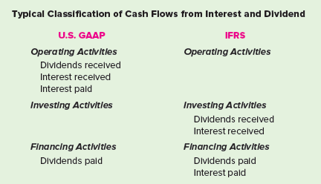
International Financial Reporting Standards
LO21-9
21-58
Notes:
Like U.S. GAAP, international standards also require a statement of cash flows. Consistent with U.S. GAAP, cash flows are classified as operating, investing, or financing. However, the U.S. standard designates cash outflows for interest payments and cash inflows from interest and dividends received as operating cash flows. Dividends paid to shareholders are classified as financing cash flows.
IAS No. 7, on the other hand, allows more flexibility. Companies can report interest and dividends paid as either operating or financing cash flows and interest and dividends received as either operating or investing cash flows. Interest and dividend payments usually are reported as financing activities. Interest and dividends received normally are classified as investing activities.

Slide 59
Concept Check: GAAP vs. IFRS
LO21-9
In regards to the typical classification of interest and dividends using U.S. GAAP and IFRS, which of the following statements is correct:
Under IFRS, interest received is an operating activity
Under U.S. GAAP, dividends received is an investing activity
Under IFRS, interest paid is a financing activity
Under U.S. GAAP, dividends paid is an operating activity
The correct answer is c.
While interest paid is classified as an operating activity under U.S. GAAP, it usually is considered a financing activity under IFRS.
21-59
Notes:
The correct answer is c.
While interest paid is classified as an operating activity under U.S. GAAP, it usually is considered a financing activity under IFRS.

Slide 60
Statement of Cash Flows—CVS Health Corp.
LO21-8
21-60
Notes:
Illustration 21–10 Statement of Cash Flows—CVS Health Corp.
The statements of cash flows from an annual report of CVS Health Corp. are shown in the illustration.

Slide 61
Statement of Cash Flows—CVS Health Corp. (continued)
LO21-8
21-61
Notes:
Illustration 21–10 Statement of Cash Flows—CVS Health Corp. (continued)

Slide 62
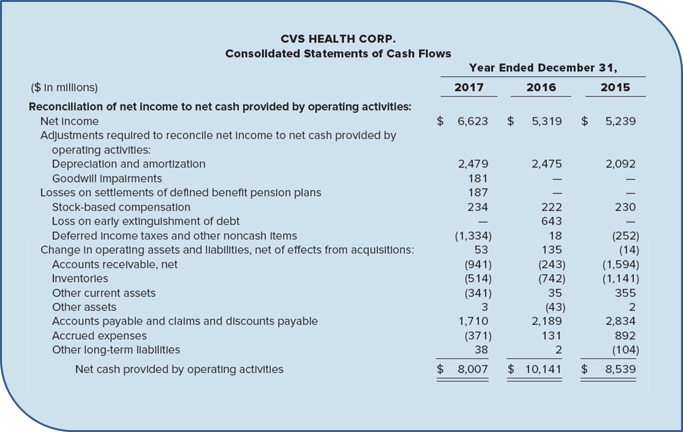
Statement of Cash Flows—CVS Health Corp. (concluded)
LO21-8
21-62
Notes:
Illustration 21–10 Statement of Cash Flows—CVS Health Corp. (concluded)
Notice that the reconciliation schedule was reported by CVS in the statement of cash flows itself. Many companies report the schedule separately in the disclosure notes.

Slide 63
Indirect Method of Reporting Cash Flows from Operating Activities
LO21-8
Net cash increase or decrease from operating activities is derived indirectly by
Starting with reported net income and
Working backwards to convert that amount to a cash basis
In the direct method we directly list the components of net income that do affect cash, after converting from accrual to cash
In the indirect method we adjust net income that don’t affect cash
21-63
Notes:
The presentation of cash flows from operating activities illustrated in Part B is referred to as the direct method. By this method, the cash effect of each operating activity (i.e., income statement item) is reported directly on the statement of cash flows. For instance, cash received from customers is reported as the cash effect of sales activities, and cash paid to suppliers is reported as the cash effect of cost of goods sold. Income statement items that have no cash effect, such as depreciation expense, gains, and losses, are simply not reported.
As we discussed previously, a permissible alternative is the indirect method, by which the net cash increase or decrease from operating activities is derived indirectly by starting with reported net income and working backwards to convert that amount to a cash basis. It simply reverses the differences between the accrual-based income statement and cash flows from operating activities.

Slide 64
Indirect Method Illustrated
LO21-8
Cash Flows from Operating Activities—Indirect Method
and
Reconciliation of Net Income to
Net Cash Flows from Operating Activities
Net Income
$12
Adjustments for noncash effects:
Gain on sale of land
(8)
Depreciation expense
3
Loss on sale of equipment
2
Changes in operating assets and liabilities:
Increase in accounts receivable
(2)
Decrease in inventory
4
Decrease in prepaid insurance
3
Increase in accounts payable
6
Increase in salaries payable
2
Decrease in income tax payable
(2)
Decrease in discount on bonds payable
2
Net cash flows from operating activities
$22
Notes:
Illustration 21–9B Indirect Method
The derivation by the indirect method of net cash flows from operating activities for UBC is shown in the illustration. For the adjustment amounts, we refer back to UBC’s balance sheets and income statement presented in Illustration 21–9.
Notice that the indirect method yields the same $22 million net cash flows from operating activities as does the direct method. This is understandable when you consider that the indirect method simply reverses the differences between the accrual-based income statement and cash flows from operating activities. We accomplish this as described in the next two sections.

Slide 65
Components of Net Income That Do Not Increase or Decrease Cash
LO21-8
Amounts that are
subtracted
added
in determining net income
are added
are subtracted
to reverse the effect of their having been:
21-65
Notes:
Amounts that were subtracted in determining net income but did not reduce cash are added back to net income to reverse the effect of their having been subtracted. For example, depreciation expense and the loss on sale of equipment are added back to net income. Other things being equal, this restores net income to what it would have been had depreciation and the loss not been subtracted at all.
Similarly, amounts that were added in determining net income but did not increase cash are subtracted from net income to reverse the effect of their having been added. For example, UBC’s gain on sale of land is deducted from net income. Here’s why. UBC sold for $18 million land that originally cost $10 million. Recording the sale produced a gain of $8 million, which UBC appropriately included in its income statement. But did this gain increase UBC’s cash? No. Certainly selling the land increased cash—by $18 million. We therefore include the $18 million as a cash inflow in the statement of cash flows. However, the sale of land is an investing activity. The gain itself, though, is simply the difference between cash received in the sale of land (reported as an investing activity) and the original cost of the land. If UBC also reported the $8 million gain as a cash flow from operating activities, in addition to reporting $18 million as a cash flow from investing activities, UBC would report the $8 million twice. So, because UBC added the gain in determining its net income but the gain had no effect on cash, the gain must now be subtracted from net income to reverse the effect of its having been added.

Slide 66
Components of Net Income That Do Increase or Decrease Cash
LO21-8
Components of net income that increase or decrease cash, but by an amount different from that reported in the income statement
Net income is adjusted for changes in the balances of related balance sheet accounts to convert their effects to a cash basis
Example: Sales of $100 million are included in the income statement as a component of net income, and yet, since accounts receivable increased by $2 million, only $98 million cash was collected from customers during the reporting period. Sales are converted to a cash basis by subtracting the $2 million increase in accounts receivable.
21-66
Notes:
For components of net income that increase or decrease cash, but by an amount different from that reported in the income statement, net income is adjusted for changes in the balances of related balance sheet accounts to convert the effects of those items to a cash basis.
For example, sales of $100 million are included in the income statement as a component of net income, and yet, since accounts receivable increased by $2 million, only $98 million cash was collected from customers during the reporting period. Sales are converted to a cash basis by subtracting the $2 million increase in accounts receivable.
The income statement reports salaries expense as $13 million. Just because employees earned $13 million during the reporting period, though, doesn’t necessarily mean UBC paid those employees $13 million in cash during the same period. In fact, we see in the comparative balance sheets that salaries payable increased from $1 million to $3 million; UBC owes its employees $2 million more than before the year started. The company must not have paid the entire $13 million expense. By analyzing salaries expense in relation to the change in salaries payable, we can determine the amount of cash paid to employees:
This inspection indicates that UBC paid only $11 million cash to its employees; the remaining $2 million of salaries expense is reflected as an increase in salaries payable. From a cash perspective, then, by subtracting $13 million for salaries in the income statement, UBC has subtracted $2 million more than the reduction in cash. Adding back the $2 million leaves UBC in the same position as if it had deducted only the $11 million cash paid to employees. Following a similar analysis of the cash effects of the remaining components of net income, those items are likewise converted to a cash basis by adjusting net income for increases and decreases in related accounts.
For components of net income that increase or decrease cash by an amount exactly the same as that reported in the income statement, no adjustment of net income is required. For example, investment revenue of $3 million is included in UBC’s $12 million net income amount. Because $3 million also is the amount of cash received from that activity, this element of net income already represents its cash effect and needs no adjustment.

Slide 67
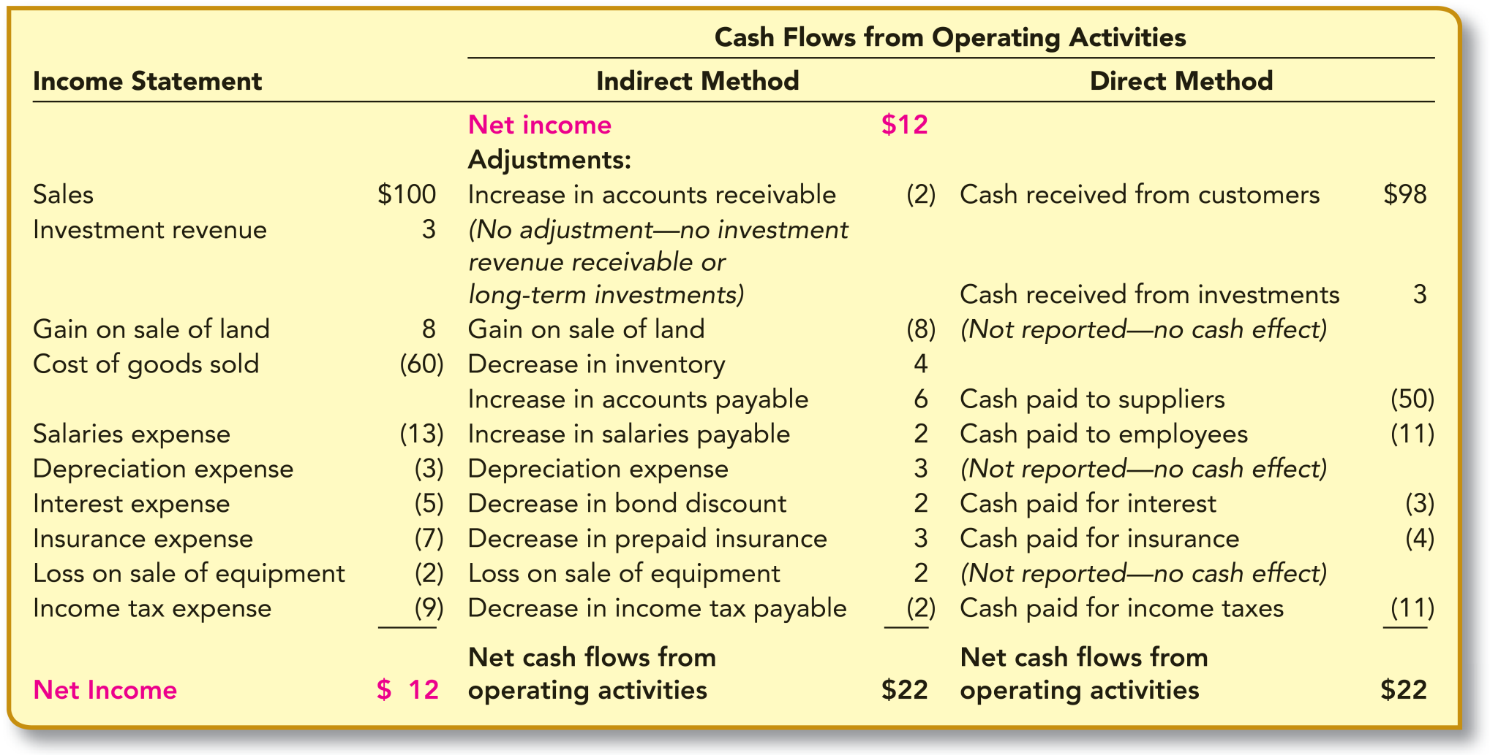
Comparison of the Indirect Method and the Direct Method of Determining Cash Flows from Operating Activities
LO21-8
21-67
Notes:
Illustration 21–11 Comparison of the Indirect Method and the Direct Method of Determining Cash Flows from Operating Activities
The indirect method is compared with the direct method in the illustration, using the data of UBC. To better illustrate the relationship between the two methods, the adjustments to net income using the indirect method are presented parallel to the related cash inflows and cash outflows of the direct method. The income statement is included in the graphic to demonstrate that the indirect method also serves to reconcile differences between the elements of that statement and the cash flows reported by the direct method.
As a practical consideration, you might notice that the adjustments to net income using the indirect method follow a convenient pattern. Increases in related assets are deducted from net income (i.e., the increase in accounts receivable) when converting to cash from operating activities. Conversely, decreases in assets are added (inventory and prepaid insurance in this case). Changes in related liabilities are handled in just the opposite way. Increases in related liabilities are added to net income (i.e., the increases in accounts payable and salaries payable) while decreases in liabilities are subtracted (i.e., decrease in income tax payable).
Of course, these are adjustments to net income that effectively convert components of income from reported accrual amounts to a cash basis.

Slide 68
Adjustments to Convert Net Income to a Cash Basis—Indirect Method
LO21-8
21-68
Notes:
Illustration 21–12 Adjustments to Convert Net Income to a Cash Basis—Indirect Method
The other adjustments to net income (gain, depreciation, loss) as pointed out earlier are to remove the three income statement components that have no effect at all on cash. This pattern is summarized in the illustration.

Slide 69
Concept Check: Adjustments to Net Income
LO21-8
In determining cash flows from operating activities (indirect method), adjustments to net income should not include:
An addition for depreciation expense
A deduction for bond discount amortization
An addition for a loss on sale of equipment
An addition for patent amortization
The correct answer is b.
The amortization amount would be added to net income.
21-69
Notes:
The correct answer is b.
The amortization amount would be added to net income.

Slide 70
Advantages of Direct Method
LO21-8
The FASB strongly encourages companies to report cash flows from operating activities by the direct method:
Investors and creditors gain additional insight into the specific sources of cash receipts and payments
Statement users can more readily interpret and understand the information presented
Nonetheless, the vast majority of companies
choose to use the indirect method
Reasons: Range from longstanding tradition to the desire to withhold information from competitors
21-70
Notes:
Although either the direct method or the indirect method is permitted, the FASB strongly encourages companies to report cash flows from operating activities by the direct method. The obvious appeal of this approach is that it reports specific operating cash receipts and operating cash payments, which is consistent with the primary objective of the statement of cash flows. Investors and creditors gain additional insight into the specific sources of cash receipts and payments from operating activities revealed by this reporting method. Also, statement users can more readily interpret and understand the information presented because the direct method avoids the confusion caused by reporting noncash items and other reconciling adjustments under the caption cash flows from operating activities. Nonetheless, the vast majority of companies choose to use the indirect method. Reasons for this choice range from longstanding tradition to the desire to withhold as much information as possible from competitors.

Slide 71
Reconciliation of Net Income to Cash Flows from Operating Activities
LO21-8
Choice of method used to derive net cash flows from operating activities does not affect the way cash flows from investing and financing activities are identified and reported
Reconciliation is presented in a separate schedule
Direct method
Identical to the presentation of net cash
flows from operating activities by the indirect method
Separate reconciliation schedule is not required
Indirect method
21-71
Notes:
As we discussed earlier, whether cash flows from operating activities are reported by the direct method or by the indirect method, the financial statements must report a reconciliation of net income to net cash flows from operating activities. When the direct method is used, the reconciliation is presented in a separate schedule and is identical to the presentation of net cash flows from operating activities by the indirect method. In other words, the previous illustration also serves as the reconciliation schedule to accompany a statement of cash flows using the direct method. Obviously, a separate reconciliation schedule is not required when using the indirect method because the cash flows from operating activities section of the statement of cash flows is a reconciliation of net income to net cash flows from operating activities.
Remember that the direct and indirect methods are alternative approaches to deriving net cash flows from operating activities only. The choice of which method is used for that purpose does not affect the way cash flows from investing and financing activities are identified and reported.

Slide 72
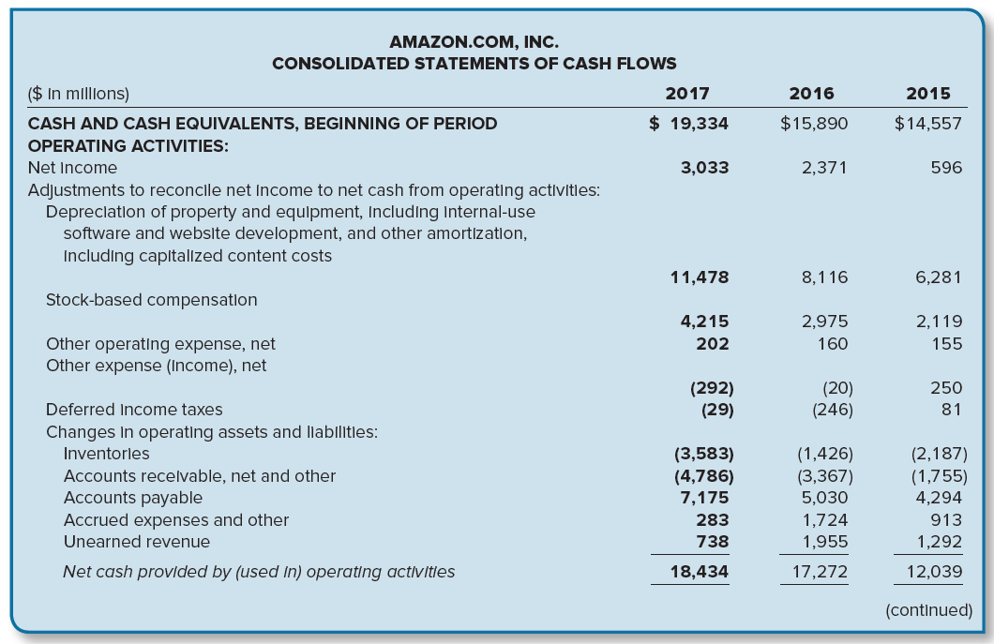
Statement of Cash Flows—Indirect Method; Amazon.com, Inc.
LO21-8
21-72
Notes:
Illustration 21–13 Statement of Cash Flows—Indirect Method; Amazon.com, Inc.
The statements of cash flows from the annual report of Amazon.com, Inc., which uses the indirect method, are shown in the illustration.

Slide 73
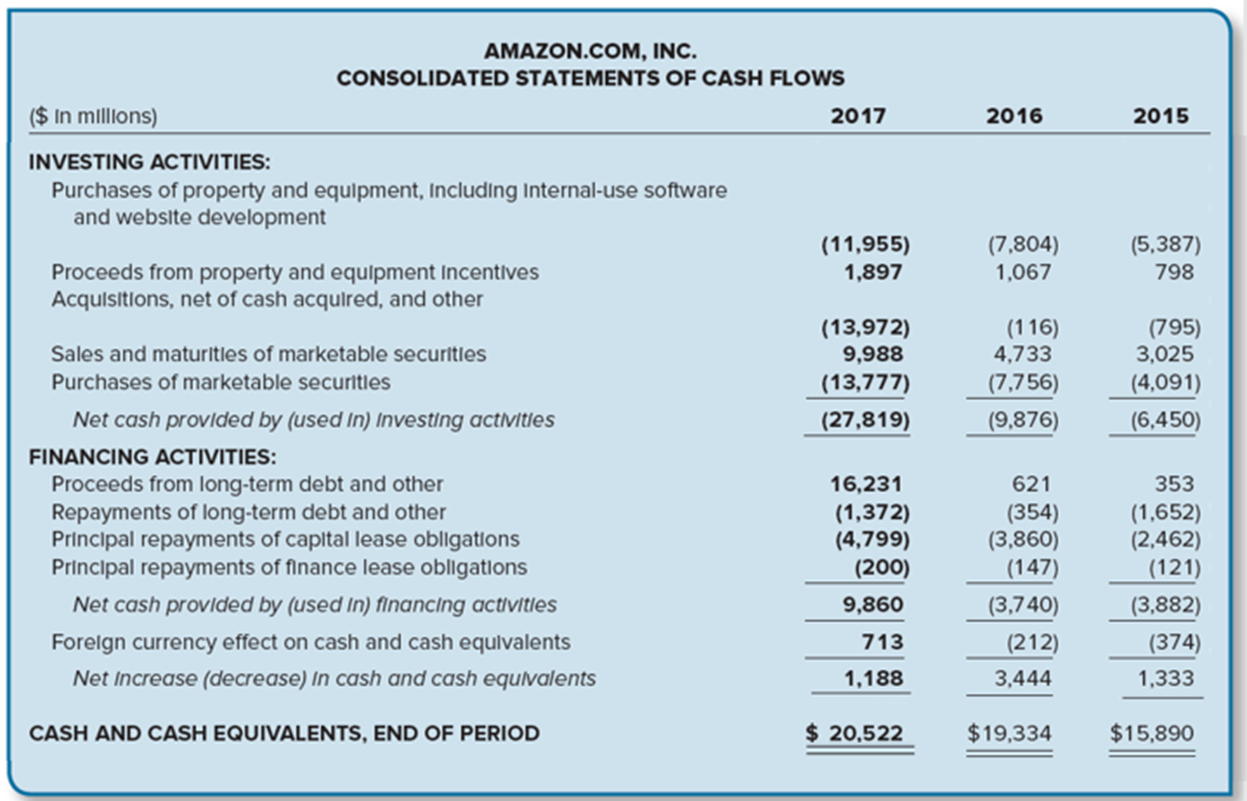
Statement of Cash Flows—Indirect Method; Amazon.com, Inc. (continued)
LO21-8
Notes:
Illustration 21–13 Statement of Cash Flows—Indirect Method; Amazon.com, Inc. (continued)

Slide 74
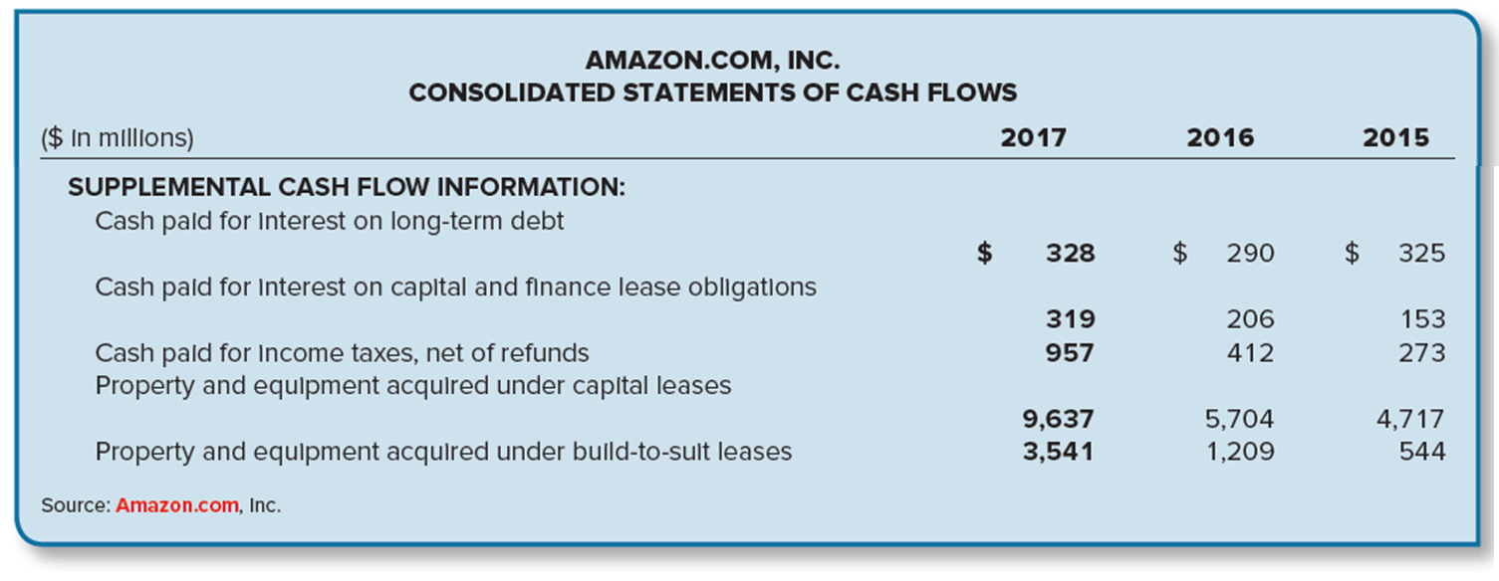
Statement of Cash Flows—Indirect Method; Amazon.com, Inc. (concluded)
LO21-8
21-74
Notes:
Illustration 21–13 Statement of Cash Flows—Indirect Method; Amazon.com, Inc. (concluded)
For most companies, expenditures for interest and for taxes are significant. Cash payments for interest and for taxes usually are specifically indicated when the direct method is employed, as is the case for CVS Health Corp. reported earlier in Illustration 21–10. When the indirect method is used, those amounts aren’t readily apparent and must be separately reported, either on the face of the statement as Amazon.com does or in an accompanying disclosure note.

Slide 75
Concept Check: Cash Flows from Operating Activities
LO21-8
The net income for Ditcher, Quick, and Hyde, Divorce Attorneys, was $140 million for the year ended December 31, 2021. Related information follows:
Amortization of patent, $1 million
Cash dividends paid, $14 million
Decrease in accounts receivable, $9 million
Decrease in salaries payable, $1 million
Depreciation expense, $20 million
Increase in L-T notes payable, $13 million
Sale of preferred stock for cash, $17 million
Cash flows from operating activities during 2021 should be reported as:
$151 million
$169 million
$171 million
$182 million
Cash dividends paid, issuance of L-T notes payable, and sale of preferred stock are financing activities.
The correct answer is b:
Net income $140
Amortization of patent 1
Depreciation expense 20
Decrease in accounts receivable 9
Decrease in salaries payable (1)
Cash flows from operating activities $169
21-75
Notes:
The correct answer is b:
Net income $140
Amortization of patent 1
Depreciation expense 20
Decrease in accounts receivable 9
Decrease in salaries payable (1)
Cash flows from operating activities $169
Cash dividends paid, issuance of L-T notes payable, and sale of preferred stock are financing activities.

Slide 76
Decision Makers’ Perspective—Cash Flow Ratios
LO21-8
Cash flow ratios are derived by simply substituting cash flow from operations (CFFO) from the statement of cash flows in place of net income in many ratios
Example:
The times interest earned ratio can be modified to reflect the number of times the cash outflow for interest is provided by cash inflow from operations and any of the profitability ratios can be modified to determine the cash generated from assets, shareholders’ equity, sales, etc.
21-76
Notes:
We have emphasized the analysis of financial statements from a decision maker’s perspective throughout this text. Often that analysis included the development and comparison of financial ratios. Ratios based on income statement and balance sheet amounts enjoy a long tradition of acceptance from which several standard ratios, including those described in earlier chapters, have evolved. To gain another viewpoint, some analysts supplement their investigation with cash flow ratios. Some cash flow ratios are derived by simply substituting cash flow from operations (CFFO) from the statement of cash flows in place of net income in many ratios, not to replace those ratios but to complement them.
For example, the times interest earned ratio can be modified to reflect the number of times the cash outflow for interest is provided by cash inflow from operations and any of the profitability ratios can be modified to determine the cash generated from assets, shareholders’ equity, sales, etc.

Slide 77
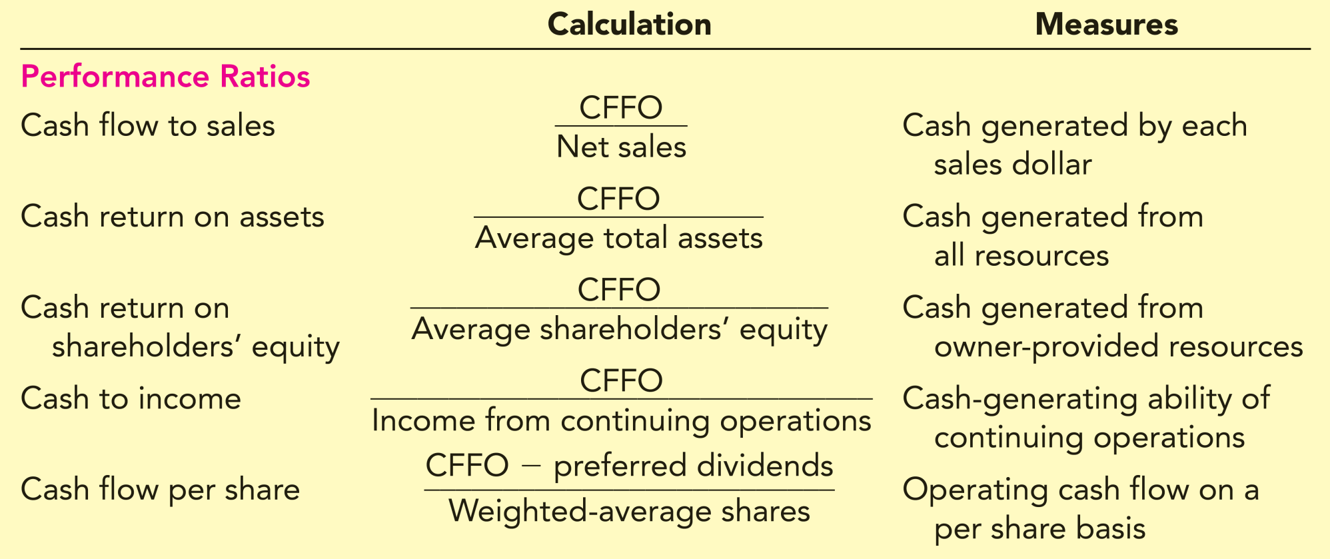
Cash Flow Ratios
LO21-8
21-77
Notes:
Illustration 21–14 Cash Flow Ratios
The illustration summarizes the calculation and usefulness of several representative cash flow ratios classified as performance ratios.
Cash flow ratios have received limited acceptance to date, due in large part to the long tradition of accrual-based ratios coupled with the relatively brief time that all companies have published statements of cash flows. A lack of consensus on cash flow ratios by which to make comparisons also has slowed their acceptance. In fact, companies are prohibited from reporting cash flow per share in the statement of cash flows. Nevertheless, cash flow ratios offer insight in the evaluation of a company’s profitability and financial strength.

Slide 78
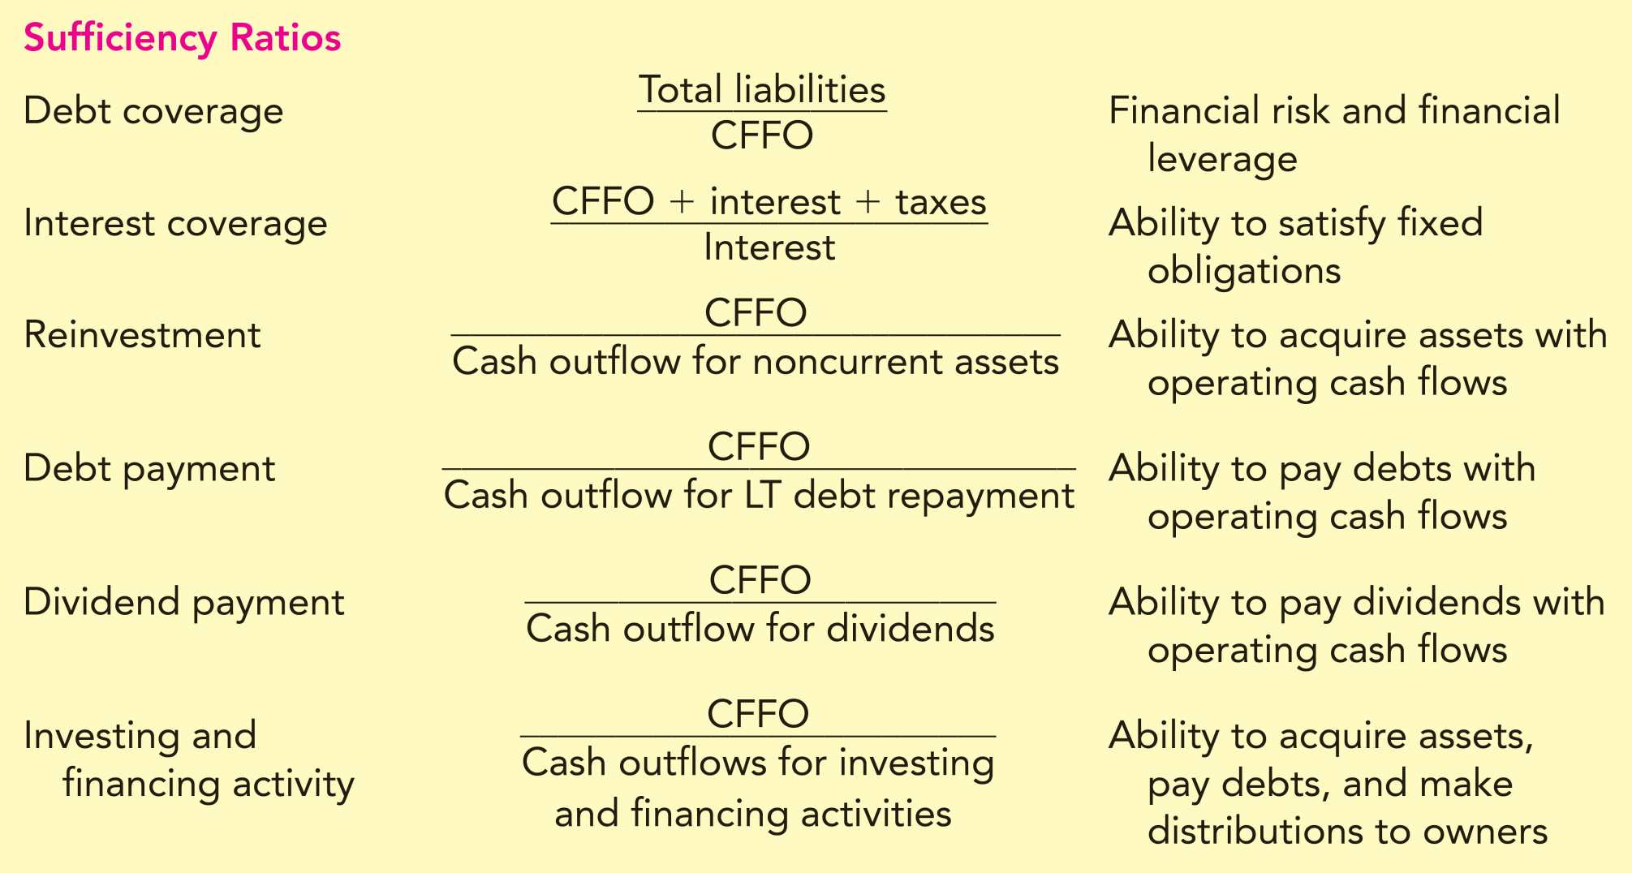
Cash Flow Ratios (continued)
LO21-8
21-78
Notes:
Illustration 21–14 Cash Flow Ratios (continued)
The illustration summarizes the calculation and usefulness of several representative cash flow ratios classified as sufficiency ratios.

Slide 79
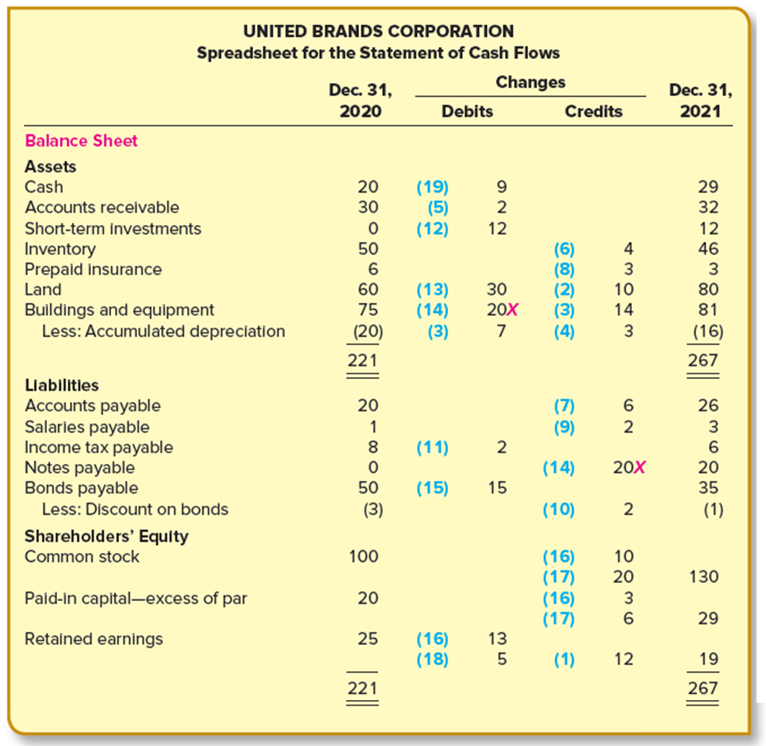
Indirect Method
APPENDIX 21A
21-79
Notes:
Illustration 21A–1 Indirect Method
A spreadsheet is equally useful in preparing a statement of cash flows whether we use the direct or the indirect method of determining cash flows from operating activities. The format of the spreadsheet differs only with respect to operating activities. The analysis of transactions for the purpose of identifying cash flows to be reported is the same. The illustration provides a spreadsheet analysis of the data for UBC.
Two differences should be noted between the spreadsheet and the spreadsheet we used earlier for the direct method. First, in the statement of cash flows section of the spreadsheet, under the heading of “cash flows from operating activities,” specific cash inflows and cash outflows are replaced by net income and the required adjustments for noncash effects. Second, we do not include an income statement section. This section is unnecessary because, using the indirect method, we are not interested in identifying specific operating activities that cause increases and decreases in cash. Instead, we need from the income statement only the amount of net income, which is converted to a cash basis by adjusting for any noncash amounts included in net income.

Slide 80
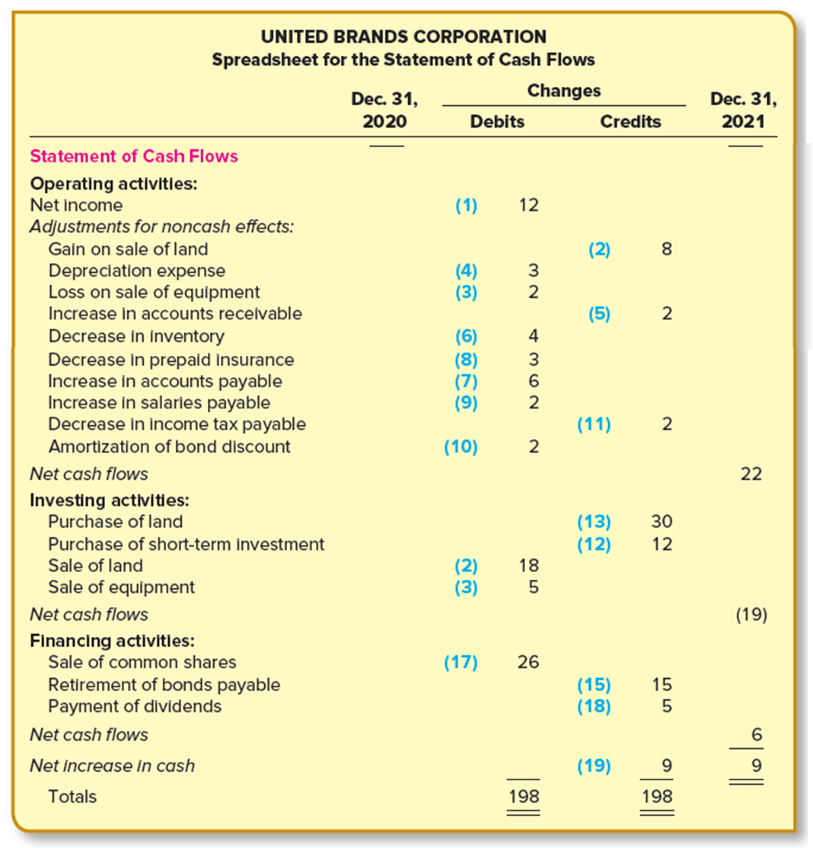
Indirect Method (continued)
APPENDIX 21A
21-80
Notes:
Illustration 21A–1 Indirect Method (continued)

Slide 81
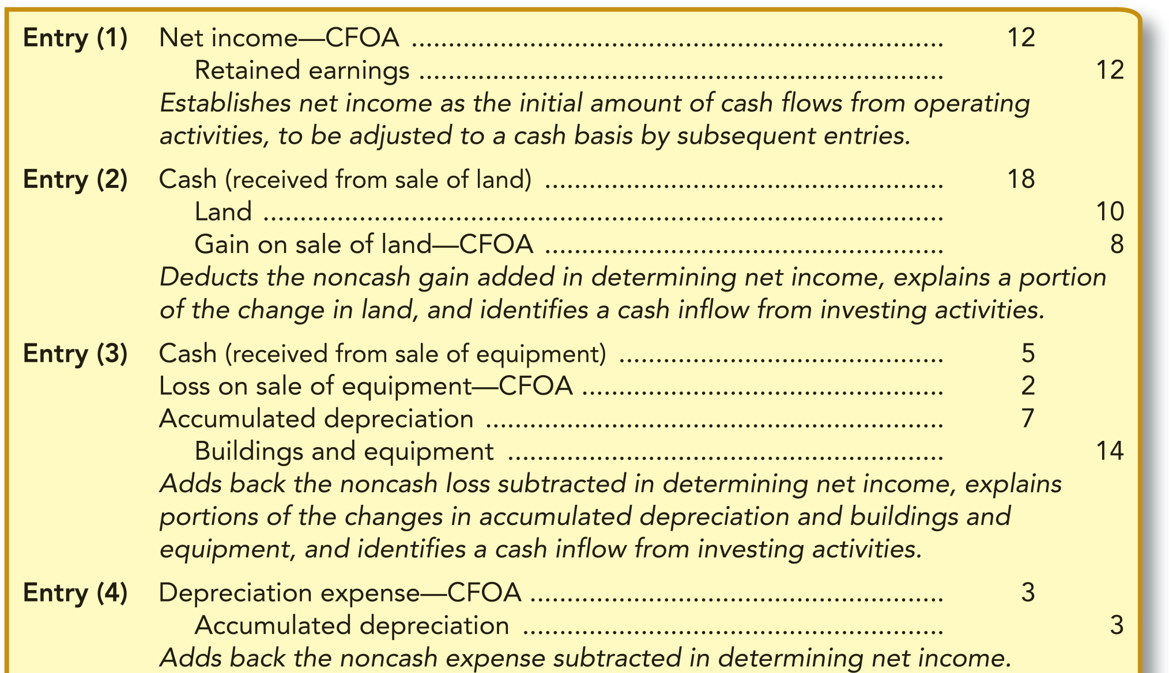
Spreadsheet Entries for the Indirect Method
APPENDIX 21A
21-81
Notes:
Illustration 21A–2 Spreadsheet Entries for the Indirect Method
The spreadsheet entries in journal entry form for the indirect method are illustrated here.
Remember that there is no mandatory order in which the account changes must be analyzed. However, since we determine net cash flows from operating activities by working backwards from net income when using the indirect method, it is convenient to start with the spreadsheet entry that represents the credit to retained earnings due to net income. This entry corresponds to summary entry (11) using the direct method. By entering the debit portion of the entry as the first item under the cash flows from operating activities (CFOA), we establish net income as the initial amount of cash flows from operating activities, which is then adjusted to a cash basis by subsequent entries. Entries (2)–(4) duplicate the transactions that involve noncash components of net income.

Slide 82
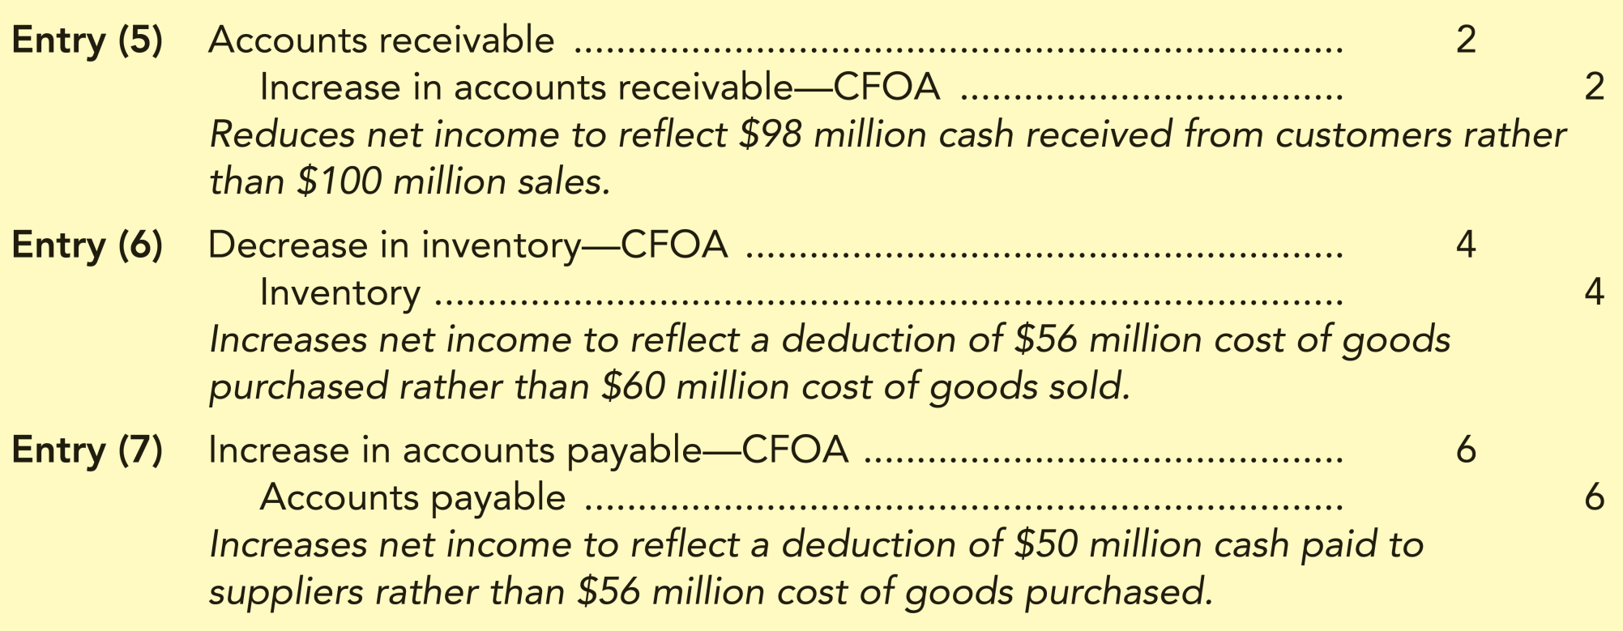
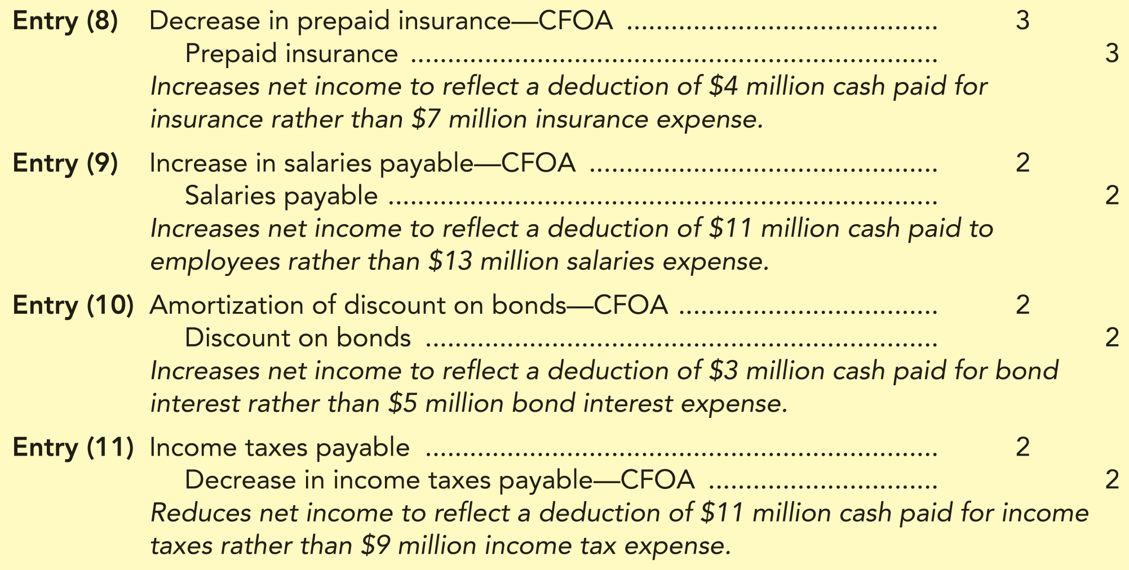
Spreadsheet Entries for the Indirect Method (continued)
APPENDIX 21A
21-82
Notes:
Illustration 21A–2 Spreadsheet Entries for the Indirect Method (continued)
Changes in current assets and current liabilities that represent differences between revenues and expenses and the cash effects of those revenues and expenses are accounted for by entries (5)–(11).

Slide 83
Spreadsheet Entries for the Indirect Method (continued 2)
APPENDIX 21A
21-83
Notes:
Illustration 21A–2 Spreadsheet Entries for the Indirect Method (continued)
Summary entries (12)–(19) explain the changes in the balance sheet not already accounted for by previous entries, and are identical to entries (12)–(19) recorded using the direct method.

Slide 84
Spreadsheet Entries for the Indirect Method (concluded)
APPENDIX 21A
21-84
Notes:
Illustration 21A–2 Spreadsheet Entries for the Indirect Method (concluded)

Slide 85
Statement of Cash Flows—Indirect Method
APPENDIX 21A
21-85
Notes:
Illustration 21A–3 Statement of Cash flows— Indirect Method
The statement of cash flows presenting net cash flows from operating activities by the indirect method is illustrated.

Slide 86
Statement of Cash flows—Indirect Method (continued)
APPENDIX 21A
21-86
Notes:
Illustration 21A–3 Statement of Cash flows— Indirect Method (continued)
All parts of the statement of cash flows except operating activities are precisely the same as in the direct method.

Slide 87
T-Account Method of Preparing the Statement of Cash Flows
APPENDIX 21B
T-account method serves the same purpose as a spreadsheet in assisting in the preparation of a statement of cash flows
Differs only by whether the entries for those transactions are recorded on a spreadsheet or in T-accounts
Less time-consuming than preparing a spreadsheet
21-87
Notes:
This chapter has demonstrated the use of a spreadsheet to prepare the statement of cash flows. A second systematic approach to the preparation of the statement is referred to as the T-account method. The two methods are identical in concept. Both approaches reconstruct the transactions that caused changes in each account balance during the year, simultaneously identifying the operating, investing, and financing activities to be reported on the statement of cash flows. The form of the two methods differs only by whether the entries for those transactions are recorded on a spreadsheet or in T-accounts. In both cases, entries are recorded until the net change in each account balance has been explained.
Some accountants feel that the T-account method is less time-consuming than preparing a spreadsheet but accomplishes precisely the same goal.

Slide 88
T-Account Method of Preparing the Statement of Cash Flows (continued)
APPENDIX 21B
Five steps outline the T-account method:
Step 1
Draw T-accounts for each income statement and balance sheet account
T-account for cash should be drawn considerably larger to accommodate the numerous debits and credits and provide headings for operating, investing, and financing activities
Step 2
Enter each account’s net change on the appropriate side (debit or credit) of the uppermost portion of each T-account
Step 3
Reconstruct the transactions that caused changes in each account balance during the year
Record the entries for those transactions directly in the T-accounts
Step 4
Prepare the statement of cash flows from the cash T-account, being careful also to report noncash investing and financing activities
Step 5
21-88
Notes:
Since both methods are simply analytical techniques to assist in statement preparation, the choice is a matter of personal preference. The following five steps outline the T-account method:
Draw T-accounts for each income statement and balance sheet account.
The T-account for cash should be drawn considerably larger than other T-accounts because more space is required to accommodate the numerous debits and credits to cash. Also, the cash T-account will serve the same purpose as the statement of cash flows section of the spreadsheet in that the formal statement of cash flows is developed from the cash flows reported there. Therefore, it is convenient to partition the cash T-account with headings for “Operating Activities,” “Investing Activities,” and “Financing Activities” before entries are recorded.
Enter each account’s net change on the appropriate side (debit or credit) of the uppermost portion of each T-account. These changes will serve as individual check figures for determining whether the increase or decrease in each account balance has been explained. These first three steps establish the basic work form for the T-account method.
Reconstruct the transactions that caused changes in each account balance during the year and record the entries for those transactions directly in the T-accounts. Again using UBC as an example, the entries we record in the T-accounts are exactly the same as the spreadsheet entries we created in the chapter when using the spreadsheet method. The analysis we used in creating those spreadsheet entries is equally applicable to the T-account method. For that reason, that analysis is not repeated here. The complete T-account work form for UBC is presented below. Account balance changes are provided from balances given in Illustration 21–9.
After all account balances have been explained by T-account entries, prepare the statement of cash flows from the cash T-account, being careful also to report noncash investing and financing activities.

Slide 89
T-Account Method of Preparing the Statement of Cash Flows (continued 2)
APPENDIX 21B
21-89
Notes:
T-Account Method of Preparing the Statement of Cash Flows (Continued)
This slide shows the T-Account Method for the accounts of cash, accounts receivable, and short-term investments.

Slide 90
T-Account Method of Preparing the Statement of Cash Flows (continued 3)
APPENDIX 21B
X Noncash Investing and Financing Activity
21-90
Notes:
T-Account Method of Preparing the Statement of Cash Flows (Continued)
This slide shows the T-Account Method for the accounts of inventory, prepaid insurance, land, buildings and equipment, accumulated depreciation, and accounts payable.

Slide 91
T-Account Method of Preparing the Statement of Cash Flows (continued 4)
APPENDIX 21B
X Noncash Investing and Financing Activity
21-91
Notes:
T-Account Method of Preparing the Statement of Cash Flows (Continued)
This slide shows the T-Account Method for the accounts of salaries payable, income tax payable, notes payable, bonds payable, discount on bonds, and common stock.

Slide 92
T-Account Method of Preparing the Statement of Cash Flows (continued 5)
APPENDIX 21B
21-92
Notes:
T-Account Method of Preparing the Statement of Cash Flows (Continued)
This slide shows the T-Account Method for the accounts of paid-in capital – excess of par and retained earnings.

Slide 93
T-Account Method of Preparing the Statement of Cash Flows (continued 6)
APPENDIX 21B
INCOME STATEMENT ACCOUNTS
21-93
Notes:
T-Account Method of Preparing the Statement of Cash Flows (Continued)
This slide shows the T-Account Method for the accounts of sales revenue, investment revenue, gain on sale of land, cost of goods sold, salaries expense, and depreciation expense.

Slide 94
T-Account Method of Preparing the Statement of Cash Flows (concluded)
APPENDIX 21B
21-94
Notes:
T-Account Method of Preparing the Statement of Cash Flows (Continued)
This slide shows the T-Account Method for the accounts of interest expense, insurance expense, loss on sale of equipment, income tax expense, and net income (income summary).

Slide 95
End of Chapter 21
21-95

