Slide 1
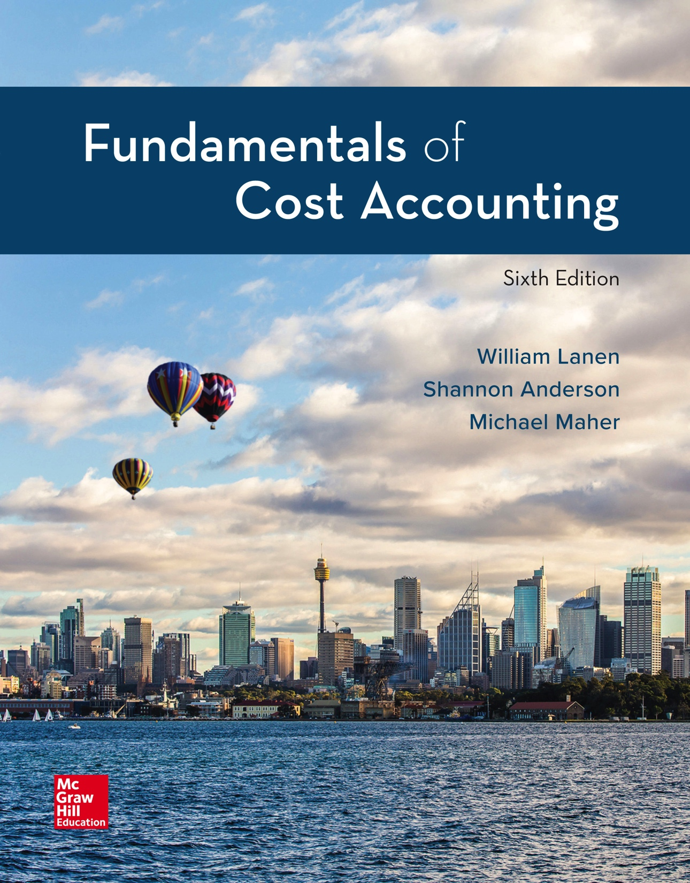
Copyright ©2020 McGraw-Hill Education. All rights reserved. No reproduction or distribution without the prior written consent of McGraw-Hill Education.
Notes:
Fundamentals of Cost Accounting, 6th edition
Lanen/Anderson/Maher

Slide 2
Process Costing
Chapter 8
Notes:
Chapter 8: Process Costing
We continue our discussion of the details of a product costing system in Chapter 8 by developing a process costing system. As we discussed in Chapter 6, the difference between job order and process costing is the level at which costs are aggregated before they are assigned to the individual units of product. Process costing assumes that all units are homogeneous and follow the same path through the production process.

Slide 3
Learning Objectives
LO 8-1 Explain the concept and purpose of equivalent units.
LO 8-2 Assign costs to products using a five-step process.
LO 8-3 Assign costs to products using weighted-average costing.
LO 8-4 Prepare and analyze a production cost report.
LO 8-5 Assign costs to products using first-in, first-out (FIFO) costing.
LO 8-6 Analyze the accounting choice between FIFO and
weighted-average costing.
LO 8-7 Know when to use process or job costing.
LO 8-8 Compare and contrast operations costing with job costing
and process costing.
Notes:
After studying this chapter you should be able to: 1. Explain the concept and purpose of equivalent units. 2. Assign cost to products using a five-step process. 3. Assign costs to products using weighted-average costing. 4. Prepare and analyze a production cost report. 5. Assign costs to products using first-in, first-out (FIFO) costing. 6. Analyze the accounting choice between FIFO and weighted-average costing. 7. Know when to use process or job costing. 8. Compare and contrast operations costing with job costing and process costing.

Slide 4
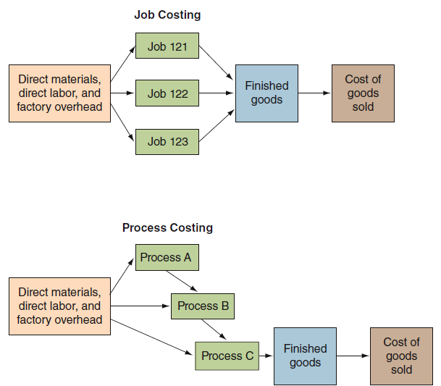
Comparison of Cost Flows
Notes:
Here is a graphical comparison of cost flows in a job costing and a process costing system. In a job costing system, each job is considered unique. Process costing assumes that all units are homogeneous and follow the same path to the production processes. In a job costing system, costs are traced to individual or specific jobs. In a process costing system, costs are traced to processes.

Slide 5
Determining Equivalent Units
LO 8-1
LO 8-1 Explain the concept and purpose of equivalent units.
Equivalent Units
Number of complete physical units to which units in
inventories are equal in terms of work done to date.
Notes:
When manufacturing a product using a continuous process we assume all units have the same costs. The problem: some units are not completed. The answer: equivalent units.

Slide 6
Determining Equivalent Units (2)
LO 8-1
At month end, three cans of paint are filled as indicated.
30%
75%
90%
(30% + 75% + 90%) ÷ 3 = 65%
Therefore, ending work-in-process inventory is 65 percent complete, on average.
Notes:
Recall from Chapter 6 that equivalent units is the number of units that could have been completed with the given costs. The number of units in process times the percentage of completion equals equivalent units. Two units half finished is equal to one equivalent unit.

Slide 7
Using Product Costing in a Process Industry
LO 8-2
LO 8-2 Assign costs to products using a five-step process.
Step 1: Measure the physical flow of resources.
Step 2: Compute the equivalent units of production.
Step 3: Identify the costs to assign to products.
Step 4: Compute the costs per equivalent unit.
Step 5: Assign product cost to batches of work.
Notes:
In chapter 6, we applied costs to products that had been transferred out of work-in-process and units that remained in work-in-process ending inventory. We will do the same thing in this chapter. The approach we follow is summarized in five steps: 1. Measure the physical flow of resources. 2. Compute the equivalent units of production. 3. Identify the costs to assign to products. 4. Compute the cost per equivalent unit. 5. Assign product cost to batches of work.

Slide 8
Using Product Costing in a Process Industry (2)
LO 8-2
Apple State Juices (ASJ), produces and bottles
various fruit juices.
Production at ASJ’s Exeter Plant takes place in three steps.
1.
Shredding
Department
2.
Pressing
Department
3.
Pasteurization
and Packaging
Department
Warehouse
Notes:
We will now look at Apple State Juices (ASJ), which produces and bottles various fruit juices.

Slide 9
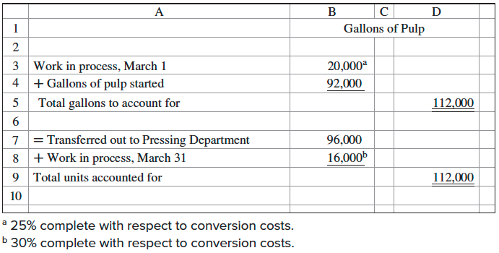
Measure the Physical Flow of Resources (Step 1)
LO 8-2
Shredding Department, March, Year 2
Notes:
Step 1: Measure the physical flow of resources. We have 112,000 total gallons to account for: 20,000 gallons that were in beginning inventory at March 1 and 92,000 gallons that were started during March. Where are the 112,000 gallons at March 31?

Slide 10
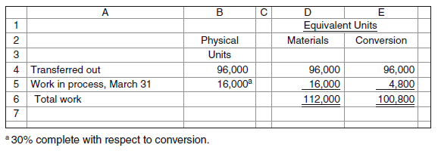
Compute the Equivalent Units of Production (Step 2)
LO 8-2
Shredding Department, March, Year 2: Equivalent Units
Notes:
At the end of March, 96,000 units were transferred out and 16,000 remain in ending inventory.

Slide 11
Identify the Costs to Assign to Products (Step 3)
Shredding Department, March, Year 2: Cost Information
Notes:
Here is the cost information for March for both work in process and current costs added in March.

Slide 12
Identify the Costs to Assign to Products (Step 3) (2)
LO 8-2
Costs:
Work-in-process costs
Current period costs
Work (EU)
Work-in-process EU*
Current period EU
Weighted
average:
Weighted-Average Unit Costs
Work-in-process costs + Current period costs
Work-in-process EU + Current period EU
FIFO:
Work-in Process Unit Costs
Current Period Unit Costs
Work-in-process costs
Work-in-process EU
Current period costs
Current period EU
*Note: EU is equivalent unit.
Notes:
There are two methods to identify the product costs for which to account for: weighted-average and FIFO.

Slide 13
Identify the Costs to Assign to Products (Steps 4 and 5)
LO 8-3
LO 8-3 Assign costs to products using weighted-average costing.
Compute the costs per equivalent unit:
Weighted-average (Step 4)
First, Steps 1, 2, and 3 must be revisited.
Notes:
Now we are going to assign costs to products using the weighted-average costing method. We need to go over steps 1, 2, and 3.

Slide 14
Measure the Physical Flow of Resources (Step 1) (2)
LO 8-3
Gallons of
Pulp
Work in process, March 1
+ Gallons of Pulp started
Total gallons to account for
=Transferred out to Pressing Department
+ Work-in-process, March 31
Total units accounted for
20,000ª
92,000
112,000
96,000
16,000^{b}
112,000
ª 25% complete with respect to conversion costs
^{b} 30% complete with respect to conversion costs
Notes:
Step 1: Measure the physical flow of resources. We have 112,000 total gallons to account for: 20,000 gallons that were in beginning inventory at March 1 and 92,000 gallons that were started during March. Where are the 112,000 gallons at March 31? 96,000 gallons have been transferred out and into the next processing department. 16,000 gallons are still in ending inventory.

Slide 15
Compute the Equivalent Units of Production (Step 2) (2)
LO 8-3
Shredding Department, March, Year 2: Equivalent Units
Physical
units
Equivalent units
Materials
Conversion
Transferred out
Work-in-process, March 31
Total work
96,000
16,000
96,000
16,000ª
112,000
96,000
4,800^{b}
100,800
ª 16,000 units × 100% (all materials added in beginning)
^{b} 16,000 units × 30%
Notes:
Step 2: Compute the equivalent units of production. 96,000 units were transferred out. Remember, when using weighted-average we do not care where those 96,000 units came from. Were they units started last month and in our beginning inventory balance at March 1 or were they units started during March? We don’t care. We will combine our units and our costs for a weighted average. We do know that if 96,000 units were transferred out they are 100% complete. If they were not complete they would still be in ending inventory. For the 16,000 units still in ending inventory, these units are 100% complete with respect to materials for equivalent units of materials of 16,000. They are also 30% complete with respect to conversion costs for equivalent units of 4,800 for conversion costs. Total equivalent units for materials are 112,000. Total equivalent units for conversion costs are 100,800.

Slide 16
Identify the Costs to Assign to Products (Step 3) (3)
LO 8-3
Total
costs
Materials
costs
Conversion
costs
Work in process, March 1
Current costs, March
Total
$ 24,286
298,274
$322,560
$ 16,160
84,640
$100,800
$ 8,126
213,634
$221,760
Notes:
Step 3: Identify costs for which to account. Total beginning inventory costs equaled $24,286 ($16,160 of materials and $8,126 of conversion costs). During March $84,640 of material costs and $213,634 conversion costs were incurred for total March costs added of $298,274. Total costs to account for are $322,560 ($100,800 of materials and $221,760 of conversion costs).

Slide 17
Compute the Cost per Equivalent Unit (Step 4)
LO 8-3
Notes:
Step 4: Compute the cost per equivalent unit. Total materials costs of $100,800 divided by 112,000 equivalent units of material gives a cost per equivalent unit for material of $0.90. Total conversion costs of $221,760 divided by 100,800 equivalent units gives a cost per equivalent unit for conversion costs of $2.20.

Slide 18
Assign Product Costs to Batches of Work (Step 5)
LO 8-3
Total
Materials
costs
Conversion
costs
Transferred out:
Equivalent units
Cost per equivalent unit
Cost assigned
Work-in-process, March 31
Equivalent units
Cost per equivalent unit
Cost assigned
Total cost assigned
$297,600
24,960
$322,560
96,000
$ 0.90
$ 86,400
16,000
$ 0.90
14,400
$100,800
96,000
$ 2.20
$211,200
4,800
$ 2.20
10,560
$221,760
Notes:
Step 5: Assign product cost to batches of work. There were 96,000 units transferred out times $0.90 per equivalent unit for materials, gives material cost transferred out of $86,400. These 96,000 units transferred out times $2.20 per equivalent unit gives $211,200 conversion cost transferred out. There are 16,000 equivalent units for materials times $0.90 per unit gives $14,400 materials cost in ending work-in-process inventory. And there are 4,800 equivalent units for conversion cost times $2.20 per unit gives $10,560 conversion cost in ending work-in-process inventory. So where are the $322,560 of costs to account for at March 31? $297,600 are assigned to units transferred out of the shredding department and $24,960 are assigned to the units in ending inventory. Total costs accounted for are $322,560.

Slide 19
The Production Cost Report
LO 8-4
LO 8-4 Prepare and analyze a production cost report.
The production cost report summarizes the
production and cost results for a period.
It is used by managers to monitor production
and cost flows.
Following is ASJ’s Shredding Department
production cost report (weighted-average
processing costing) for March.
Notes:
The production cost report summarizes production and costs for a period and is used by managers to monitor production and cost flows.

Slide 20
Production Cost Report: Weighted-Average Process Costing
LO 8-4
Flow of units
Physical
units
Equivalent units
Materials
Conversion
Units to be accounted for:
In work-in-process beginning inventory
Units started this period
Total units to account for
20,000ª
92,000
112,000
Units accounted for:
Completed and transferred out
In work-in-process ending inventory
Total units accounted for
96,000
16,000
112,000
96,000
16,000ª
112,000
96,000
4,800^{b}
100,800
ª 100 % complete with respect to materials ^{b} 30% complete with respect to conversion
Notes:
Here is the production cost report for the Shredding Department for the month ending March 31. Does this look familiar?
It should. The production cost report is the five-step process that we just used to account for costs. The first part of the production cost report shows units to be accounted for and units accounted for.

Slide 21
Production Cost Report: Weighted-Average Process Costing (2)
LO 8-4
Flow of costs
Total
Materials
Costs
Conversion
Costs
Costs to be accounted for:
Work-in-process beginning inventory
Current period costs
Total costs to be accounted for
$ 24,286
298,274
$322,560
$ 16,160
84,640
$100,800
$ 8,126
213,634
$221,760
Cost per equivalent unit
$ 0.90^{c}
$ 2.20^{d}
Costs accounted for:
Costs assigned to transferred-out units
Costs assigned to WIP ending inventory
Total costs accounted for
$297,600
24,960
$322,560
$ 86,400e
14,400^{g}
$100,800
$211,200^{f}
10,560^{h}
$221,760
^{c} $100,000 ÷ 112,000 EU ^{d} $221,760 ÷ 100,800 EU ^{e} 96,000 EU × $0.90 per EU
^{f} 96,000 EU × $2.20 per EU ^{g} 16,000 EU × $0.90 per EU ^{h} 4,800 EU × $2.20 per EU
Notes:
The second part shows costs to be accounted for and costs accounted for. We just did all these calculations. The production cost report is the five-step process in report format.

Slide 22
Assigning Costs Using FIFO
LO 8-5
LO 8-5 Assign costs to products using first-in, first-out (FIFO) costing.
Use the same five-step process.
Step 1: Measure the physical flow of resources.
Step 2: Compute the equivalent units of production.
Step 3: Identify the costs to assign to products.
Step 4: Compute the costs per equivalent unit.
Step 5: Assign product cost to batches of work.
Notes:
It should come as no surprise that assigning costs using FIFO will follow the same five-step process. 1. Measure the physical flow of resources. 2. Compute the equivalent units of production. 3. Identify the costs to assign to products. 4. Compute the cost per equivalent unit. And, finally, 5. assign product cost to batches of work. Remember the difference between weighted-average and FIFO is that using FIFO we separate what was done last period from what was done this period.

Slide 23
Measure the Physical Flow of Resources (Step 1) (3)
LO 8-5
Exactly the same as weighted-average.
Gallons of
Pulp
Work in process, March 1
+ Gallons of pulp started
Total gallons to account for
=Transferred out to Pressing Department
+ Work-in-process, March 31
Total units accounted for
20,000ª
92,000
112,000
96,000
16,000^{b}
112,000
ª 25% complete with respect to conversion costs
^{b} 30% complete with respect to conversion costs
Notes:
Step 1, measuring the physical flow of resources is exactly the same as weighted-average. We have 112,000 units to account for: 20,000 units were in beginning inventory and those units were 100% complete with respect materials and 25% complete respect to conversion costs at the beginning of the period. Another 92,000 units were started this month. Of those 112,000 units, 96,000 were transferred out during the month and 16,000 units were in ending inventory (100% complete for materials and 30% complete for conversion costs).

Slide 24
Compute the Equivalent Units of Production (Step 2) (3)
LO 8-5
Physical
units
Equivalent units
Materials
Conversion
From beginning work in process
Started and completed
Total completed and transferred out
In work-in-process inventory
Total units accounted for
Less work from beginning WIP
New work done in March
20,000
76,000
96,000
16,000
112,000
20,000
92,000
20,000
76,000
96,000
16,000
112,000
20,000
92,000
20,000
76,000
96,000
4,800^{b}
100,800
5,000^{c}
95,800
ª 100% complete with respect to materials
^{b} 30% complete with respect to conversion
^{c} 20,000 units × 25% complete
Notes:
Step 2: Compute the equivalent units of production. There are 96,000 units transferred out. Of these units, 20,000 came from beginning inventory, so 76,000 units were started and completed during March. Separate out the work done on the beginning inventory last period from the work done on beginning inventory this period. Those 20,000 units were 100% complete with respect to materials on March 1, so -0-% of the material costs were added during the month of March. Therefore, equivalent units for completing 20,000 units in beginning inventory for materials is –0-% of 20,000 or -0- units. Those 20,000 units were 25% complete with respect to conversion cost so 75% of the conversion costs were added during March. Equivalent units for completing 20,000 beginning inventory units is 15,000 for conversion costs. 76,000 units were started and completed in March. 100% of the work was done in March for equivalent units of 76,000 for materials and conversion costs. Finally, the 16,000 units in ending inventory that are 100% complete with respect to materials and 30% complete with respect to conversions costs is equivalent to 16,000 units (16,000 units times 100%) and 4,800 units (16,000 times 30%) for materials and conversion costs respectively. -0- equivalent units from beginning inventory plus 76,000 units started and completed in March plus 16,000 equivalent units in ending inventory equals 92,000 equivalent units for materials. 15,000 equivalent units from beginning inventory plus 76,000 units started and completed in March plus 4,800 equivalent units in ending inventory equals 95,800 equivalent units for conversion costs.

Slide 25
Identify the Costs to Assign to Products (Step 3) (4)
LO 8-5
Exactly the same as weighted-average.
Total
costs
Materials
costs
Conversion
costs
Work-in-process, March 1
Current costs, March
Total
$ 24,286
298,274
$322,560
$ 16,160
84,640
$100,800
$ 8,126
213,624
$221,760
Notes:
Just as identifying the units to account for is identical for weighted-average and FIFO, identifying the costs to account for is identical for weighted-average and FIFO.

Slide 26
Compute the Cost per Equivalent Unit (Step 4) (2)
LO 8-5
Total
costs
Materials
costs
Conversion
costs
Current costs, March
Total equivalent units (Step 2)
Cost per equivalent unit
$298,274
$84,640
92,000^{d}
$ 0.92
$213,634
95,800e
$ 2.23
^{d} $84,640 ÷ 92,000 equivalent units
^{e} $213,634 ÷ 92,000 equivalent units
Note: Include only current period costs and activities.
Notes:
However, when calculating the cost per equivalent unit, only use current period costs. March’s materials cost of $84,640 divided by 92,000 equivalent units gives $0.92 per equivalent unit for materials. March’s conversion costs of $213,634 divided by 95,800 equivalent units results in $2.23 per equivalent unit for conversion costs. To calculate the cost per equivalent unit using FIFO, only include current period costs and current period activities.

Slide 27
Assign Product Costs to Batches of Work (Step 5) (2)
LO 8-5
Total
Materials
costs
Conversion
costs
Costs from beginning WIP
Current costs to complete
beginning WIP inventory
Total costs from beginning
WIP inventory
Current costs of units started
and completed
Total costs transferred out
Costs assigned to WIP
ending inventory
Total costs accounted for
$ 24,286
33,450
$ 57,736
239,400
$297,136
25,424
$322,560
$ 16,160
-0-
$ 16,160
69,920^{g}
$ 86,080
14,720^{i}
$100,800
$ 8,126
33,450^{f}
$ 41,576
169,480^{h}
$211,056
10,704^{j}
$221,760
^{f} 15,000 EU × $2.23 per EU ^{g} 76,000 EU × $0.92 ^{h} 76,000 EU × $2.23 per EU
^{I} 16,000 EU × $0.92 per EU ^{j} 4,800 EU × $2.23 per EU
Notes:
Now we have to assign the product cost to units transferred out and units in ending inventory.
First cost the 96,000 units transferred out. Remember, the first units that we transferred out were the 20,000 units in beginning inventory. What is the final cost of the 20,000 units that were in beginning inventory at March 1? First, they had prior period cost of $24,286: $16,160 of material and $8,126 of conversion costs. Now calculate the costs incurred during the current period to complete the beginning work in process. For materials, -0- equivalent units at $0.92 per unit gives a cost of $-0-. For conversion costs equivalent units to complete beginning inventory of 15,000 times $2.23 per unit equals $33,450. The 76,000 units started and completed in a March had materials cost of $0.92 per unit and conversion costs of $2.23 per unit for costs of $69,920 materials and $169,480 conversion costs. Total cost of units transferred out equals $297,136: $86,080 materials and $211,056 conversion costs. Review this calculation. Total cost of materials transferred out equals $16,160 from last period, $-0- to finish the beginning inventory and $69,920 to start and complete 76,000 units this period for total materials cost of $86,080. Total conversion costs are $8,126 from last period, $33,450 to finish the beginning inventory and $169,480 to start and complete 76,000 units this period for total conversion costs transferred out of $211,056.
To allocate cost to ending work-in-process inventory we have 16,000 equivalent units of materials times $0.92 per equivalent unit for $14,720 in material costs. And 4,800 equivalent units times $2.23 per equivalent unit for conversion costs of $10,704. Cost assigned to work-in-process inventory at March 31 is $25,424. Total cost assigned $322,560: $100,800 material cost and $221,760 conversion cost.

Slide 28
Determining Which is Better: FIFO or Weighted-Average?
LO 8-6
LO 8-6 Analyze the accounting choice between FIFO and weighted-average costing.
Weighted-average
Does not separate prior period and current
period activities and costs.
FIFO
Separates prior period and current period
activities and traces the prior period and
current period costs to the respective units.
Notes:
Take a moment to compare FIFO and weighted-average. FIFO separates prior period and current period activities and traces the prior period and current period costs to the respective units. Weighted-average does not separate prior period and current period activities and costs.

Slide 29
Determining Which is Better: FIFO or Weighted-Average? (2)
LO 8-6
Comparison of weighted-average and FIFO
process costing (ASJ’s Shredding Department)
Weighted-
average
FIFO
Equivalent unit costs:
Materials
Conversion costs
Batch costs:
Cost goods transferred out
Work-in-process, ending inventory
Total costs assigned
$ 0.90
2.20
$297,600
24,960
$322,560
$ 0.92
2.23
$297,136
25,424
$322,560
Notes:
Looking at ASJ’s Shredding Department, $322,560 were accounted for. Using FIFO, $297,136 were assigned to cost of goods transferred out and $25,424 were assigned to ending work-in-process inventory. Using weighted-average, $297,600 were assigned to cost of goods transferred out and $24,960 were assigned to ending work-in-process inventory. This $464 difference doesn’t look like much but that’s because we were working with small numbers. Imagine inventory in the hundreds of thousands or millions of dollars. The cost assigned to goods transferred out and goods in ending inventory can differ significantly between FIFO and weighted-average.

Slide 30
Using Costs Transferred in from Prior Departments
LO 8-6
Prior department costs are costs incurred in
one department and transferred to a
subsequent department.
It is important to distinguish between prior
department costs and prior period costs.
Prior period costs are costs that were incurred
in a previous accounting period.
Notes:
It is important to distinguish between prior department costs and prior period costs. Prior department costs arise from partially completed products produced by another department. Prior period costs are costs that were incurred in a previous accounting period and are recorded as Work-In-Process Inventory. Prior department costs will never include prior period costs of the current department.

Slide 31
Choosing between Job and Process Costing
LO 8-7
LO 8-7 Know when to use process or job costing.
Job Costing
Process Costing
An accounting system
that traces costs to
individual units or to
specific jobs, contracts,
or batches of goods.
An accounting system
used when identical
units are produced
through a series of
uniform production steps.
Custom homes
Movies
Services
Corn flakes
Beverages
Paint
Notes:
In job costing, costs are collected for each unit produced. In process costing, costs are accumulated by department for an accounting period and then spread evenly, or averaged, over the units produced that period.

Slide 32
Operations Costing
LO 8-8
LO 8-8 Compare and contrast operations costing
with job costing and process costing.
Operations costing is a hybrid of job and
process costing.
It is used in manufacturing goods that have
some common characteristics plus some
individual characteristics.
Notes:
Operations costing is used in manufacturing goods that have some common characteristics and some individual characteristics.

Slide 33
Operations Costing (2)
LO 8-8
Notes:
The key difference between operations costing and job and process costing, is that in operations costing for each work order or batch passing through a particular operation, direct materials are different but then conversion costs (direct labor and manufacturing overhead) are the same.

Slide 34
Product Costing in Operations
LO 8-8
St. Ignace Sports Company makes two models
of snowmobiles, Ocelots and Tigers.
The Ocelot has a larger engine and requires
more expensive materials.
Notes:
Now, let’s look at St. Ignace Sports Company. It produces two models of snowmobiles. The Ocelot requires more expensive materials.

Slide 35
Product Costing in Operations (2)
LO 8-8
Operations—St. Ignace Sports Company
Materials
Assembly
Painting
Finished
goods
Tigers
Customization
Ocelots
Conversion
costs
Notes:
This is a diagram of operations for St. Ignace Sports Company. Notice that more materials are added to the Ocelots model.

Slide 36
End of Chapter 8
Notes:
End of Chapter 8.

