Slide 1
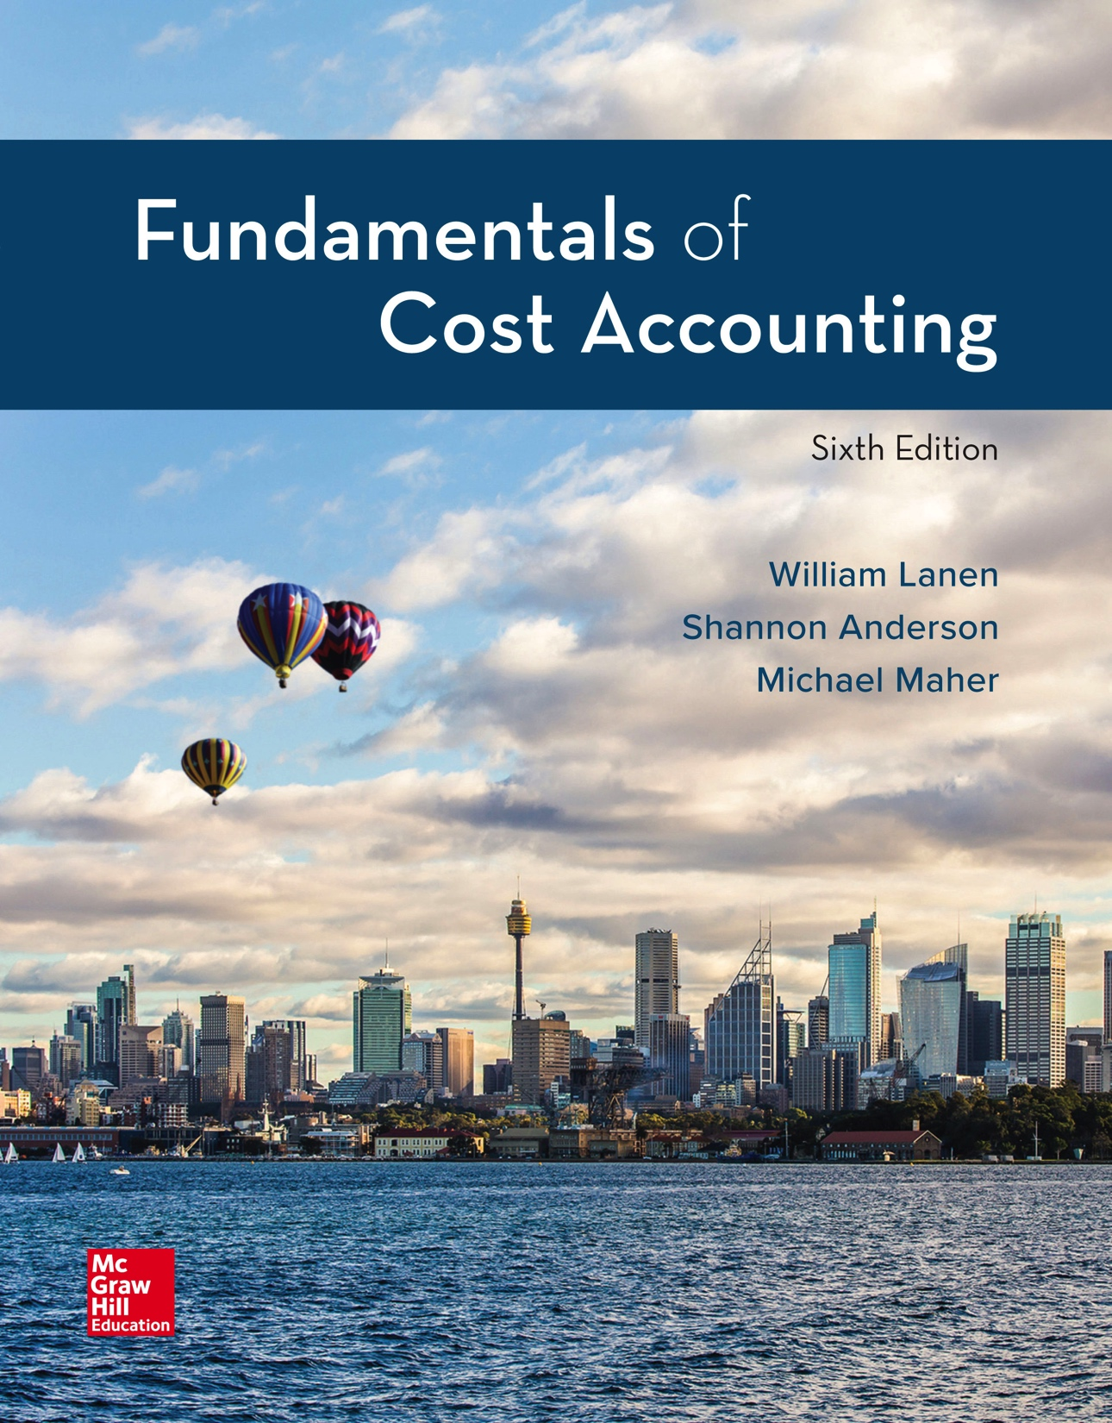
Copyright ©2020 McGraw-Hill Education. All rights reserved. No reproduction or distribution without the prior written consent of McGraw-Hill Education.
Notes:
Fundamentals of Cost Accounting, 6th edition
Lanen/Anderson/Maher

Slide 2
Cost Estimation
Chapter 5
Notes:
Chapter 5: Cost Estimation
When managers make decisions they need to compare the costs (and benefits) among alternative actions. In this chapter, we discuss how to estimate the costs required for decision making.

Slide 3
Learning Objectives
LO 5-1 Understand the reasons for estimating fixed and variable costs.
LO 5-2 Estimate costs using engineering estimates.
LO 5-3 Estimate costs using account analysis.
LO 5-4 Estimate costs using statistical analysis.
LO 5-5 Interpret the results of regression output.
LO 5-6 Identify potential problems with regression data.
LO 5-7 Incorporate the effects of learning when estimating costs.
LO 5-8 Evaluate the advantages and disadvantages of alternative
cost estimation methods.
LO 5-9 (Appendix A) Use Microsoft Excel to perform a regression
analysis.
LO 5-10(Appendix B) Understand the mathematical relationship
describing the learning phenomenon.
Notes:
After completing Chapter 5 you should: Understand the reasons for estimating fixed and variable costs and be able to estimate costs using engineering estimates, account analysis, and statistical analysis. You should be able to interpret the results of regression output and identify potential problems with regression data. You should be able to incorporate the effects of learning when estimating costs. You should also be able to evaluate the advantages and disadvantages of alternative cost estimation methods. After completing the Appendix you should be able to use Microsoft Excel to perform analysis.

Slide 4
Why Estimate Costs?
Managers make decisions and need to compare
costs and benefits among alternative actions.
Cost estimates can be an important element
in helping managers make decisions.
Notes:
You saw in Chapters 3 and 4 that good decisions require good information about costs. Cost estimates are an important element in helping managers make decisions that add value to the company.

Slide 5
Basic Cost Behavior Patterns
LO 5-1
LO 5-1 Understand the reasons for estimating fixed and variable costs.
Costs
Fixed costs
Variable costs
Total fixed costs do not
change proportionately
as activity changes.
Total variable costs
change proportionately
as activity changes.
Per unit fixed costs
change inversely as
activity changes.
Per unit variable cost
remain constant as
activity changes.
Notes:
By now you understand the importance of cost behavior. Cost behavior is the key distinction for decision making. Costs behave as either fixed or variable. Fixed costs are fixed in total; variable costs vary in total. On a per-unit basis, fixed costs vary inversely with activity and variable costs stay the same. Are you getting the idea? Cost behavior is critical for decision making.

Slide 6
What Methods Are Used to Estimate Cost Behavior?
LO 5-1
Joseph, owner of JK Renovations (JK), wants to estimate the cost opening of a new center.
Engineering estimates
Account analysis
Statistical methods
Notes:
Let’s meet Joseph, the owner of JK Renovations. In this chapter we are going to help Joseph estimate costs. Three methods used to estimate costs are: engineering estimates, account analysis, and statistical methods.

Slide 7
Engineering Estimates
LO 5-2
LO 5-2 Estimate costs using engineering estimates.
Cost estimates are based on measuring and
then pricing the work involved in a task.
Identify the activities involved:
– Labor
– Rent
– Insurance
Estimate the time and cost for each activity.
Notes:
Engineering cost estimates are based on measuring and then pricing the work involved in a task. Managers first identify activities such as labor, rent, and insurance and then estimate the time and cost required for each activity.

Slide 8
Engineering Estimates (2)
LO 5-2
Details each step required to perform an operation.
Permits comparison of other centers with similar operations.
Costs for totally new activities can be estimated without
prior activity data.
Can be quite expensive to use.
Based on optimal conditions.
Notes:
The advantages of engineering estimates are as follows. First, it details each step required to perform an operation. Second, it permits a comparison of other centers in which similar operations are performed and enables the company to review its productivity and identify specific strengths and weaknesses. And finally, costs for totally new activities can be estimated without prior activity data. However, engineering estimates can be quite expensive to use and are based on optimal conditions.

Slide 9
Account Analysis Method
LO 5-3
LO 5-3 Estimate costs using account analysis.
Review each account comprising the total cost being analyzed.
Identify each cost as either fixed or variable.
Fixed
Variable
Notes:
Estimating costs using account analysis involves a review of each account making up the total costs being analyzed. Then, each cost should be identified as either fixed or variable, depending on the relation between the cost and some activity. Fixed costs are those costs that are fixed in total regardless of the activity level and variable costs. Variable costs are those costs that vary in total as activity changes.

Slide 10
Account Analysis Method (2)
LO 5-3
Costs for 720 labor-hours
Notes:
An account analysis of JK shows estimated overhead cost per month for an average location operating at about 720 repair-hours. Each major class of overhead cost is itemized and then divided into estimated variable and fixed components. The rental contract includes a share of the revenue as part of the rent, so a portion of the rent is variable. Other costs are also mixed, having some fixed and some variable elements. Using account analysis, estimated fixed costs are $21,756 and the total variable costs are $22,032 for 720 repair-hours. Because variable costs are directly related to the expected activity level, we can state variable overhead per repair-hour as $30.60 ($22,032 divided by 720 repair-hours).

Slide 11
Account Analysis Method (3)
LO 5-3
Fixed costs + (Variable cost/unit × No. of units) = Total cost
Cost at 720 repair-hours:
$21,756 + ($30.60 × 720) = $43,788
Cost at 960 repair-hours:
$21,756 + ($30.60 × 960) = $51,132
Notes:
Using account analysis we can now estimate cost for other levels of repair-hours. Estimated costs at 960 repair-hours equals fixed costs of $21,756 plus $30.60 per repair-hour times 960 repair-hours (or $29,376 total variable costs). Total estimated costs at 960 repair-hours equals $51,132.

Slide 12
Account Analysis Method (4)
LO 5-3
Managers and accountants are familiar with company operations and the way costs react to changes in activity levels.
Managers and accountants may be biased.
Decisions often have major economic consequences
for managers and accountants.
Notes:
An advantage of using account analysis to estimate costs is that managers and accountants are familiar with company operations and the way costs react to changes in activity levels. However, managers and accountants may be biased. Furthermore, decisions often have major economic consequences for managers and accountants.

Slide 13
Statistical Cost Estimation
LO 5-4
LO 5-4 Estimate costs using statistical analysis.
Analyze costs within a relevant range, which is
the limits within which a cost estimate may be valid.
Relevant range for a projection is usually between
the upper and lower limits (bounds) of past activity
levels for which data is available.
Notes:
A statistical cost analysis analyzes costs within the relevant range using statistics. Do you remember how we defined relevant range?
A relevant range is the range of activity where a cost estimate is valid. The relevant range for cost estimation is usually between the upper and lower limits of past activity levels for which data is available.

Slide 14
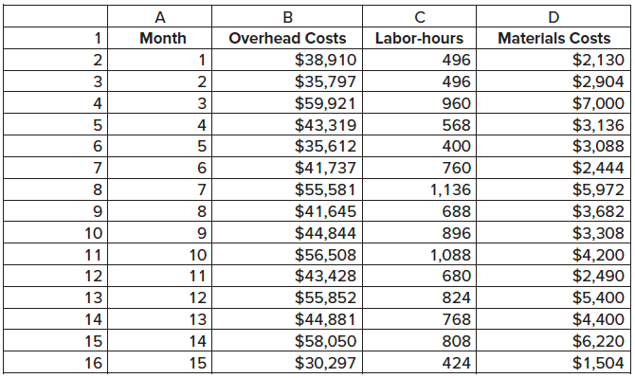
Overhead Cost Estimation for JK Renovations
LO 5-4
These data will be used to estimate costs using
a statistical analysis.
Notes:
Here we have the overhead costs data for JK for the last 15 months. Let’s use these data to estimate costs using a statistical analysis.

Slide 15
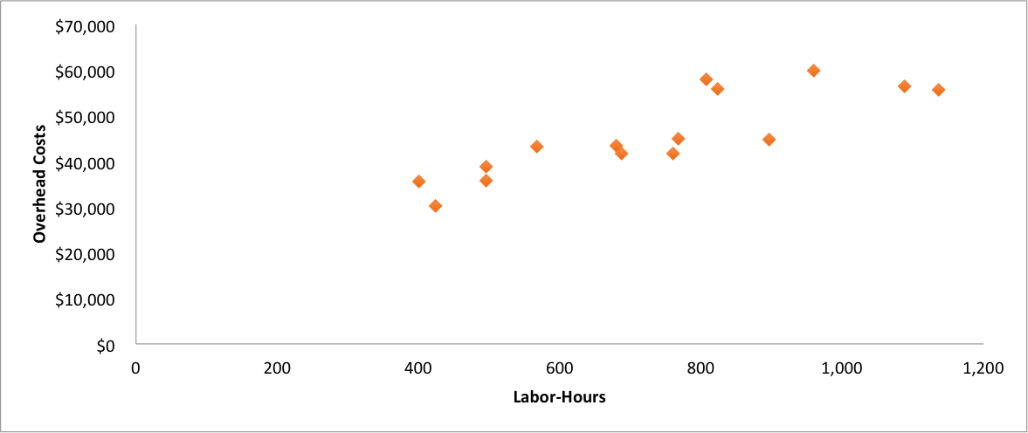
Scattergraph
LO 5-4
Does it look like a relationship exists
between labor-hours and overhead costs?
Notes:
We will start with a scattergraph. A scattergraph is a plot of cost and activity levels. This gives us a visual representation of costs. Does it look like a relationship exists between labor-hours and overhead cost?

Slide 16
Scattergraph (2)
LO 5-4
We use “eyeball judgment” to determine the intercept and slope of the line.
Notes:
Now we “eyeball” the scattergraph to determine the intercept and the slope of a line through the data points. Do you remember graphing our total cost in Chapter 3? In this case, the slope of the line represents the estimated costs per unit, and the intercept with the vertical axis represents an estimate of the fixed costs. So we use “eyeball judgment” to determine fixed cost and variable cost per unit to arrive at total cost for a given level of activity. As you can imagine, preparing an estimate on the basis of a scattergraph is subject to a high level of error. Consequently, scattergraphs are usually not used as the sole basis for cost estimates but to illustrate the relations between costs and activity and to point out any past data items that might be significantly out of line.

Slide 17
High-Low Cost Estimation
LO 5-4
This is a method to estimate cost based on two cost
observations, the highest and lowest activity levels.
Month
Overhead
costs
Labor-
hours
High
$55,581
1,136
Low
$35,612
400
Change
$19,969
736
Notes:
A simple approach to estimating the relation between cost and activity is to choose two points on the scattergraph. This approach is the high-low method. Using the high-low method, we estimate cost based on costs at the highest activity level and costs at the lowest activity level. Using these two points we can determine the total cost.

Slide 18
High-Low Cost Estimation (2)
LO 5-4
Variable cost per unit (V) =
Fixed cost (F) =
or
Total cost at
lowest activity
–
(Variable cost × Lowest activity level)
Notes:
The slope of the total cost line estimates the variable cost per unit. Remember from statistics, the slope of the line is the change in Y divided by the change in X. So we calculate the slope, or the variable cost per unit as the change in costs divided by the change in activity. The change in cost is cost at the highest activity level minus the cost at the lowest activity level. The change in activity is the highest activity minus the lowest activity. After calculating the variable cost per unit we use the activity level and calculate total variable costs. Total costs minus total variable costs equals fixed cost. We can use the highest activity level or the lowest activity level to calculate fixed costs. Let’s put the numbers in the equations.

Slide 19
High-Low Cost Estimation (3)
LO 5-4
Variable cost
per RH (V)
=
($55,581 – $35,612)
1,136 LH – 400 LH
=
$19,969
736 LH
=
$27.13
per LH
Fixed costs (F)
=
($55,581 – ($27.13 × 1,136 LH)
=
$24,761
or
Fixed costs (F)
=
($35,612 – ($27.13 × 400 LH)
=
$24,760
Rounding
difference
Notes:
To prepare a high-low analysis, select the high and low points and calculate the change in both OH Cost ($19,969) and labor hours (736). Since the OH cost change is due to a change in volume (labor hours), it is assumed to be strictly a variable cost. To calculate the variable cost per unit all we need to do is divide the change in OH cost by the change is repair-hours ($19,969 ÷ 736) which is $27.13 variable cost per unit. Now all we have to do is use either the high or low point and plug in the known values to the total cost equation: Fixed costs = (High cost – ($27.13 × High activity) or $55,581 – ($27.13 × 1,136) = $24,761.
Fixed costs = (Low cost – ($27.13 × Low activity) or $35,612 – ($27.13 × 400) = $24,760. The difference is simply due to rounding.
So, our equation estimating total cost is: Total cost = $24,761 + ($27.13 × Labor hours).

Slide 20
High-Low Cost Estimation (4)
LO 5-4
How do we estimate manufacturing
overhead with 960 repair-hours?
TC = F + VX
TC = $24,761 + ($27.13 × 960) = $50,806
Notes:
Now that we know the estimated fixed costs are $24,761 and the estimated variable cost per unit is $27.13 we can estimate manufacturing overhead for a level of 960 labor-hours. Total manufacturing overhead at 960 repair-hours equals $24,761 plus $27.13 per unit times 960 units or $50,806. Can we estimate overhead at 1,250 labor-hours? Remember our data for the last 15 months included repair hours between the activity levels of 400 and 1,136 labor-hours. So 1,250 labor-hours is out of the relevant range for a projection. The cost structure may change once the activity goes beyond 1,136 labor-hours.

Slide 21
Regression Analysis
LO 5-4
Regression is a statistical procedure to
determine the relation between variables.
It helps managers determine how well the
estimated regression equation describes
the relations between costs and activities.
Notes:
Regression statistically measures the relationship between two variables, activities and costs. Regression techniques are designed to generate a line that best fits a set of data points. In addition, regression techniques generate information that helps a manager determine how well the estimated regression equation describes the relations between costs and activities.

Slide 22
Regression Analysis (2)
LO 5-4
High-Low Method
Uses two data points
Regression
Uses all of the data points
Notes:
Although the high-low method allows a computation of estimates of the fixed and variable costs, it ignores most of the information available to the analyst. The high-low method uses two data points to estimate costs; regression is a statistical procedure that uses all of the data points to estimate costs.

Slide 23
Regression Analysis (3)
LO 5-4
Y = a + bX
Y = Intercept + (Slope × X)
For JK Renovations:
OH = Fixed costs + (V × Labor-hours)
Notes:
You already know that an estimate for the costs at any given activity level can be computed using the equation TC = F + VX. The regression equation, Y = a + bX, represents the cost equation. Y equals the intercept plus the slope times the number of units. When estimating overhead costs for JK, total overhead costs equals fixed costs plus the variable cost per unit of labor-hours times the number of labor-hours.

Slide 24
Interpreting Regression
LO 5-5
LO 5-5 Interpret the results of regression output.
Independent Variable
– The X term, or predictor
– The activity that predicts (causes)
the change in costs
Activities
– Labor-hours
Dependent Variable
– The Y term
– The dependent variable
– The cost to be estimated
Costs
– Overhead costs
Notes:
For JK, labor-hours are the activities, the independent variable, or predictor variable. In regression, the independent variable or predictor variable is identified as the X term. Overhead costs is the dependent variable, or Y term. What we are saying is: overhead costs are dependent on labor-hours, or predicted by labor-hours.

Slide 25
Interpreting Regression (2)
LO 5-5
The computer output of JK’s scattergraph
gives the following formula:
Total overhead = $20,378 + ($34.63 per LH × No. of LH)
Estimate JK’s overhead with 960 labor hours.
TC = F + VX
TC = $20,378 + ($34.63 × 960) = $53,623
Notes:
The computer output gives an estimate for total cost of $53,623 with 960 labor-hours.

Slide 26
Interpreting Regression (3)
LO 5-5
Correlation Coefficient (R)
This measures the linear relationship between
variables. The closer R is to 1.0, the closer the
points are to the regression line. The closer R is
to zero, the poorer the fit of the regression line.
Coefficient of Determination (R²)
This is the square of the correlation coefficient.
It is the proportion of the variation in the dependent
variable (Y) explained by the independent variable(s) (X).
Notes:
Continuing to interpret the regression output, the Multiple R is called the correlation coefficient and measures the linear relationship between the independent and dependent variables. R Square, the square of the correlation cost efficient, determines and identifies the proportion of the variation in the dependent variable, in this case, overhead costs, that is explained by the independent variable, in this case, labor-hours.

Slide 27
Interpreting Regression (4)
LO 5-5
T-Statistic
This is the value of the estimated coefficient, b, divided
by its estimated standard error (SE_{b}). Generally, if it is
over 2, then it is considered significant. If significant,
the cost is NOT totally fixed.
From the data used in the JK regression, the t-statistic is:
t = b ÷ SE_{b}
= 34.6349÷ 5.7971
= 5.975
Notes:
If the t-statistic is over 2, it is considered significant. For JK Renovations, the t-statistic is significant.

Slide 28
Interpreting Regression (5)
LO 5-5
An 0.856 correlation coefficient means that a linear
relationship does exists between labor hours
and overhead costs.
An 0.733 coefficient of determination means that
73.3% of the changes in overhead costs can be
explained by changes in labor hours.
Both have t-statistics that are greater than 2,
so the cost is not totally fixed.
Notes:
The Multiple R, the correlation coefficient, of 0.856 tells us that a linear relationship does exist between labor-hours and overhead costs. The R Square, or coefficient of determination, tells us that 73.3% of the changes in overhead costs can be explained by changes in labor-hours.

Slide 29
Multiple Regression
LO 5-5
Multiple Regression
When more than one predictor (x) is in the model
Are labor-hours the only activity that drives
overhead costs at JK?
Predictors
X₁: Labor hours
X₂: Materials cost
Equation
TC = VC(X₁) + VC(X₂) + FC
Notes:
Multiple regression is used when more than one predictor is needed to adequately predict the value. For example, it might lead to more precise results if JK uses both labor hours and materials cost in order to predict the total cost. Let’s look at this example.

Slide 30
Multiple Regression Output
LO 5-5
The adjusted R-squared is the correlation coefficient
squared and adjusted for the number of independent
variables used to make the estimate.
The statistics supplied with the output (rounded off) are:
– Correlation coefficient (R) = 0.951
– R² = 0.904
– Adjusted R² = 0.888
Notes:
In multiple regression, the adjusted R-square is the correlation coefficient squared and adjusted for the number of independent variables used to make the estimate. Reading this output tells us that 89% of the changes in overhead costs can be explained by changes in labor-hours and materials cost. Remember, 73.3% of the changes in overhead costs were explained when one independent variable, labor-hours, was used to estimate the costs. Can you use this regression output to estimate overhead costs for 960 labor-hours and $5,200 materials cost?

Slide 31
Multiple Regression Output (2)
LO 5-5
TC = F + V₁X₁ + V₂X₂
TC = $19,894 + ($17.84 × 960 LH) +
(3.32 × $5,200)
TC = $54,284
Notes:
Estimated overhead costs for 960 labor-hours and $5,200 of materials cost equal:
Fixed costs of $19,894 plus $17.84 per labor-hour times 960 labor-hours, plus 3.32 material costs times materials cost of $5,200.

Slide 32
Practical Implementation Problems
LO 5-6
LO 5-6 Identify potential problems with regression data.
Effect of:
– Nonlinear relations
– Outliers
– Spurious relations
– Using data that do not fit the assumptions
of regression analysis
Notes:
It’s easy to be over confident when interpreting regression output. It all looks so official. But beware of some potential problems with regression data. We already discussed in earlier chapters that costs are curvilinear and cost estimations are only valid within the relevant range. Data may also include outliers and the relationships may be spurious. Let’s talk a bit about each.

Slide 33
Practical Implementation Problems (2)
LO 5-6
The Effect of Nonlinear Relations
$800
$700
$600
$500
$400
$300
$200
$100
$0
Assumed actual cost function
Cost
Regression
estimate
Relevant
range
Capacity
0 5 10 15 20 25 30 35 40
Volume
Notes:
There are practical implementation problems such as the effect of nonlinear relations.

Slide 34
Practical Implementation Problems (3)
LO 5-6
Problem:
Attempting to fit a linear model to nonlinear data
Likely to occur near full-capacity
Solution:
Define a more limited relevant range.
(Example: from 25-75% capacity)
Design a nonlinear model.
Notes:
If the cost function is curvilinear, then a linear model contains weaknesses. This generally occurs when the firm is at or near capacity.

Slide 35
Practical Implementation Problems (4)
LO 5-6
The Effect of Outliers on the Computed Regression
Computed
regression line
“Outlier”
True regression line
Notes:
Because regression calculates the line that best fits the data points, observations that lie a significant distance away from the line could have an overwhelming effect on the regression estimate. Here we see the effect of one significant outlier. The computed regression line is a substantial distance from most of the points. The outlier moves the regression line.

Slide 36
Practical Implementation Problems (5)
LO 5-6
Problem:
Outliers move the regression line.
Solution:
Prepare a scattergraph, analyze the graph,
and eliminate highly unusual observations
before running the regression.
Notes:
Outliers move the regression line. Therefore a scattergraph should be prepared to eliminate unusual observations.

Slide 37
Practical Implementation Problems (6)
LO 5-6
The Effect of Spurious Relations
Problem:
Using too many variables in the regression
(i.e., using direct labor to explain materials costs).
Although the association is very high, actually
both are driven by output.
Solution:
Carefully analyze each variable and determine
the relationship among all elements before
using in the regression.
Notes:
We should carefully analyze each variable in order to determine if relationships exist among all elements before using the regression.

Slide 38
Practical Implementation Problems (7)
LO 5-6
The Effect of Using Data That Do Not
Fit the Assumptions of Regression Analysis
Problem:
If the assumptions in the regression are not
satisfied, then the regression is not reliable.
Solution:
There is no clear solution. Limit time to help
assure costs behavior remains constant,
yet this causes the model to be weaker
due to less data.
Notes:
Although there may be solutions for spurious relations, it appears that there are no clear cut solutions to the problem of assumptions. If you increase your data size then accuracy increases, but the time covered also increases which could cause a curvilinear problem. If you decrease your sample, then you may get rid of the curvilinear problem, but you weaken the output due to fewer observations.

Slide 39
Learning Phenomenon
LO 5-7
LO 5-7 Incorporate the effects of learning when estimating costs.
Learning phenomenon is the systematic relationship
between the amount of experience in performing
a task and the time required to perform it.
Notes:
The learning phenomenon means that variable costs tend to decrease per unit as the volume of activity increases.

Slide 40
How an Estimation Method is Chosen
LO 5-8
LO 5-8 Evaluate the advantages and disadvantages
of alternative cost estimation methods.
Reliance on historical data is relatively inexpensive.
Computational tools allow for more data to be used
than for non-statistical methods.
Reliance on historical data may be the only readily
available, cost-effective basis for estimating costs.
Analysts must be alert to cost-activity changes.
Notes:
Using regression to estimate costs relies on past data that is relatively inexpensive. Computational tools allow for more data to be used than for nonstatistical methods. However, analysts must be alert to cost-activity changes.

Slide 41
Data Problems
LO 5-8
Missing data
Outliers
Allocated and discretionary costs
Inflation
Mismatched time periods
Notes:
No matter what method is used to estimate costs, the results are only as good as the data used. Collecting appropriate data is complicated by missing data, outliers, allocated and discretionary costs, inflation, and mismatched time periods.

Slide 42
Effect of Different Methods on Cost Estimates
LO 5-8
Estimated manufacturing overhead with 960 labor-hours.
Method
Total
estimated
costs
Estimated
fixed
costs
Estimated
variable
costs
Account analysis
High-low
Simple regression
Multiple regression
$51,132
$50,806
$53,623
$54,284
$21,756
$24,761
$20,378
$19,894
$30.60/labor-hour
$27.13/labor-hour
$34.63/labor-hour
$17.84/labor-hour
+ 332% of materials cost
Notes:
Each cost estimation method can yield a different estimate of the costs that are likely to result from a particular management decision. This underscores the advantage of using more than one method to arrive at a final estimate. Which method is the best? Management must weigh the cost-benefit related to each method.

Slide 43
Appendix A: Regression Analysis Using Microsoft Excel
LO 5-9
LO 5-9 (Appendix A) Use Microsoft Excel to perform a regression analysis.
Many software programs exist to aid in performing
regression analysis.
In order to use Microsoft Excel®, the Analysis ToolPak
must be installed.
Data are entered and the user then selects the data and
type of regression analysis to be generated.
The analyst must be well-schooled in regression in order
to determine the meaning of the output.
Notes:
As we saw in Chapter 3 (CVP), there are software packages that allow users to easily generate a regression analysis. If, however, the user has little or no knowledge regarding regression, the output will be of little use.

Slide 44
Appendix B: Learning Curves
LO 5-10
LO 5-10 (Appendix B) Understand the mathematical relationship describing the learning phenomenon.
This is the systematic relationship between
the amount of experience in performing a task
and the time required to perform it.
Notes:
Another element that can change the shape of the total cost curve is the notion of a learning phenomenon. As workers become more skilled they are able to produce more output per hour. This will impact the total cost curve since it leads to a lower per unit cost, the higher the output.

Slide 45
Appendix B: Learning Curves (2)
LO 5-10
Unit
Time to
produce
Calculation
of time
First unit
Second unit
Fourth unit
Eighth unit
100.0 hours
80.0 hours
64.0 hours
51.2 hours
(assumed)
80% × 100 hours
80% × 80 hours
80% × 64 hours
Impact: It causes the unit price to decrease
as production increases.
This implies a nonlinear model.
Notes:
Another element that can change the shape of the total cost curve is the notion of a learning phenomenon. As workers become more skilled they are able to produce more output per hour. This will impact the total cost curve since it leads to a lower per unit cost, the higher the output.

Slide 46
End of Chapter 5
Notes:
End of Chapter 5.

