Slide 1
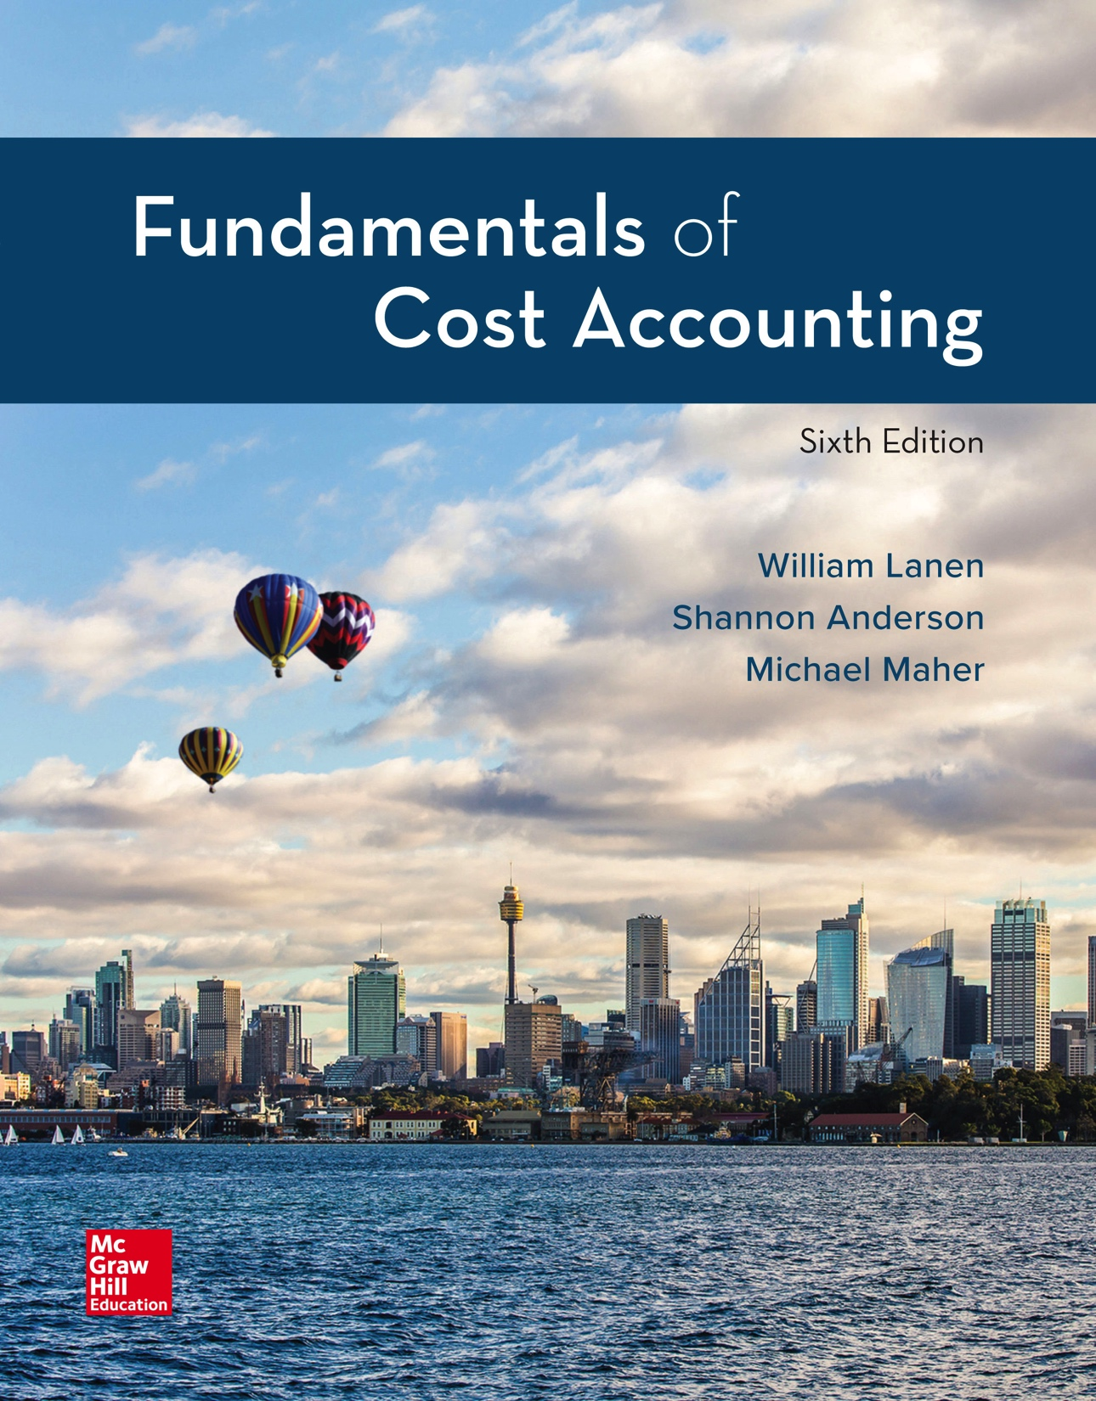
Copyright ©2020 McGraw-Hill Education. All rights reserved. No reproduction or distribution without the prior written consent of McGraw-Hill Education.
Notes:
Fundamentals of Cost Accounting, 6th edition
Lanen/Anderson/Maher

Slide 2
Cost Concepts and Behavior
Chapter 2
Notes:
Chapter 2: Cost Concepts and Behavior
Chapter 2 covers cost concepts and behavior. You want to be certain that you have a thorough understanding of these concepts before going forward. Understanding of the concepts in Chapter 2 is critical for success in this course.

Slide 3
Learning Objectives
LO 2-1 Explain the basic concept of “cost.”
LO 2-2 Explain how costs are presented in financial statements.
LO 2-3 Explain the process of cost allocation.
LO 2-4 Understand how material, labor, and overhead costs are
added to a product at each stage of the production process.
LO 2-5 Define basic cost behaviors, including fixed, variable,
semivariable, and step costs.
LO 2-6 Identify the components of a product’s costs.
LO 2-7 Understand the distinction between financial and
contribution margin income statements.
Notes:
Each objective covers critical information for success in a cost accounting course. Successful understanding of the seven learning objectives will provide a solid foundation for you to build on the rest of the semester. First, you must be able to explain the basic concept of “cost.” Second, explain how costs are presented in financial statements. Third, explain the process of cost allocation. Fourth, understand how material, labor, and overhead costs are added to a product at each stage of the production process. Fifth, define basic cost behaviors including fixed, variable, semivariable, and step costs. Sixth, identify the components of a product’s costs. And finally, understand the distinction between financial and contribution margin income statements.

Slide 4
What is a Cost?
LO 2-1
LO 2-1 Explain the basic concept of “cost.”
Cost is a sacrifice of resources.
Notes:
Let’s start with the basic concept of cost. A cost is a sacrifice of resources. When we buy one thing, we give up (sacrifice) the ability to use these resources, for example cash, to buy something else.

Slide 5
Cost versus Expenses
LO 2-1
Cost
Outlay Costs
Past, present,
or future cash
outflow
Opportunity Costs
Forgone benefit from
the best alternative
course of action
Expense
Cost charged against
revenue in an
accounting period
Notes:
A cost can be an outlay cost, that is, a past, present, or future outflow of cash, or it can be an opportunity cost. An opportunity cost does not require an outlay of cash, but rather represents the foregone benefit from the best alternative course of action. Because an outlay cost represents an outflow of cash, it will ultimately end up on your financial statements. On the other hand, an opportunity cost will never show up on your financial statements. Are cost and expense the same thing? No. A cost is a sacrifice of resources. An expense, on the other hand, is a cost that is charged against revenue in a accounting period. Can you identify a cost that is never an expense? Remember, an expense shows up on your income statement. An outlay cost, an outflow of cash, that is never an expense, is the purchase of land.

Slide 6
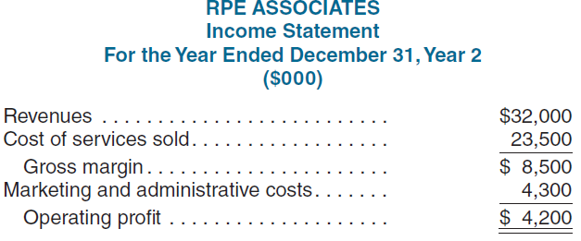
Presentation of Costs in Financial Statements
LO 2-1
LO 2-2 Explain how costs are presented in financial statements.
Cost of
billable
hours
The excess of operating revenue over costs
necessary to generate those revenues
Notes:
Now let’s look at recording costs in financial statements. Cost accounting focuses on operating profit, the excess of operating revenues over the operating costs incurred to generate those revenues. Operating profit is not the same as net income. Net income is operating profit adjusted for interest, income taxes, and other adjustments required to comply with GAAP or other regulations. The basic income statement is the same for a service company and a merchandise company. For both a service company and a merchandise company, revenue minus cost of goods or services sold equals gross margin and gross margin minus marketing and administrative costs equal operating profit. A service company generates service revenue. A service company’s cost of services sold is the cost of billable hours.

Slide 7
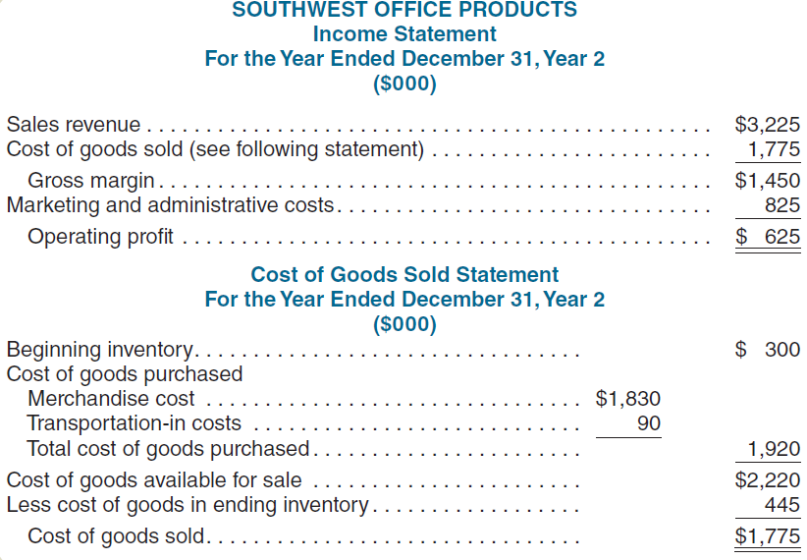
Presentation of Costs in Financial Statements (2)
LO 2-2
Expense assigned
to products sold
during a period
The excess of operating revenue over costs
necessary to generate those revenues
Notes:
When you buy food, clothes, or a book, you are buying from a retail (or maybe a wholesale) firm. Retail and wholesale firms sell but do not make a tangible product. The income statement for these companies includes revenue and cost items as does that for service companies, but for retailers and wholesalers, it has an added category of cost information (called cost of goods sold) to track the cost of the tangible goods they buy and sell. Southwest Office Products is a retail company that sells office supplies, such as paper products and computer accessories. The company’s income statement and cost of goods sold statement are shown on this slide. The cost of goods sold statement shows how the cost of goods sold was computed. The term cost of goods sold includes only the actual costs of the goods that were sold. It does not include the costs required to sell them, such as the salaries of salespeople, which are marketing costs, or the salaries of top executives, which are administrative costs.

Slide 8
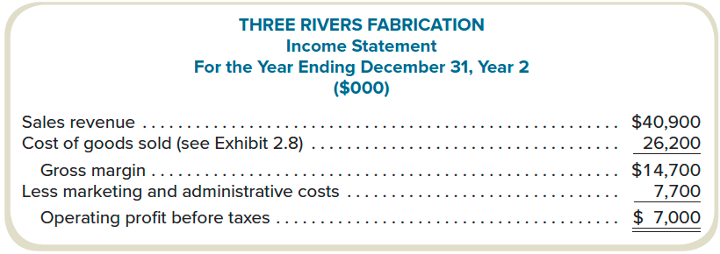
Presentation of Costs in Financial Statements (3)
LO 2-2
Cost incurred to manufacture
the product sold
Product costs recorded as
“inventory” when cost is incurred
Expense when sold
Period costs recorded as
an expense in the period
the cost is incurred
Notes:
A manufacturing company is a little more complicated than a service company or merchandise company because a manufacturing company makes the product it sells. Financial reporting distinguishes costs in a manufacturing firm based on when the costs are recognized as expenses on the financial statements. Product costs are those costs incurred to manufacture a product. A product cost is recorded as an asset in inventory when the cost is incurred and recognized as an expense on the income statement when the product is sold. Let’s explore in more detail the financial statements for a manufacturing company.

Slide 9
Product versus Period Costs
LO 2-2
Two types of manufacturing costs:
Product Costs
Costs related to
inventory
Period Costs
Nonmanufacturing
costs related to the firm
Notes:
A product cost is also referred to as a manufacturing cost or as an inventoried cost. A period cost is a nonmanufacturing cost. It is a cost that is incurred to sell a product and to operate the business. A period cost is recognized as an expense when the cost is incurred.

Slide 10
Product versus Period Costs (2)
LO 2-2
Product Costs
Costs that are recorded
as an asset in inventory when
incurred and expensed as
Cost of Goods Sold when sold
Period Costs
Costs recognized for financial
reporting when incurred
Notes:
Product costs are recognized as expenses on the income statement as Cost of Goods Sold when the product is sold. Period costs are recognized as expense when incurred.

Slide 11
Direct and Indirect Manufacturing Costs
LO 2-2
Direct Costs
Costs that, for a reasonable cost, can
be directly traced to the product
Direct Materials
Materials directly
traceable to the product
Direct Labor
Work directly traceable to
transforming materials
into the finished product
Notes:
Let’s look at product costs more closely. Remember, product costs are manufacturing costs that are recognized as assets in inventory when the costs are incurred and as expenses when the products are sold. These costs are also referred to as manufacturing costs or inventory costs. Our product costs consist of both direct costs and indirect costs. Costs are either direct or indirect with reference to a cost object. Direct product costs are those costs that can be directly traced to the product. Make this connection, direct cost can be directly traced to the product. The direct costs are direct materials and direct labor.

Slide 12
Direct and Indirect Manufacturing Costs (2)
LO 2-2
Indirect Costs
Costs that cannot reasonably
be directly traced to the product
Manufacturing Overhead
All production costs except
direct materials and direct labor
Indirect materials
Indirect labor
Other indirect costs
Notes:
Indirect costs are costs that cannot be directly traced to the product. These costs are called manufacturing overhead. Manufacturing overhead is comprised of all the production costs except direct materials and direct labor. These costs include indirect materials, indirect labor, and all other indirect costs.

Slide 13
Prime Costs and Conversion Costs
LO 2-2
Prime Costs
The “primary” costs
of the product
Direct
materials
Direct
labor
Conversion Costs
Costs necessary to
“convert” materials
into a product
Direct
labor
Manufacturing
overhead
Notes:
It is useful in managing costs for a manufacturing company to look at product costs as either prime costs or conversion costs. Prime costs are direct materials and direct labor. Prime costs are the primary costs of the product. Once again, make this connection. Prime costs are the primary costs of the product. Direct materials and direct labor can be directly traced to the product and are the primary costs of the product. Conversion costs are the costs necessary to convert materials into a product. Again make the connection. Conversion costs convert materials into a product. What costs are necessary to convert material into a product? Direct labor and manufacturing overhead. So direct labor and manufacturing overhead are the conversion costs.

Slide 14
Nonmanufacturing (Period) Costs
LO 2-2
Recognized as expenses when the costs are incurred
Marketing
Costs necessary to
sell the products
Advertising
Sales commissions
Shipping costs
Administrative
Costs necessary to
operate the business
Executive salaries
Data processing
Legal costs
Notes:
Identifying period costs is not quite as complicated. Period costs are costs necessary to sell the product and operate the business. These costs are recognized as expenses when the costs are incurred. Marketing or selling costs are costs necessary to sell the products. Marketing costs consist of advertising, sales commissions, and shipping costs. Administrative costs are those costs necessary to operate the business. Administrative costs consist of such things as executive salaries, data processing, and legal costs.

Slide 15
Cost Allocation
LO 2-3
LO 2-3 Explain the process of cost allocation.
It is the process of assigning indirect costs to products, services, people, business units, etc.
Notes:
Because indirect costs cannot be traced directly to a cost object, they need to be allocated to the cost object. Let’s look at the process of cost allocation. The process of assigning indirect costs to a cost object consists of three steps: defining the cost pool, determining the cost allocation rule, and finally, assigning the costs to the cost object. The cost pool is a collection of all the indirect costs to be assigned to the cost object. The cost allocation rule is the method used to assign the costs in the cost pool to the cost object. The cost object is the end to which the cost is to be assigned. For example, indirect costs might need to be assigned to various products or product lines for costing purposes. In other cases, management may want to assign costs to departments or customers.

Slide 16
Cost Allocation (2)
LO 2-3
1. Define the cost pool:
The collection of costs to be assigned to cost objects
2. Determine the cost allocation rule:
The method used to assign costs in the cost pool
to cost objects
3. Assign the costs in the cost pool to the cost object:
Any end to which a cost is assigned—product,
product line, department, customer, etc.
Notes:
Cost allocation is the process of assigning indirect costs to products, services, people, business units, etc.

Slide 17
Cost Allocation: Example
LO 2-3
Rockford Corporation has two divisions: East Coast and West Coast. Both divisions are supported by the IS Group.
 | East Coast | West Coast | Total
Revenues | $80 million | $20 million | $100 million
1. Define the cost pool:
IS department’s costs of $1,000,000
2. Determine the cost allocation rule:
IS costs are allocated based on
divisional revenue. (% of revenue)
3. Assign to the cost object:
East Coast: 80% of cost
West Coast: 20% of cost
Notes:
As an example, let’s look at Rockford Corporation. Rockford Corp. has $1 million in corporate information systems cost. The corporate information systems cost is the cost pool that needs to be allocated. The cost objects are the divisions: the East Coast division and the West Coast division. We will use percent of revenue as the cost allocation rule. Suppose Rockford Corp. has total revenues of $100 million of which $80 million are generated by the East Coast division and $20 million are generated by the West Coast division. If the cost allocation rule is a percent of revenue, how much is allocated to each division?

Slide 18
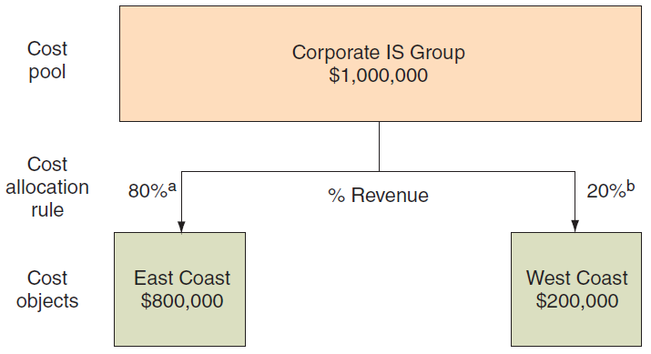
Cost Flow Diagram
LO 2-3
ª 80% = $80 million revenue ÷ ($80 million + $20 million) ^{b} 20% = $20 million revenue ÷ ($80 million + $20 million)
Notes:
We allocate the $1 million in information systems cost 80%, or $800,000, to the East Coast division and 20%, or $200,000, to the West Coast division.

Slide 19
Details of Manufacturing Cost Flows
LO 2-4
LO 2-4 Understand how material, labor, and overhead costs are
added to a product at each stage of the production process.
Product costs are recorded in inventory when costs are incurred.
A manufacturing company has three inventory accounts:
1. Raw Materials Inventory:
Materials purchased to make a product
2. Work-in-Process Inventory:
Products currently in the production process,
but not yet completed
3. Finished Goods Inventory:
Completed products that have not yet been sold
Notes:
How do manufacturing costs get added to a product? Remember product costs are recorded in inventory when the costs are incurred.
A manufacturing company has three inventory accounts: raw materials, work-in-process, and finished goods. Raw materials inventory is comprised of materials purchased to make the product. Work-in-process inventory includes products in the production process that are not yet complete. Finished goods inventory contains products that are fully completed but are not yet sold.

Slide 20
Inventory Accounts – The Balance Sheet
LO 2-4
Direct Materials
Inventory
Work-in-Process
Inventory
Finished Goods
Inventory
Beg. RM inventory
Beg. WIP inventory
Beg. FG inventory
+ Purchases
+ Direct materials
transferred from
raw materials
+ Cost of goods
completed and
transferred from WIP
= Raw materials
available for
production
+ Direct labor
= Goods available
for sale
– Ending RM inventory
+ Manufacturing overhead
= Raw materials
transferred to WIP
= Total manufacturing costs
= Ending FG inventory
= Ending WIP inventory
– Cost of goods sold
– Costs of goods completed
and transferred to
finished goods (or cost of
goods manufactured)
To the Income
Statement
Notes:
Inventory accounts are assets on the balance sheet. Product costs go into inventory when the costs are incurred. Look at the three inventory accounts. To the raw materials beginning balance, we add purchases to calculate raw materials available for production. Purchasing material is a cost that goes into inventory when the cost is incurred. Subtract ending raw material inventory from raw materials available for production to obtain the raw materials that are transferred to work-in-process and you have your ending raw material inventory. When raw materials are transferred to work-in-process, the cost of those materials is transferred from one inventory to another inventory account. To beginning work-in-process inventory, we add our product costs: direct materials, direct labor, and manufacturing overhead. From this total, our total manufacturing cost, we subtract the ending work-in-process inventory to obtain cost of goods completed and transferred to finished goods. The cost of goods completed and transferred to finished goods is also called the cost of goods manufactured. Again, note, product costs are transferred from one inventory account, work-in-process, to another inventory account, finished goods. Finally, beginning finished goods inventory plus the cost of goods manufactured equals the goods available for sale. Subtracting ending finished goods inventory from the goods available for sale gives us the cost of goods sold. Remember, product costs become expenses when the goods are sold. Note, the cost of goods sold, or the transfers out of finished goods, go to the income statement. At this time the product costs become an expense.

Slide 21
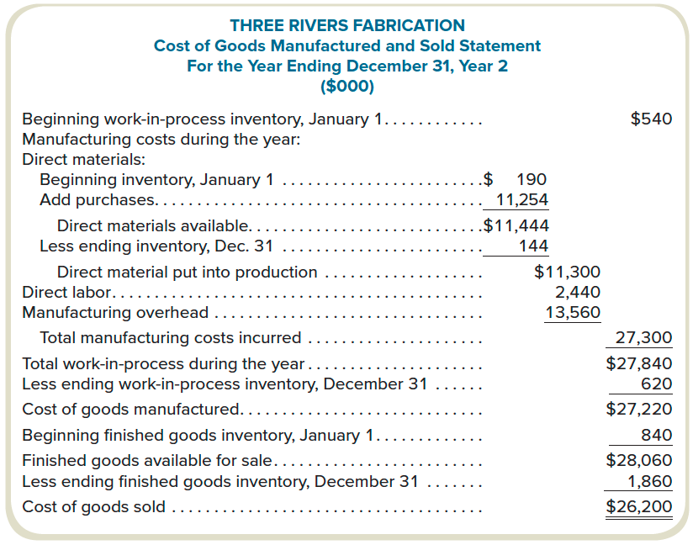
How Costs Flow through the Statements
LO 2-4
Next, determine the cost of goods sold.
Notes:
You are now able to do a cost of goods manufactured statement. Let’s prepare the Cost of Goods Manufactured Statement for the year ending December 31, Year 2 for Three Rivers Fabrication. Beginning work-in-process inventory at January 1 equaled $540,000. Manufacturing costs added to work-in-process during the year included direct materials, direct labor, and manufacturing overhead. Direct materials had a beginning inventory at January 1 of $190,000. Purchases for the year totaled $11,254,000. Adding the beginning inventory and the purchases, gives us direct materials available of $11,444,000. Subtract the $144,000 ending inventory at December 31 and we have direct materials put into production of $11,300,000. Direct labor costs equaled $2,440,000 and manufacturing overhead equaled $13,560,000. Total manufacturing costs incurred this period equal $27,300,000. Beginning work-in-process plus total manufacturing costs incurred totals $27,840,000. Subtract ending work-in-process inventory at December 31 of $620,000 and we have cost of goods manufactured of $27,220,000.

Slide 22
How Costs Flow through the Statements (2)
LO 2-4
Notes:
Now let’s look at the Cost of Goods Sold Statement for Three Rivers Fabrication for the year ending December 31, Year 2 (this includes the Cost of Goods Manufactured calculation from the previous slide). Beginning finished goods inventory at January 1 equaled $840,000. The cost of goods manufactured, from the cost of goods manufactured statement that we just prepared, equaled $27,220,000. Therefore, finished goods available for sale equaled $28,060,000. Subtracting ending finished goods inventory at December 31 of $1,860,000 results in cost of goods sold of $26,200,000.

Slide 23
How Costs Flow through the Statements (3)
LO 2-4
Notes:
Going forward from the Cost of Goods Sold Statement, we can prepare Three Rivers Fabrication Income Statement for the year ending December 31, Year 2. Sales of $40,900,000 less cost of goods sold of $26,200,000 equals a gross margin of $14,700,000. Gross margin minus marketing and administrative expenses of $7,700,000 results in an operating profit of $7,000,000.

Slide 24
Cost Behavior
LO 2-5
LO 2-5 Define basic cost behaviors, including fixed,
variable, semivariable, and step costs.
Cost Behavior
How costs respond to a change in
activity level within the relevant range
Relevant Range
Activity levels within which a given total fixed
cost or unit variable cost will be unchanged
Notes:
Now let’s talk about cost behavior. Cost behavior refers to how costs respond to a change in activity level within the relevant range. What is the relevant range? The relevant range is the range of activity where the total fixed costs or unit variable costs remain unchanged. Let’s clarify this. It is how costs respond to changes in activity within the relevant range that determine if a cost is variable or fixed.

Slide 25
Fixed Costs
LO 2-5
Fixed costs in total remain unchanged as volume changes within the relevant range.
Fixed costs per unit varies inversely to a change in activity.
Fixed costs are “fixed” in “total” as activity changes.
Cost ($)
Activity Level
Notes:
Fixed costs are costs that are unchanged in total as volume changes within the relevant range of activity. On a per-unit basis, fixed costs vary inversely as activity changes.

Slide 26
Variable Costs
LO 2-5
Costs that change in direct proportion with a change in the volume within the relevant range
Variable costs “vary” in “total” as activity changes.
Variable cost per unit stays constant when activity changes within the relevant range.
Cost ($)
Activity Level
Notes:
Variable costs, on the other hand, are costs that change in total in direct proportion with a change in volume within the relevant range of activity. Variable costs vary in total as activity changes. On a per unit basis the cost stays the same as activity changes. If there is no activity, then there are no variable costs.

Slide 27
Relevant Range
LO 2-5
Notes:
A relevant range is the activity levels within which a given total fixed cost or unit variable cost will be unchanged.

Slide 28
Semivariable Costs
LO 2-5
Costs that have both fixed and variable components
Also known as mixed costs
Cost ($)
Activity Level
Notes:
Costs that have both fixed and variable components are referred to as semivariable or mixed costs. The fixed component is fixed in total as activity changes and the variable component varies in total as activity changes.

Slide 29
Step Costs
LO 2-5
Costs that increase in total with steps when the volume changes to a particular level.
Also known as semifixed costs.
Cost ($)
Activity Level
Notes:
Step costs are costs that increase with volume in steps. These costs are also called semifixed costs. For example, if one clerk can process 450 work orders a week the cost of processing work orders is fixed from zero to 450 work orders. However, after 450 work orders we need to hire a second clerk and so on. The cost of the clerks represents a step cost.

Slide 30
Components of Product Costs
LO 2-6
LO 2-6 Identify the components of a product’s costs.
Full Cost
The sum of all costs of manufacturing
and selling a unit of the product
Full Absorption Cost
The sum of all variable and fixed costs
of manufacturing a unit of the product
Variable Cost
The sum of all variable costs of manufacturing
and selling a unit of the product
Notes:
We have looked at various cost concepts. Some of these concepts make cost information more useful for managerial decision making. Others were determined by financial accounting rules. Now let’s identify components of a product’s cost and look at those components from a managerial decision-making perspective and from financial reporting rules. Full cost refers to all costs of manufacturing and selling a unit of product. Full absorption cost is the sum of all variable and fixed costs of manufacturing a unit of product. Variable cost is the sum of all variable costs of manufacturing and selling a unit of product. Let’s look at what this means.

Slide 31
Components of Product Costs (2)
LO 2-6
Direct materials = $8
Direct labor = $7
Variable
manufacturing
cost = $23
Full
absorption
cost per unit
= $29
Variable manufacturing
overhead = $8
Full cost
per unit
= $40
Unit
variable
cost = $27
Fixed manufacturing
overhead = $6
Variable
marketing and
administrative
costs = $4
Variable marketing and
administrative costs = $4
Fixed marketing and
administrative costs = $7
Notes:
Here is an example. If the per unit costs of a product consists of direct materials of $8, direct labor of $7, variable manufacturing overhead of $8, fixed manufacturing overhead of $6, variable marketing and administrative cost of $4, and fixed marketing and administrative cost of $7, what is the full cost per unit? The full absorption cost per unit? And the variable cost per unit?
Start with the full cost per unit. The full cost per unit is all costs of manufacturing and selling a unit of product. Full cost includes direct materials, direct labor, variable manufacturing overhead, fixed manufacturing overhead, variable marketing and administrative, and fixed marketing and administrative cost. The full cost per unit in our example is $40.
What is the full absorption cost per unit? The full absorption cost per unit includes all variable and fixed costs of manufacturing a unit of the product. In this example the variable and fixed costs of manufacturing a unit of product includes direct materials, direct labor, variable manufacturing overhead, and fixed manufacturing overhead. The full absorption cost per unit is $29.
What is the variable cost per unit? The variable cost per unit is all variable costs of manufacturing and selling a unit of product. In this example, variable costs include direct materials, direct labor, variable manufacturing overhead, and variable marketing and administrative costs. The variable cost per unit in this example is $27.

Slide 32
Making Cost Information Useful
LO 2-7
LO 2-7 Understand the distinction between financial
and contribution margin income statements.
Full absorption costing:
Required by GAAP
Used for:
– Financial purposes
– External reporting
Variable costing:
Used for:
– Managerial purposes
– Internal decision
making
Sales revenue
Sales revenue
– Cost of goods sold
– Variable costs
= Gross margin
= Contribution margin
Notes:
In preparing income statements for financial purposes and external reporting, Generally Accepted Accounting Principles (GAAP) require the use of full absorption costing. On the other hand, for managerial purposes and internal decision making, variable costing is used. A financial income statement, using full absorption costing, has sales revenue minus cost of goods sold equals gross margin. A contribution margin income statement, using variable costing, has sales revenue minus variable costs equals contribution margin. We will see in Chapter 3 how valuable the contribution margin is for decision making. Remember, when we are talking about variable costs, we are talking about those costs that remain the same on a per unit basis as long as we are in the relevant range.

Slide 33
Making Cost Information Useful (2)
LO 2-7
Financial income
statement
Contribution margin
income statement
Full absorption
costing
Variable
costing
Sales price
Sales price
– Full absorption cost
– Variable costs
= Gross margin
= Contribution margin
Notes:
Remember, full absorption costing uses the full absorption cost of a product. The full absorption cost of a product is all the costs necessary to manufacture the product and includes direct materials, direct labor, variable manufacturing overhead, and fixed manufacturing overhead. The contribution margin income statement uses variable costing. Variable costs, remember, include direct materials, direct labor, variable manufacturing overhead, and variable marketing and administrative costs.

Slide 34
Income Statement: Full Absorption Costing
LO 2-7
Sales revenue
Full absorption
– Cost of goods sold
Variable and fixed
manufacturing costs
= Gross margin
Period costs
– Marketing and
administrative costs
Variable and fixed
marketing and
administrative costs
= Operating profit
Notes:
Back to the income statements. Full absorption costing subtracts the cost of goods sold from sales revenue to determine the gross margin. The cost of goods sold is the full absorption cost of a product. The full absorption cost is the variable and fixed manufacturing cost necessary to make the product. The full absorption cost includes direct materials, direct labor, variable manufacturing overhead, and fixed manufacturing overhead as product costs. Marketing and administrative costs are period costs and subtracted from gross margin to arrive at operating profit.

Slide 35
Income Statement: Variable Costing
LO 2-7
Sales revenue
Variable manufacturing costs
and variable marketing
and administrative costs
– Variable costs
= Contribution margin
– Fixed costs
Fixed manufacturing costs
and fixed marketing and
administrative costs
= Operating profit
Notes:
The variable costing income statement has a contribution margin, rather than a gross margin. Sales revenues minus all variable costs equals the contribution margin. Variable costs include the product costs, direct materials, direct labor, and variable manufacturing overhead and the period costs, variable marketing and administrative costs. Fixed costs, including fixed manufacturing overhead, and fixed marketing and administrative costs, are subtracted from the contribution margin to determine operating profit.

Slide 36
End of Chapter 2
Notes:
End of Chapter 2.

