Slide 1
Time Value of Money
Appendix B
Wild and Shaw
Financial and Managerial Accounting
8th Edition
Copyright ©2019 McGraw-Hill Education. All rights reserved. No reproduction or distribution without the prior written consent of McGraw-Hill Education.
Notes:
Appendix B: Applying Present and Future Values

Slide 2
Appendix B Learning Objectives
CONCEPTUAL
C1 Describe the earning of interest and the concepts of present and future values.
PROCEDURAL
P1 Apply present value concepts to a single amount by using interest tables.
P2 Apply future value concepts to a single amount by using interest tables.
P3 Apply present value concepts to an annuity by using interest tables.
P4 Apply future value concepts to an annuity by using interest tables.
© McGraw-Hill Education
2

Slide 3
Describe the earning of interest and the concepts of present and future values.
Learning Objective C1
© McGraw-Hill Education
3

Slide 4
Present and Future Value Concepts
Value of assets and liabilities change over time.
Change is due to interest.
Example: Cash in savings earns interest.
Present and future value computations help us measure interest over time.
Present value used to determine value of future-day assets today.
Future value used to determine value of present-day assets at a future date.
© McGraw-Hill Education
4
Learning Objective C1: Describe the earning of interest and the concepts of present and future values.
Notes:
Time is money means that as time passes, the values of assets and liabilities change. This change is due to interest; a borrower’s payment to the owner of an asset for its use. The most common example of interest is a savings account. Cash in the account earns interest paid by the financial institution. An example of a liability is a car loan.
As we carry the balance of the loan, we accumulate interest costs on it. We must ultimately repay this loan with interest. Present and future value computations enable us to measure or estimate the interest component of holding assets or liabilities over time. The present value computation is used to compute the value of future-day assets today. The future value computation is used to compute the value of present-day assets at a future date.
We will first focus on the present value of a single amount. Then, we will focus on the future value of a single amount. Finally, both the present and future values of a series of amounts (called an annuity) are defined and explained.

Slide 5
Apply present value concepts to a single amount by using interest tables.
Learning Objective P1
© McGraw-Hill Education
5

Slide 6
Present Value of a Single Amount for One Period
Exhibit B.2
Formula to compute present value of a single amount:
p = present value (PV)
f = future value (FV)
i = interest rate per period
n = number of periods
Illustration of PV of a Single Amount for One Period:
p = $200
f = $220
i = 10%
n = 1
© McGraw-Hill Education
Learning Objective P1: Apply present value concepts to a single amount by using interest tables.
6
Notes:
The formula to compute the present value of a single amount is shown in Exhibit B.2, where p = present value (PV); f = future value (FV); I = rate of interest per period; and n = number of periods. (Interest is also called the discount, and an interest rate is also called the discount rate.)
To illustrate present value concepts, assume that we need $220 one period from today. We want to know how much we must invest now, for one period, at an interest rate of 10% to provide for this $220.
We know that p must be less than $220. This is clear from the answer to: Would we rather have $220 today or $220 at some future date? If we had $220 today, we could invest it and see it grow to something more than $220 in the future. Therefore, we would prefer the $220 today. This means that if we were promised $220 in the future, we would take less than $220 today.
We compute an estimate of the present value of the $220 to be received one period from now using the formula in Exhibit B.2: $220 divided by (1 + 0.10)¹ = $200.
We interpret this result to say that given an interest rate of 10%, we are indifferent between $200 today or $220 at the end of one period.

Slide 7
Present Value of a Single Amount for Multiple Periods
Exhibit B.2
Formula to compute present value of a single amount:
p = present value (PV)
f = future value (FV)
i = interest rate per period
n = number of periods
Illustration of PV of a Single Amount for Multiple Periods:
p = $200
f = $242
i = 10%
n = 2
© McGraw-Hill Education
Learning Objective P1: Apply present value concepts to a single amount by using interest tables.
7
Notes:
We can use the formula in Exhibit B.2 to compute the present value for any number of periods.
To illustrate, consider a payment of $242 at the end of two periods at 10% interest. The present value of this $242 to be received two periods from now is computed as follows:
$242 divided by (1 + 0.10)² = $200.
These results tell us we are indifferent between $200 today, or $220 one period from today, or $242 two periods from today given a 10% interest rate per period.
The number of periods (n) in the present value formula does not have to be expressed in years. Any period of time such as a day, a month, a quarter, or a year can be used.

Slide 8
Using Present Value Table to Compute PV of a Single Amount
Exhibit B.3
Present value table helps with computations.
Provides present values (factors) for variety of interest rates and periods.
Present value assumes that the future value equals 1.
Present value of 1 table – Table B.1
Formula to compute present value of a single amount:
p = present value (PV)
i = interest rate per period
n = number of periods
© McGraw-Hill Education
8
Learning Objective P1: Apply present value concepts to a single amount by using interest tables.
Notes:
A present value table helps us with present value computations. It gives us present values (factors) for a variety of both interest rates (i) and periods (n). Each present value in a present value table assumes that the future value (f) equals 1. When the future value (f) is different from 1, we simply multiply the present value (p) from the table by that future value to give us the estimate. The formula used to construct a table of present values for a single future amount of 1 is shown in Exhibit B.3.
This formula is identical to that in Exhibit B.2 except that f equals 1. Table B.1 at the end of this appendix is such a present value table. It is often called a present value of 1 table. A present value table has three factors: p, i, and n. Knowing two of these three factors allows us to compute the third. (A fourth is f, but as already explained, we need only multiply the 1 used in the formula by f. ).

Slide 9
Present Value Table to Compute PV of 1
Case 1: solve for p of $20 when knowing i = 10% and n = 1.
Table B.1: row for one period and column for 10%
p = 0.9091
p = $220 × 0.909 = $220
Case 2: solve for n when knowing i = 12%= and p =$13,000; Want $100,000 in n years and have $13,000 today.
$13,000 / $100,000 = 0.1300
Table B.1: find value nearest to 0.1300 in 12% column
n = 18 periods or 18 years
Case 3: solve for i when knowing p = $60,000 and n = 9; Want $120,000 in 9 years and have $60,000 today.
$60,000 / $120,00 = 0.5000
Table B.1: find nearest value to 0.5000 in row 9
i = 8%
© McGraw-Hill Education
9
Learning Objective P1: Apply present value concepts to a single amount by using interest tables.
Notes:
To illustrate the use of a present value table, consider three cases.
Case 1: Solve for p when knowing I and n. To show how we use a present value table, let’s look again at how we estimate the present value of $220 (the f value) at the end of one period (n = 1) where the interest rate (i) is 10%. To solve this case, we go to the present value table (Table B.1) and look in the row for one period and in the column for 10% interest. Here we find a present value (p) of 0.9091 based on a future value of 1. This means, for instance, that $1 to be received one period from today at 10% interest is worth $0.9091 today. Because the future value in this case is not $1 but $220, we multiply the 0.9091 by $220 to get an answer of $200.
Case 2: Solve for n when knowing p and i. To illustrate, assume a $100,000 future value (f) that is worth $13,000 today (p) using an interest rate of 12% (i) but where n is unknown. In particular, we want to know how many periods (n) there are between the present value and the future value. To put this in context, it would fit a situation in which we want to retire with $100,000 but currently have only $13,000 that is earning a 12% return and we are unable to save additional money. How long will it be before we can retire? To answer this, we go to Table B.1 and look in the 12% interest column. Here we find a column of present values (p) based on a future value of 1. To use the present value table for this solution, we must divide $13,000 (p) by $100,000 (f), which equals 0.1300. This is necessary because a present value table defines f equal to 1, and p as a fraction of 1. We look for a value nearest to 0.1300 (p), which we find in the row for 18 periods (n). This means that the present value of $100,000 at the end of 18 periods at 12% interest is $13,000; alternatively stated, we must work 18 more years.
Case 3: Solve for i when knowing p and n. In this case, we have, say, a $120,000 future value (f) worth $60,000 today (p) when there are nine periods (n) between the present and future values, but the interest rate is unknown. As an example, suppose we want to retire with $120,000 in nine years, but we have only $60,000 and we are unable to save additional money. What interest rate must we earn to retire with $120,000 in nine years? To answer this, we go to the present value table (Table B.1) and look in the row for nine periods. To use the present value table, we must divide $60,000 (p) by $120,000 (f), which equals 0.5000. Recall that this step is necessary because a present value table defines f equal to 1 and p as a fraction of 1. We look for a value in the row for nine periods that is nearest to 0.5000 (p), which we find in the column for 8% interest (i). This means that the present value of $120,000 at the end of nine periods at 8% interest is $60,000 or, in our example, we must earn 8% annual interest to retire in nine years.

Slide 10
Apply future value concepts to a single amount by using interest tables.
Learning Objective P2
© McGraw-Hill Education
10

Slide 11
Future Value of a Single Amount for One Period
Exhibit B.4
Formula to compute future value of a single amount:
p = present value (PV)
f = future value (FV)
i = interest rate per period
n = number of periods
Illustration of FV of a Single Amount for One Period:
p = $200
f = $220
i = 10%
n = 1
© McGraw-Hill Education
Learning Objective P2: Apply future value concepts to a single amount by using interest tables.
11
Notes:
We must modify the formula for the present value of a single amount to obtain the formula for the future value of a single amount. In particular, we multiply both sides of the equation in Exhibit B.2 by (1 + i)n to get the result shown in Exhibit B.4
The future value (f) is defined in terms of p, i, and n. We can use this formula to determine that $200 (p) invested for one (n) period at an interest rate of 10% (i) yields a future value of $220.

Slide 12
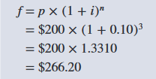
Future Value of a Single Amount for Multiple Periods
Exhibit B.4
Formula to compute future value of a single amount:
p = present value (PV)
f = future value (FV)
i = interest rate per period
n = number of periods
Illustration of FV of a Single Amount for Multiple Periods:
p = $200
f = $266.20
i = 10%
n = 3
© McGraw-Hill Education
Learning Objective P2: Apply future value concepts to a single amount by using interest tables.
12
Notes:
This formula can be used to compute the future value of an amount for any number of periods into the future. To illustrate, assume that $200 is invested for three periods at 10%. The future value of this $200 is $266.20.

Slide 13
Using Present Table to Compute FV of a Single Amount
Exhibit B.5
Future value table helps with computations.
Provides future values (factors) for variety of interest rates and periods.
Future value assumes that the present value equals 1.
Future value of 1 table - Table B.2.
Formula to compute present value of a single amount:
f = future value (FV)
i = interest rate per period
n = number of periods
© McGraw-Hill Education
Learning Objective P2: Apply future value concepts to a single amount by using interest tables.
13
Notes:
A future value table makes it easier for us to compute future values (f) for many different combinations of interest rates (i) and time periods (n). Each future value in a future value table assumes the present value (p) is 1. If the future amount is something other than 1, we multiply our answer by that amount. The formula used to construct a table of future values (factors) for a single amount of 1 is in Exhibit B.5.
There are some important relations between Tables B.1 and B.2. In Table B.2, for the row where n = 0, the future value is 1 for each interest rate. This is so because no interest is earned when time does not pass. We also see that Tables B.1 and B.2 report the same information but in a different manner. In particular, one table is simply the reciprocal of the other. To illustrate this inverse relation, let’s say we invest $100 for a period of five years at 12% per year. How much do we expect to have after five years? We can answer this question using Table B.2 by finding the future value (f) of 1, for five periods from now, compounded at 12%. From that table we find f = 1.7623. If we start with $100, the amount it accumulates to after five years is $176.23 ($100 × 1.7623). We can alternatively use Table B.1. Here we find that the present value (p) of 1, discounted five periods at 12%, is 0.5674. Recall the inverse relation between present value and future value. This means that p = 1∕f (or equivalently, f = 1∕p). We can compute the future value of $100 invested for five periods at 12% as follows: f = $100 × (1∕0.5674) = $176.24 (which equals the $176.23 just computed, except for a 1 cent rounding difference).

Slide 14
Future Value Table to Compute PV of 1
Case 1: solve for f when knowing i = 12% and n = 5;
Invest $100 for five years at 12%.
Table B.2: row for five periods and column for 12%.
f = 1.7623
f = $100 × 1.7623 = $176.23
Case 2: solve for n when knowing i = 7%= and f =$3,000; Have $2,000 and want $3,000 in n years at 7%.
$3,000 / $2,000 = 1.500
Table B.2: look in 7% column and find value nearest to 1.500
n = 6 periods or 6 years
Case 3: solve for i when knowing f = $4,000 and n = 9; Have $2,001 and want $4,000 in 9 years.
$4,000 / $2,001 = 1.9990
Table B.2: row 9 find nearest value to 1.9990
i = 8%
© McGraw-Hill Education
Learning Objective P2: Apply future value concepts to a single amount by using interest tables.
14
Notes:
To illustrate the use of a future value table, consider three cases:
Case 1: Solve for f when knowing i and n. Our preceding example fits this case. We found that $100 invested for five periods at 12% interest accumulates to $176.24.
Case 2: Solve for n when knowing f and i. In this case, we have, say, $2,000 (p) and we want to know how many periods (n) it will take to accumulate to $3,000 (f) at 7% interest (i). To answer this, we go to the future value table (Table B.2) and look in the 7% interest column. Here we find a column of future values (f) based on a present value of 1. To use a future value table, we must divide $3,000 (f) by $2,000 (p), which equals 1.500. This is necessary because a future value table defines p equal to 1, and f as a multiple of 1. We look for a value nearest to 1.50 (f), which we find in the row for six periods (n). This means that $2,000 invested for six periods at 7% interest accumulates to $3,000.
Case 3: Solve for i when knowing f and n. In this case, we have, say, $2,001 (p), and in nine years (n) we want to have $4,000 (f). What rate of interest must we earn to accomplish this? To answer that, we go to Table B.2 and search in the row for nine periods. To use a future value table, we must divide $4,000 (f) by $2,001 (p), which equals 1.9990. Recall that this is necessary because a future value table defines p equal to 1 and f as a multiple of 1. We look for a value nearest to 1.9990 (f), which we find in the column for 8% interest (i). This means that $2,001 invested for nine periods at 8% interest accumulates to $4,000.

Slide 15
Apply present value concepts to an annuity by using interest tables.
Learning Objective P3
© McGraw-Hill Education
15

Slide 16
Present Value of an Annuity
Annuity – series of equal payments occurring at equal intervals.
Ordinary annuity – equal end-of-period payments at equal intervals.
Can compute PV of ordinary annuity using Table B.1.
Direct way use PV of annuity table – Table B.3.
Example of using Table B.1 vs Table B.3:
© McGraw-Hill Education
Learning Objective P3: Apply present value concepts to an annuity by using interest tables.
16
Notes:
An annuity is a series of equal payments occurring at equal intervals. One example is a series of three annual payments of $100 each. An ordinary annuity is defined as equal end-of-period payments at equal intervals. An ordinary annuity of $100 for three periods and its present value (p) are illustrated in Exhibit B.6.
A direct way is to use a present value of annuity table. Table B.3 at the end of this appendix is one such table. This table is called a present value of an annuity of 1 table. If we look at Table B.3 where n = 3 and i = 15%, we see the present value is 2.2832. This means that the present value of an annuity of 1 for three periods, with a 15% interest rate, equals 2.2832.
A present value of an annuity formula is used to construct Table B.3. It can also be constructed by adding the amounts in a present value of 1 table. To illustrate, we use Tables B.1 and B.3 to confirm this relation for the prior example.

Slide 17
Apply future value concepts to an annuity by using interest tables.
Learning Objective P4
© McGraw-Hill Education
17

Slide 18
Future Value of an Annuity
Can compute FV of ordinary annuity using Table B.2.
Direct way use FV of annuity table – Table B.4.
Example of using Table B.2 vs Table B.4:
© McGraw-Hill Education
Learning Objective P4: Apply future value concepts to an annuity by using interest tables.
18
Notes:
The future value of an ordinary annuity is the accumulated value of each annuity payment with interest as of the date of the final payment. To illustrate, let’s consider the earlier annuity of three annual payments of $100. Exhibit B.7 shows the point in time for the future value (f). The first payment is made two periods prior to the point when future value is determined, and the final payment occurs on the future value date.
One way to compute the future value of an annuity is to use the formula to find the future value of each payment and add them. This is identical to using Table B.2 and summing the future values of each payment, or adding the future values of the three payments of 1 and multiplying the sum by $100.
A more direct way is to use a table showing future values of annuities. Such a table is called a future value of an annuity of 1 table. Table B.4 at the end of this appendix is one such table. Note that in Table B.4 when n= 1, the future values equal 1 (f= 1) for all rates of interest. This is because such an annuity consists of only one payment and the future value is determined on the date of that payment—no time passes between the payment and its future value. The future value of an annuity formula is used to construct Table B.4. We can also construct it by adding the amounts from a future value of 1 table. To illustrate, we use Tables B.2 and B.4 to confirm this relation for the prior example.
Note that the future value in Table B.2 is 1.0000 when n= 0, but the future value in Table B.4 is 1.0000 when n= 1. Is this a contradiction? No. When n= 0 in Table B.2, the future value is determined on the date when a single payment occurs. This means that no interest is earned because no time has passed, and the future value equals the payment. Table B.4 describes annuities with equal payments occurring at the end of each period. When n= 1, the annuity has one payment, and its future value equals 1 on the date of its final and only payment. Again, no time passes between the payment and its future value date.

Slide 19
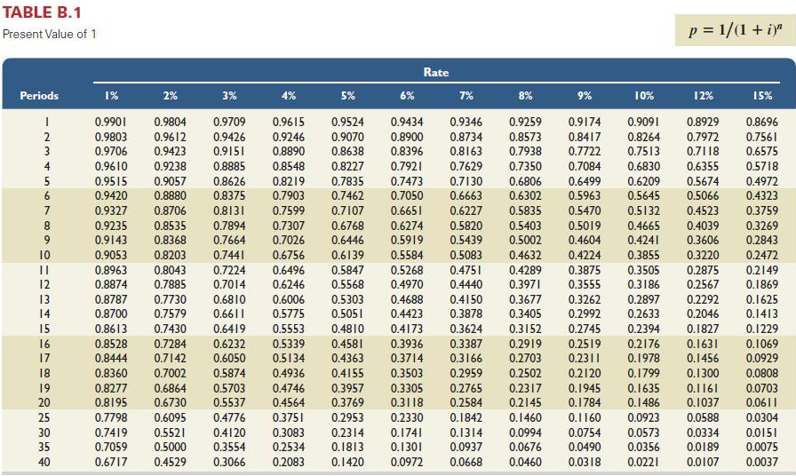
Table B.1
© McGraw-Hill Education
19

Slide 20
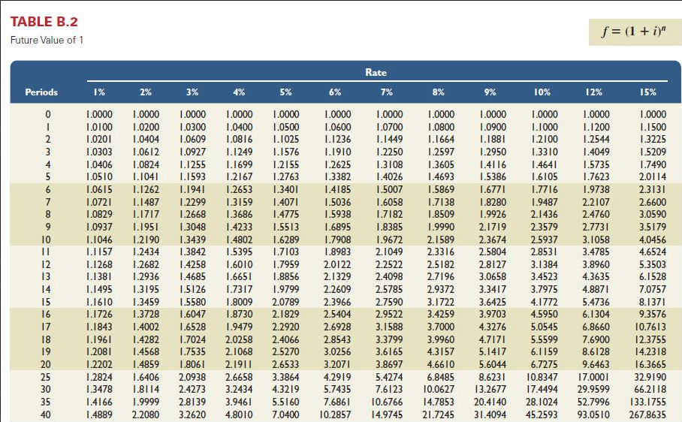
Table B.2
© McGraw-Hill Education
20

Slide 21
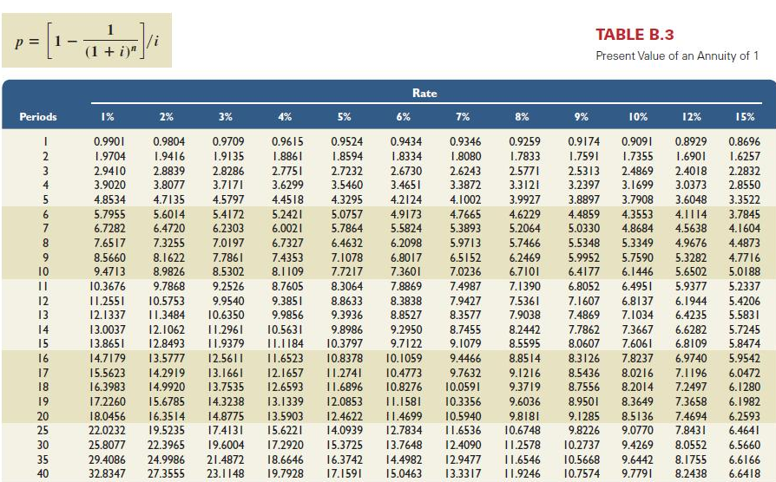
Table B.3
© McGraw-Hill Education
21

Slide 22
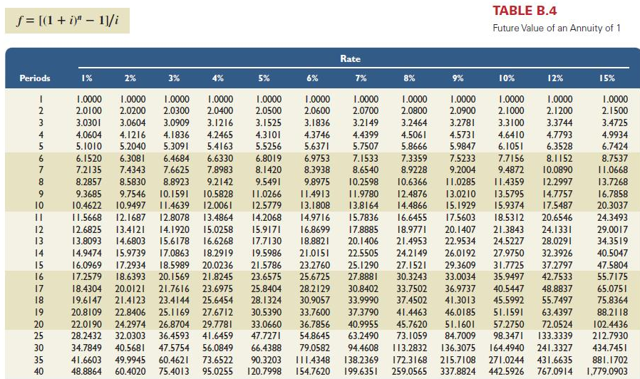
Table B.4
© McGraw-Hill Education
22

Slide 23
End of Appendix B
© McGraw-Hill Education
23

