Slide 1
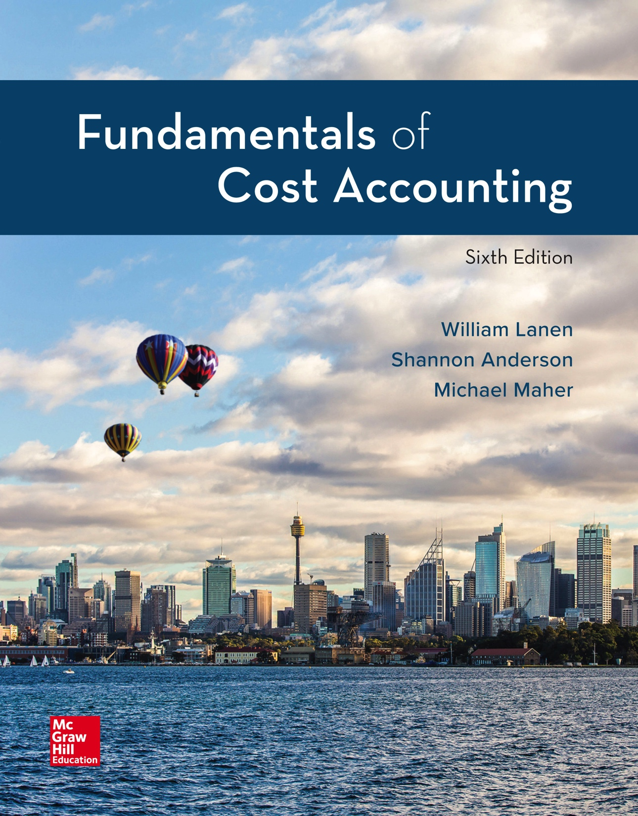
Copyright ©2020 McGraw-Hill Education. All rights reserved. No reproduction or distribution without the prior written consent of McGraw-Hill Education.
Notes:
Fundamentals of Cost Accounting, 6th edition
Lanen/Anderson/Maher

Slide 2
Job Costing
Chapter 7
Notes:
Chapter 7: Job Costing
In Chapter 6, we developed the basics of a cost management system designed to report the costs of products and services. In this chapter, we describe a job costing system used in many service and discrete manufacturing settings.

Slide 3
Learning Objectives
LO 7-1 Explain what job and job shop mean.
LO 7-2 Assign costs in a job cost system.
LO 7-3 Account for overhead using predetermined rates.
LO 7-4 Apply job costing methods in service organizations.
LO 7-5 Understand the ethical issues in job costing.
LO 7-6 Describe the difference between jobs and projects.
Notes:
After studying this chapter you should be able to explain what job and job shop mean; assign costs in a job cost system; account for overhead using predetermined rates; apply job costing methods in service organizations; understand the ethical issues in job costing; and describe the difference between jobs and projects.

Slide 4
Defining a Job
LO 7-1
LO 7-1 Explain what job and job shop mean.
Job
Unit of a product that is easily distinguishable from other units
Job Shop
Firm that produces jobs
Notes:
A job is an easily distinguished cost object for which a cost is desired. A job shop is a firm that produces jobs.

Slide 5
Using Accounting Records in a Job Shop
LO 7-1
Job Cost Sheet
Record of the cost of the job kept in the accounting system
Subsidiary Ledger Account
Account that records financial transactions for a specific customer, vendor, or job (Job 1 WIP, Job 2 WIP, Job 3 WIP, etc.)
Control Account
Account in the general ledger that summarizes a set of subsidiary ledger accounts
Notes:
A job cost sheet is a record of the cost of the job kept in the accounting system. A subsidiary ledger account is an account that records financial transactions for each specific job. For example, costs of Job 1, Job 2, and Job 3 would be recorded separately in the subsidiary ledger. A control account is the account in the general ledger that summarizes a set of subsidiary ledger accounts. In other words, the work-in-process inventory control account would consist of Job 1, Job 2, and Job 3 work-in-process subsidiary accounts.

Slide 6
Production Process at Gupta
LO 7-2
LO 7-2 Assign costs in a job cost system.
Gupta Designs manufactures furniture for
offices and homes.
Notes:
Suppose Gupta Designs manufactures furniture for offices and homes.
Suppose Gupta Designs has jobs 12-03, 01-01 and 01-02.

Slide 7
Records of Costs at Gupta
LO 7-2
Materials
Work-in-process
Direct
materials
12-03
Total
WIP
Raw
materials
01-01
01-02
Indirect
materials
Overhead
Notes:
Transfers out of raw materials inventory are direct materials into jobs 12-03, 01-01, and 01-02 (work-in-process subsidiary accounts). Indirect materials are recorded in an overhead control account.

Slide 8
Records of Costs at Gupta (2)
LO 7-2
Labor
Work-in-process
Direct
labor
12-03
Total
WIP
Labor
01-01
01-02
Indirect
labor
Overhead
Notes:
Direct labor is recorded to jobs 12-03, 01-01, and 01-02 (work-in-process subsidiary accounts). Indirect labor is recorded in the overhead control account.

Slide 9
Records of Costs at Gupta (3)
LO 7-2
Overhead
Work-in-process
12-03
Total
WIP
Overhead
01-01
01-02
OH costs are applied to each job using the POHR.
Notes:
And, remember, overhead costs will be charged to and recorded in the subsidiary ledger accounts for jobs 12-03, 01-01, and 01-02 using a predetermined overhead rate.

Slide 10
Inventory Accounts
LO 7-2
On January 1, Gupta has the following balances
in each of its three inventory accounts:
Direct materials inventory $30,000
Work-in-process inventory (Job 12-03) $41,000
Finished goods inventory (Job 12-02) $27,000
Now, let’s record January’s activities for Gupta.
Notes:
Gupta began January with $30,000 in Raw (Direct) Materials, $41,000 in Work-in-Process, and $27,000 in Finished Goods.
Work-in-Process was comprised of Job 12-03 and Finished Goods had Job 12-02 which had not yet been sent to the client.
Now, let’s record January’s activities.

Slide 11
Direct Materials
LO 7-2
Gupta purchased $135,000
of raw materials on account.
Materials Inventory
Accounts Payable
BB 30,000
(1) 135,000
17,000 BB
135,000 (1)
Notes:
Gupta purchased $135,000 of raw materials on credit, debiting Materials Inventory and crediting Accounts Payable.

Slide 12
Direct Materials (2)
LO 7-2
Gupta used $12,000 of direct materials for 12-03.
They also started 01-01 and 01-02 and used $102,000
and $15,000 of direct materials respectively.
Materials Inventory
WIP Inventory
BB 30,000
(1) 135,000
129,000 (2)
BB 41,000
(2) 129,000
Subsidiary WIP Accounts
WIP 12-03
WIP 01-01
WIP 01-02
BB 41,000
(2) 12,000
(2) 102,000
(2) 15,000
Notes:
Gupta requested $129,000 of materials for specific jobs (direct materials). Of the $129,000 of materials, $12,000 was for 12-03, $102,000 for 01-01, and $15,000 for a new job 01-02. Gupta debited WIP for the total and allocated the total to the subsidiary accounts and credited Materials Inventory for $129,000.

Slide 13
Direct Materials (3)
LO 7-2
Direct labor of $98,000 was incurred ($16,000 for 12-03,
$71,000 for 01-01, and $11,000 for 01-02).
WIP Inventory
Wages Payable
BB 41,000
(2) 129,000
(3) 98,000
98,000 (3)
Subsidiary WIP Accounts
WIP 12-03
WIP 01-01
WIP 01-02
BB 41,000
(2) 12,000
(3) 16,000
(2) 102,000
(3) 71,000
(2) 15,000
(3) 11,000
Notes:
Gupta processed the time tickets for the workers—all direct labor. The total was $98,000: $16,000 was for job 12-03, $71,000 for job 01-01, and $11,000 for job 01-02. WIP was debited for the total $98,000 and the subsidiaries for their portion, and Wages Payable was credited for $98,000.

Slide 14
Manufacturing Overhead
LO 7-2
Gupta incurred the following “actual” overhead
costs in January:
JE#
Item
Amount
(4)
(5)
(6)
(6)
(6)
Indirect material requisitioned
Indirect labor incurred
Utilities & other factory expenses (credit A/P)
Prepaid factory expenses used
Factory depreciation
Total actual overhead expenses
$12,000
9,500
13,750
5,000
11,200
$51,450
With this information, let’s continue recording
Gupta’s activities.
Notes:
Gupta incurred overhead comprised of $12,000 indirect materials, $9,500 indirect labor, $13,750 utilities and other factory expenses (credit to A/P), $5,000 of prepaid expenses, and $11,200 factory depreciation. Let’s record these overhead expenses.

Slide 15
Manufacturing Overhead (2)
LO 7-2
MOH Control
Prepaid Expense
Accum. Depreciation
(4) 12,000
(5) 9,500
(6) 13,750
(6) 5,000
(6) 11,200
5,000 (6)
11,200 (6)
Materials Inventory
Accounts Payable
Wages Payable
BB 30,000
(1) 135,000
(2) 129,000
(4) 12,000
17,000 BB
135,000 (1)
13,750 (6)
98,000 (3)
9,500 (5)
Notes:
The manufacturing overhead control account is debited for the total of the expenses and Materials Inventory, Wages Payable, A/P, Prepaid Expenses, and Accumulated Depreciation are credited for the appropriate amounts.

Slide 16
How Manufacturing Overhead Costs Are Recorded at Gupta
LO 7-3
LO 7-3 Account for overhead using predetermined rates.
Two common events that lead to manufacturing
overhead being recorded are:
1. Preparing financial statements
2. Completing a job
Notes:
Manufacturing overhead is periodically recorded on the job cost sheet.

Slide 17
Predetermined Rate
LO 7-3
The estimated manufacturing overhead predetermined
rate is the estimated overhead divided by the estimated
activity for the allocation base.
Gupta uses estimates based on annual manufacturing
overhead and annual production volume.
Why?
Because it does not want erratic or monthly costs or
production volumes to affect the long-run production costs.
Notes:
Job shops use predetermined rates to assign manufacturing overhead to jobs. Gupta uses estimates based on annual manufacturing overhead and annual production volume.

Slide 18
Application of Manufacturing Costs to Jobs
LO 7-3
Overhead is allocated to jobs using
direct labor cost as its base.
Gupta estimated that the manufacturing
overhead for the coming year would be
$600,000 and that direct labor cost
would be $1,200,000.
Notes:
Gupta allocates overhead using direct labor cost. Gupta uses an account known as Applied Manufacturing Overhead to allocate the overhead using the predetermined overhead rate times the actual direct labor cost incurred. The Applied Manufacturing Overhead account will be credited when overhead is applied to job tickets and Work-in-Process Inventory is debited.

Slide 19
Application of Manufacturing Costs to Jobs (2)
LO 7-3
Direct labor costs
POHR = $600,000 ÷ $1,200,000 = $0.50/DL$ or 50% of direct labor cost
Notes:
The predetermined overhead rate equals estimated overhead costs divided by the estimated application base. For Gupta, the allocation base will be direct labor costs. If estimated overhead costs are $600,000 and estimated direct labor costs are $1,200,000, the predetermined overhead rate is $0.50 per direct labor dollar. Stated another way, the predetermined overhead rate is 50 percent of direct labor cost.

Slide 20
Application of Manufacturing Costs to Jobs (3)
LO 7-3
Job #
DL$
Rate
OH Applied
12-03
01-01
01-02
Total
$16,000
71,000
11,000
$98,000
50%
50%
50%
50%
$ 8,000
35,500
5,500
$49,000
Notes:
A worksheet is prepared calculating the overhead to be applied to each job. The sheet contains the job number, direct labor cost, the predetermined overhead rate of 50 percent, and the amount of overhead to apply. Once calculated, WIP is debited for the total ($49,000).

Slide 21
Application of Manufacturing Costs to Jobs (4)
LO 7-3
MOH - Applied
43,500 (7)
5,500 (11)
WIP 12-03
WIP 01-01
WIP 01-02
BB 41,000
(2) 12,000
(3) 16,000
(7) 8,000
(2) 102,000
(3) 71,000
(7) 35,500
(2) 15,000
(3) 11,000
(11) 5,500
Notes:
Each job ticket is debited for its share and Applied Manufacturing Overhead is credited for the total applied, $49,000.

Slide 22
Cost of Jobs Completed in January
LO 7-3
Gupta completed Jobs 12-03 and 01-01
and transferred them to Finished Goods.
Job Ticket Summary
Job 12-03
Job 01-01
Beginning inventory January 1
Direct materials – January
Direct labor – January
OH applied – January
Total cost on job tickets
$41,000
12,000
16,000
8,000
$77,000
$ -0-
102,000
71,000
35,500
$208,500
Notes:
Gupta completed Jobs 12-03 and 01-01. The job tickets are summed. Job 12-03 totals $77,000 and Job 01-01 is $208,500.

Slide 23
Cost of Jobs Completed in January (2)
LO 7-3
Finished Goods Inventory (12-03) 77,000
Finished Goods Inventory (01-01) 208,500
Work-in-Process Inventory (12-03) 77,000
Work-in-Process Inventory (01-01) 208,500
Next, Jobs 12-02 and 12-03 were sold for
$35,000 and $95,000, respectively.
Notes:
When jobs are finished, they are transferred from WIP to Finished Goods. WIP is credited for the total of each ticket and Finished Goods Inventory is debited. Don’t forget, whenever an amount is added or deducted from WIP, the job tickets must also be adjusted. The sum of open tickets should always equal the balance of the WIP account.

Slide 24
Cost of Jobs Sold in January
LO 7-3
Cost of Goods Sold (12-02) 27,000
Cost of Goods Sold (12-03) 77,000
Finished Goods Inventory (12-02) 27,000
Finished Goods Inventory (12-03) 77,000
Accounts Receivable (12-02) 35,000
Accounts Receivable (12-03) 95,000
Revenue (12-02) 35,000
Revenue (12-03) 95,000
Notes:
Jobs 12-02 and 12-03 are sold on account and shipped. To record the cost of goods sold, debit Cost of Goods Sold for $27,000 (Job 12-02) and $77,000 (Job 12-03) and credit Finished Goods Inventory for the same amounts. To record the sale on account, debit Accounts Receivable for $35,000 (Job 12-02) and $95,000 (Job 12-03) and credit Revenue for the same amounts.

Slide 25
Cost Flows Through T-Accounts
LO 7-3
After the journal entries are completed,
the accounts have the following ending balances.
Materials Inventory
Work-in-Process Inventory
EB 24,000
EB 31,500
Finished Goods Inventory
Cost of Goods Sold
EB 208,500
EB 104,000
Notes:
After the entries are completed, Materials Inventory has an ending balance of $24,000 (debit), WIP $31,500 (debit), Finished Goods Inventory $208,500 (debit) and Cost of Goods Sold $104,000 (debit).

Slide 26
The Job Cost Sheet
LO 7-3
Notes:
A job cost sheet is a record of the cost of the job kept in the accounting system.

Slide 27
The Job Cost Sheet (2)
LO 7-3
Total Costs for Job 01-01
Direct materials
Direct labor
Manufacturing overhead
Total
Transferred to finished goods inventory
Direct materials
Direct labor
Manufacturing overhead
Total
$102,000
71,000
35,500
$208,500
$102,000
71,000
35,500
$208,500
Notes:
The job cost sheet aids in identifying the total cost of the job. The total cost of Job 01-01 is $208,500.

Slide 28
An Alternative Method of Recording and Applying Manufacturing Overhead
LO 7-3
Assume Gupta maintains two manufacturing
overhead accounts:
Manufacturing Overhead Control, which is used to track all actual overhead expenses.
Applied Manufacturing Overhead, which is used to allocate overhead to jobs based on the predetermined OH rate.
Some companies combine these two accounts into one account.
Notes:
Some companies use an alternative method to record and apply manufacturing overhead. Assume Gupta uses this method. The two overhead accounts are: One, “Manufacturing Overhead Control” to track actual overhead expenses incurred (this account will be debited for actual overhead incurred), and the second account (already discussed), “Applied Manufacturing Overhead” to allocate the overhead using the predetermined overhead rate times the actual direct labor hours used. The Applied Manufacturing Overhead account will be credited when overhead is applied to job tickets.

Slide 29
An Alternative Method of Recording and Applying Manufacturing Overhead (2)
LO 7-3
Underapplied Overhead
The excess of actual overhead costs incurred
over applied overhead costs
Overapplied Overhead
The excess of applied overhead costs over
actual overhead costs incurred
Notes:
Indirect costs are recorded in the overhead control account when they are incurred and applied to products based on a predetermined overhead application rate. When overhead is applied, the overhead control account is credited and the work-in-process subsidiary accounts are debited. Underapplied overhead is the excess of actual overhead costs incurred over the overhead costs applied. Overapplied overhead is the excess of applied overhead costs over actual overhead costs incurred.

Slide 30
Writing Off Over- or Underapplied Overhead
LO 7-3
The two manufacturing overhead accounts
are not balance sheet accounts.
The combined ending balance must be zero.
The combined OH is $2,450 underapplied.
Manufacturing Overhead
Control
Applied Manufacturing
Overhead
12,000
9,500
13,750
5,000
11,200
51,450
49,000
49,000
Notes:
The overhead control account is not a balance sheet account and, therefore, must have an ending balance of zero. The overhead control account for Gupta has been debited for $12,000 indirect materials used, $9,500 indirect labor costs incurred, $13,750 for utilities, $5,000 for prepaid expenses, and $11,200 for depreciation relating to the factory. The total debits to the Manufacturing Overhead Control account were $51,450. Since $49,000 overhead has been applied to the work-in-process accounts, overhead is underapplied by $2,450.

Slide 31
Writing Off Over- or Underapplied Overhead (2)
LO 7-3
Applied Manufacturing
Overhead
Cost of Goods Sold
49,000
2,450
51,450
104,000
2,450
106,450
After entry, the applied and control overhead accounts sum to zero.
Notes:
Ultimately overhead costs incurred need to be accounted for. One approach is to account for under- or overapplied overhead by adjusting cost of goods sold. Because overhead costs incurred were $2,450 more than overhead applied to jobs during the month for Gupta, an adjustment is necessary. For underapplied overhead, the applied overhead account is credited for $2,450 and cost of goods sold is increased or debited for $2,450.

Slide 32
Writing Off Over- or Underapplied Overhead (3)
LO 7-3
Some firms use only one OH account.
In this condition, the debit side of the OH account contains
actual data and the credit side contains applied data.
For either condition of under- or overapplied, actual must
equal applied in the Overhead control account at the end
of the period.
Overhead
Cost of Goods Sold
12,000
9,500
13,750
5,000
11,200
51,450
49,000
2,450
51,450
104,000
2,450
106,450
Notes:
Some firms prefer to use only one overhead account. If that is the case, then the debit side of the overhead account will contain the actual overhead incurred and the credit side will contain overhead applied. You would still transfer any over/under overhead applied to Cost of Goods Sold at the end of the period.

Slide 33
Writing Off Over- or Underapplied Overhead (4)
LO 7-3
Some companies prorate the over/under
applied MOH to WIP, FG, and COGS.
Accounts at January 31
Costs
% of Total
Work-in-Process Inventory
Finished Goods Inventory
Cost of Goods Sold
Total
$ 31,500
208,500
104,000
$344,000
9.2%
60.6%
30.2%
100.0%
Notes:
Another option for adjusting under- or overapplied overhead is to adjust the accounts that contain the cost of the products worked on during the period. At the end of the month, where are the goods that had overhead applied to them during the period? The goods are either still in work-in-process, finished goods, or cost of goods sold. At January, Cost of Goods Sold has costs of $104,000 or 30.2% of the total product costs for the period. Finished Goods Inventory has cost of $208,500 or 60.6%. And Work-in-Process Inventory has $31,500 or 9.2% of the total product costs of $344,000 for the month of January.

Slide 34
Writing Off Over- or Underapplied Overhead (5)
LO 7-3
Allocate underapplied overhead to finished goods,
cost of good sold and WIP.
Work-in-Process Inventory
Finished Goods Inventory
31,500
225
(2,450 × 0.092)
208,500
1,485
(2,450 × 0.606)
Cost of Goods Sold
Overhead
104,000
740
(2,450 × 0.302)
51,450
49,000
2,450
Notes:
Using the percent of total product costs to allocate underapplied overhead, Cost of Goods Sold is debited $740 (30.2% of $2,450), Finished Goods Inventory $1,485 (60.6% of $2,450) and Work-in-Process Inventory $225 (9.2% of $2,450). The Manufacturing Overhead Control account is credited for $2,450.

Slide 35
Using Normal, Actual, and Standard Costing
LO 7-3
Normal
Cost of job determined by actual direct material, actual
direct labor, and applied overhead using the POHR
and the actual allocation base
Actual
Cost of job determined by actual direct material, actual
direct labor, and applied overhead using actual overhead
rate and the actual allocation base
Standard
Cost of job determined by standard (budgeted) direct
material, standard direct labor, and applied overhead
using the POHR and a standard (budgeted) allocation base
Notes:
When Gupta Designs recorded manufacturing overhead to the individual jobs, actual direct labor dollars were multiplied by the predetermined overhead rate of $0.50 per direct labor dollar. This is called normal costing. Using normal costing, the cost of a job is determined by actual direct material and actual direct labor costs and applied overhead using the predetermined overhead rate times the actual allocation base. Normal costing uses estimates for the cost of overhead. An alternative costing method is actual costing. Actual costing is actual direct cost plus overhead applied using a rate based on actual overhead and actual allocation base. Actual costing requires management to wait until actual costs are known before costing the product, but does provide more current information. A third method is standard costing. Using standard costing, the cost of the job is determined by standard or budgeted direct cost and applied overhead using the predetermined overhead rate and a standard allocation base.

Slide 36
Using Job Costing in Service Organizations
LO 7-4
LO 7-4 Apply job costing methods in service organizations.
Service organizations use fewer direct materials
than manufacturing companies.
Service companies’ overhead accounts have
slightly different names.
Finished goods (or services) are charged to
Cost of Services Billed.
Notes:
Service organizations are labor intensive and use fewer direct materials than manufacturing companies.

Slide 37
Using Job Costing in Service Organizations (2)
LO 7-4
Labor
Work in process
Direct
labor
Contract 782
Total
WIP
Labor
Contract 783
Contract 784
Indirect
labor
Overhead
Notes:
Applying job costing methods in a service organization works the same way. The subsidiary ledger accounts are clients rather than jobs. Direct costs are traced directly to the client and indirect costs are applied to the client’s work-in-process account using a predetermined overhead rate.

Slide 38
Ethical Issues
LO 7-5
LO 7-5 Understand the ethical issues in job costing.
Improprieties include:
– Misstating the stage of completion
– Charging costs to the wrong jobs
– Misrepresenting the cost of jobs
Notes:
Some of the more common improprieties regarding job costing are the misstatement of the stage of completion, charging costs to wrong jobs or categories, and misrepresenting costs.

Slide 39
Managing Projects
LO 7-6
LO 7-6 Describe the difference between jobs and projects.
A project is a complex job that often takes months
or years to complete and requires the work of many
departments, divisions, or subcontractors.
Notes:
The terms “project” and “job” are sometimes used to mean the same thing. Yet, projects and jobs are different. A project is frequently comprised of many jobs. Projects are complex and often take months or even years to complete. They require the work of many departments, divisions, or subcontractors.

Slide 40
End of Chapter 7
Notes:
End of Chapter 7.

