Slide 1
Flexible Budgets and Standard Costs
Chapter 21
Wild and Shaw
Financial and Managerial Accounting
9th Edition
Copyright ©2022 McGraw-Hill Education. All rights reserved. No reproduction or distribution without the prior written consent of McGraw-Hill Education.

Slide 2
Chapter 21 Learning Objectives
CONCEPTUAL
C1 Define standard costs and explain how standard cost information is useful.
ANALYTICAL
A1 Analyze changes in sales from expected amounts.
PROCEDURAL
P1 Prepare a flexible budget and interpret a flexible budget performance report.
P2 Compute the total cost variance.
P3 Compute direct materials and direct labor variances.
P4 Compute overhead controllable and volume variances.
P5 Compute overhead spending and efficiency variances. (Appendix 21A)
P6 Prepare journal entries for standard costs and account for price and quantity variances. (Appendix 21A)
21-2
© McGraw-Hill Education

Slide 3
Prepare a flexible budget and interpret a flexible budget performance report.
Learning Objective P1
21-3
© McGraw-Hill Education

Slide 4
Fixed and Flexible Budgets
Managers use budgets to control operations and see that planned objectives are met.
A master budget is based on a predicted level of activity for the budget period.
Budget reports – compare actual results to budgeted results.
Fixed budget, static budget, based on one predicted amount of sales or other activity measure.
A flexible budget, or variable budget, based on more than one amount of sales or other activity measure.
21-4
© McGraw-Hill Education
Learning Objective P1: Prepare a flexible budget and interpret a flexible budget performance report.
Notes:
Managers use budgets to control operations and see that planned objectives are met.
Budget reports compare budgeted results to actual results.
A master budget is based on a predicted level of activity, such as sales volume, for the budget period. In preparing a master budget, two alternative approaches can be used: fixed budgeting or flexible budgeting.
A fixed budget, also called a static budget, is based on one predicted amount of sales or other activity measure.
A flexible budget, also called a variable budget, is based on more than one amount of sales or other activity measure.

Slide 5
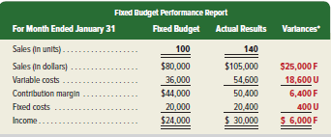
Fixed Budget Performance Report
A fixed budget is based on one predicted amount of sales.
Exhibit 21.2
Fixed budget performance reports compares actual results with results expected under a fixed budget.
This fixed budget is based on 100 units, but 140 actual units were sold resulting in the variances shown here.
21-5
© McGraw-Hill Education
Learning Objective P1: Prepare a flexible budget and interpret a flexible budget performance report.
Notes:
One use of a budget is to compare actual results with planned activities. A performance report shows budgeted amounts, actual amounts, and variances. A variance is the difference between budgeted and actual amounts.
Exhibit 21.2 shows a fixed budget performance report, a report that compares actual results with the results expected under a fixed budget. January’s fixed budget for the guitar maker is based on 100 units, but 140 units were actually sold. The far-right column shows the variances between the budgeted and actual dollar amounts for each budget item. We use the letters F and U to identify variances.
A fixed budget report is limited because it is not an apples-to-apples comparison based on similar levels of activity. In Exhibit 21.2, the budgeted amounts use 100 units of activity, but 140 units were actually sold.
Favorable variance (F): when actual income is higher than budgeted income. It is also when actual revenue is higher than budgeted revenue or when actual cost is lower than budgeted cost.
Unfavorable variance (U): when actual income is lower than budgeted income. It is also when actual revenue is lower than budgeted revenue, or when actual cost is higher than budgeted cost.

Slide 6
Purpose of Flexible Budgets
Prepared before period begins is
based on several levels of activity
Provide a “what-if” analysis that includes best-case and worst-case activity levels.
Provides an “apples to apples”
comparison.
Prepared after period ends help
evaluate performance. Management
can focus on problems.
21-6
© McGraw-Hill Education
Learning Objective P1: Prepare a flexible budget and interpret a flexible budget performance report.
Notes:
A flexible budget prepared before the period begins is often based on several levels of activity. Budgets for different levels provide a “what-if” analysis that often includes best-case and worst-case activity levels. This allows management to make adjustments to increase profits or decrease losses.
A flexible budget prepared after the period ends helps evaluate performance. It is an apples-to-apples comparison because budgeted activity level equals actual activity level. Comparisons of actual results with budgeted performance at the same activity level are more likely to reveal the real causes of any variances. Managers then focus attention on problems resulting in unfavorable variances and opportunities resulting in favorable variances.

Slide 7
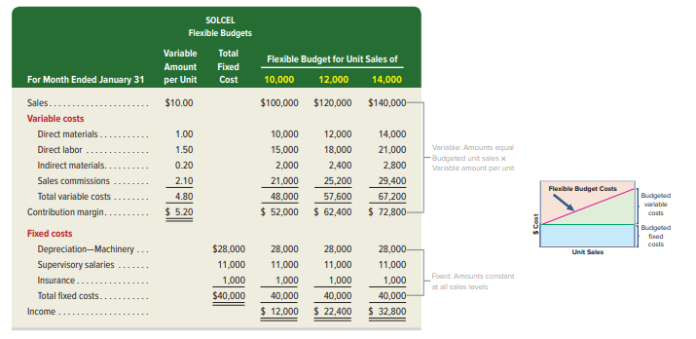
Preparation of Flexible Budgets
Exhibit 21.3
Total Budgeted Costs = Total Fixed Costs + (Total Variable Cost Per Unit x Units of Activity).
21-7
© McGraw-Hill Education
Learning Objective P1: Prepare a flexible budget and interpret a flexible budget performance report.
Notes:
To prepare a flexible budget, follow these steps:
1. Identify the activity level, such as units produced or sold.
Identify costs and classify them as fixed or variable within the relevant range of activity.
Compute budgeted sales (Sales price per unit x Units of activity). Compute budgeted variable costs. Variable costs per unit x Units of activity. Compute budgeted fixed costs. Fixed costs are constant at each activity level. Compute budgeted income. Sales minus Variable minus Fixed costs.
Flexible Budgeted Equation for Total Budgeted Costs: flexible budgets can be prepared at any activity level using the following formula:
Total Budgeted Costs = Total Fixed Costs + (Total Variable Cost Per Unit x Units of Activity).
Let’s see how flexible budgeting works by preparing flexible budgets for 10,000 units, 12,000 units, and 14,000 units for SolCel. Notice that SolCel’s costs have been classified by behavior, either variable or fixed, in the flexible budget. The flexible budget follows a contribution margin format beginning with sales followed by variable costs and then fixed costs.

Slide 8
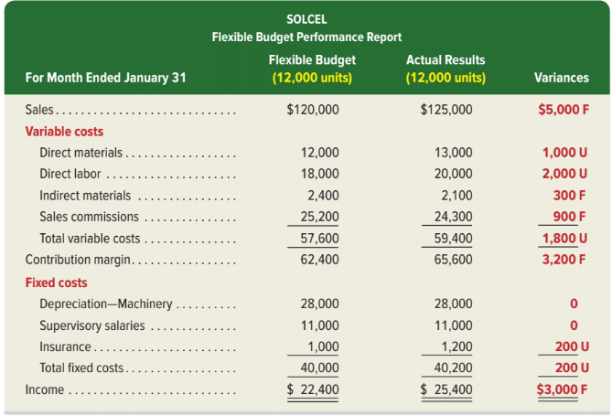
Flexible Budget Performance Report
A flexible budget performance report compares actual performance and budgeted performance based on actual level.
Favorable sales variance because average selling price was greater than $10.00 per unit.
Unfavorable total direct materials and direct labor variances because actual costs are greater than expected.
Favorable sales commissions variance because actual sales commissions are less than expected.
Exhibit 21.4
21-8
© McGraw-Hill Education
Learning Objective P1: Prepare a flexible budget and interpret a flexible budget performance report.
Notes:
A flexible budget performance report compares actual performance and budgeted performance based on actual activity level.
This report directs management’s attention to actual amounts that differ greatly from budgeted amounts.
For SolCel, the flexible budget is based on 12,000 units produced and sold for January.
Management often focuses on large variances. Exhibit 21.4 shows a $5,000 favorable variance in dollar sales. Because actual and budgeted sales volumes are both 12,000 units, the $5,000 favorable sales variance must have resulted from a higher-than-expected selling price. Management would like to determine if the conditions that resulted in higher selling prices will continue.
Both the direct materials ($1,000 U) and direct labor ($2,000 U) variances are relatively large and unfavorable. On the other hand, a relatively large favorable variance is observed for sales commissions ($900 F). Management will try to determine the causes for these variances, both favorable and unfavorable, and make changes to operations if needed.

Slide 9
Define standard costs and explain how standard cost information is useful.
Learning Objective C1
21-9
© McGraw-Hill Education

Slide 10
Standard Costing
Standard costs can be used in a flexible budgeting system to enable management to better understand the reasons for variances
Preset costs for delivering a product
or service under normal conditions.
The expected level of performance.
Standard costs are
Manufacturers use standard costing for direct materials, direct labor and overhead costs.
21-10
© McGraw-Hill Education
Learning Objective C1: Define standard costs and explain how standard cost information is useful.
Notes:
In the next few slides, we show how standard costs can be used in a flexible budgeting system to enable management to better understand the reasons for variances.
Standard costs are preset costs for delivering a product or service under normal conditions. We can think of standard costs as budgeting on a per unit basis. We expect to operate within the standard cost allowances under normal conditions. Production managers and engineers often determine the production requirements for one unit of product, and accountants put those requirements into dollars.
When actual costs vary from standard costs, management follows up to identify potential problems and take corrective actions. Management by exception means that managers focus attention on the most significant differences between actual costs and standard costs.
Budgets are prepared using standard costs.
Standard costs can also help control nonmanufacturing costs. Companies providing services instead of products can also benefit from the use of standard costs. For example, while quality medical service is crucial, efficiency in providing that service is also important in controlling medical costs. The use of budgeting and standard costing is effective in controlling costs, especially overhead.

Slide 11
Setting Standard Costs
Direct Materials
Quantity
& Grade
Cost
Motion
Studies
Direct Labor
Time Studies
Resources
Variable Overhead
21-11
© McGraw-Hill Education
Learning Objective C1: Define standard costs and explain how standard cost information is useful.
Notes:
An ideal standard is based on 100% efficiency. A practical standard is based on normal operating conditions which allow for some inefficiency.
The standard direct labor rate should include allowances for employee breaks, cleanup, and machine downtime. Most companies use practical rather than ideal standards.
Standards for direct labor are set by time and motion studies that show the direct labor hours required under normal operations.
Standards for direct materials are set by studying the quantity, grade, and cost of each material used.
Overhead standards are set by studying the resources needed to support production activities.
Standards should be challenging but attainable and should acknowledge machine breakdowns, material waste, and idle time.

Slide 12
Standard Costs Example
The standard costs of direct materials, direct labor, and overhead for one bat, manufactured by ProBat, are shown below. This is called a standard cost card.
Exhibit 21.5
These standard cost amounts are then used to prepare manufacturing budgets for a budgeted level of production.
21-12
© McGraw-Hill Education
Learning Objective C1: Define standard costs and explain how standard cost information is useful.
Notes:
Direct materials The purchasing department sets a standard price of $10 per pound for high-grade wood. The purchasing department considers the quality of materials, economic conditions, supply factors (shortages and excesses), and discounts.
Direct labor Two hours of direct labor are required to manufacture a bat. The direct labor rate is $15 per hour. This rate includes wages, taxes, and direct benefits.
Overhead ProBat applies overhead at the rate of $5 per direct labor hour (DLH).
The standard costs of direct materials, direct labor, and overhead for one bat, manufactured by ProBat, are shown on this slide. This is called a standard cost card.

Slide 13
Compute the total cost variance.
Learning Objective P2
21-13
© McGraw-Hill Education

Slide 14
Cost Variances
Cost variance is the difference between actual and standard cost.
If actual cost < standard cost Variance is favorable (F).
If actual cost > standard cost Variance is unfavorable (U).
21-14
© McGraw-Hill Education
Learning Objective P2: Compute the total cost variance.
Notes:
The difference between actual cost and standard cost is called a cost variance. Cost variances can be favorable or unfavorable.
If actual costs are less than standard costs, variance is favorable (F).
If actual costs are greater than standard cost, variance is unfavorable (U).

Slide 15
Cost Variance Analysis
Exhibit 21.6
Preparing a standard cost performance report.
Computing and analyzing variances.
Identifying questions and their answers.
Taking corrective and strategic actions.
21-15
© McGraw-Hill Education
Learning Objective P2: Compute the total cost variance.
Notes:
The flow of events in variance analysis is: (1) preparing a standard cost performance report, (2) computing and analyzing variances, (3) identifying questions and their answers, and (4) taking corrective and strategic actions. These variance analysis steps are interrelated and are frequently applied in good organizations.

Slide 16
Cost Variance Computation
Management needs information about the factors causing a cost variance, but first it must properly compute the variance. In its most simple form, a cost variance (CV) is computed as:
Exhibit 21.7
Actual quantity (AQ) is the actual amount of direct material or direct labor used to manufacture the actual quantity of output.
Standard quantity (SQ) is the standard amount of input for the actual quantity of output.
Actual price (AP) is the actual amount paid to acquire the actual direct material or direct labor used during the period.
Standard price (SP) is the standard price.
21-16
© McGraw-Hill Education
Learning Objective P2: Compute the total cost variance.
Notes:
Cost variance (CV) is computed as: Actual Cost (AC) minus Standard Cost (SC).
A cost variance is further defined by its components. Actual quantity (AQ) is the actual amount of direct material or direct labor used to manufacture the actual quantity of output. Standard quantity (SQ) is the standard input expected for the actual quantity of output. Actual price (AP) is the actual amount paid to acquire the actual direct material or direct labor used for the period, and standard price (SP) is the standard price of direct material or direct labor.
Price variances result when we pay an actual price for a resource that differs from the standard price that should have been paid. Quantity variances are caused by using an actual amount of a resource that differs from the standard amount that should have been used.

Slide 17
Compute direct materials and direct labor variances.
Learning Objective P3
© McGraw-Hill Education
21-17

Slide 18
Direct Materials and Direct Labor Variances
Two main factors cause materials and labor variances:
Exhibit 21.8
Exhibit 21.9
21-18
© McGraw-Hill Education
Learning Objective P3: Compute direct materials and direct labor variances.
Notes:
Two factors cause materials and labor variances:
1. Price (or rate) variance is the difference between actual price per unit of input and standard price per unit of input.
2. Quantity (or efficiency) variance is the difference between actual quantity of input used and standard quantity of input that should have been used.
Managers sometimes find it useful to use alternative formulas for price and quantity variances, as in Exhibit 21.9. Results from applying the formulas in Exhibits 21.8 and 21.9 are identical.

Slide 19
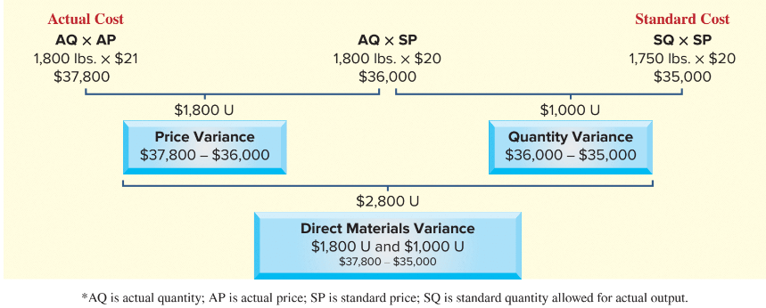
Direct Materials Variances
G-Max produced and sold 3,500 units Used 1,800 pounds of DM at $21.00 per lb.
Standard is 1,750 lbs. (0.5 lbs. per unit) at $20 per lb.
Exhibit 21.10
21-19
© McGraw-Hill Education
Learning Objective P3: Compute direct materials and direct labor variances.
Notes:
G-Max produced and sold 3,500 units in May and it used 1,800 pounds of direct materials (titanium) costing $21 per pound. Actual cost of its direct materials cost is $37,800.
Its materials standard shows that it should have used 1,750 pounds of direct materials to produce 3,500 units (0 .5 lb. per unit). Using the standard cost of $20 per pound, we get the standard cost of $35,000 for 3,500 units. Its direct materials variance is $2,800 Unfavorable.
To identify the causes of this $2,800 unfavorable (U) variance, the materials price and quantity variances are analyzed in Exhibit 21.10. The $1,800 unfavorable price variance results from paying $1 more per pound than the standard price, then multiplied by the 1,800 actual pounds purchased and used. The $1,000 unfavorable quantity variance results from using 50 pounds more of material than the standard quantity, then multiplied by the $20 per pound standard cost.

Slide 20
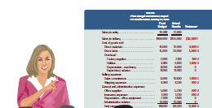
Evaluating Direct Materials Variances
Who is responsible for direct material cost variances?
I am not responsible for this unfavorable material quantity variance.
You purchased cheap material, so my people had to use more of it.
You used too much material because of poorly trained workers and poorly maintained equipment.
21-20
© McGraw-Hill Education
Learning Objective P3: Compute direct materials and direct labor variances.
Notes:
The purchasing department is responsible for the price paid for materials. The purchasing manager might have negotiated poor prices, or purchased higher-quality materials.
The production department is responsible for the quantity of direct material used. The production department might have used more than the standard amount of material because low quality material caused excessive waste. In this case, the purchasing manager must explain why inferior materials were acquired. However, if that waste was due to inefficiencies, not poor-quality materials, the production manager must explain why. In sum, variance analysis along with corrective action can improve future performance.

Slide 21
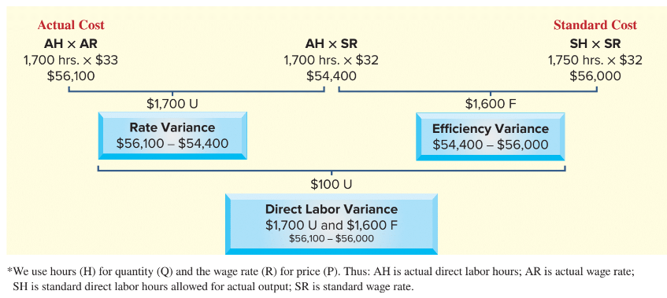
Direct Labor Variances
G-Max produced and sold 3,500 units Used 1,700 hours of DL at $33.00 per hr.
Standard is 1,750 lbs. (0.5 hr. per unit) at $32 per hr.
Exhibit 21.11
21-21
© McGraw-Hill Education
Learning Objective P3: Compute direct materials and direct labor variances.
Notes:
G-Max used 1,700 direct labor hours at a cost of $33 per hour in May. Actual cost of its direct labor is $56,100 ; see top row in this table.
G-Max should have used 1,750 direct labor hours to produce 3,500 units (0.5 DLH per unit). Using the standard cost of $32 per DLH, we get the standard cost of $56,000 for 3,500 units; see second row in table. Its direct labor variance is $100 U.
Actual direct labor cost is $100 over the standard, which might suggest no concern. A closer look reveals a problem. The direct labor variance can be divided into price and quantity variances, called rate and efficiency variances. Exhibit 21.11 shows the $100 total unfavorable labor variance results from a $1,600 favorable efficiency variance and a $1,700 unfavorable rate variance.

Slide 22
Evaluating Direct Labor Variances
One possible explanation of G-Max’s labor rate and efficiency variances is the use of workers with different skill levels.
Using highly paid skilled workers to perform unskilled tasks results in an unfavorable rate variance.
However, fewer labor hours might be required for the work resulting in a favorable efficiency variance.
High skill, high rate
Low skill, low rate
21-22
© McGraw-Hill Education
Learning Objective P3: Compute direct materials and direct labor variances.
Notes:
To produce 3,500 units, G-Max should use 1,750 direct labor hours (3,500 units × 0.5 standard DLH per unit). The $1,600 F efficiency variance results from using 50 fewer direct labor hours (1,700 actual DLH − 1,750 standard DLH) than standard for the units produced. The $50 fewer hours at $32 per hour result in the $1,600 favorable efficiency variance.
The production manager should explain how direct labor hours were reduced. If this efficiency can be repeated and transferred to other departments, more savings are possible.
The $1,700 U rate variance results from paying a rate that is $1 per hour higher than the standard ($33 actual rate - $32 standard rate). Each of the 1,700 actual direct labor hours used costs $1 more, resulting in the $1,700 unfavorable rate variance. Human resources or the production manager needs to explain why the wage rate is higher than the standard.

Slide 23
Compute overhead controllable and volume variances.
Learning Objective P4
21-23
© McGraw-Hill Education

Slide 24
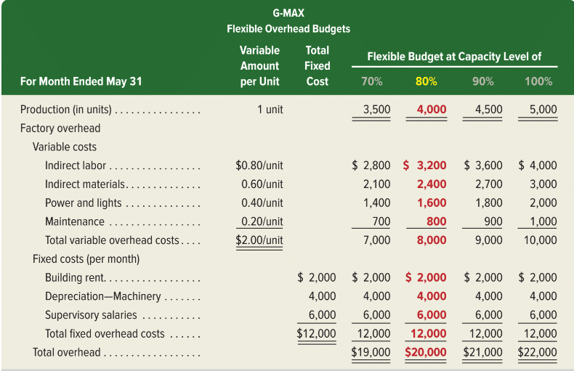
Flexible Overhead Budgets
Exhibit 21.12
21-24
© McGraw-Hill Education
Learning Objective P4: Compute overhead controllable and volume variances.
Notes:
In a standard costing system managers apply overhead costs to products and services using a standard overhead rate. The resulting standard overhead costs are the overhead amounts budgeted to occur at a specific activity level. Managers set standards and budgets before each period in a desire to better control, monitor, and assign costs to products and services.
We begin by showing how to use standard costs to develop flexible overhead budgets. The left two number columns of Exhibit 21.12 show the budgeted variable costs per unit and fixed costs for May. With these variable and fixed overhead costs, G-Max can prepare flexible overhead budgets at different capacity levels (see rightmost number columns). At its maximum capacity of 100%, G-Max can produce 5,000 clubheads. At 70% of capacity, G-Max can produce 3,500 clubheads (5,000 × 70%). At 100% capacity, total variable overhead costs are budgeted at $10,000 (5,000 × $2). At 70% capacity, total variable overhead costs are budgeted at $7,000 (3,500 × $2). At all capacity levels within the relevant range, fixed overhead costs are budgeted at $12,000 per month.

Slide 25
Standard Overhead Rate
Step 1: Determine an Allocation Base
Step 2: Predict an Activity Level
Standard Overhead Rate
Step 3: Compute the Standard
Overhead Rate
21-25
© McGraw-Hill Education
Learning Objective P4: Compute overhead controllable and volume variances.
Notes:
To compute the standard rate we use a three-step process:
Step 1: Determine an Allocation Base – The allocation base is a measure of input related to overhead costs. Examples include direct labor hours or machine hours. G-Max uses direct labor hours as an allocation base and it has a standard of 0.5 direct labor hour per unit.
Step 2: Predict an Activity Level - The predicted activity level is not set at 100% of capacity. Difficulties in scheduling work, equipment breakdowns, and low product demand typically cause the activity level to be less than full capacity. G-Max managers predicted an 80% activity level for May, or a production volume of 4,000 clubheads. We assume all units produced are sold.
Step 3: Compute the Standard Overhead Rate -- At the predicted activity level of 4,000 units, the flexible budget in Exhibit 21.12 shows total overhead of $20,000. To make 4,000 units, the standard direct labor hours required are 2,000 DLH computed as 4,000 units × 0.5 DLH per unit. The standard overhead rate is used to compute overhead cost variances. Standard overhead rate depends on the predicted activity level.
We can separate the overhead rate into two rates: one for variable overhead (VOH) and one for fixed overhead (FOH). Both rates are computed using numbers in the 80% column from Exhibit 21.12.

Slide 26
Computing Overhead Variances
Overhead variance is the difference between the actual total overhead and the standard overhead applied.
Exhibit 21.13
Exhibit 21.14
21-26
© McGraw-Hill Education
Learning Objective P4: Compute overhead controllable and volume variances.
Notes:
The standard amount of the allocation base is the overhead that should have been used, based on the actual production. Recall that G-Max actually produced 3,500 units in May, which differs from its predicted activity level of 4,000 units in May which should have used 1,750 direct labor hours computed as 3,500 actual units times 0.5 standard DLH per unit.
Standard overhead applied = Actual x Standard amount of x Standard overhead rate
production allocation base (at predicted activity level)
Standard overhead applied = 3,500 units x 0.5 Direct labor hour per unit x $10 per DLH = $17,500
Actual total overhead often differs from the standard overhead applied. The difference between the actual total overhead and the standard amount of overhead applied is the overhead variance shown on this slide.
Overhead variance = Actual total overhead minus Standard overhead applied
Overhead variance = $18,150 - $17,500 = $650 Unfavorable
The variance is unfavorable because actual overhead is higher than the standard.

Slide 27
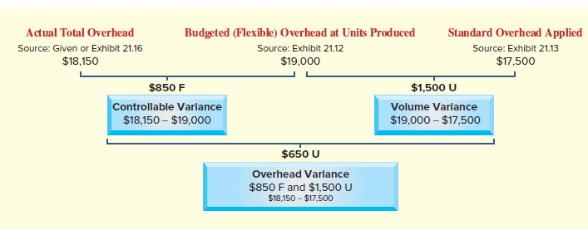
Volume Variance
Exhibit 21.15
21-27
© McGraw-Hill Education
Learning Objective P4: Compute overhead controllable and volume variances.
Notes:
To understand the factors driving the overhead variance, managers compute volume variance and controllable variance as shown here.
A volume variance is the difference between budgeted overhead and the standard overhead applied at the actual units produced. It occurs when the company operates at a different capacity level than was predicted. G-Max expected to manufacture 4,000 units, but it only manufactured 3,500 units. The volume variance is usually considered outside the control of the production manager, which is why it is also titled noncontrollable variance. Volume variance is computed as shown in Exhibit 21.15.
G-Max’s budgeted overhead is $19,000 at 3,500 units as shown in Exhibit 21.12. Standard overhead applied is $17,500. This results in the following $1,500 volume variance. The volume variance is unfavorable because G-Max made 500 fewer units than predicted.

Slide 28
Controllable Variance
Exhibit 21.15
21-28
© McGraw-Hill Education
Learning Objective P4: Compute overhead controllable and volume variances.
Notes:
Controllable variance is computed as:
Controllable variance = Actual total overhead – Budgeted (flexible) total overhead at actual units produced
= $18,150 - $19,000 = $850 (favorable)
The controllable variance is a part of the overhead variance under the production manager’s control. Actual total overhead is $18,150 (given). Flexible budget total overhead at 3,500 units is $19,000 as shown in Exhibit 21.12. Controllable variance is as shown on this slide.

Slide 29
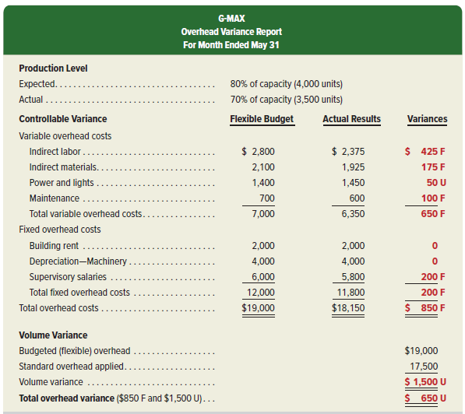
Overhead Variance Report
Exhibit 21.16
21-29
© McGraw-Hill Education
Learning Objective P4: Compute overhead controllable and volume variances.
Notes:
To help management isolate the drivers of overhead variance, an overhead variance report is prepared. An overhead variance report shows actual overhead costs and how they differ from budgeted amounts. Exhibit 21.16 shows G-Max’s overhead variance report.
The listing of individual overhead costs reveals the following sources of the $850 unfavorable controllable variance: (1) Actual costs for indirect materials, indirect labor, and maintenance were lower than budgeted. (2) Actual costs for power and lights were higher than budgeted. (3) Fixed supervisory salaries were lower than budgeted. Management uses the overhead variance report to identify controllable overhead costs to investigate.
The $1,500 unfavorable volume variance means the company did not reach its predicted activity level. While 80% of manufacturing capacity was budgeted, only 70% was used.
Management needs to know why the actual level of production differs from the predicted level. The reasons for failing to meet the predicted production level are often due to factors, such as customer demand that are beyond the production manager’s control.

Slide 30
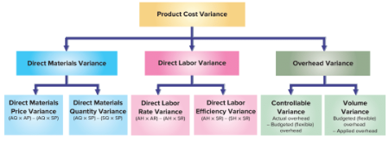
Variance Summary
Exhibit 21.17
21-30
© McGraw-Hill Education
Learning Objective P4: Compute overhead controllable and volume variances.
Notes:
Exhibit 21.17 summarizes manufacturing variances. The total cost variance equals the difference between budgeted (standard) costs and actual costs for the three manufacturing costs. Direct materials, direct labor, and overhead variances are each the sum of detailed variances.

Slide 31
Analyze changes in sales from expected amounts.
Learning Objective A1
21-31
© McGraw-Hill Education

Slide 32
Sales Variances
A similar analysis can be applied to sales variances. We will use two additional G-Max products, Excel golf balls and Big Bert drivers, to illustrate.
21-32
© McGraw-Hill Education
Learning Objective A1: Analyze changes in sales from expected amounts,
Notes:
Variance analysis also applies to sales. The budgeted amount of unit sales is the predicted activity level, and the budgeted selling price is treated as a “standard” price. To illustrate, consider the following sales data from G-Max for two of its products, Excel golf balls and Big Bert drivers.

Slide 33
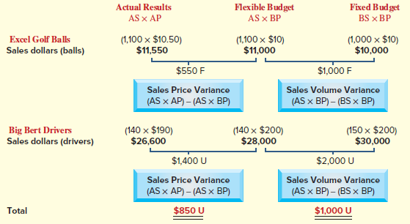
Computing Sales Variances
Sales price variance –actual sales price minus budgeted
Sales volume variance – actual sales minus budgeted
Exhibit 21.18
21-33
© McGraw-Hill Education
Learning Objective A1: Analyze changes in sales from expected amounts,
Notes:
The sales price variance and the sales volume variance are in Exhibit 21.18. The sales price variance measures the impact of the actual sales price differing from the expected price. The sales volume variance measures the impact of operating at a different capacity level than predicted by the fixed budget. The total sales price variance is $850 unfavorable, and the total sales volume variance is $1,000 unfavorable. Further analysis of these variances reveals that both the sales price and sales volume variances for Excel golf balls are favorable, while both variances are unfavorable for the Big Bert driver.
Managers use sales variances for planning and control. G-Max sold 90 combined total units (both balls and drivers) more than budgeted, yet its total sales price and sales volume variances are unfavorable. The unfavorable sales price variance is due mainly to a decrease in the selling price of Big Bert drivers by $10 per unit. Management must assess whether this price decrease should continue. The unfavorable sales volume variance is due to G-Max selling fewer Big Bert drivers (140) than were budgeted (150). Management must assess whether this decreased demand for Big Bert drivers will persist.

Slide 34
Appendix 21A Compute overhead spending and efficiency variances.
Learning Objective P5
21-34
© McGraw-Hill Education

Slide 35
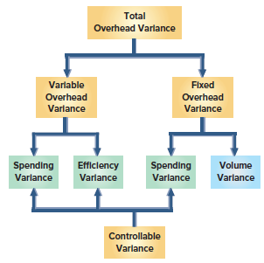
Expanded Framework for Total Overhead Variance
Exhibit 21A.1
21-35
© McGraw-Hill Education
Learning Objective P5: Compute overhead spending and efficiency variances.
Notes:
Exhibit 21A.1 shows an expanded framework for analyzing overhead variances consisting of a spending variance and an efficiency variance. This exhibit also shows that controllable variance is the total of the variable overhead spending variance, the fixed overhead spending variance, and the variable overhead efficiency variance.
A spending variance occurs when management pays an amount different than the standard price to acquire an item. For instance, the actual wage rate paid to indirect labor might be higher than the standard rate. Similarly, actual supervisory salaries might be different than expected.
An efficiency variance occurs when standard direct labor hours (the allocation base) expected for actual production differ from the actual direct labor hours used.

Slide 36
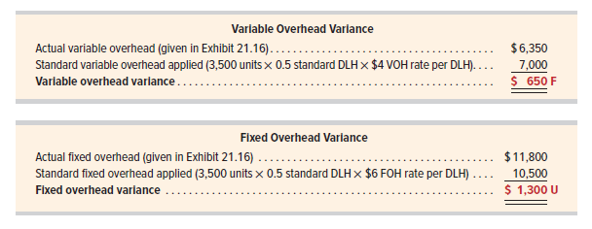
Computing Variable and Fixed Overhead Variances
21-36
© McGraw-Hill Education
Learning Objective P5: Compute overhead spending and efficiency variances.
Notes:
Recall the G-Max illustration in the chapter. G-Max produced 3,500 units when 4,000 units were budgeted. Additional data (from Exhibit 21.16) show that actual overhead incurred is $18,150 (the variable portion is $6,350 and the fixed portion is $11,800). From Exhibit 21.12, each unit requires 0.5 hour of direct labor.
With this information, we compute overhead variances for both variable and fixed overhead as follows. To help better isolate the causes of these variances, more detailed overhead variances can be used, as we show next.

Slide 37
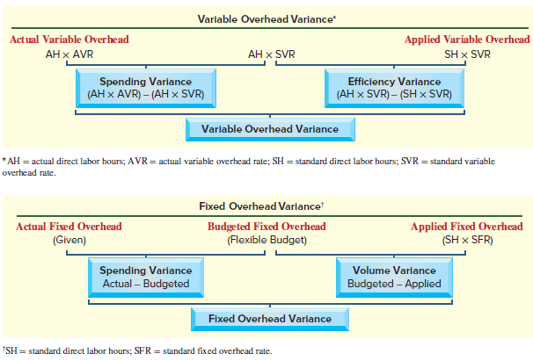
Expanded Overhead Variance Formulas
Exhibit 21A.2
21-37
© McGraw-Hill Education
Learning Objective P5: Compute overhead spending and efficiency variances.
Notes:
Exhibit 21A.2 shows formulas to use in computing detailed overhead variances.

Slide 38
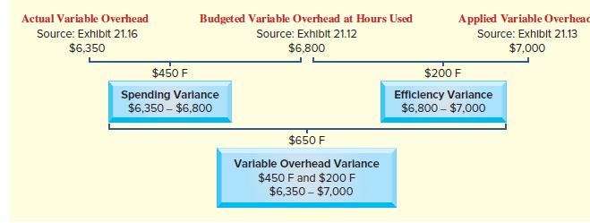
Variable Overhead Variance
Exhibit 21A.3
21-38
© McGraw-Hill Education
Learning Objective P5: Compute overhead spending and efficiency variances.
Notes:
Using these formulas, Exhibit 21A.3 shows the detailed analysis of G-Max’s $650 favorable variable overhead variance. G-Max applies overhead based on direct labor hours. It actually used 1,700 direct labor hours to produce 3,500 units. This compares favorably to the standard requirement of 1,750 direct labor hours at 0.5 labor hour per unit. At a standard variable overhead rate of $4.00 per direct labor hour, this should have resulted in variable overhead costs of $6,800 (middle column of Exhibit 21A.3).
G-Max reports actual variable overhead of $6,350, or $450 less than budgeted. This means G-Max has a favorable variable overhead spending variance of $450 ($6,800 − $6,350). G-Max also used 50 fewer direct labor hours than budgeted to make 3,500 units. Thus, G-Max has a favorable variable overhead efficiency variance of $200 ($7,000 − $6,800).

Slide 39
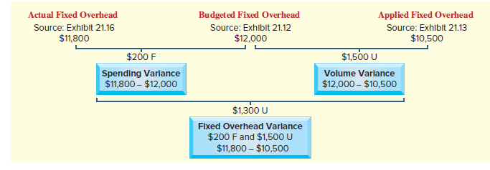
Fixed Overhead Variance
Exhibit 21A.4
21-39
© McGraw-Hill Education
Learning Objective P5: Compute overhead spending and efficiency variances.
Notes:
Exhibit 21A.4 provides insight into the causes of G-Max’s $1,300 unfavorable fixed overhead variance. G-Max incurred $11,800 in actual fixed overhead; this amount is $200 less than the $12,000 budgeted fixed overhead at the expected production level of 4,000 units (see Exhibit 21.12). This $200 favorable fixed overhead spending variance suggests good control of fixed overhead costs.
We showed how to compute the $1,500 unfavorable volume variance in the chapter and its calculation is repeated in Exhibit 21A.4.

Slide 40
Appendix 21A Prepare journal entries for standard costs and account for price and quantity variances.
Learning Objective P6
21-40
© McGraw-Hill Education

Slide 41
Direct Materials Journal Entry
Standard cost systems also record costs and variances in accounts. The entries in the next few slides briefly illustrate the important aspects of this process for G-Max’s standard costs and variances for May.
Recording G-Max direct material costs.
21-41
© McGraw-Hill Education
Learning Objective P6: Prepare journal entries for standard costs and account for price and quantity variances.
Notes:
Most standard cost systems record standard costs and variances in accounts. The entries in this section briefly illustrate key aspects of this process for G-Max’s standard costs and variances for May.
The first entry records standard direct materials cost of $35,000 in the Work in Process Inventory account. This entry credits Raw Materials Inventory for the actual cost of direct materials used of $37,800. The difference between standard and actual direct materials costs is recorded with debits to two separate direct materials variance accounts (recall Exhibit 21.10). Both direct materials price and quantity variances are recorded as debits because they reflect additional costs higher than the standard cost (if actual costs are less than the standard, they are recorded as credits).

Slide 42
Direct Labor Journal Entry
Recording G-Max labor costs for May
21-42
© McGraw-Hill Education
Learning Objective P6: Prepare journal entries for standard costs and account for price and quantity variances.
Notes:
The second entry increases Work in Process Inventory for the standard direct labor cost of $56,000. Actual direct labor cost of $56,100 is credited to Factory Wages Payable. The difference between standard and actual labor costs is explained by two variances (see Exhibit 21.11). The direct labor rate variance is unfavorable and is debited. The direct labor efficiency variance is favorable and is credited. The direct labor efficiency variance is favorable because it represents a lower cost.

Slide 43
Overhead Journal Entry
Recording G-Max overhead costs for May
When Factory Overhead is applied to Goods in Process Inventory, the actual amount is credited to the Factory Overhead account. To account for the difference between actual and standard overhead costs, the entry includes a $500 debit to the Volume Variance, a $250 debit to the Variable Overhead Spending Variance, and a $100 credit to the Variable Overhead Efficiency Variance.
21-43
© McGraw-Hill Education
Learning Objective P6: Prepare journal entries for standard costs and account for price and quantity variances.
Notes:
The entry to record standard overhead is to debit $17,500 to Work in Process Inventory. Actual overhead costs of $18,150 were debited to Factory Overhead during the period (entries not shown here). Crediting Factory Overhead for $18,150 reduces its balance to zero. To account for the difference between actual and standard overhead costs, the entry includes an $850 credit to the Controllable Variance account and a $1,500 debit to the Volume Variance account.
The balances of these different variance accounts accumulate until the end of the accounting period. As a result, the unfavorable variances of some months can offset the favorable variances of other months.
These ending variance account balances, which reflect results of the period’s various transactions and events, are closed at period-end. If the amounts are immaterial, they are added to or subtracted from the balance of the Cost of Goods Sold account. This process is similar to that shown in the job order costing chapter for eliminating an underapplied or overapplied balance in the Factory Overhead account.
In addition to budget reports, management can use a standard costing income statement to summarize company performance for a period. This income statement reports sales and cost of goods sold at their standard amounts, and then lists individual sales and cost variances to compute gross profit at actual cost. Unfavorable cost variances are added to cost of goods sold at standard cost; favorable cost variances are subtracted from cost of goods sold at standard cost.

Slide 44
End of Chapter 21
21-44
© McGraw-Hill Education

