Slide 1
Job Order Costing
Chapter 15
Wild and Shaw
Financial and Managerial Accounting
9th Edition
Copyright ©2022 McGraw-Hill Education. All rights reserved. No reproduction or distribution without the prior written consent of McGraw-Hill Education.

Slide 2
Chapter 15 Learning Objectives
CONCEPTUAL
C1 Explain job order costing and job cost sheets.
ANALYTICAL
A1 Apply job order costing in pricing services.
PROCEDURAL
P1 Describe and record the flow of materials costs in job order costing.
P2 Describe and record the flow of labor costs in job order costing.
P3 Describe and record the flow of overhead costs in job order costing.
P4 Close overapplied and underapplied factory overhead.
© McGraw-Hill Education
15-2

Slide 3
Explain job order costing and job cost sheets.
Learning Objective C1
© McGraw-Hill Education
15-3

Slide 4
Cost Accounting Systems
Process Costing
Job Order Costing
Chapter 16
Exhibit 15.1
15-4
© McGraw-Hill Education
Learning Objective C1: Explain job order costing and job cost sheets.
Notes:
A cost accounting system accumulates production costs and then assigns them to products and services.
The two basic types of cost accounting systems are job order costing and process costing.
Many companies produce customized products for specific customers. Each customized product is manufactured separately and its production is called job order production or job order manufacturing.
Process operations, also called process manufacturing or process production, is the mass production of large quantities of similar products in a continuous flow of steps.
Exhibit 15.1 lists important features of job order and process operations.

Slide 5
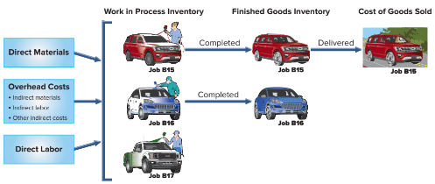
Production Activities in Job Order Costing
Exhibit 15.2
© McGraw-Hill Education
15-5
Learning Objective C1 Explain job order costing and job cost sheets.
Notes:
An overview of job order production activity and cost flows is shown. This slide shows the March production activity of Road Warriors, which customizes any vehicle with paint, speakers, amplifiers, video systems, alarms, and reinforced exteriors.
Job order production requires materials, labor, and overhead costs.
Direct materials are key parts of a finished product and are clearly identified with one job.
Direct labor is employee effort to directly convert materials to finished product on one job.
Factory overhead includes manufacturing costs that indirectly support production of more than one job.
Common overhead items are depreciation on factory buildings and equipment, indirect materials, supervision and maintenance (indirect labor), factory insurance and property taxes, factory cleaning, and factory utilities.
This slide shows that direct materials, direct labor, and overhead are added to three jobs started during the month (March). Alarm systems and paint jobs are added to Jobs B15, B16, and Job B17. Job B16 also receives a high-end audio system. The company completed Job B15 in March and delivered it to the customer. At the end of March, Job B16 is in finished goods inventory and Job B17 is still in work in process inventory.

Slide 6
Cost Flows
Manufacturing costs flow:
Raw materials inventory – direct and indirect materials
Work in process inventory – job is being produced
Finished goods inventory – completed goods
Cost of goods sold – goods which are sold
Subsidiary records store specific cost data about the manufacturing costs for each job.
© McGraw-Hill Education
15-6
Learning Objective C1: Explain job order costing and job cost sheets.
Notes:
Because they are product costs, manufacturing costs flow through inventory accounts (Raw Materials Inventory, Work in Process Inventory, and Finished Goods Inventory) until the related goods are sold. While a job is being produced, its accumulated costs are kept in Work in Process Inventory. When a job is finished, its accumulated costs are transferred from Work in Process Inventory to Finished Goods Inventory. When a finished job is delivered to a customer, its accumulated costs are transferred from Finished Goods Inventory to Cost of Goods Sold.
These general ledger inventory accounts do not provide enough detail for managers to plan and control production activities. Managers need to know the costs of each individual job (or job lot). Subsidiary records store this information about the manufacturing costs for each job.

Slide 7
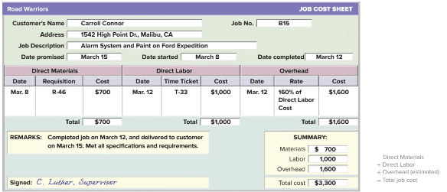
Job Cost Sheet
Exhibit 15.3
© McGraw-Hill Education
15-7
Learning Objective C1: Explain job order costing and job cost sheets.
Notes:
A job cost sheet is a record maintained for each job.
This job cost sheet identifies the customer, the job number, the costs, and key dates. Only product costs are recorded on job cost sheets. Direct materials and direct labor costs actually incurred on the job are on this sheet. For Job B15, direct materials and direct labor costs total $700 and $1,000, respectively. Estimated overhead costs are $1,600.
Estimated overhead costs are included on job cost sheets, through a process we discuss later in the chapter.
When each job is complete, the supervisor enters the date of completion and signs the sheet. Managers use job cost sheets to monitor costs incurred and to predict and control costs for each job.

Slide 8
Describe and record the flow of materials costs in job order costing.
Learning Objective P1
© McGraw-Hill Education
15-8

Slide 9
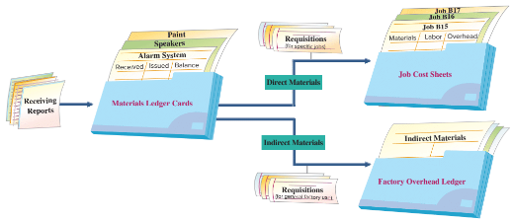
Materials and Labor Costs
Materials received recorded in a receiving report
Receiving report – materials source document
Materials ledger cards –updated when materials are purchased and issued for use in production
Exhibit 15.4
© McGraw-Hill Education
15-9
Learning Objective P1: Describe and record the flow of materials costs in job order costing.
Notes:
Exhibit 15.4 shows the flow of materials costs. When materials are received, the employees count and inspect them and record the items’ quantity and cost on a receiving report. The receiving report is the source document used for recording materials received in a materials ledger card.
Materials ledger cards are perpetual records that are updated each time materials are purchased and each time materials are issued for use in production.
To illustrate the purchase of materials, Road Warriors purchased $2,750 of materials on credit on March 4. These include both direct and indirect materials. This purchase is recorded with a debit to Raw Materials Inventory and a credit to Accounts Payable.

Slide 10
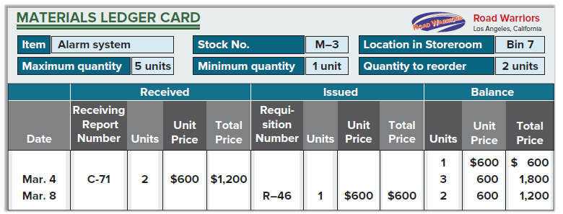
Materials Ledger Card
Exhibit 15.5
© McGraw-Hill Education
15-10
Learning Objective P1: Describe and record the flow of materials costs in job order costing.
Notes:
This slide shows a materials ledger card for an alarm system received and issued by Road Warriors. The card shows the item’s stock number, its location in the storeroom, information about the maximum and minimum quantities that available, and the reorder quantity. For example, two alarm systems were purchased on March 4 as recorded in receiving report C-71. After this purchase the company has three alarm systems on hand.

Slide 11
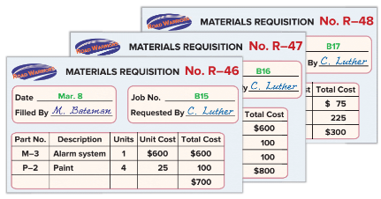
Materials Requisition
Exhibit 15.6
15-11
© McGraw-Hill Education
Learning Objective P1: Describe and record the flow of materials costs in job order costing.
Notes:
When materials are needed in production, a production manager prepares a materials requisition and sends it to the materials manager. For direct materials, the requisition shows the job number, the types of materials, and the quantities needed.
This slide shows the materials requisition for alarm system wiring for Job B15. For requisitions of indirect materials, which cannot be traced to individual jobs, the “Job No.” line in the requisition form might read, “For General Factory Use.”

Slide 12
Materials Requisition Journal Entry
15-12
© McGraw-Hill Education
Learning Objective P1: Describe and record the flow of materials costs in job order costing.
Notes:
Requisitions are often accumulated and recorded in one journal entry. The frequency of entries depends on the job, the industry, and management procedures. In this example, Road Warriors records materials requisitions at the end of each week.
The use of direct materials for the week (including alarm system for Job B15) is shown on this slide.
This entry is posted both to general ledger accounts and to subsidiary records. Posting to subsidiary records includes debits to job cost sheets and credits to materials ledger cards.

Slide 13
Describe and record the flow of labor costs in job order costing.
Learning Objective P2
© McGraw-Hill Education
15-13

Slide 14
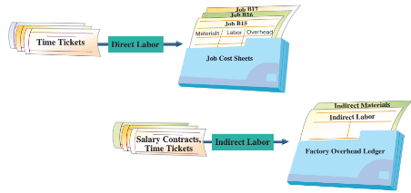
Labor Cost Flows
Exhibit 15.8
© McGraw-Hill Education
15-14
Learning Objective P2: Describe and record the flow of labor costs in job order costing.
Notes:
Labor is the next manufacturing cost to account for. This slide shows that labor costs are classified as either direct or indirect. Direct labor costs flow to job cost sheets. To assign direct labor costs to individual jobs, companies use time tickets to track how each employee’s time is used. This process is often automated: Employees swipe identification badges and a computer system assigns employees’ hours worked to individual jobs.
Indirect labor includes factory costs like supervisor salaries and maintenance worker wages. These costs are not assigned directly to individual jobs. Instead, indirect labor costs flow to the Factory Overhead ledger account.

Slide 15
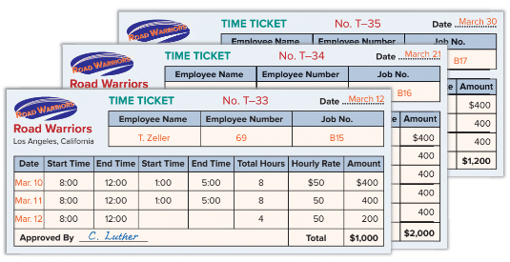
Labor Time Ticket
Exhibit 15.9
© McGraw-Hill Education
15-15
Learning Objective P2: Describe and record the flow of labor costs in job order costing.
Notes:
This slide shows a time ticket reporting the time a Road Warrior employee spent working on Job B15. The employee’s supervisor signed the ticket to confirm its accuracy. The hourly rate and total labor cost are computed after the time ticket is turned in.

Slide 16
Labor Time Ticket Journal Entry
© McGraw-Hill Education
15-16
Learning Objective P2: Describe and record the flow of labor costs in job order costing.
Notes:
Time tickets are often accumulated and recorded in one journal entry. For March, Road Warriors’ direct labor costs total $4,200.
The entry shown records direct labor for the month, based on all the direct labor time tickets for the month.

Slide 17
Describe and record the flow of overhead costs in job order costing.
Learning Objective P3
15-17
© McGraw-Hill Education

Slide 18
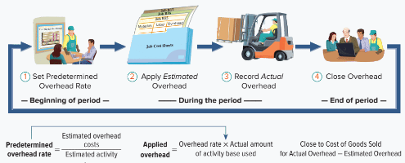
Overhead Costs
Exhibit 15.11
© McGraw-Hill Education
Learning Objective P3: Describe and record the flow of overhead costs in job order costing.
15-18
Notes:
We turn now to overhead costs. Unlike direct materials and direct labor, actual overhead costs cannot be cost-effectively traced to individual jobs. Still, each job’s total cost must include estimated overhead costs.
The accounting for overhead costs follows the four-step process shown in this slide. Overhead accounting requires managers to first estimate what total overhead costs will be for the coming period. Managers cannot wait until the end of a period to allocate actual overhead to jobs, because they need it in setting prices and monitoring job profitability. At the end of each period, the company closes its overhead account.

Slide 19
Set Predetermined Overhead Rate
Road Warriors uses a predetermined overhead rate (POHR) based on direct labor cost to apply overhead to jobs.
Exhibit 15.12
© McGraw-Hill Education
15-19
Learning Objective P3: Describe and record the flow of overhead costs in job order costing.
Notes:
Being able to estimate overhead in advance requires a predetermined overhead rate, also called predetermined overhead allocation (or application) rate. The predetermined overhead rate requires an estimate of total overhead cost and an estimated activity base before the start of the period. This slide shows the formula for computing a predetermined overhead rate. This rate is used during the period to apply estimated overhead to jobs based on each job’s actual usage of the activity. A company can use multiple predetermined overhead rates for different types of products and services.
At the start of the year, Road Warriors estimated total direct labor costs of $125,000 and total overhead costs of $200,000. It’s predetermined overhead rate is computed as $200,000 divided by $125,000 which equals 160% or 1.6 times direct labor costs.

Slide 20
Predetermined Overhead Rate
Exhibit 15.13
© McGraw-Hill Education
15-20
Learning Objective P3: Describe and record the flow of overhead costs in job order costing.
Notes:
Earlier we showed that Road Warriors used $4,200 of direct labor in March. We then use the predetermined overhead rate of 160% to allocate $6,720 (equal to $4,200 x 1.60) of overhead. The entry to record this allocation is shown.
Then, the $6,720 of overhead cost is allocated to each job based on the amount of the activity base that job used (in this example, direct labor). This slide shows these calculations for Road Warriors’ March production activity.

Slide 21
Record Actual Overhead
Indirect Material
Indirect Labor
Other Overhead Costs
© McGraw-Hill Education
15-21
Learning Objective P3: Describe and record the flow of overhead costs in job order costing.
Notes:
We now show the accounting for actual overhead costs. Actual overhead costs are not recorded in job cost sheets.
Factory overhead includes indirect materials, indirect labor, and other overhead costs. These costs are recorded from materials requisition forms for indirect materials, and from salary contracts or time tickets for indirect labor. Other sources of information on overhead costs include (1) vouchers authorizing payment for factory items such as supplies or utilities and (2) adjusting journal entries for costs such as depreciation on factory assets.
Factory overhead usually contains many different costs. These costs are recorded with debits to the Factory Overhead general ledger account, and with credits to various accounts.

Slide 22
Record Indirect Materials Used
15-22
© McGraw-Hill Education
Learning Objective P3: Describe and record the flow of overhead costs in job order costing.
Notes:
During March, Road Warriors incurred $550 of actual indirect materials costs which leads to this journal entry.
This entry is posted to the general ledger accounts, Factory Overhead and Raw Materials Inventory. Unlike the recording of direct materials, the actual indirect materials costs are not recorded in Work in Process Inventory and are not posted to job cost sheets.

Slide 23
Record Indirect Labor Used
15-23
© McGraw-Hill Education
Learning Objective P3: Describe and record the flow of overhead costs in job order costing.
Notes:
During March, Road Warriors incurred $1,100 of actual indirect labor costs which leads to the journal entry shown here.
This entry is posted to the general ledger accounts, Factory Overhead and Factory Wages Payable. Unlike the recording of direct labor, the actual indirect labor costs incurred are not recorded immediately in Work in Process Inventory and are not posted to job cost sheets.

Slide 24
Record Other Overhead Costs
15-24
© McGraw-Hill Education
Learning Objective P3: Describe and record the flow of overhead costs in job order costing.
Notes:
During March, Road Warriors incurred $5,270 of actual other overhead costs. These costs could include items such as factory building rent, depreciation on the factory building, factory utilities, expired factory insurance, and other costs indirectly related to production activities. These costs are recorded with a debit to Factory Overhead and credits to other accounts such as Cash, Accounts Payable, Utilities Payable, and Accumulated Depreciation. The entry to record these other overhead costs for March is shown here.
This entry is posted to the general ledger account, Factory Overhead, and is posted to the subsidiary factory overhead ledger. These actual overhead costs are not recorded in Work in Process Inventory and are not posted to job cost sheets. Only applied overhead is recorded in Work in Process Inventory and posted to job cost sheets.

Slide 25
Cost Flows to Financial Statements
Exhibit 15.15
15-25
© McGraw-Hill Education
Learning Objective P3: Describe and record the flow of overhead costs in job order costing.
Notes:
This slide shows that direct materials used, direct labor used, and factory overhead applied flow through the Work in Process Inventory and Finished Goods balance sheet accounts. The cost of goods manufactured (COGM) is computed and shown on the schedule of cost of goods manufactured. When goods are sold, their costs are transferred from Finished Goods Inventory on the balance sheet to the income statement as cost of goods sold.
Period costs (selling and general and administrative expenses) do not impact inventory accounts. As a result, they do not impact cost of goods sold and they are not reported on the schedule of cost of goods manufactured. They are reported on the income statement as operating expenses.
.

Slide 26
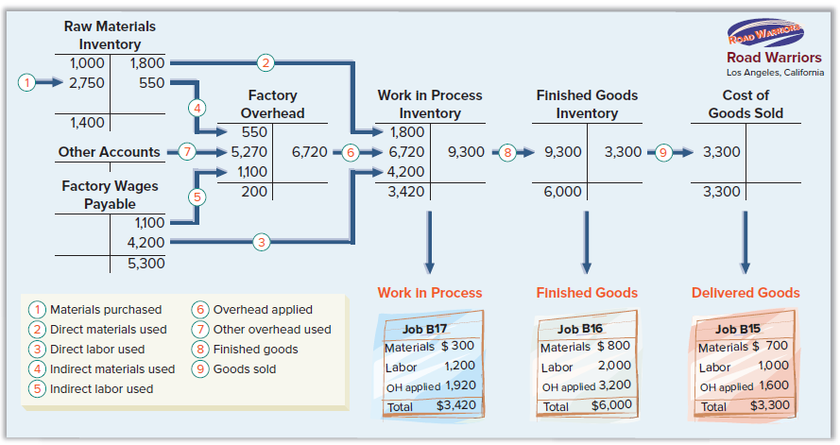
Accounting for Cost Flows
Exhibit 15.16
© McGraw-Hill Education
15-26
Learning Objective P3: Describe and record the flow of overhead costs in job order costing.
Notes:
The upper part of Exhibit 15.16 shows the flow of Road Warriors’ direct materials, direct labor, and overhead costs through the inventory accounts and eventually cost of goods sold. Each numbered cost flow reflects journal entries made in March.
The lower part of Exhibit 15.16 shows job cost sheets at the end of March. The costs assigned to the job in process (Job B17) equals the $3,420 balance in Work in Process Inventory. Costs assigned to the completed Job B16 equal the $6,000 balance in Finished Goods Inventory. The balances in Raw Materials Inventory, Work in Process Inventory, and Finished Goods Inventory are reported on the end-of-period balance sheet. The costs assigned to the sold Job B15 equals the $3,300 balance in Cost of Goods Sold. This is reported on the income statement for the period.

Slide 27
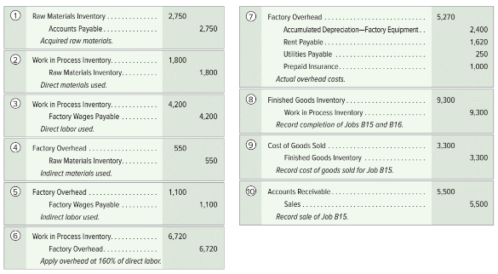
Summary of Cost Flows: Journal Entries
Exhibit 15.17
15-27
© McGraw-Hill Education
Learning Objective P3: Describe and record the flow of overhead costs in job order costing.
Notes:
This slide shows the journal entries made in March. Each entry is numbered to link with the arrow lines in Exhibit 15.16. In addition, this slide concludes with the summary journal entry to record the sales (on account) of Job B15.

Slide 28
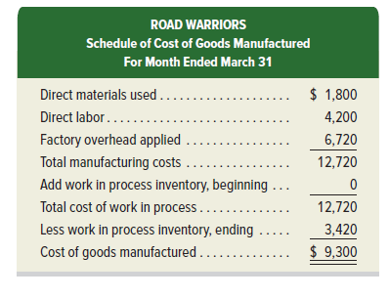
Schedule of Cost of Goods Manufactured
Exhibit 15.18
© McGraw-Hill Education
15-28
Learning Objective P3: Describe and record the flow of overhead costs in job order costing.
Notes:
Road Warriors’ schedule of cost of goods manufactured shown here. This schedule is similar to the one reported in the previous chapter, with one key difference: Total manufacturing costs include overhead applied rather than actual overhead costs. In this example, actual overhead costs were $6,920, while applied overhead was $6,720. We discuss how to account for the difference between applied and actual overhead difference next.

Slide 29
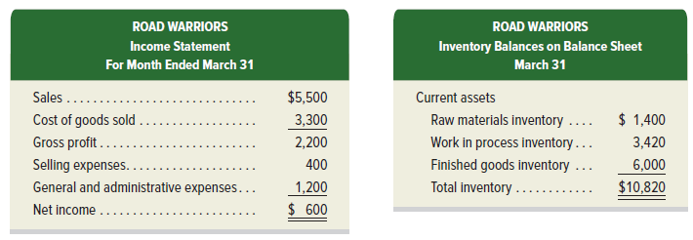
Financial Statements
15-29
© McGraw-Hill Education
Learning Objective P3: Describe and record the flow of overhead costs in job order costing.
Notes:
Road Warriors’ income statement for the month ended March 31 and a partial balance sheet as of March 31 follow. The income statement reports sales and cost of goods sold information from Exhibit 15.17. Selling expenses of $400 and general and administrative expenses of $1,200 are provided by management. The balance sheet reports inventory account balances from Exhibit 15.16.

Slide 30
Close overapplied and underapplied factory overhead.
Learning Objective P4
© McGraw-Hill Education
15-30

Slide 31
Adjusting Factory Overhead
Exhibit 15.19
Exhibit 15.20
© McGraw-Hill Education
15-31
Learning Objective P4: Close overapplied and underapplied factory overhead.
Notes:
The top graphic in this slide shows a Factory Overhead T-account. The company applies overhead (credits the Factory Overhead account) using a predetermined rate estimated at the beginning of the year. During the year, the company records actual overhead costs with debits to the Factory Overhead account. At period-end, we determine whether the applied overhead is more or less than the actual overhead:
When actual overhead is more than applied amounts, the remaining debit balance in the Factory Overhead account is called underapplied overhead.
When actual overhead costs are less than applied amounts, the resulting credit balance in the Factory Overhead account is called overapplied overhead.
When overhead is underapplied, it means that individual jobs have not been charged enough overhead during the period, and cost of goods sold for the period is too low. When overhead is overapplied, it means that jobs have been charged too much overhead during the period, and cost of goods sold is too high. In either case, a journal entry is needed to adjust Factory Overhead and Cost of Goods Sold.
The bottom graphic summarizes the journal entry assuming the difference between applied and actual overhead is not material.

Slide 32
Adjust Underapplied or Overapplied Overhead
15-32
© McGraw-Hill Education
Learning Objective P4: Close overapplied and underapplied factory overhead.
Notes:
To illustrate, assume that Road Warriors applied $6,720 of overhead to jobs during March, but it incurred actual overhead of $6,920 during March. This means that the Factory Overhead account has a debit balance of $200 as shown on this slide.
The $200 debit balance is underapplied overhead. The means the balances in Work in Process Inventory, Finished Goods Inventory, and Cost of Goods Sold understate the manufacturing costs incurred. Assuming this difference is immaterial, it is closed to Cost of Goods Sold with the entry shown on this slide.
The $200 debit (increase) to Cost of Goods Sold reduces net income by $200. After this entry, the Factory Overhead account has a zero balance (is closed). Cost of Goods Sold now reflects actual overhead costs for the period. The entry to close Factory Overhead at period-end does not impact any job cost sheets. Note: If instead we had overapplied overhead at the end of the period, we would debit Factory Overhead and credit Cost of Goods Sold for the amount.

Slide 33
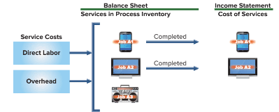
Job Order Costing of Services
Job order costing applies to service companies. Differences for service firms:
Service firms do not have raw materials or finished goods inventory. They have supplies, but these may be considered overhead.
Direct labor is used to apply overhead.
Typically use different account titles such as Services in Process Inventory and Services Overhead.
Exhibit 15.21
© McGraw-Hill Education
15-33
Learning Objective P4: Close overapplied and underapplied factory overhead.
Notes:
Job order costing also applies to service companies. Most service companies meet customers’ needs by performing a custom service for a specific customer.
Job order costing has some important differences for service firms.
1. Most service firms do not have raw materials inventory or finished goods inventory. They do, however, have inventories of supplies, and they can have services in process inventory. Often these supplies are immaterial and are considered overhead costs.
2. Direct labor is often used to apply overhead because service firms do not use direct materials.
3. Service firms typically use different account titles, for example Services in Process Inventory and Services Overhead. When service jobs are completed, costs are transferred from Services in Process Inventory to Cost of Services Provided.
Exhibit 15.21 shows the flow of costs for a service firm called AdWorld, a developer of advertising materials. During the month, AdWorld worked on custom advertising campaigns for clients that wanted ads for three different platforms: mobile devices, television, and radio. In this chapter’s Decision Analysis section we show an example of using job order costing to price advertising services for AdWorld.

Slide 34
Apply job order costing in pricing services.
Learning Objective A1
© McGraw-Hill Education
15-34

Slide 35
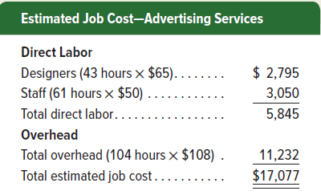
Pricing for Services
Service providers also use job order costing.
Cost for each individual job are tracked separately.
Total costs include labor and overhead.
15-35
© McGraw-Hill Education
Learning Objective A1: Apply job order costing in pricing services.
Notes:
Service providers also use job order costing. Cost for each individual job are tracked separately. Total costs include labor and overhead which are determined for each job using the procedures in this chapter.
Consider AdWorld, an advertising agency that develops web-based ads (and ads for other types of media). Each of its customers has unique requirements, so costs for each individual job must be tracked separately.
AdWorld uses two types of labor: designers ($65 per hour) and staff ($50 per hour). It also incurs overhead costs that it assigns using a predetermined overhead allocation rate of $108 per hour. For each job, AdWorld must estimate the number of designer and staff hours needed. Then, total costs of each job are determined using the procedures in the chapter.
To illustrate, a chip manufacturer requested a quote from AdWorld for an advertising engagement. AdWorld estimates that the job will require 43 designer hours and 61 staff hours, with the following total estimated cost for this job of $17,077.

Slide 36
Gross Profit Ratio for Service Companies
Service providers also use job order costing.
Cost for each individual job are tracked separately.
Total costs include labor and overhead.
15-36
© McGraw-Hill Education
Learning Objective A1: Apply job order costing in pricing services.
Notes:
Service companies can use the gross profit ratio, also called gross margin ratio, computed as shown here.
A higher gross profit ratio indicates a company is more able to submit a lower price quote. This ability increases when a company increases its gross profit ratio. This also applies when comparing companies: the company with the higher gross profit ratio has more ability to bid a lower price for a job.

Slide 37
End of Chapter 15
© McGraw-Hill Education
15-37

