Slide 1
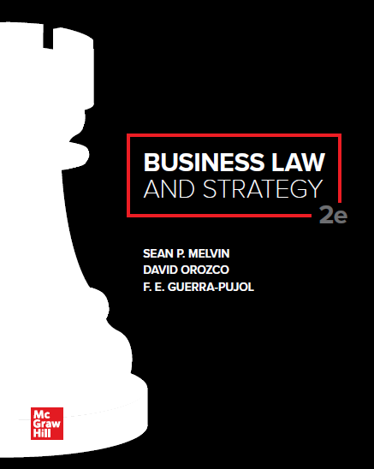
© McGraw Hill LLC. All rights reserved. No reproduction or distribution without the prior written consent of McGraw Hill LLC.

Slide 2
Chapter 18
U C C Article 2A: Lease Contracts

Slide 3
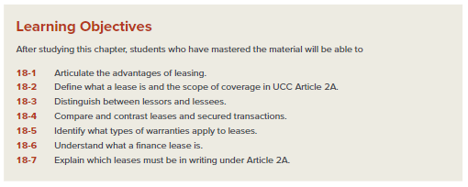
Chapter Learning Objectives

Slide 4
Introduction to Article 2A of the UCC
Contracts for the lease of goods are governed by state statutory laws that are modeled after UCC Article 2A.
Leasing is an attractive option for many firms because it allows the firm use equipment on an exclusive basis without the large up-front investment required to purchase it.
The decision to lease versus purchase is a strategic management decision.

Slide 5
UCC Article 2A Coverage
Article 2A applies to the lease of goods, such as machinery, equipment, and vehicles. It does not apply to the lease of real estate.
A lease is transfer of the right to possession and use of goods for a term in return for consideration.
A sale or retention of a security interest is not a lease.
Unlike a lease, a sale transfers ownership, or title, to goods from the seller to buyer.
A lease, by contrast, does not transfer title.

Slide 6
Case 18.1: In Re: Pillowtex, Inc.
HELD: The Third Circuit Court of Appeals applied the “economic realities test” to the transaction in this case and held that even though the parties intended their Master Agreement to be a lease, the transaction was in fact a secured financing agreement.

Slide 7
Some Basic Terminology: Lessors and Lessees
Lessor (Def.): The party who owns the leased goods and who makes them available for lease.
Lessee (Def.): The party who acquires the right to temporary possession and use of goods under a lease.

Slide 8
True Leases Versus Secured Transactions
According to the UCC, “A true lease of goods (versus a secured transaction) involves the payment for temporary possession … with an expectation that the goods will be returned to the owner at the end of the lease term.”

Slide 9
True Leases Versus Secured Transactions (Cont.)
A secured transaction occurs when the seller retains a security interest in goods being sold.
A secured transaction passes conditional title to the buyer.
The transfer of title is conditional because the buyer can retain the goods if the payment obligations are satisfied, but the seller or secured party can repossess the goods in the event of default.
Generally, in cases of default, the secured party must dispose of the goods and apply the proceeds to the outstanding indebtedness.
Any surplus proceeds belong to the lessee.

Slide 10
True Leases Versus Secured Transactions (Cont.)
Unlike a secured transaction, in a lease the lessor may not only retake the goods following a default by the lessee; the lessor, unlike a seller, is not required to dispose of the goods and need not distribute any proceeds of disposition to the lessee.

Slide 11
True Leases Versus Secured Transactions (Cont.)
An apparent lease transaction of goods will create a security interest in the goods if the lessee (buyer) is obligated to make payments on the goods for the entire term of the lease without a right to early termination, and if any of the following is true:
The lease term is equal to or greater than remaining useful life of the goods;
The lessee is required either to renew the lease for the remaining useful life of the goods or to become the owner of the goods;
The lessee has the option to renew the lease for the remaining useful life of the goods at no additional charge or for a nominal charge upon compliance with the lease agreement; or
The lessee has the option to become the owner of the goods for no additional charge or for a nominal charge upon compliance with lease agreement.

Slide 12
Warranties
Warranty (Def.): A guarantee or promise providing assurance by one contracting party to the other party that specific facts or conditions are true or will happen.
The UCC applies its warranty rules for the sale of goods to leases.
The rules for the major types of warranties—express warranties, the implied warranty of merchantability, and the implied warranty of fitness for a particular purpose—are all nearly identical for sales and for leases.
The rules regarding exclusion of warranties in lease contracts are also like the exclusion rules for sales contracts.

Slide 13
Finance Leases
A finance lease is a type of lease in which the lessor is not the fundamental supplier of the goods leased, but leases goods to lessees as a means of financing its acquisition from the supplier.
Finance leases involve a relationship among three separate parties: (1) the supplier; (2) the lessee; and (3) the finance lessor.

Slide 14
Finance Leases (Cont.)
UCC Article 2A conditions to qualify as a finance lease:
Must be a true lease, not a secured transaction.
The finance lessor cannot participate in selecting, manufacturing or supplying goods.
The finance lessor’s acquisition of the goods must be “in connection with the lease.”
The finance lessor must use one of four stated methods to give the lessee advance notification of applicable warranties and promises by the supplier.

Slide 15
Leases that Must Be in Writing
Statute of frauds (Def.): A law governing which contracts must be in writing to be enforceable.
The UCC has a statute of frauds for leases.
Under the UCC, if the total payments to be made under the lease, excluding payments for options to renew or buy, are $1,000 or more, the lease must be in writing.

Slide 16
Leases That Must Be in Writing (Cont.)
Two exceptions to the statute of frauds writing requirement for leases:
(1) “specially manufactured” goods or
(2) goods that have already been received and accepted by the lessee.
In these two special cases, the parties’ agreement need not be in writing to be enforceable.

